Slide 1
Smart Attendance System
Using Face Recognition
Institution Name: Indus University
Department: IICT
Course/Sem. : MSC-IT / 3 - C
Project Guide/Mentor: Ms. Archana Srivastava
Team Members:
Yash Italiya : [IU2554100005]
Ashish Vaghasiya : [IU2554100015]

Slide 2
Introduction
Overview: A modern, automated web-based application designed to streamline attendance tracking.
Core Objective: Eliminate manual roll-calls and proxy attendance.
Leverages advanced biometric face recognition and liveness detection.
Technology Stack:
Frontend: HTML,CSS(BOOTSTRAP),JS, AJAX
Backend: Python, Flask Framework
Database: MySQL
AI/CV Engine: OpenCV, face_recognition library(dlib)
Plateform : VS CODE

Slide 3
Existing System
Manual Roll-Call:
Faculty calling names or passing around sheets during class.
Legacy ERP Entry:
Faculty manually entering data into portals after class.
Traditional Biometrics:
Shared RFID cards or fingerprint scanners at classroom doors.

Slide 4
Problem Areas of Existing System
Time Consumption: Wastes 5-10 minutes of valuable instructional time.
Proxy Attendance: High risk of buddy punching (fake attendance).
Administrative Burden: Manual percentage calculations and absentee management.
Hygiene & Bottlenecks: Fingerprint scanners create long queues and pose hygiene concerns.

Slide 5
Need for the New System
Complete Automation:
Zero-touch, self-service attendance linked to live class schedules.
Uncompromised Security:
Advanced anti-spoofing pipeline ensures strict liveness detection.
High Precision Accuracy:
Deep learning-based 128-d face encodings provide highly accurate matches.
Real-Time Analytics:
Instant, role-based dashboards for students and faculty.

Slide 6
System Flow Diagram

Slide 7
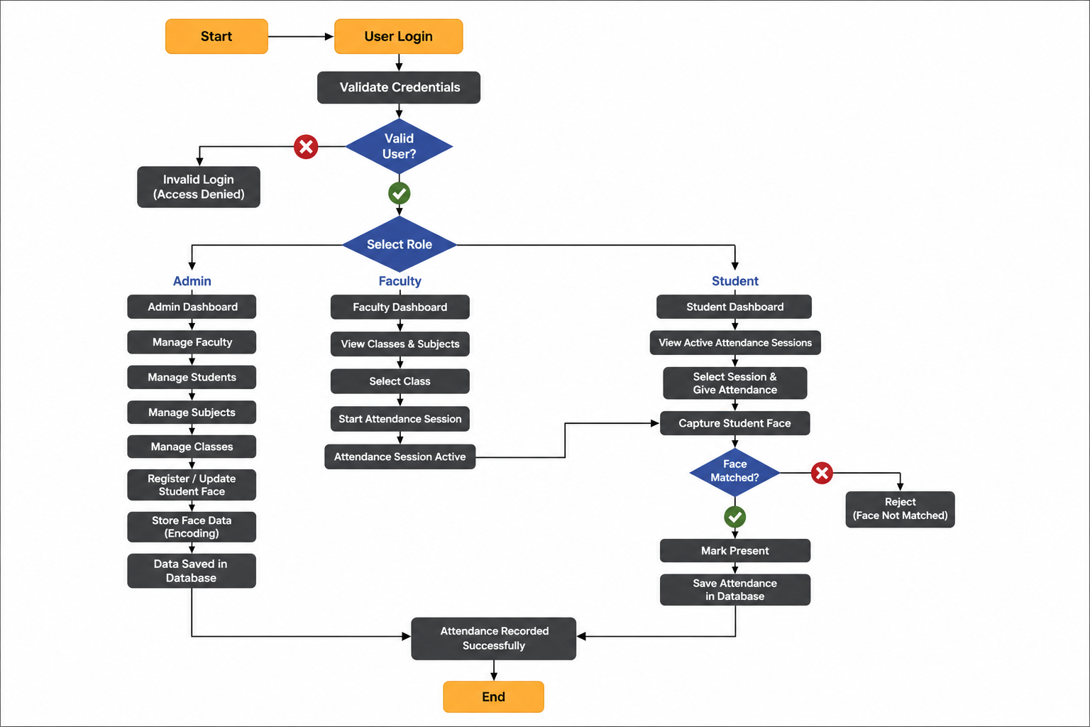

Slide 8
Data Dictionary

Slide 9
Table: roles
Field | Data Type | Description
role_id | INT | Unique role ID (PK)
role_name | VARCHAR(100) | Admin / Faculty / Student

Slide 10
Table: users
Field | Data Type | Description
user_id | INT | Unique user ID (PK)
role_id | INT | User role (FK)
full_name | VARCHAR(100) | User's full name
email | VARCHAR(50) | Login email
password | VARCHAR(255) | Hashed password
profile_img | VARCHAR(100) | Profile image path
status | INT | Account status
created_at | TIMESTAMP | Account creation time

Slide 11
Table: students
Field | Data Type | Description
student_id | INT | Unique student ID (PK)
user_id | INT | Linked user ID (FK)
course_id | INT | Student course (FK)
semester_id | INT | Student semester (FK)
face_registered | TINYINT(1) | Face registration status

Slide 12
Table: faculty
Field | Data Type | Description
faculty_id | INT | Unique faculty ID (PK)
user_id | INT | Linked user ID (FK)
designation | VARCHAR(100) | Faculty designation

Slide 13
Table: courses
Field | Data Type | Description
course_id | INT | Unique course ID (PK)
course_name | VARCHAR(100) | Course name
course_code | VARCHAR(20) | Unique course code

Slide 14
Table: semesters
Field | Data Type | Description
semester_id | INT | Unique semester ID (PK)
semester_name | VARCHAR(30) | Semester name

Slide 15
Table: subjects
Field | Data Type | Description
subject_id | INT | Unique subject ID (PK)
course_id | INT | Linked course (FK)
semester_id | INT | Linked semester (FK)
faculty_id | INT | Assigned faculty (FK)
subject_name | VARCHAR(100) | Subject name
subject_code | VARCHAR(20) | Unique subject code

Slide 16
Table: face_data
Field | Data Type | Description
face_id | INT | Unique face record ID (PK)
student_id | INT | Linked student (FK)
image_path | VARCHAR(255) | Registered face image path
face_encoding | MEDIUMTEXT | Stored facial encoding

Slide 17
Table: classes
Field | Data Type | Description
class_id | INT | Unique class ID (PK)
subject_id | INT | Class subject (FK)
faculty_id | INT | Class faculty (FK)
class_date | DATE | Date of class
start_time | TIME | Class start time
end_time | TIME | Class end time
attendance_started | TINYINT(1) | Attendance session status

Slide 18
Table: attendance
Field | Data Type | Description
attendance_id | INT | Unique attendance ID (PK)
class_id | INT | Related class (FK)
student_id | INT | Student (FK)
attendance_time | DATETIME | Attendance time
status | VARCHAR(10) | Present / Absent
confidence_score | DECIMAL(5,2) | Face-match confidence

Slide 19
Table: feedback
Field | Data Type | Description
feedback_id | INT | Unique feedback ID (PK)
name | VARCHAR(50) | Sender's name
email | VARCHAR(50) | Sender's email
subject | VARCHAR(100) | Feedback subject
message | TEXT | Feedback message

Slide 20
THANK YOU

