Slide 1
IILM UNIVERSITY
STUDENT CREDENTIALS
GREATER NOIDA, UTTAR PRADESH
Ashish Kumar
THIRANEX VIRTUAL INTERNSHIP
Enrollment / Roll No.
Program & Semester
UI/UX Designing
25SCS1003000879
B.Tech (CSE)
A 4-Week Professional Internship Presentation Report
INTERNSHIP DURATION
22 Aug 2026 – 21 Sept 2026 (4 Weeks)
HOST ORGANIZATION
Thiranex
Skill Development & Future Tech

Slide 2

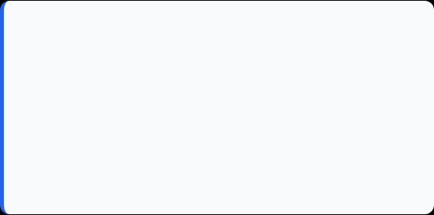
Candidate & Program Overview
Candidate Details
Internship Profile
Student Name: ASHISH KUMAR
Program Name: Thiranex Virtual Internship Program
Roll Number: 25SCS1003000879
Specialization Domain: UI/UX Designing
Degree: B.Tech CSE (Core)
Duration: 4 Weeks (22 Aug 2026 – 21 Sept 2026)
Academic Batch: 2025 – 2029
Certificate ID: To be issued on completion
University: IILM University, Greater Noida, U.P.
Offer Letter Ref: THX-AUG2226-122 (Intern ID)

Slide 3


Organization Profile: Thiranex
Thiranex is an MSME-registered ed-tech platform (Thiranex IT Solutions) operating under the vision of “Skill Development & Future Tech”.
Verified & Free Access: Offers 100% free, verified virtual internships with instant offer letters to students across India.
Multi-Domain Platform: Runs project-based internship tracks across 15+ domains, including UI/UX Design, Web Development, AI/ML, and Data Science.
Mentored, Task-Based Format: Interns complete weekly deliverables with due dates and mentor review, similar to a real design team workflow.

Slide 4

Problem Statement & Industry Context
The Industry Challenge
The Solution Scope
Design courses cover UI/UX theory and tools, but students often get little practice applying user research and iterative testing to a real product before entering the industry.
This internship covers the complete UI/UX design lifecycle: user research, wireframing, visual design, interactive prototyping, and usability testing.
Using industry-standard tools (Figma, Adobe XD, InVision) to move from a design brief to a validated, user-tested interface.
A visually polished screen has little value unless it is grounded in real user needs, checked against usability heuristics, and validated with actual users.

Slide 5
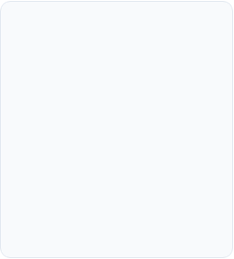

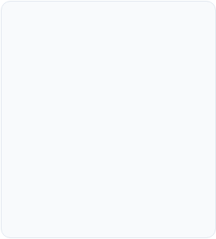
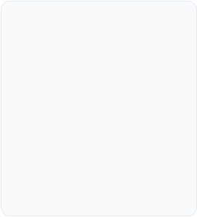




Core Project Objectives
Research & Wireframing
Visual & UI Design
Interactive Prototyping
Usability Testing
Plan and run usability test sessions, record user feedback, and report findings to guide design improvements.
Conduct early-stage user research and translate findings into low-fidelity wireframes and user flows using Figma and Adobe XD.
Redesign an existing website interface with heuristic evaluation, mood boards, style guides, and responsive high-fidelity mockups.
Convert wireframes into clickable, animated prototypes in Figma and InVision that simulate real app navigation.

Slide 6





Tools & UI/UX Toolkit
Design & Wireframing
Prototyping
Research & Evaluation
Usability Testing
Wireframing Tools: Figma, Adobe XD
Prototyping Tools: Figma, InVision
Methods: Heuristic evaluation, mood boards
Testing: Test plans, user sessions, feedback collection
Output: High-fidelity, responsive mockups
Reporting: Findings reports and design recommendations
Deliverables: User personas, user flows, low-fi wireframes
Features: Animations, transitions, navigation flows

Slide 7
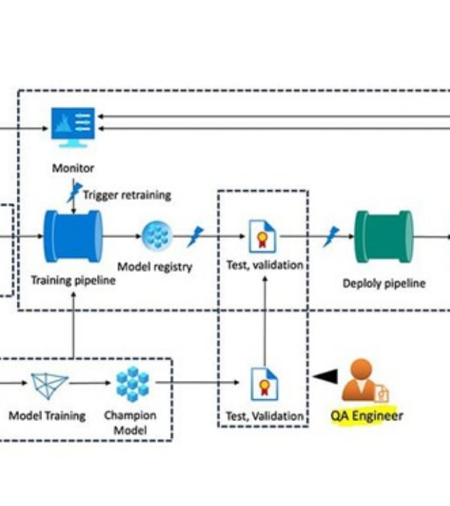
1
Research
UI/UX Design Process
2
Wireframe
Research Layer: Understanding users through research and personas.
Wireframe Layer: Low-fidelity wireframes and user flows in Figma/XD.
Visual Design Layer: High-fidelity, responsive UI mockups and consistent style guides.
3
Visual Design
Prototype Layer: Interactive, clickable prototypes simulating real navigation and flows.
Testing Layer: Usability testing and feedback-driven design iteration.
4
Prototype
5
Testing

Slide 8
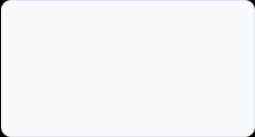
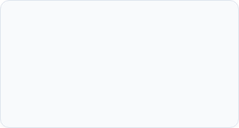
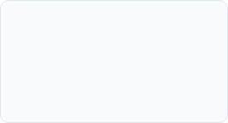
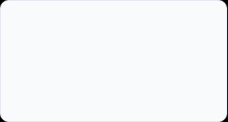
Internship Timeline (Weeks 1 to 4)
Week 2
Week 4
Website UI Redesign Heuristic evaluation, mood boards, high-fidelity mockups (due 05 Sept 2026).
Usability Testing & Analysis Test plans, user sessions, findings report (due 19 Sept 2026).
Week 1
Week 3
Mobile App Wireframing User research, personas & flows, low-fi wireframes (due 29 Aug 2026).
Interactive Prototype Creation Clickable prototypes, animations, navigation flows (due 12 Sept 2026).

Slide 9
Key Projects & Demonstrated Skills
Mobile App Wireframing: Designed low-fidelity wireframes and user flows for a mobile app. (Completed)
Website UI Redesign: Redesigned an existing website's interface using heuristic evaluation, mood boards, and responsive high-fidelity mockups. (Completed)
Interactive Prototype Creation: Converted wireframes into a clickable, animated Figma prototype simulating real app navigation. (In Review)
Usability Testing & Analysis: Ran usability test sessions on a digital product and reported findings with improvement recommendations. (In Review)
Design Process Documentation: Maintained process documentation, mood boards, and style guides across all four tasks for design handoff.

Slide 10

Internship Verification Details
Verification Metric | Official Record / Credential Details
Internship Title | UI/UX Designing Internship
Issuing Organization | Thiranex (MSME-Registered – Skill Development & Future Tech)
Work Mode | Remote / Project-Based
Internship Duration | 22 Aug 2026 – 21 Sept 2026
Intern ID | THX-AUG2226-122
Certification Status | To be issued upon successful completion of all tasks

Slide 11
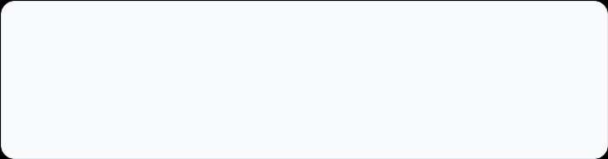
Thank You!
Ashish Kumar
UI/UX Design Intern – Thiranex
Roll No: 25SCS1003000879
IILM University, Greater Noida, U.P.

