Slide 1
OLIST ECOMMERCE ANALYTICS
P511 | Group 3

Slide 2
C ONT E NT S
Here are the KPIs mentioned organized for clarity
1. Weekday Vs Weekend Payment Statistics
2. Review Score and Payment Type Orders
3. Average Pet Shop Delivery Days
4. Average Price & Payment Value for Sao Paulo Customers
5. Shipping Days & Review Scores Relationship
6. Top 10 Highest Selling Products
7. Top 10 Lowest Selling Products
8. Percentage of Orders with Payment Type
9. Top 10 Average Payment Value per Product Category
10. Cancellation Rate by Day of Week
11. Sum of Payment Value Payment Type
9. Total Payment Value by Month
10. Average Payment value by Customer State

Slide 3
DATA CLEANING METHODS
Here are the titles and purposes of the data cleaning methods:
1. Removing Duplicate Entries
Purpose: Ensure unique entries, especially for identifiers like `customer_unique_id`, `order_id`, `product_id`, `seller_id`.
2. Handling Missing Values
- Purpose: Address gaps in essential data fields to ensure completeness.
3. Standardizing Data Formats
Purpose: Ensure consistency in data formats (dates, numbers).
4. Correcting Data Types
Purpose: Ensure columns contain the correct data types (dates, numbers, text).
5. Trimming Whitespace
Purpose: Remove leading/trailing spaces that can cause errors.
6. Fixing Inconsistent Data Entries
Purpose: Ensure consistency in text fields (`customer_city`, `payment_type`).
7. Filtering and Correcting Outliers
Purpose: Identify and handle anomalies in numerical data (e.g., high `freight_value`).
8. Merging and Concatenating Columns
Purpose: Combine columns for completeness (e.g., full address).
9. Creating Derived Columns
Purpose: Add new columns for easier analysis (e.g., extracting year).

Slide 4
Data modeling techniques
1. Data Modeling Overview
Purpose: Provide an introduction to data modeling and its importance in organizing and analyzing data effectively.
2. Entity-Relationship Diagram (ERD)
Purpose: Visualize the relationships between different entities in the dataset, such as customers, orders, products, and sellers.
3. Data Aggregation
Purpose: Summarize and consolidate data to provide meaningful insights, often used in reporting and dashboarding to analyze trends over time or across different dimensions.
4. Data Transformations
Purpose: Prepare data for analysis by applying various transformations such as filtering, grouping, pivoting, and calculations to derive new fields or aggregate existing ones.
5. Data Integration
Purpose: Combine data from multiple sources into a unified dataset, ensuring consistency and compatibility across different data sets.
6. Data Cleansing and Enrichment
Purpose: Cleanse and enhance data quality by identifying and correcting errors, filling missing values, standardizing formats, and enriching data with additional information.
These data modeling techniques are essential for structuring and optimizing the dataset for efficient analysis in Power BI or any other data analytics platform.

Slide 5
Goal of the Project
The primary goal of this project is to analyze and visualize key performance indicators (KPIs) from the Olist dataset to provide actionable insights into customer behavior, sales performance, and operational efficiency. This will help stakeholders make data-driven decisions to optimize business strategies and enhance customer satisfaction.
Key Points:
1. Understand Sales Trends: Analyze total sales and sales trends over time. - Identify top-selling and low-selling products to optimize inventory and marketing strategies.
2. Customer Insights: Evaluate the number of unique customers and their geographical distribution. - Analyze customer purchase behavior, including preferred payment methods and average spending.
3. Operational Efficiency: Measure delivery performance, including average delivery duration and shipping times. - Assess the relationship between shipping times and customer satisfaction (review scores).
4. Customer Satisfaction: Analyze review scores to understand customer satisfaction levels. - Evaluate the impact of different payment types on review scores.
5. Sales Performance by Categories: Identify top product categories by sales and average payment value. - Assess the financial performance across different product categories.
6. Cancellation Analysis: Evaluate order cancellation rates by day of the week to identify patterns and potential operational issues.
7. Payment Methods Analysis: Determine the percentage of orders by different payment types to understand customer Preferences. By focusing on these key points, the project aims to provide a comprehensive overview of the business's current performance and identify areas for improvement. The insights gained will enable stakeholders to make informed decisions to drive growth and enhance the overall customer experience

Slide 6
Phases involved in this project
Data Preparation Phase:
Excel:
- Import raw data into Excel.
- Perform data cleaning tasks such as removing duplicates, handling missing values, and standardizing formats.
- Transform data using Excel functions and formulas as needed.
- Prepare the data for import into a relational database.
MySQL:
- Design and create a relational database schema that aligns with the data structure and requirements.
- Import cleaned data from Excel into MySQL tables.
Perform further data cleaning and manipulation using SQL queries.
2. Data Visualization Phase:
Power BI:
- Connect Power BI to the MySQL database.
- Design interactive visualizations using Power BI's drag-and-drop interface.
- Create dashboards and reports to visualize key metrics, trends, and insights.
- Apply filters, slicers, and other interactive elements for user-driven exploration.
- Implement data-driven alerts and notifications to highlight important trends or anomalies.
Tableau:
- Connected to the database.
- Design visually appealing dashboards using Tableau's intuitive interface.
- Utilize various chart types, maps, and other visualization elements to convey insights effectively.
Implement interactivity and drill-down capabilities to allow users to explore data in-depth.
3. Analysis and Iteration Phase:
- Analyze the visualizations and reports generated in Power BI and Tableau to identify trends, patterns, and anomalies.
- Gather feedback from stakeholders and users to refine and improve the visualizations.
- Iterate on the data preparation and visualization processes as needed to address new requirements or changes in the data.
- Continuously monitor and update the visualizations to ensure they remain relevant and actionable.

Slide 7
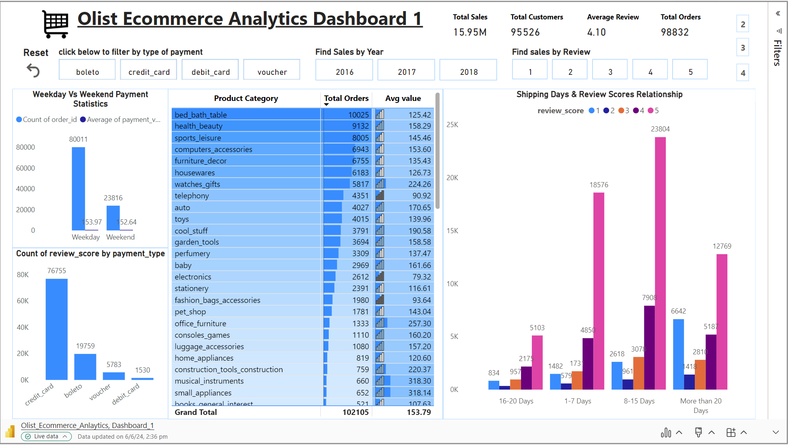

Slide 8
Power BI Dashboards

Slide 9
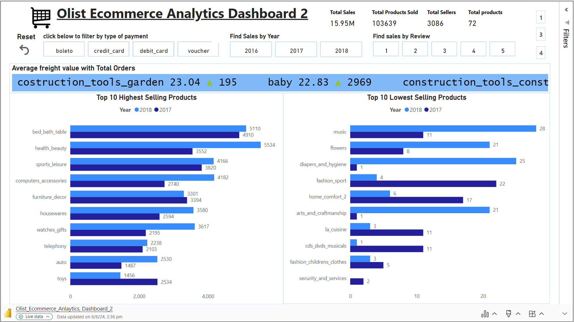

Slide 10
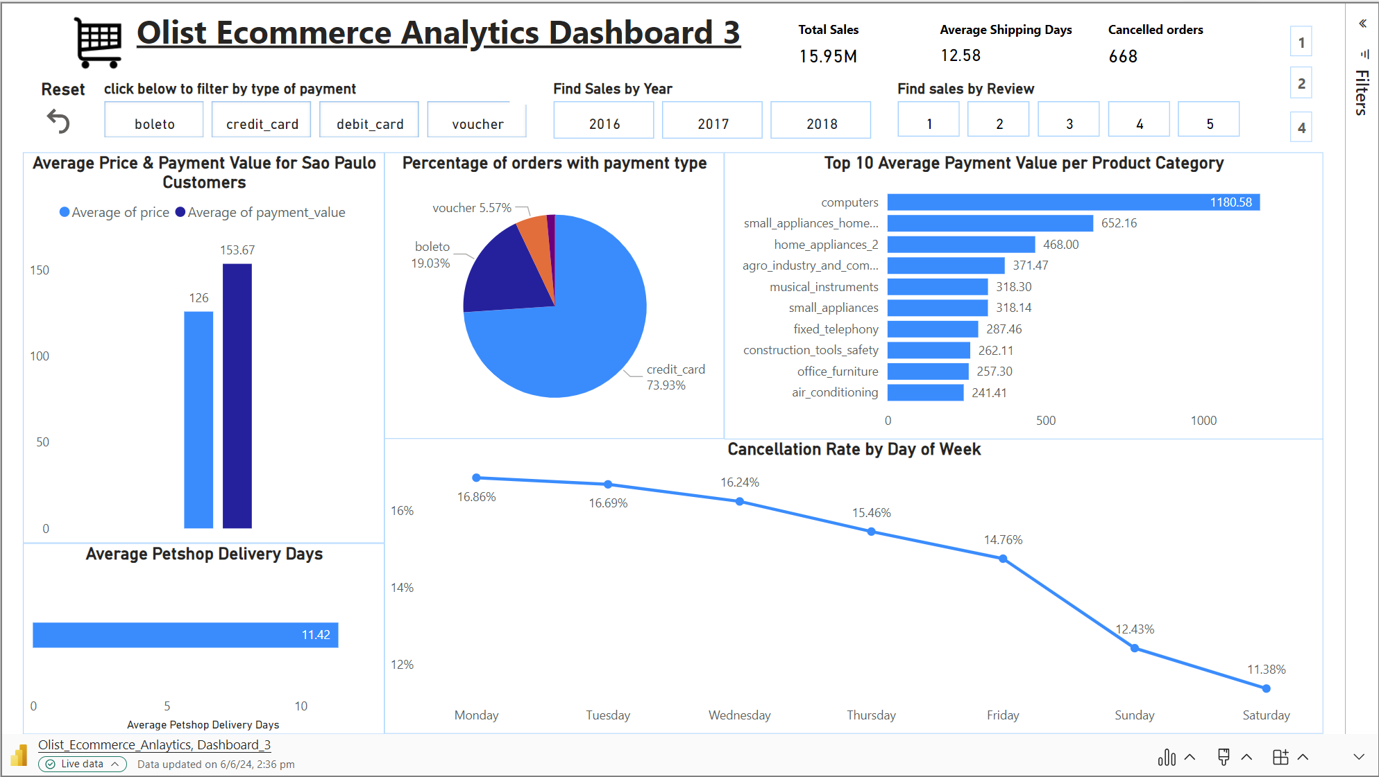

Slide 11
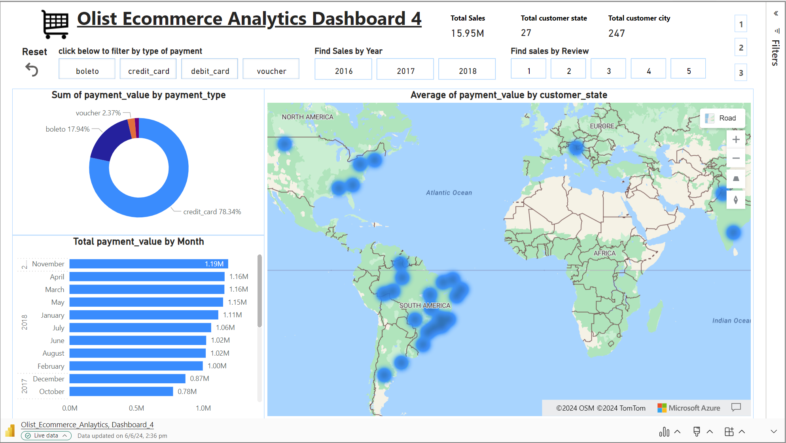

Slide 12
Tableau Dashboards

Slide 13
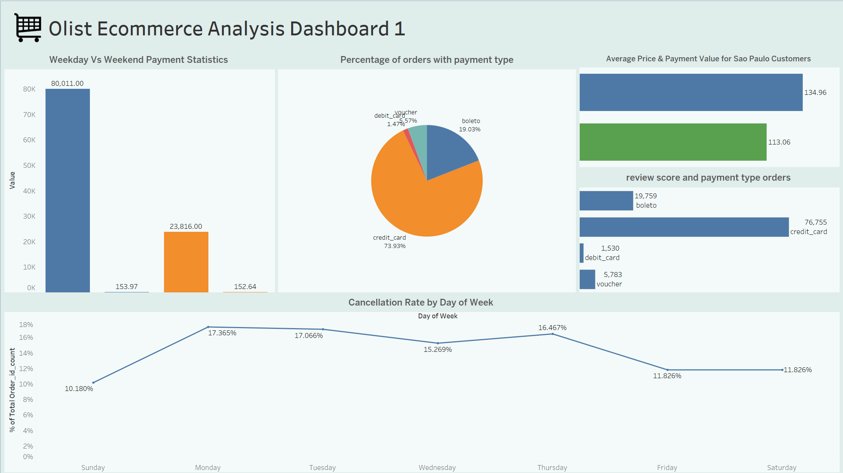

Slide 14
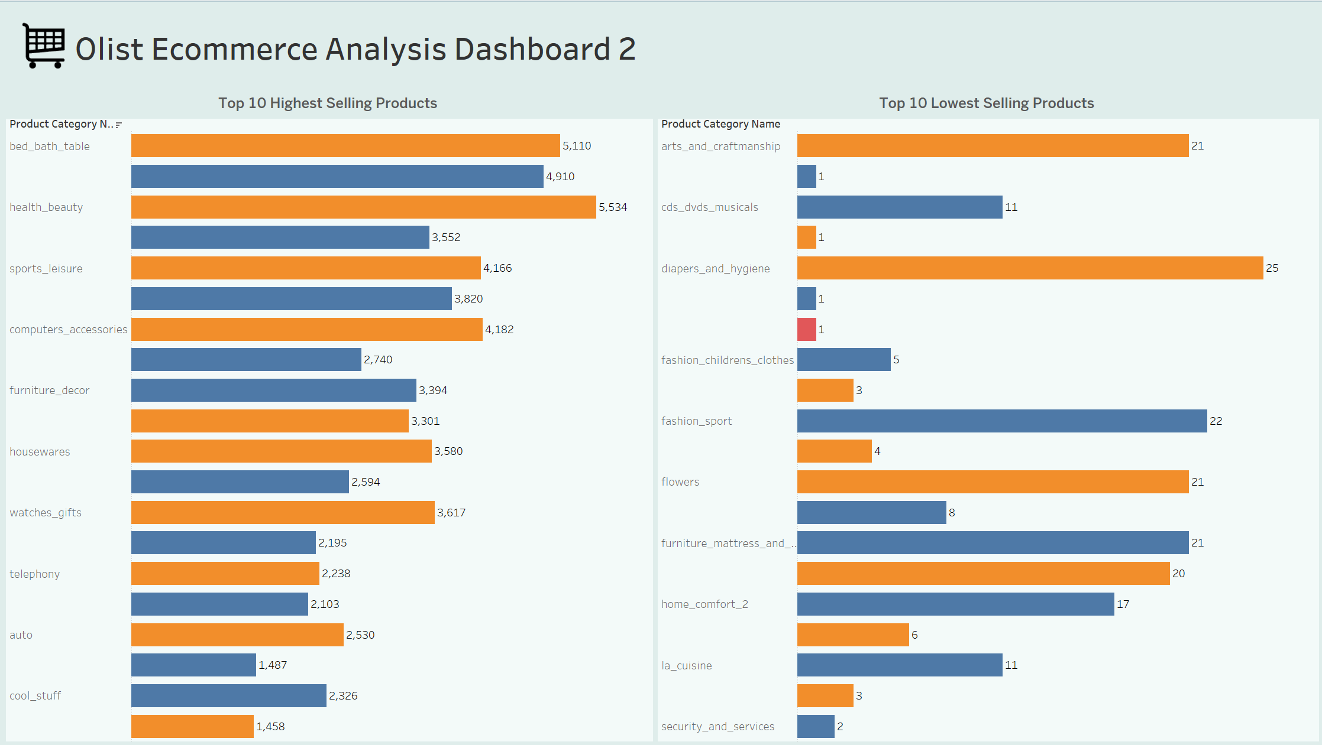

Slide 15
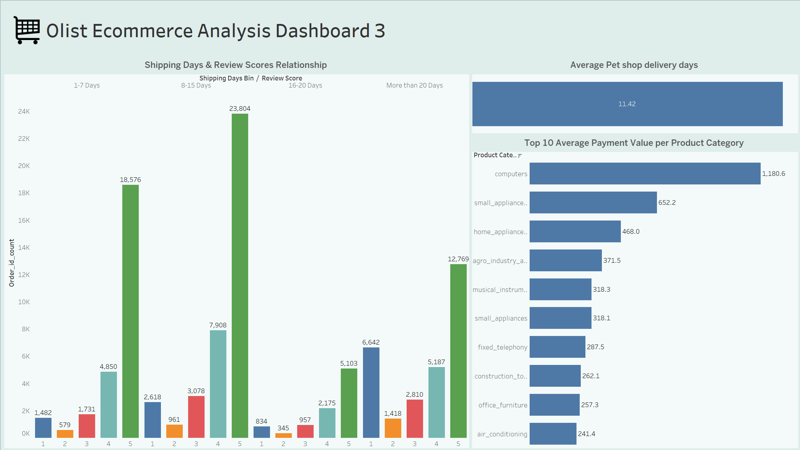

Slide 16
INSIGHTS :
1. Weekday Vs Weekend Payment Statistics:
- Weekend payments are significantly lower compared to weekdays, indicating potential opportunities to implement targeted marketing or promotional strategies to boost weekend sales.
2. Review Score and Payment Type Orders:
- Orders made through certain payment types tend to receive higher review scores, suggesting a correlation between payment convenience and customer satisfaction.
3. Average Pet Shop Delivery Days:
- Pet shop products have a longer average delivery duration compared to other categories, indicating a need to optimize logistics or communication processes for these specific orders.
4. Average Price & Payment Value for Sao Paulo Customers:
- Sao Paulo customers tend to make higher-value purchases compared to customers from other regions, highlighting the importance of tailoring marketing and pricing strategies for different geographic segments.
5. Shipping Days & Review Scores Relationship:
- Faster shipping times are associated with higher review scores, emphasizing the importance of efficient order fulfillment and delivery processes in driving customer satisfaction.
6. Top 10 Highest Selling Products:
- Identify top-performing products to focus marketing efforts and inventory management, maximizing revenue potential.
7. Top 10 Lowest Selling Products:
- Investigate reasons for low sales of these products, such as pricing, product quality, or market demand, to optimize inventory or marketing strategies.
8. Percentage of Orders with Payment Type:
- Gain insights into preferred payment methods among customers, enabling targeted promotions or partnerships with payment providers to enhance customer experience.
9. Top 10 Average Payment Value per Product Category:
- Identify product categories with the highest average payment values to prioritize marketing efforts or product development in lucrative segments.
10. Cancellation Rate by Day of Week:
- Analyze cancellation patterns to identify days with the highest cancellation rates and explore potential reasons such as order processing delays or customer preferences, aiming to reduce cancellations and improve customer satisfaction.

Slide 17
RECOMMENDATIONS
1. Weekday Vs Weekend Payment Statistics:
- Offer weekend-specific promotions or discounts to incentivize purchases during low-traffic periods.
2. Review Score and Payment Type Orders:
- Encourage the use of payment types associated with higher review scores by offering incentives or discounts.
3. Average Pet Shop Delivery Days:
- Optimize logistics and communication channels to reduce delivery times for pet shop products, potentially by partnering with more efficient shipping carriers.
4. Average Price & Payment Value for Sao Paulo Customers:
- Implement targeted marketing campaigns or loyalty programs for Sao Paulo customers to capitalize on their higher average spending.
5. Shipping Days & Review Scores Relationship:
- Streamline order fulfillment processes to ensure faster shipping times, potentially by investing in better inventory management systems or optimizing shipping routes.
6. Top 10 Highest Selling Products:
- Increase inventory levels for top-selling products and consider bundling or cross-promoting them with related items to maximize sales.
7. Top 10 Lowest Selling Products:
- Evaluate the viability of low-selling products and consider discontinuing or repositioning them to focus resources on more profitable offerings.
8. Percentage of Orders with Payment Type:
- Offer discounts or incentives for using preferred payment types to encourage their adoption among customers.
9. Top 10 Average Payment Value per Product Category:
- Allocate resources towards marketing and product development efforts for high-value product categories to further capitalize on their profitability.
10. Cancellation Rate by Day of Week:
- Analyze the root causes of high cancellation rates on certain days and take corrective actions such as improving order processing efficiency or enhancing product descriptions to manage customer expectations better.
These recommendations aim to leverage the insights from the KPIs to optimize various aspects of the e-commerce business, from marketing strategies to operational efficiencies, ultimately improving customer satisfaction and driving revenue growth.

Slide 18
THANK YOU

