Slide 1
EnviroScan
AI-Powered Pollution Source Identifier
A Machine Learning & Geospatial Analytics Based System

Slide 2
Introduction
• Pollution systems measure levels but not sources
• EnviroScan solves this using AI + GIS + Weather Data
• Supports real-time decision making

Slide 3
Objective
• Identify pollution sources
• Provide hotspot heatmaps
• Offer alerts & dashboards
• Assist policymakers

Slide 4
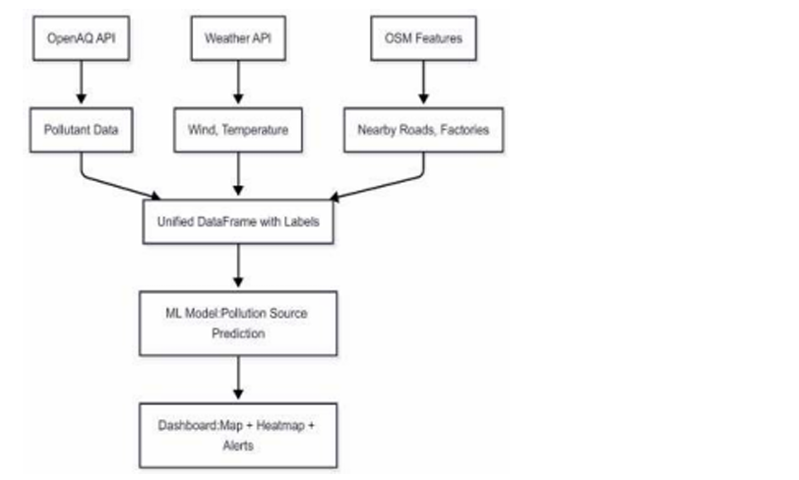
System Architecture
Overall flow of data sources → processing → ML → dashboard

Slide 5
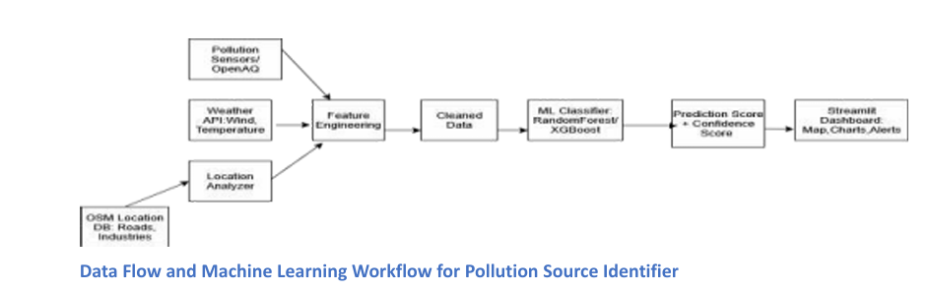
ML Data Flow & Workflow
Illustration of end-to-end ML pipeline from sensors to dashboard

Slide 6
Data Collection
• OpenAQ API: Pollutants
• Weather API: Temperature, Wind
• OSMnx: Roads, Factories
• Unified dataset created

Slide 7
Feature Engineering
• Missing value handling
• Proximity scoring
• Temporal filters
• Normalization
• Final ML-ready dataset

Slide 8
Model Training
Models used:
• Random Forest
• XGBoost
• Decision Tree
Evaluated using accuracy, F1 score, confusion matrix

Slide 9
Geospatial Mapping
• Pollution heatmaps
• Source markers
• High-risk zones
• Folium-based visualization

Slide 10
Dashboard (Streamlit)
• Live predictions
• Heatmaps
• Alerts
• Charts
• Data export options

Slide 11
Conclusion
EnviroScan delivers:
• Pollution source intelligence
• GIS-based monitoring
• Real-time insights
• Actionable dashboards

