Slide 1

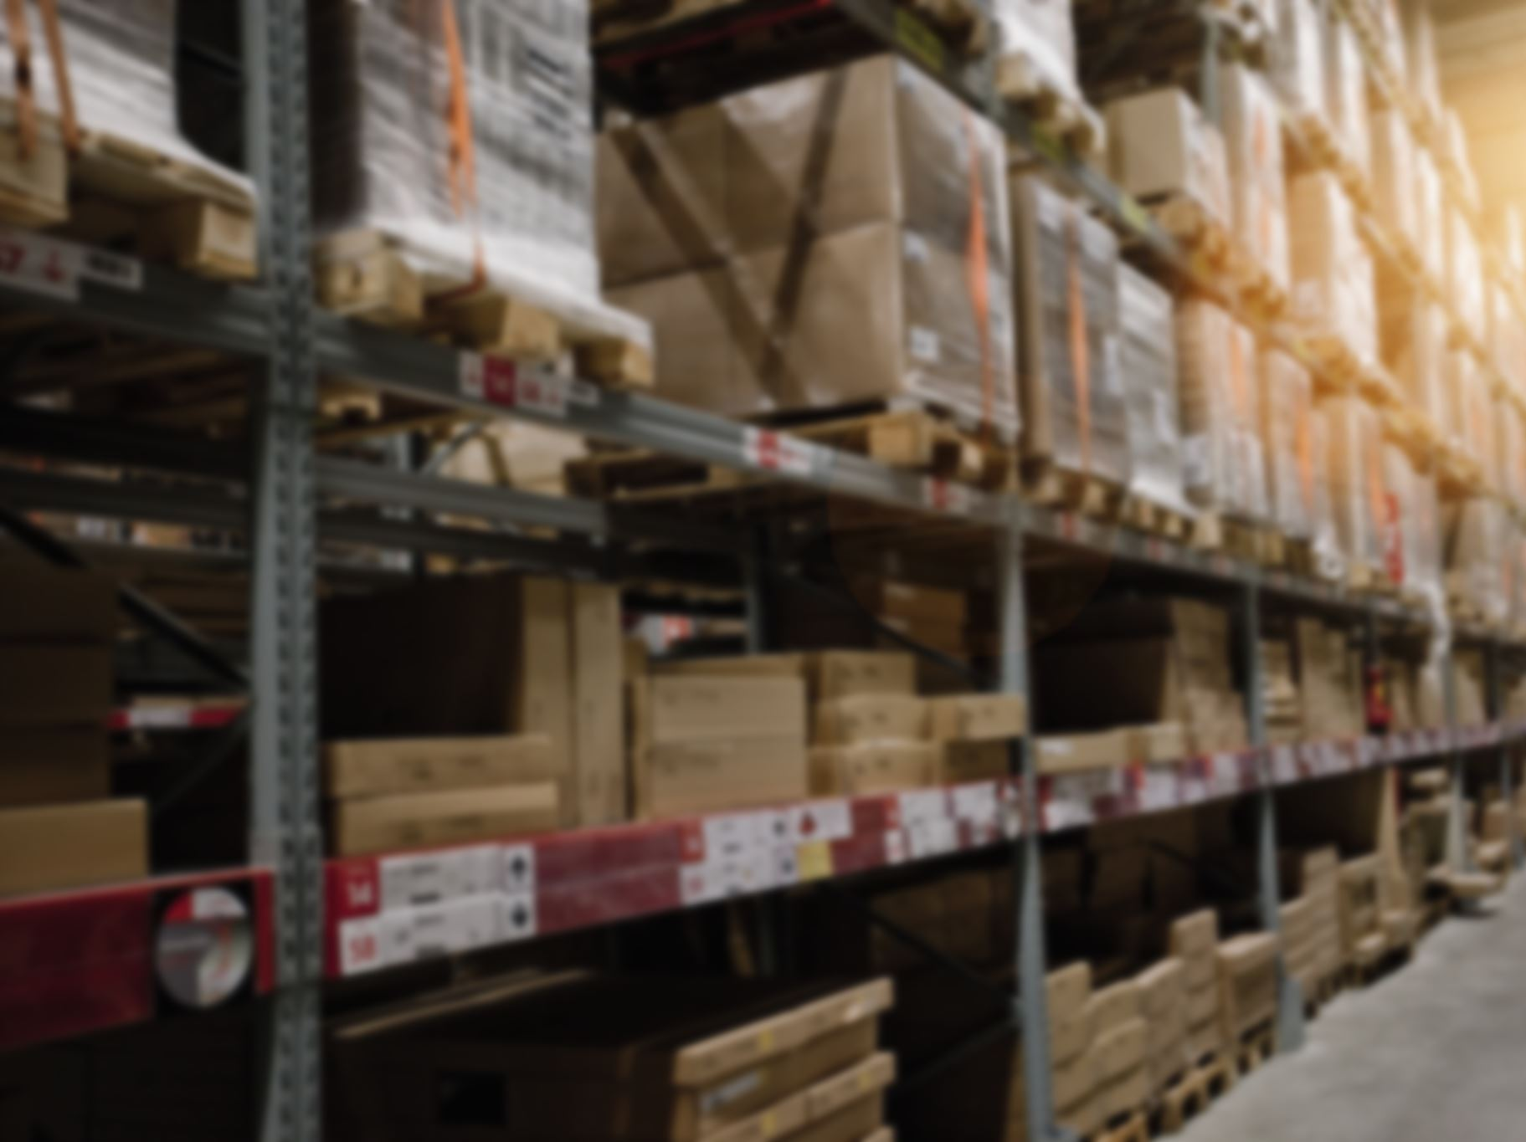
Superstore Sales Analysis – Insights & Recommendations
Prepared by Ashish Kumar
October 2025

Slide 2
Key Insights – Overall Performance
Total Sales: $1.6M across 22K transactions with an average sale of $175K.
West region leads with 33% of total sales, followed by East (29%) and Central (22%).
Consumer segment dominates with 48% share, Corporate (33%), and Home Office (19%).
COD is the preferred payment mode (43%), followed by Online (35%) and Cards (22%).
Average delivery time of 4 days indicates efficient logistics operations.
Sales growth pattern shows consistent year-on-year improvement across months.

Slide 3
Key Insights – Product & Category
Technology category generates the highest revenue at $0.64M, followed by Office Supplies ($0.47M) and Furniture ($0.45M).
Top-performing sub-categories: Phones ($0.20M), Chairs ($0.18M), Binders ($0.17M), and Storage ($0.15M).
Standard class shipping dominates with $0.91M in sales – fast-moving category.
Strong product mix diversity with steady contribution from all categories.
Profitability trends show peaks in Q2 and Q4 – linked to seasonal demand cycles.

Slide 4
Key Insights – Regional & Forecast Analysis
California leads with $0.34M in sales, followed by New York ($0.19M) and Texas ($0.12M).
Western states dominate performance, while Midwest regions show growth potential.
Sales forecast for the next 15–20 days predicts stable growth between $8K–$10K daily.
Forecast highlights consistent demand, suggesting effective marketing and product alignment.
East region shows steady sales volume, but margin optimization opportunities exist.
South region underperforming with only 16% share – improvement opportunity.

Slide 5
Recommendations – Sales & Growth Strategy
Focus marketing and discount campaigns in South and Central regions to balance sales distribution.
Promote high-demand subcategories (Phones, Chairs, Binders) through bundled offers and online campaigns.
Introduce loyalty programs for Consumer and Corporate segments to improve retention.
Optimize sales calendar around Q2 and Q4 peak demand seasons.
Encourage online payment adoption by providing additional rewards or discounts for digital transactions.
Partner with logistics for faster delivery and same-day options in metro regions.

Slide 6

Recommendations – Operations & Customer Engagement
Streamline inventory forecasting for top categories using predictive analytics.
Improve underperforming regions with region-specific marketing and price adjustments.
Enhance customer experience by reducing average delivery days from 4 to 3 via route optimization.
Leverage data from high-performing states (CA, NY, TX) to identify successful regional practices.
Strengthen after-sales engagement through email and loyalty communication.
Expand online channel visibility through targeted social media ads and product promotions.

Slide 7
Recommendations – Long-Term Strategy
Introduce region-specific product assortments based on sales and customer demographics.
Invest in technology integration for dynamic pricing and demand-based discounts.
Enhance supplier partnerships to reduce stockouts in high-demand categories.
Launch sustainability initiatives – eco-packaging and green logistics to attract eco-conscious buyers.
Expand into unexplored geographic markets with digital-first campaigns.
Monitor forecast accuracy regularly to align production, marketing, and logistics efforts.

Slide 8
Conclusion
The Superstore sales data highlights strong overall performance with consistent revenue growth led by the West and East regions. Technology and Office Supplies remain key drivers, with high engagement from Consumer and Corporate segments. By enhancing regional focus, leveraging predictive analytics, and promoting digital payment adoption, the Superstore can further scale its $1.6M revenue base and sustain profitability growth across all segments.
In conclusion, Superstore stands in a strong growth phase. By combining data-led decision-making, customer-centric strategies, and operational excellence, it can transform its current performance into long-term sustainable success and achieve consistent double-digit growth in revenue and profitability.

Slide 9





THANK YOU

