Slide 1
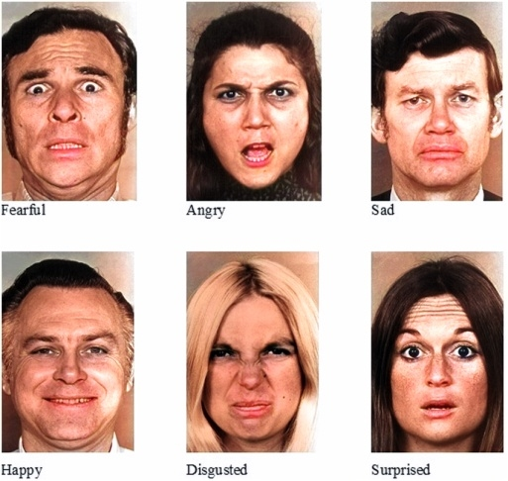
Facial Emotion Recognition Using Deep Learning
Project by. Ashish Kumar Singh

Slide 2
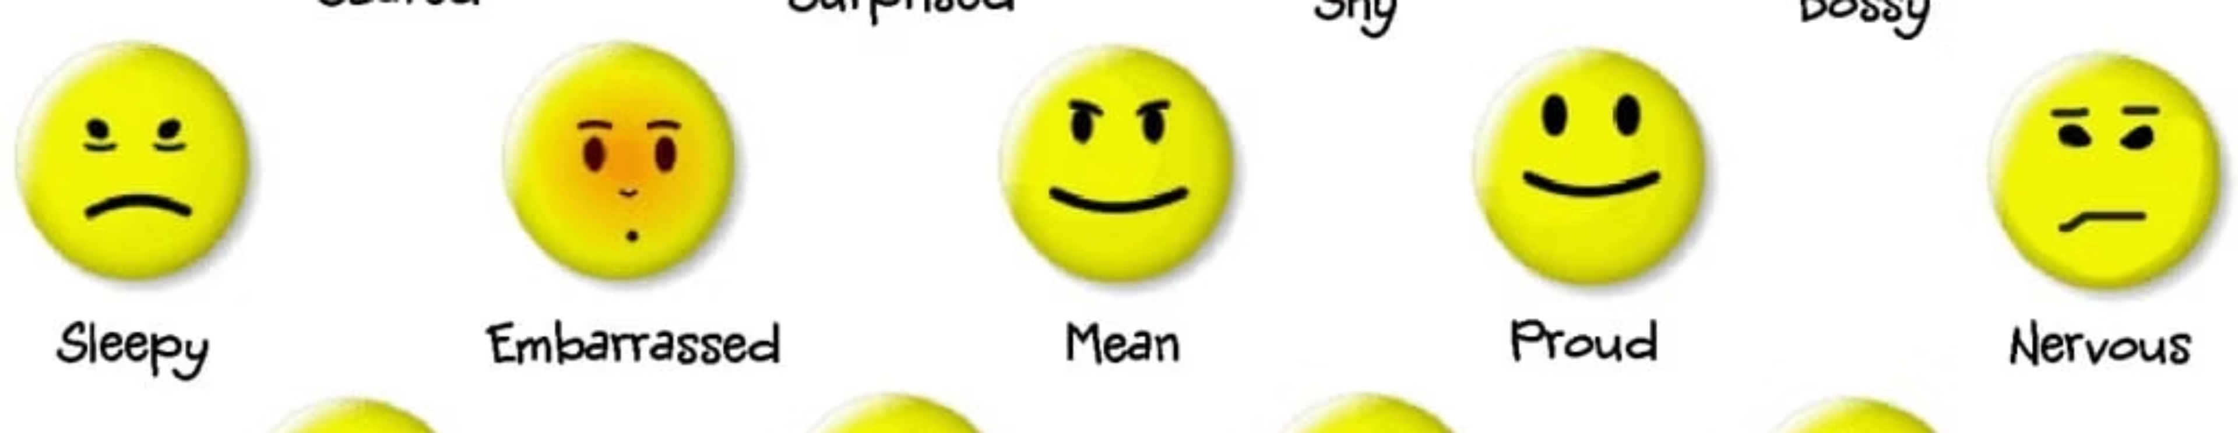
The Challenge: Capturing Human Emotion
Complex Variations
Manual Limitations
Our Goal
Facial emotions are influenced by lighting, pose, and expression intensity, making accurate recognition difficult.
Manual classification of emotions is unreliable and highly time-consuming for large datasets
Develop a robust deep learning model for precise classification of seven core human emotions.

Slide 3
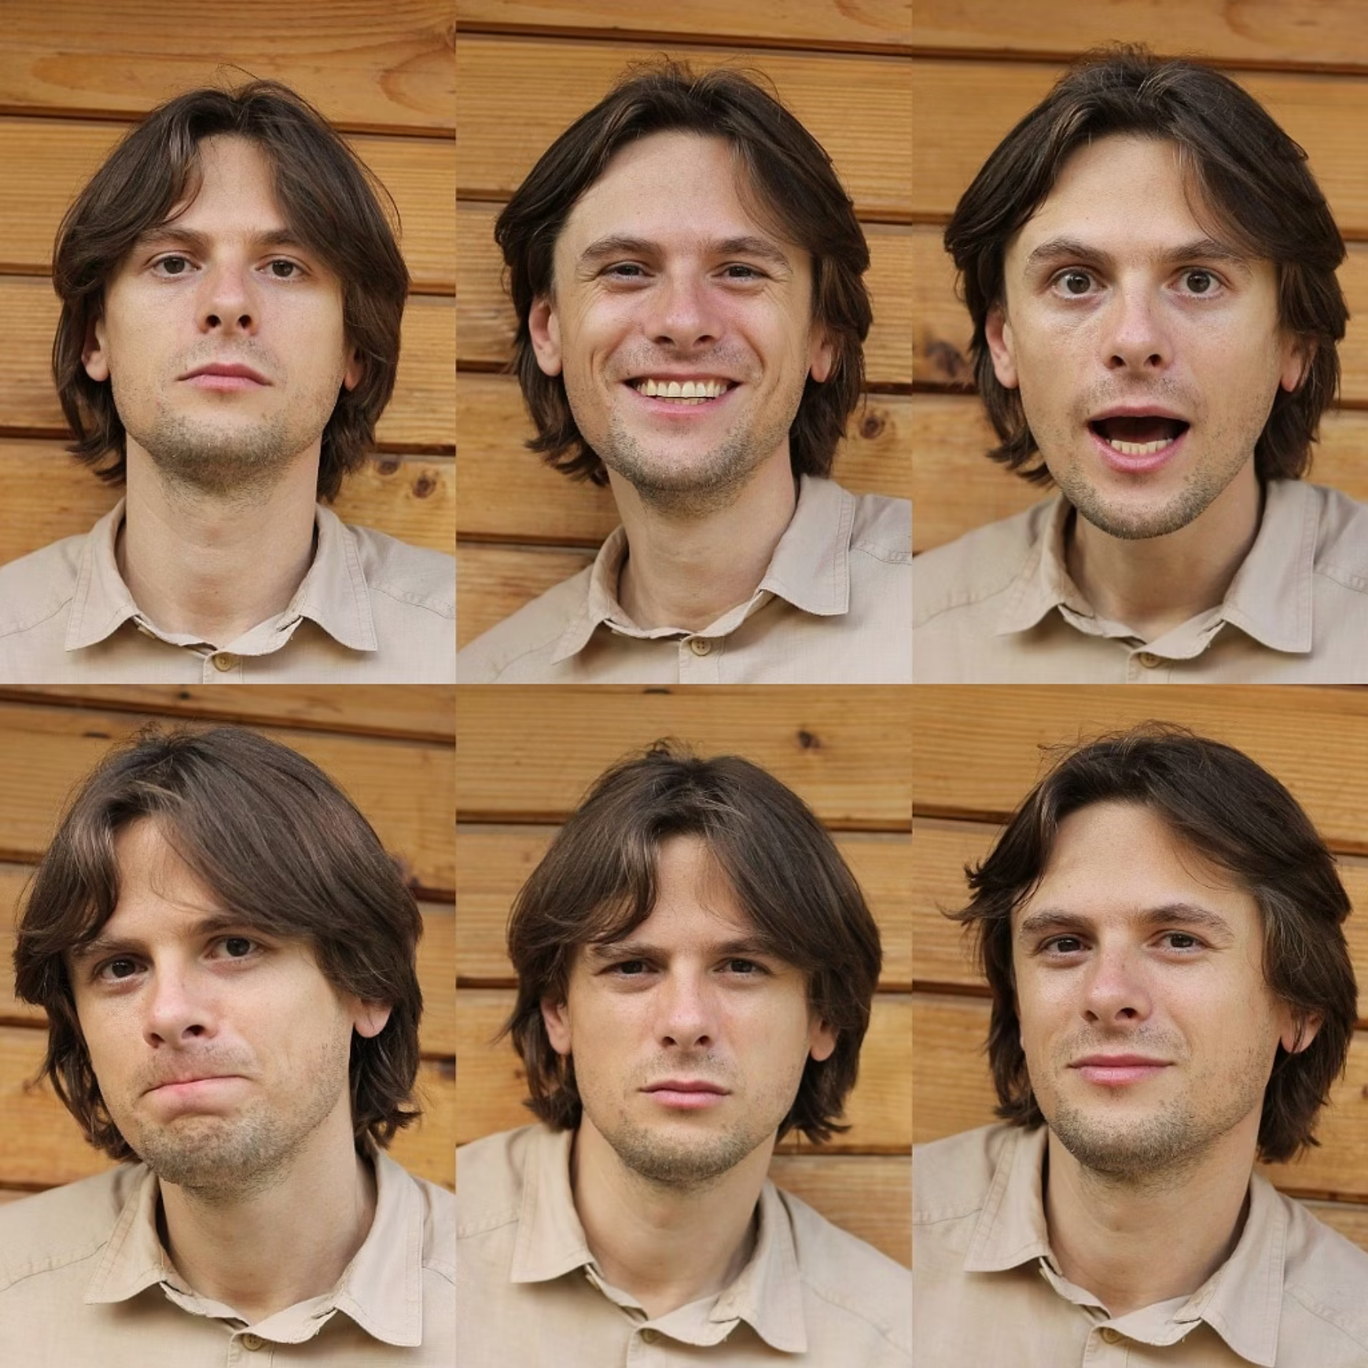

Dataset Overview: Training the Model
Our dataset comprises thousands of facial images, categorised into seven distinct emotion classes:
Fear
Happy
Neutral
Sad
Surprise
Disgust
Angry
These images reflect natural variations in expressions, crucial
for real-world applicability.
Preprocessing Steps
Images undergo resizing, normalisation, and augmentation to enhance model robustness. An 80/20 split ensures rigorous training and validation.

Slide 4





Methodology: Our Approach
Data Preparation
Model Training
Augmentation
Loading and meticulous preprocessing of the comprehensive dataset.
Training four distinct deep learning models: Perceptron, MLP, CNN, and VGG16.
Implementing data augmentation techniques to significantly improve model generalisation and robustness.
Evaluation Metrics
Comparative Analysis
Assessing performance using accuracy, loss metrics, and detailed confusion matrices.
Rigorous comparison of results to identify the optimal model for facial emotion recognition.

Slide 5
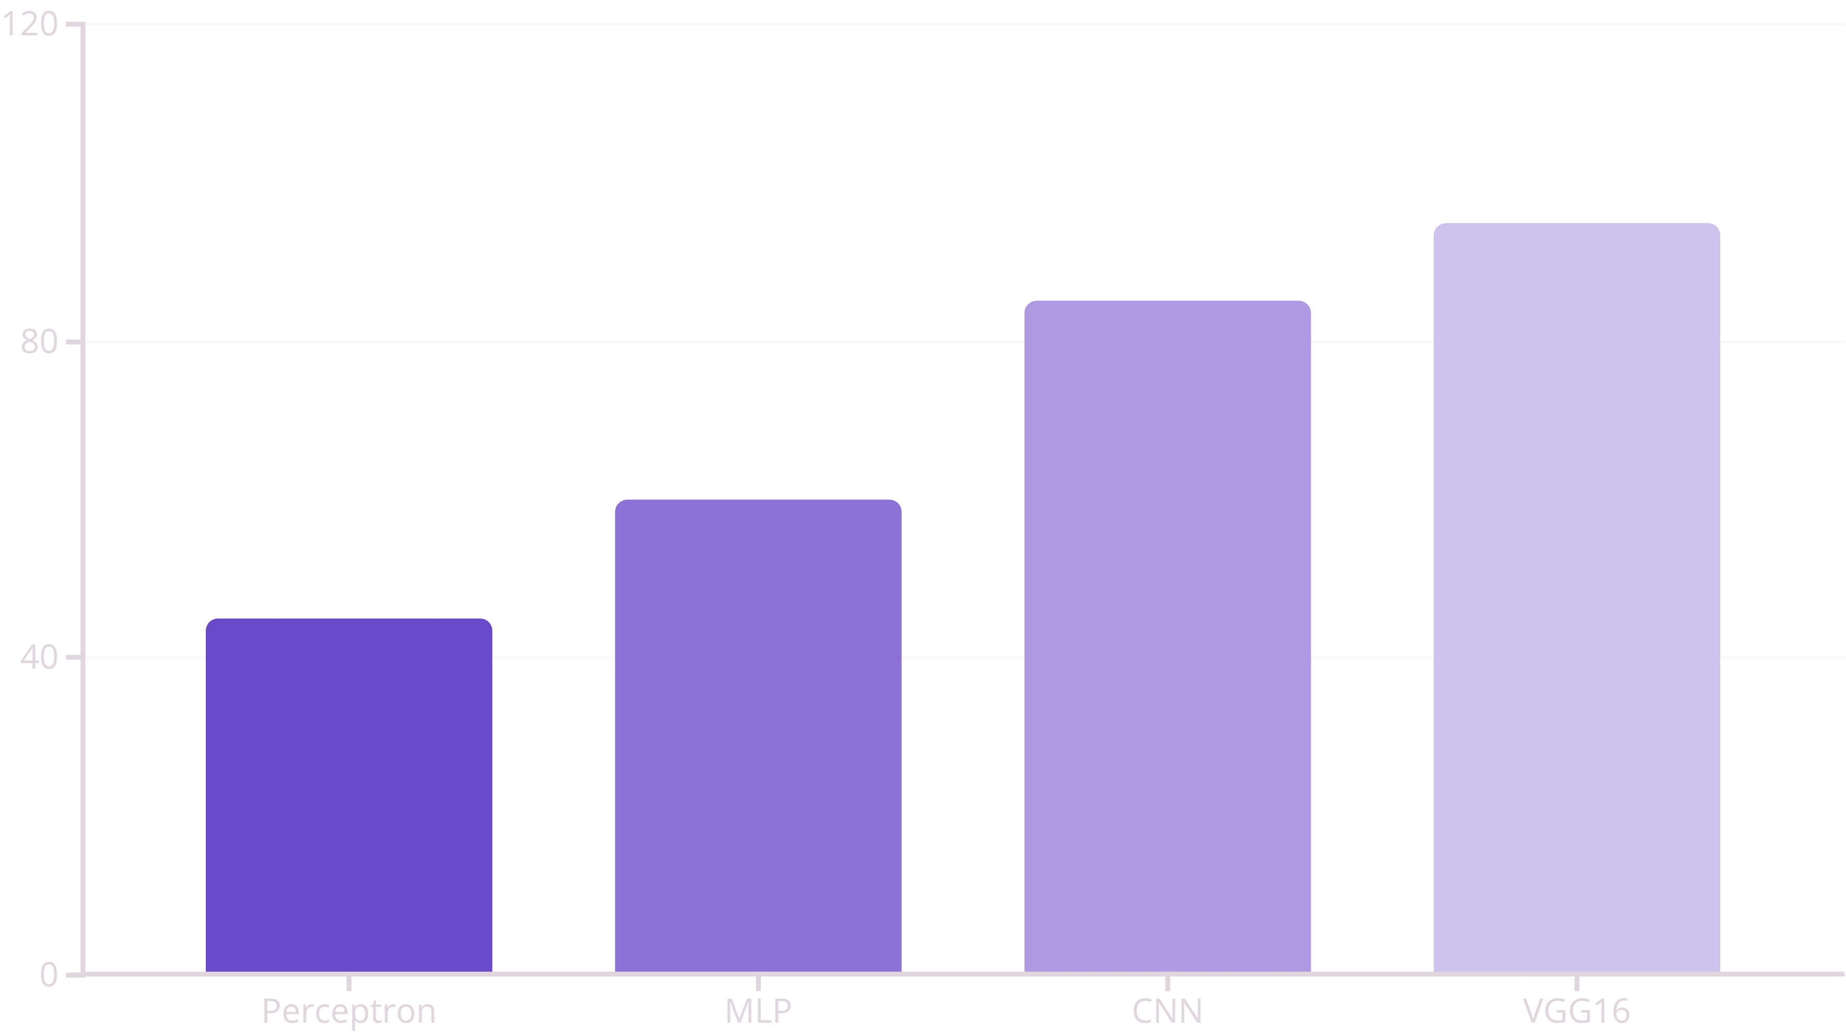
Model Performance: A Comparative View
Observe the improvement in accuracy as model complexity scales, from basic perceptrons to advanced convolutional networks.

Slide 6
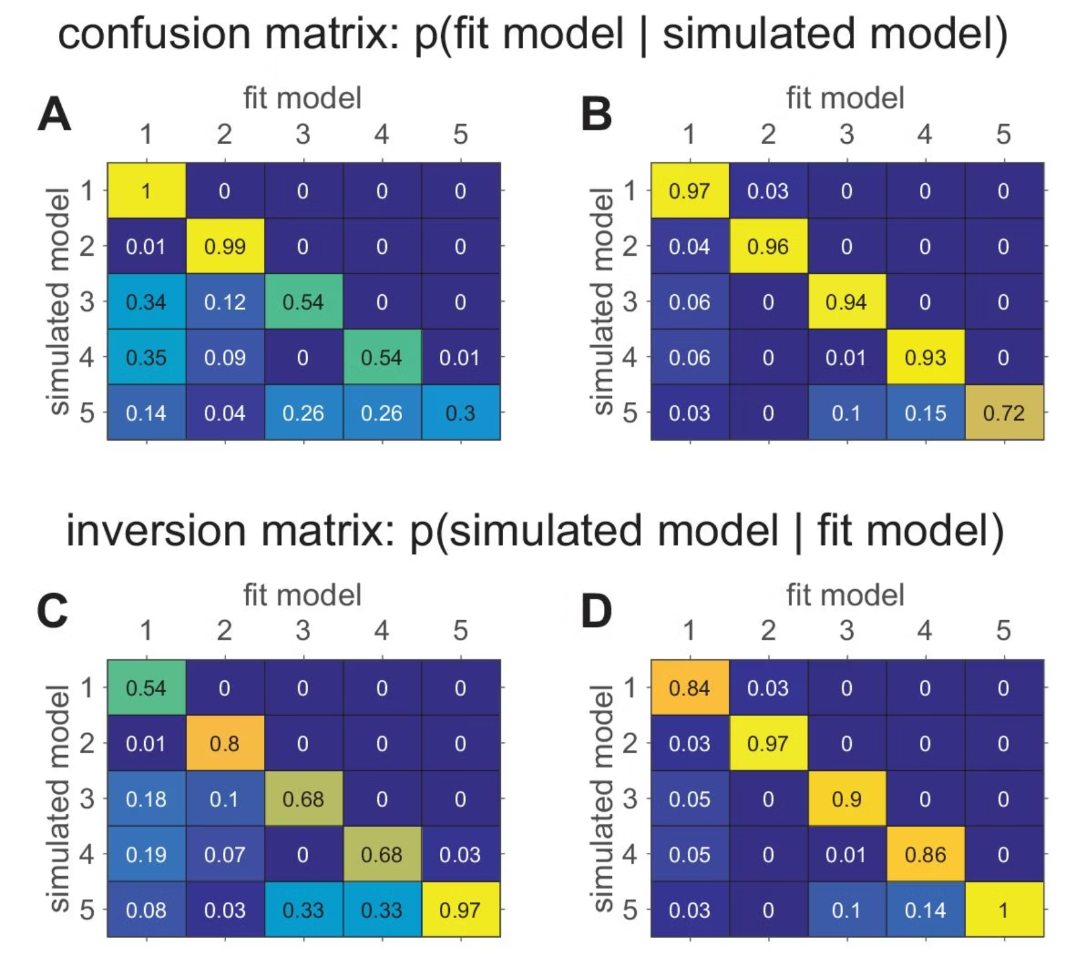
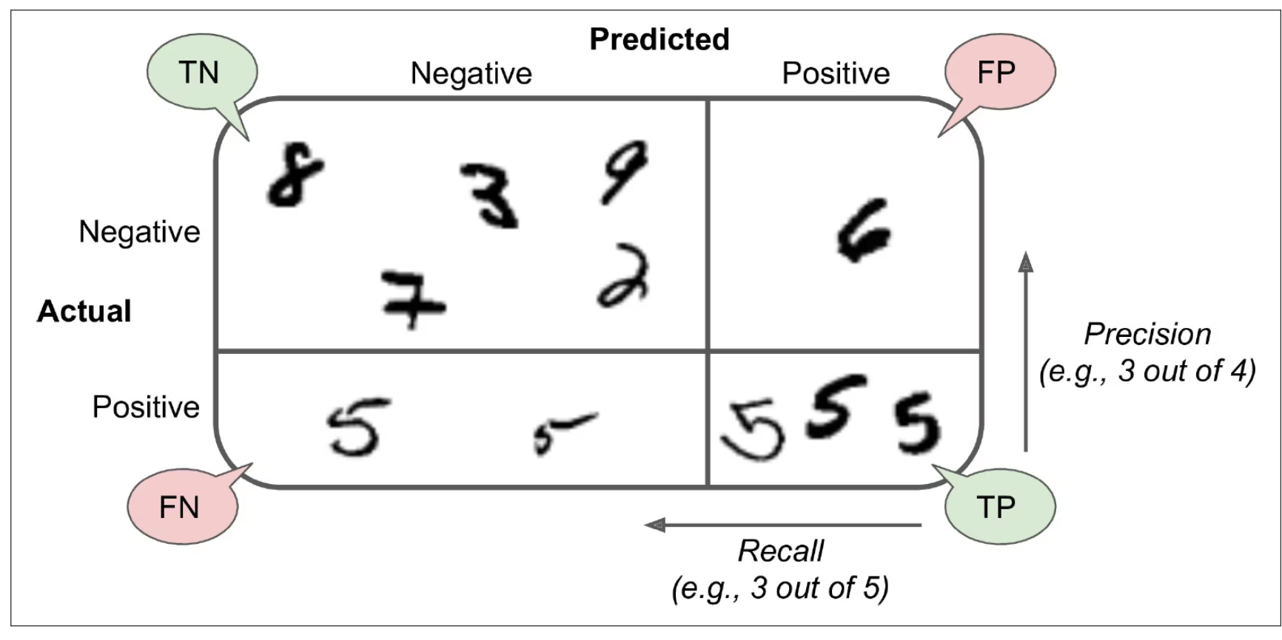
CNN vs. VGG16: Understanding Confusion
CNN Confusion Matrix
VGG16 Confusion Matrix
The CNN model demonstrates strong overall performance but exhibits some confusion between closely related emotions like 'Fear' and 'Surprise'.
Leveraging transfer learning, VGG16 achieves the highest accuracy with minimal confusion, clearly separating all seven emotion classes.
VGG16's deeper architecture and pre-trained weights significantly reduce misclassifications.

Slide 7
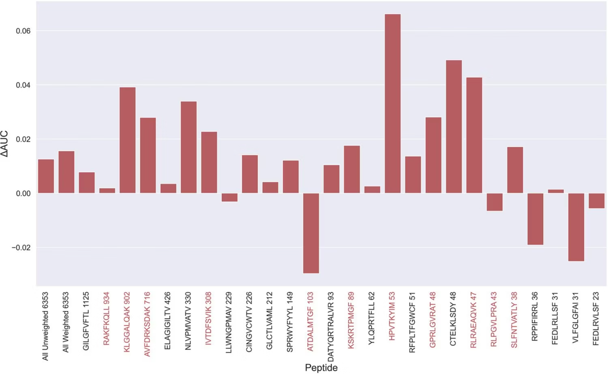
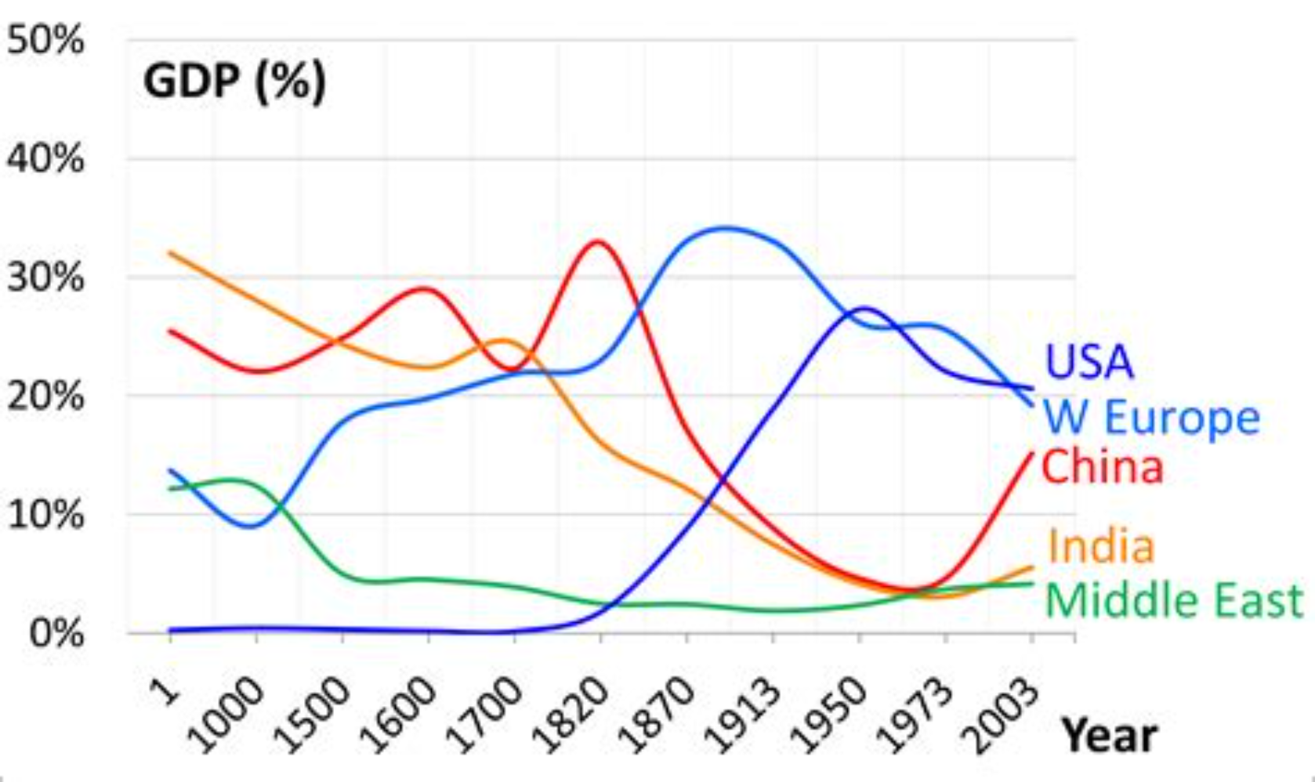
Learning Progression: Accuracy & Loss
Training vs. Validation Accuracy
Training vs. Validation Loss
This graph illustrates the learning progression of our best model, showing consistent improvement in both training and validation accuracy over epochs.
The stable decline in both training and validation loss confirms proper model convergence without significant overfitting.
These metrics are vital for ensuring the model generalises well to unseen data.

Slide 8
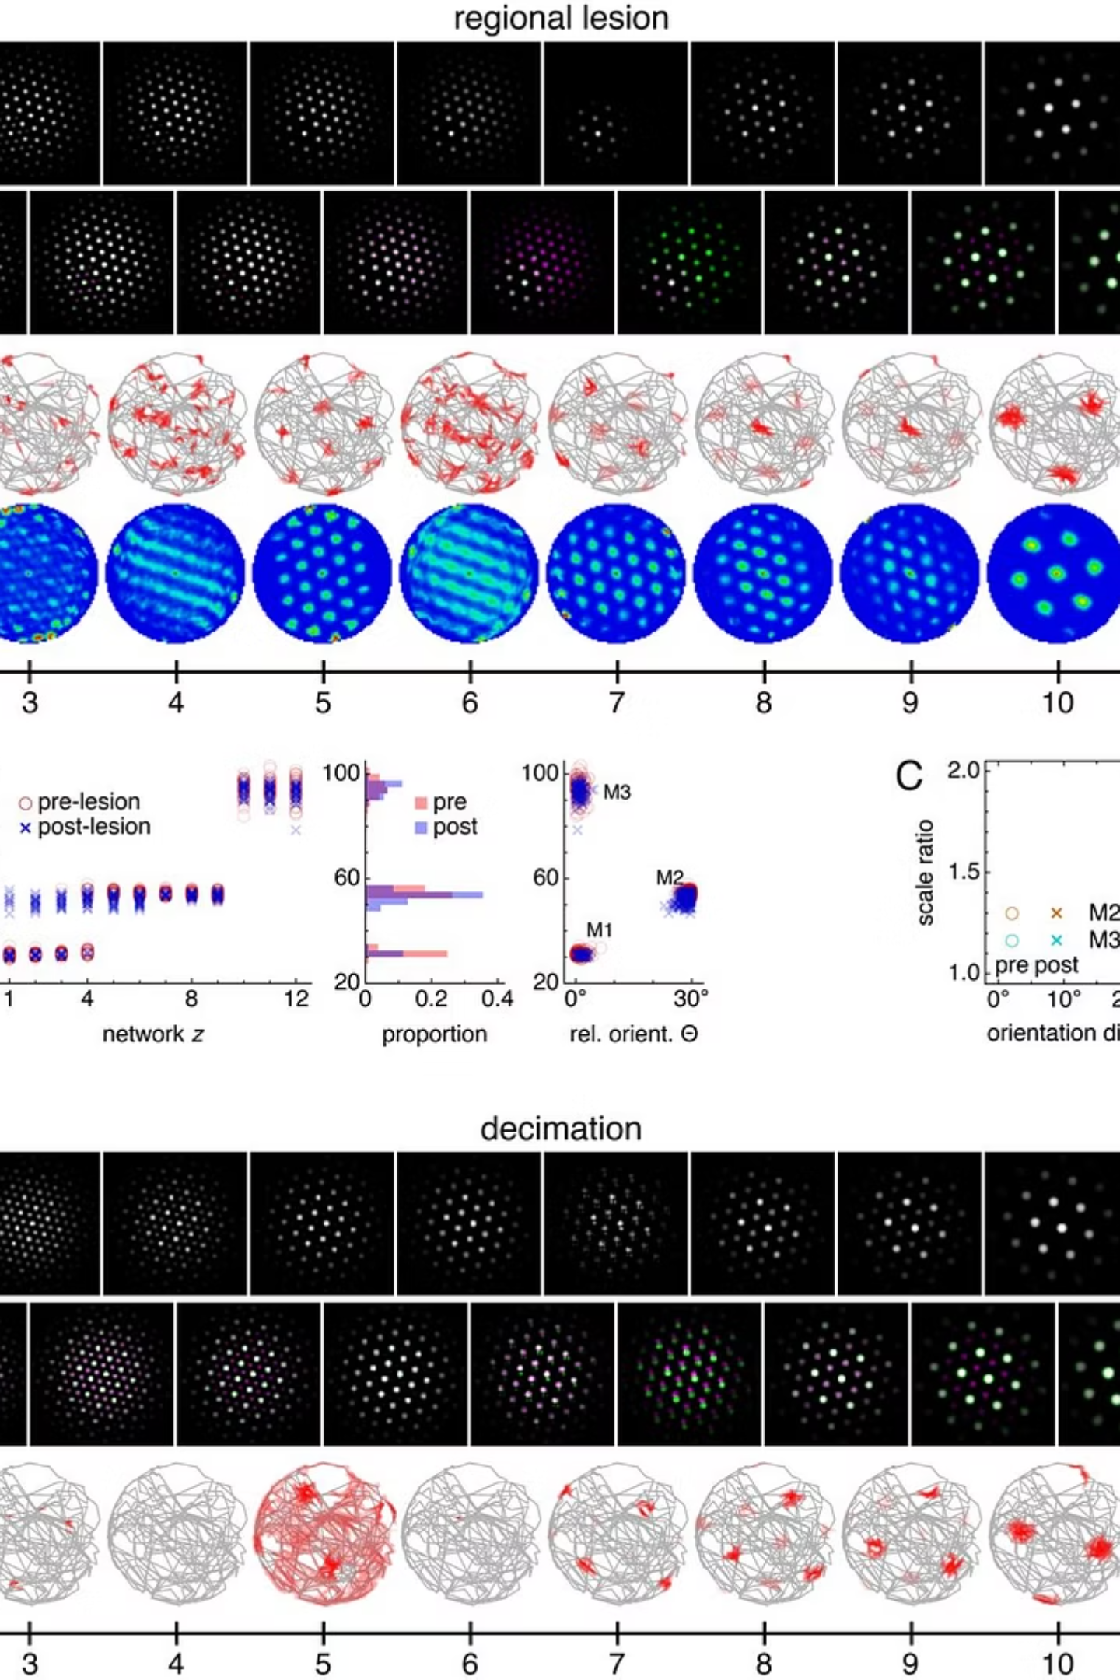
Conclusion: Robust FER for Real-World Use
Basic Models Inadequate
CNN's Breakthrough
Perceptron and MLP models struggle with the complexity of image data, resulting in poor performance.
Convolutional Neural Networks (CNNs) effectively extract spatial features, leading to a significant boost in accuracy for FER.
VGG16: The Apex
VGG16, enhanced by transfer learning, achieves unparalleled performance (90-97% accuracy), making it ideal for robust FER applications.
Our final VGG16-based model is highly robust, suitable for diverse real-world facial emotion recognition scenarios.

