Slide 1
Secure Communication over TCP and UDP: Network Security Analysis.
By: Ashish Balaji Rajkumar

Slide 2
PROJECT OVERVIEW
Compare TCP <-> TLS
Compare UDP <-> DTLS
Perform Real packet-level attacks
Show how encryption prevents attack
Detect Replay Attack (UDP)
Observe Anti-Replay (DTLS)
Detect ICMP Tunneling (Covert Data Exfiltration)

Slide 3
Module 1: TCP (Insecure Communication)
Goal: Show how plaintext TCP exposes all data
What is Insecure TCP?
  TCP establishes 3-Way Handshake.
  After Handshake, data is sent and read as plain Text.
  No Encryption, no authentication, no integrity.
  Attackers can sniff all the data in transit.
  Man-in-the-Middle(MITM) attacks are easy.
  Communication can be modified or injected.
  Replay Attacks are possible.
What Wireshark Shows
  Packet-> Data section displays plaintext messages:
  Example: “Hello Server", "Hi Client”.
  Full ASCII text visible under:
  Frame-> Ethernet-> IP->TCP-> Data
  Demonstrates no confidentiality.

Slide 4
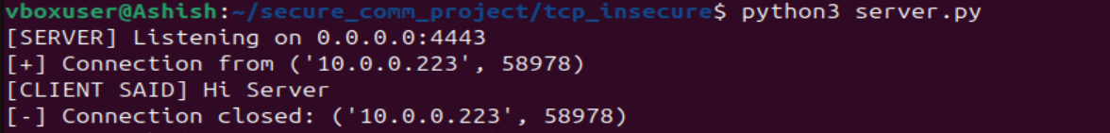
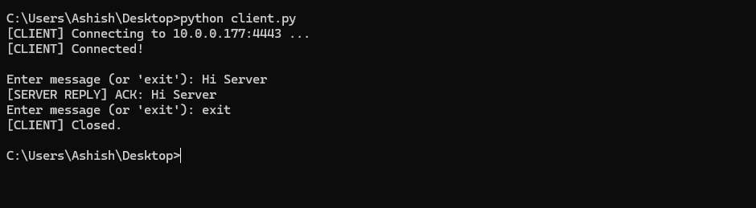

Slide 5
Module 2: TCP+TLS
Goal: Show how TLS adds encryption, integrity, and authentication to TCP.
What TLS Adds on Top of TCP
  Encrypts all application data.
  Ensure data integrity.
  Authenticates the server via certificates.
  Prevents MITM attacks
  Adds replay resistant session keys.
TLS Handshake
  ClientHello: supported Ciphers, random value.
  ServerHello: Selected Cipher.
  Certificate: Server Identity.
  Key Exchange: create shared session key.
  ChangeCipherSpec: switch to encrypted mode.
  Finished: mutual verify handshake.
  Application Data is marked as “TLSv1.2 Encrypted Application Data”

Slide 6
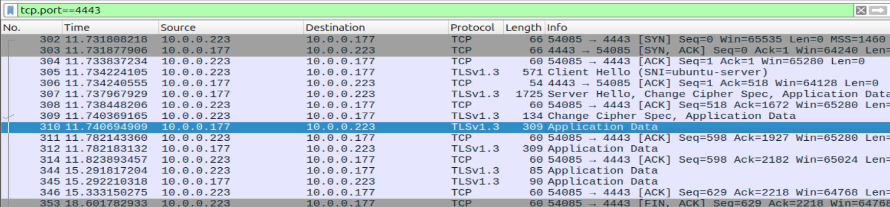

Slide 7
Module 3: UDP (Insecure Communication)
Goal: Show how UDP sends data without any security mechanism.
UDP is a lightweight, connectionless protocol. No handshake, no guarantee of delivery, no built-in sequencing, ordering or reliability, designed for speed, not security.
Core Security Problems: No encryption, No Authentication, No Integrity, No sequencing, No reliability.
Real-World UDP Attacks: IP Spoofing, Replay Attack, Packet Injection, UDP Reflection/Amplification(DDoS).

Slide 8


Slide 9
Module 3 (Part 2): UDP Replay Attack
Goal: Demonstrate how insecure UDP can be exploited through packet replay.
A replay attack happens when an attacker captures a valid UDP packet and sends the same packet again, the server accepts it as a legitimate packet message.
UDP is vulnerable to replay because UDP packet is treated as a fresh request. No session date, No cryptographic signature and server blindly processes whatever it receives.
Replay attacks on UDP can cause Re-executed commands, duplicate transactions, Unauthorized actions and attackers may even automate DDoS attacks.

Slide 10
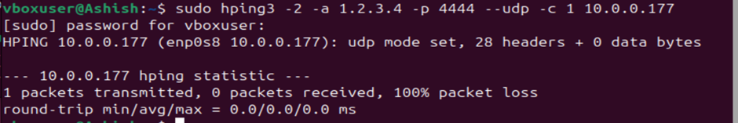
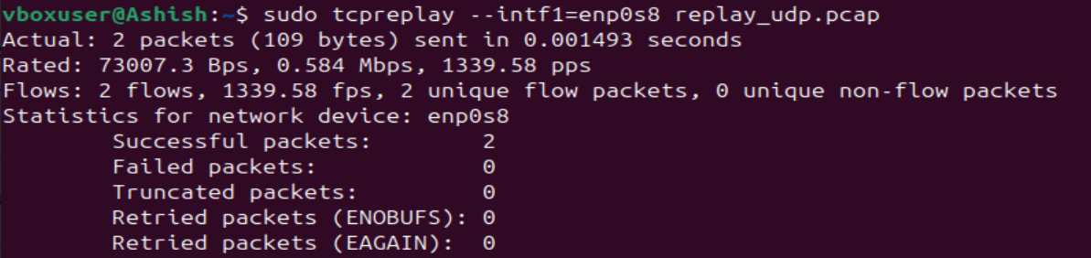

Slide 11
Module 4: DTLS(Secure Communication over UDP)
Goal: Show how DTLS protects UDP using encryption, sequencing, and anti-replay.
Datagram Transport Layer Security(DTLS) provides encryption integrity, authentication, anti-replay protection.

Slide 12
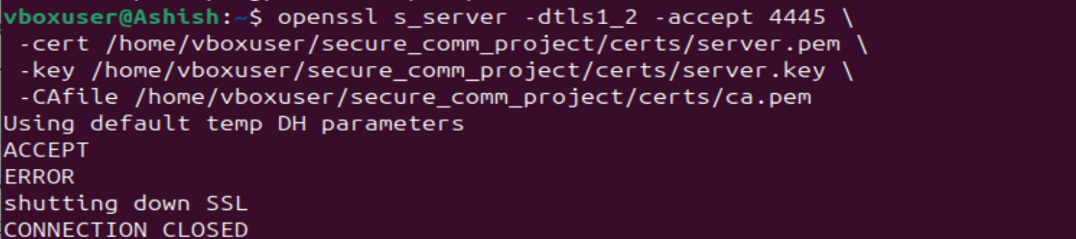
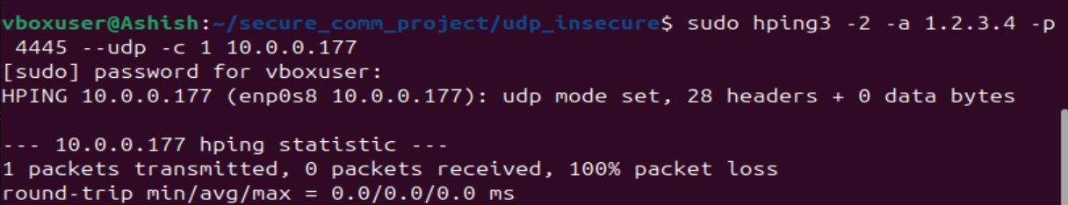

Slide 13
Module 4 (Part 2): DTLS Anti-Replay Protection (Deep Dive)
Why Replay must be prevented: Re-Trigger past actions, Re-use invalid commands, cause DDoS or duplicated operations.
DTLS Anti-Replay uses Sequence Numbers, Epoch Numbers, Replay Windows and MAC integrity verification.

Slide 14
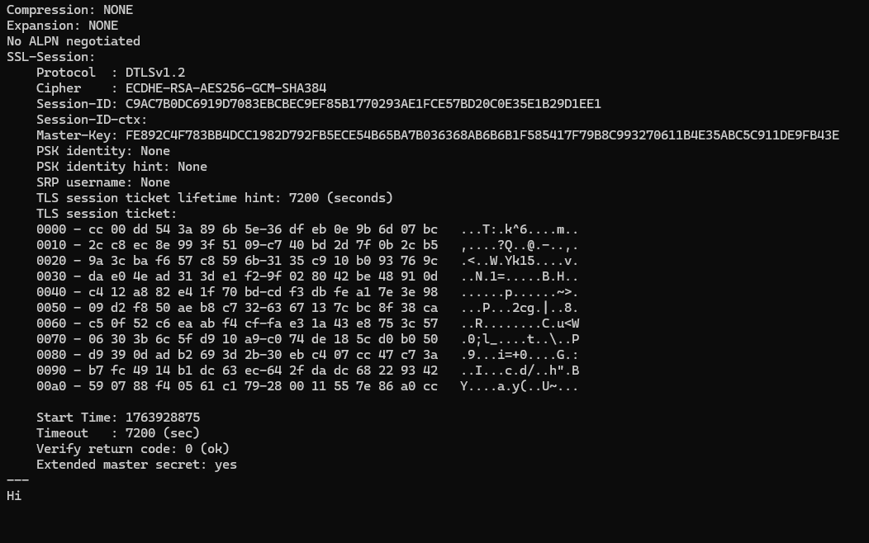
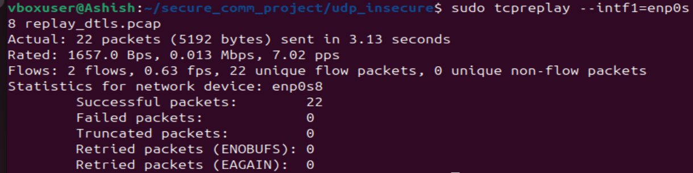

Slide 15
Module 5: ICMP Tunnelling (Covert Data Exfiltration)
Goal: Show how attackers bypass secure TCP/TLS & UDP/DTLS by abusing ICMP.
The Internet Control Message Protocol is a network layer protocol that network devices use to send control and error messages, such as "destination unreachable" or "time exceeded“.
ICMP normally carries Echo Request/Echo Reply, Attackers embed hidden data inside ICMP packets, used for covert channels and stealthy data exfiltration.
Usually bypasses firewall since ICMP is usually allowed.
Attackers hide credentials, keys, Command & Control (C2) instructions, Base64 encoded or encrypted payloads.
Indicators of ICMP tunnelling is abnormally large ICMP payloads, Repeated Data patterns, Encoded Data.

Slide 16
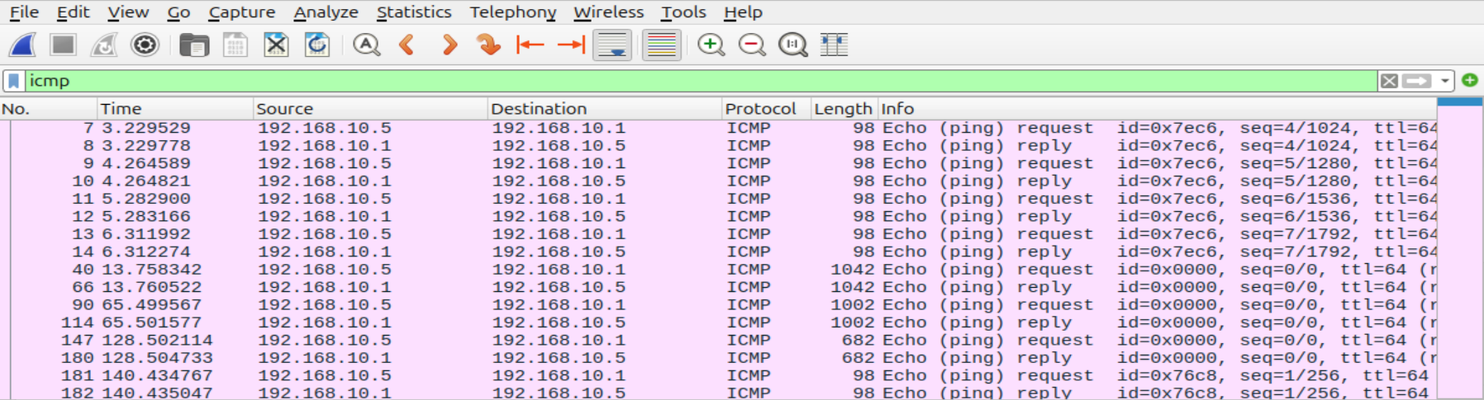

Slide 17
CONCLUSION
Insecure communication is Easy to Attack.
TLS and DTLS Transform Communication Security.
True network security requires confidentiality (TLS/DTLS), integrity, replay protection, AND protocol monitoring to detect covert channels like ICMP tunneling.
Encryption protects communication, replay protection communication, protocol analysis detects hidden threats and a complete security model must combine all of the above.

