Slide 1
AI-Stock Market Analysis Dashboard
Premium AI-Powered Intelligence for Indian Investors
Tailored for NSE India

Slide 2
Core Objective
• Democratize high-end quantitative stock analysis.
• Provide real-time 'Buy/Hold/Sell' recommendations.
• Deliver a premium, distraction-free investor experience.
• Unified interface for charts, news, and technical metrics.

Slide 3
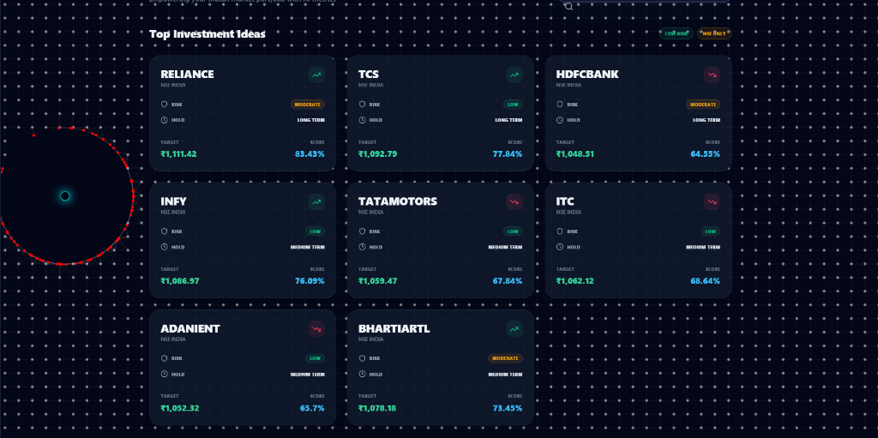
Premium UI/UX Experience
• Sleek Glassmorphism Design Language.
• Dynamic Background: Glowing Particle Mesh Cursor Trail.
• Intelligent Stock Search with auto-suggestions.
• Paginated Dashboard grid for scalable tracking.
• Mobile-first responsive layout with Framer Motion animations.

Slide 4
Technical Analysis Engine
• Automated Trend detection (SMA 50/200 crossover).
• Relative Strength Index (RSI) calculation to identify overbought/oversold levels.
• Dynamic OHLC Candlestick charts for price action monitoring.
• Aggregated 'Market Intel' news feed for fundamental context.

Slide 5
AI & Machine Learning Integration
• Random Forest Regressor trained on 5 years of historical NSE data.
• Feature Engineering: Volatility, Momentum (5d/20d), and RSI integration.
• Real-time Inference: Model predicts prices based on live technical features.
• Confidence Scores: Quantitative assessment of prediction reliability.

Slide 6
Technical Architecture
• Frontend: React + Vite + Tailwind CSS (High performance).
• Backend: FastAPI (Asynchronous Python for concurrency).
• ML Engine: Scikit-learn + Pandas + yfinance.
• Database: persistent SQLite for watchlists and user settings.
• Infrastructure: Netlify (Frontend) & Render (Backend) with CI/CD.

Slide 7
Future Roadmap
• Integration of Real-time WebSockets for Nifty 50 live ticks.
• Multi-asset support (Commodities, Crypto, Global Markets).
• Automated Trading Signal Alerts (WhatsApp/Telegram integration).
• Personalized Portfolio Performance Tracking.

Slide 8
Thank You!
• Project Repository: https://github.com/Ashish1372004/ai-stock-analysis
• Deployed App: Live on Netlify.

