Slide 1
STUDENT DETAILS
Name:- Ashish Kumar Nayak
Skillsbuild Email:- ashishnayak.2403@gmail.com
College:- C.V. Raman Global University, Bhubaneswar, Odisha
Internship Domain:- Data Analytics (DA)
Start Date:- 12/06/2023
End Date:- 24/07/2023
Internship ID:- INTERNSHIP_168198413964410a8b547b1
AICTE Student ID:- STU645e63c607a491683907526

Slide 2
PROJECT TITLE/Problem Statement
Analysis of Sample Superstore Dataset
“The management of Superstore, a retail business, is looking to enhance operations and profitability by gaining insights into sales data. They have made available a dataset that includes details on their clients, goods, and transactions over a specific time frame. By utilising different data analytics methodologies and statistical analysis, the project's goal is to assess the dataset and derive actionable insights. Finding patterns, trends, and links within the data as well as elements that might have an influence on sales and consumer behaviour should be the main goal of the research. The project should also offer suggestions to the management team on possible tactics to boost sales, save expenses, and improve overall company performance in light of the research' findings.”

Slide 3
AGENDA
1. Introduction to the Superstore Sales Dataset:
Overview of the dataset structure and variables.
Understanding the business context and objectives of the project.
2. Data Exploration and Cleaning:
Exploring the dataset to identify missing values, outliers, and inconsistencies.
Cleaning the dataset by addressing missing values, outliers, and inconsistencies.
3. Descriptive Analytics:
Performing basic statistical analysis to summarize and describe the dataset.
Generating descriptive statistics, such as mean, median, mode, standard deviation, etc., for relevant variables.
Visualizing data using charts, graphs, and histograms to gain initial insights.
4. Customer Segmentation:
Conducting customer segmentation based on various customer attributes (e.g., demographics, purchase behavior, etc.).
Applying clustering algorithms (e.g., K-means clustering) to identify distinct customer segments.
Analyzing the characteristics and preferences of each segment.

Slide 4
5. Sales Analysis:
Analyzing sales trends over time (e.g., monthly, quarterly, yearly) to identify patterns and seasonality.
Examining the performance of different product categories and sub-categories.
Investigating the correlation between sales and other factors (e.g., region, customer segment, etc.).
6. Profitability Analysis:
Calculating profit margins for different products and product categories.
Identifying the most profitable and least profitable products.
Analyzing the impact of discounts, shipping costs, and other factors on profitability.
7. Recommendations and Insights:
Summarizing the key findings and insights from the analysis.
Providing actionable recommendations to improve sales, profitability, and customer satisfaction.
Presenting the results in a clear and concise manner using visualizations and data-driven insights.
8. Conclusion:
Concluding the analysis project and summarizing the key takeaways.
Reflecting on the limitations of the analysis and potential areas for further exploration.

Slide 5
PROJECT OVERVIEW
The Analysis of Superstore Dataset project aims to leverage data analytics techniques to gain insights into the sales data of Sample Superstore, a retail company. The project involves analyzing a provided dataset containing information about customers, products, and transactions over a specific period.
The primary objectives of the project are as follows:
1. Data Exploration and Cleaning:
Explore the dataset to understand its structure and variables.
Identify and handle missing values, outliers, and inconsistencies.
Prepare the dataset for further analysis.
2. Descriptive Analytics:
Perform basic statistical analysis to summarize and describe the dataset.
Generate descriptive statistics, such as mean, median, mode, and standard deviation, for relevant variables.
Visualize data using charts, graphs, and histograms to gain initial insights.
3. Customer Segmentation:
Conduct customer segmentation based on various customer attributes, such as demographics and purchase behavior.
Apply clustering algorithms (e.g., K-means clustering) to identify distinct customer segments.
Analyze the characteristics and preferences of each segment.

Slide 6
4. Sales Analysis:
Analyze sales trends over time (e.g., monthly, quarterly, yearly) to identify patterns and seasonality.
Examine the performance of different product categories and sub-categories.
Investigate the correlation between sales and other factors, such as region and customer segment.
5. Profitability Analysis:
Calculate profit margins for different products and product categories.
Identify the most profitable and least profitable products.
Analyze the impact of discounts, shipping costs, and other factors on profitability.
6. Recommendations and Insights:
Summarize the key findings and insights from the analysis.
Provide actionable recommendations to improve sales, profitability, and customer satisfaction.
Present the results in a clear and concise manner using visualizations and data-driven insights.

Slide 7
WHO ARE THE END USERS OF THIS PROJECT?
The end users of the Analysis of Sample Superstore Dataset project can include various stakeholders within the Sample Superstore company. These stakeholders may include:
The Management team at Superstore is the primary audience for the project's research and insights, which they will use to make strategic choices and put new ideas into practize to increase operations, sales, and profitability.
Business analysts may learn more about how customers behave, how well products operate, and how sales are trending, and they can use this knowledge to improve their reports and suggestions.
The Sales team may optimize their sales strategy by comprehending sales trends, product performance, and customer behavior, while the marketing team can design focused marketing strategies based on consumer segmentation and preferences.
The finance team can find ways to cut costs and enhance pricing strategies.
The operations team can simplify procedures, improve inventory management, and optimize supply chain operations.
Data analysts and data scientists can contribute their knowledge in analyzing the information and drawing conclusions by using the project as a standard for future data-driven initiatives and a reference for analyses of a similar nature.

Slide 8
YOUR SOLUTION AND ITS VALUE PROPOSITION
Solution:
Advanced data analytics techniques are used in the Analysis of Superstore Sales Dataset project to find patterns, trends, and linkages. Customer segmentation, sales analysis, profitability analysis, and customer behavior analysis are important elements.
Value Proposition:
The analysis offers actionable insights for Superstore's management team, enabling them to make data-driven decisions and identify areas for improvement. This leads to improved sales and customer satisfaction, cost optimization, enhanced decision-making, a competitive advantage, and streamlined operations. By understanding customer behavior, sales trends, and product performance, the analysis enables targeted marketing strategies and sales approaches, increasing revenue and customer satisfaction. The profitability analysis identifies profitable products and factors impacting profitability, enabling the management team to optimize pricing, manage discounts, and streamline operations for cost savings. The solution is scalable and adaptable, accommodating additional datasets, variables, and analysis requirements, allowing Superstore to leverage data analytics for ongoing improvement and growth.

Slide 9
HOW DID YOU CUSTOMIZE THE PROJECT AND MAKE IT YOUR OWN
Personalized Project Objectives: I would review the initial project objectives and consider any additional goals or specific areas of focus that align with my expertise or interests.
2. Tailored Analysis Techniques: I would apply my understanding of sophisticated analytics techniques or specific statistical models that might give deeper insights, even though the project may have suggested analytical methodologies. In order to increase the project's value and produce more precise forecasts or actionable suggestions, this can require adding predictive modeling, time series analysis, or sentiment analysis.
3. Creative Data Visualization: I may look at innovative data visualization approaches outside of the standard charts and graphs in order to display the analytical findings in a visually appealing and clear way. This might entail involving stakeholders and successfully communicating the insights through the use of interactive dashboards, narrative approaches, or infographics.
4. Domain-specific Insights: I would offer context-specific insights that go beyond the fundamental analysis using my domain expertise or past experience.
5. Real-world Implementation Strategies: Despite the fact that recommendations are an important element of the project, I would make sure they are useful and implementable. To help the management team implement the suggested improvements, this could entail offering particular implementation tactics, such as starting loyalty programs, refining pricing structures, or enhancing inventory management.
6. Reflecting Personal Style: I would infuse my personal style into the project by using clear and concise language, incorporating effective storytelling techniques, and presenting the analysis results in a visually appealing and engaging format.

Slide 10
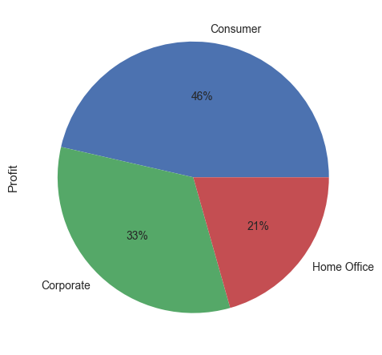
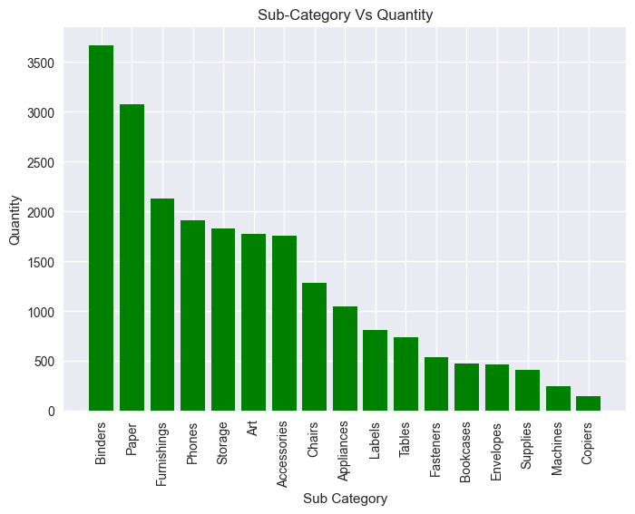
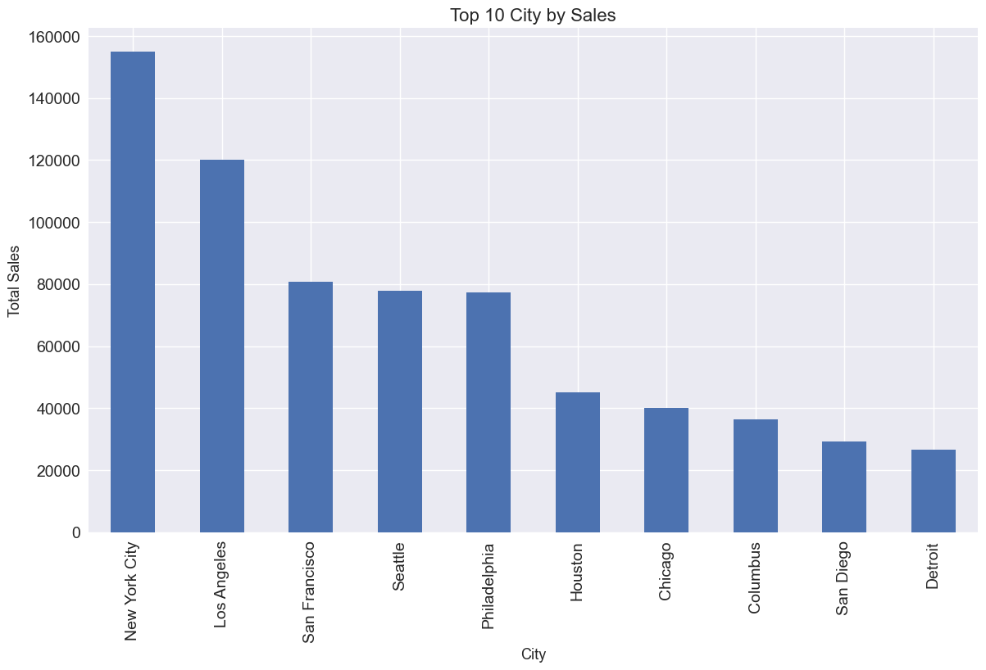
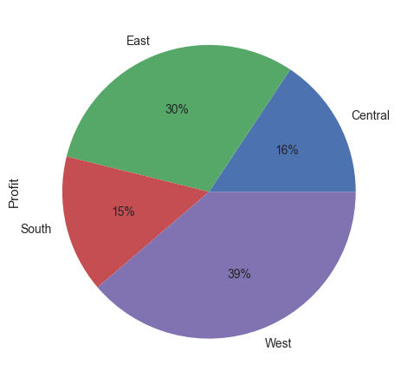
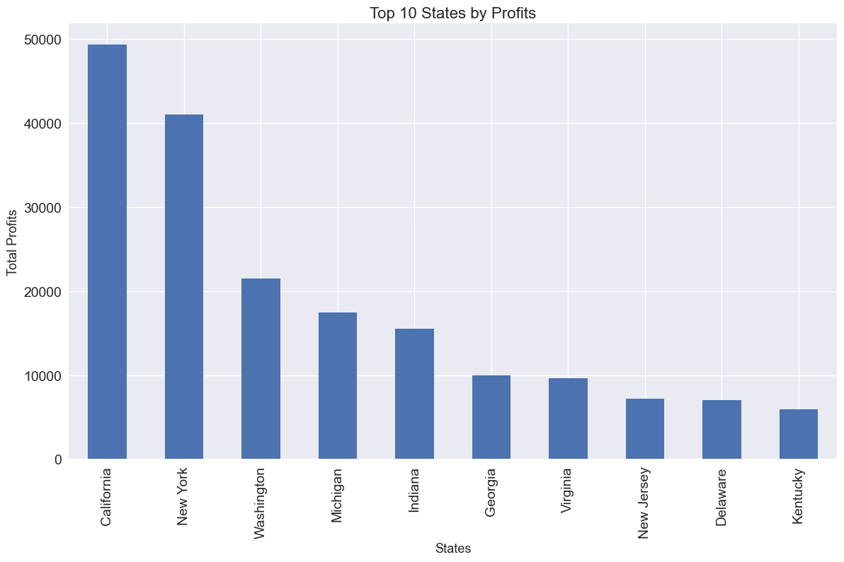
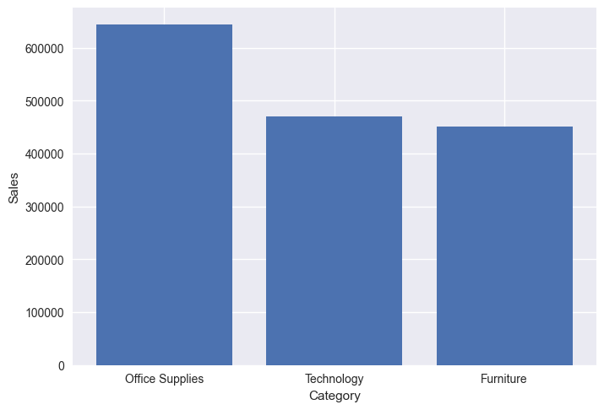
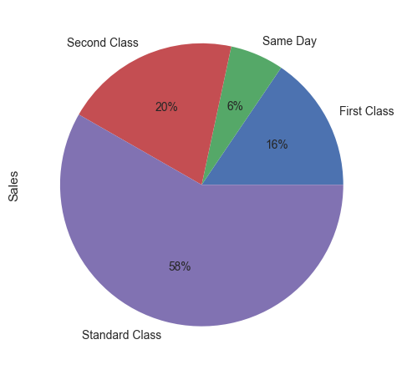
MODELLING

Slide 11
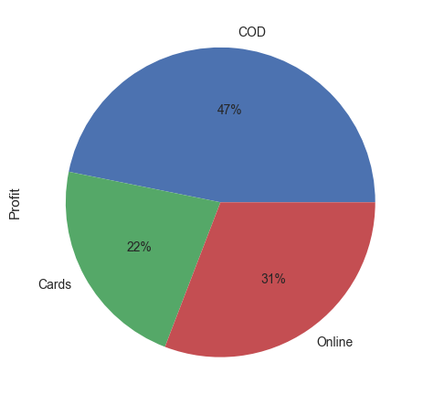
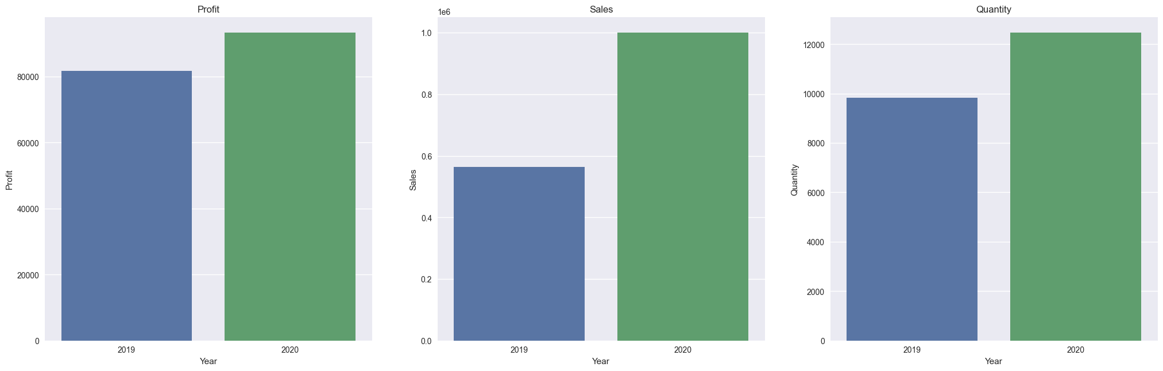
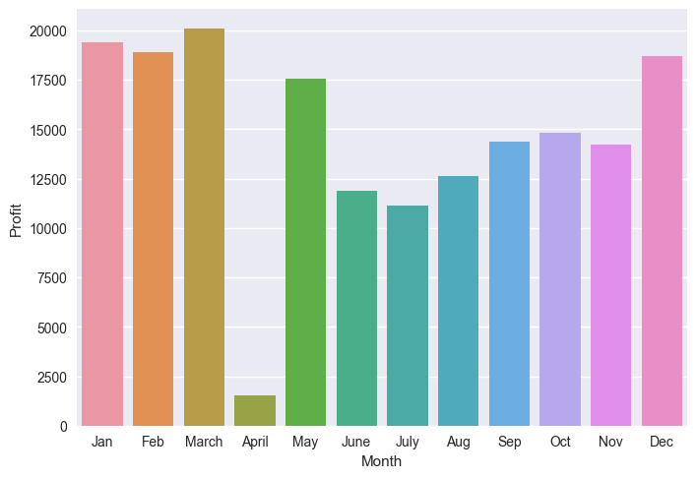
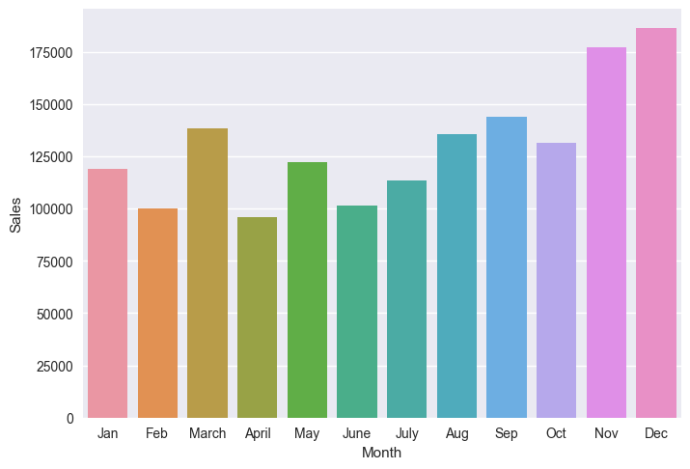
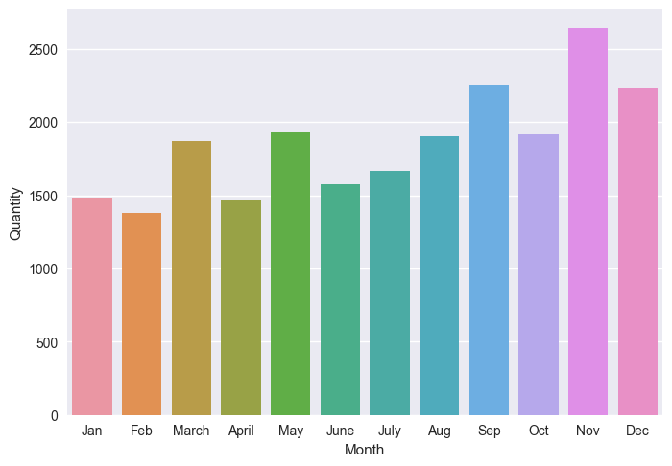

Slide 12
Results
1. Customer Segmentation Results:
- Identified distinct customer segments based on demographics, purchasing behavior, or geographic location.
- Analyzed the characteristics and preferences of each segment, such as high-value customers, frequent purchasers, or price-sensitive customers.
2. Sales Analysis Results:
- Identified sales trends over time (monthly, quarterly, yearly) and identified peak seasons or periods of high demand.
- Analyzed the performance of different product categories and identified top-selling and underperforming products.
- Explored correlations between sales and factors like region, customer segment, or product attributes.
3. Profitability Analysis Results:
- Calculated profit margins for different products and product categories to identify the most profitable and least profitable items.
- Analyzed the impact of discounts, shipping costs, or other factors on profitability.
- Identified opportunities to optimize pricing strategies, reduce costs, or improve overall profitability.
4. Recommendations and Insights:
- Provided actionable recommendations to improve sales, profitability, and customer satisfaction based on the analysis results.
- Proposed strategies for targeted marketing campaigns, product promotions, or customer retention initiatives.
- Highlighted potential areas for process optimization, inventory management, or supply chain efficiency improvements.

Slide 13
Results
Sales = $1.57M and Profit = $175.26k of the company.
Out of Top 10 States. Most sales & profit were done in ‘California’ followed by ‘New York’. So, the company should focus on above 2 states to make most profit and most quantity sales are done there only.
Most sales and profit were made in ‘West’ Region followed by ‘East’.
‘Consumer’ segment made the most sales and profit as compared to ‘Corporate’ and ‘Home Office’ segments.
In ‘Office Supplies’ category business we got more sales as compared to Other two business. But, In ‘Technology’ category business we get more Profit as compared to other two business. These is because of less Discount. So, we should shift focus on ‘Furniture’ category due to less profit and more discount
We must concentrate on the Sales & Profit of ‘Arizona’, ‘Colorado’, ‘North Carolina’, ‘Ohio’, ‘Texas’ states.
Visualization cluster graphs are plotted for analytical insights on category, region, segment, states.
In ‘Ship Mode’ Analysis, most value was made on ‘Standard Class’.
From the Yearly stats we find out that the year 2020 was most sellable and profitable year compared to the year 2019.
From the Monthly stats we can find out the March is the most profitable month. But the Sales value is highest in the month of December.
Hence, To get good profit in any business you must focus on increasing sales but not giving more discount.

Slide 14

links
Github Repo:- https://github.com/Ashish20010015/Super-Store-Sales-Analysis.git
References:
www.wikipedia.com
www.researchgate.com
www.academia.edu
https://medium.com/analytics-vidhya/exploratory-data-analysis- super-store-cb91c37bcb06
https://github.com/alairdata/Superstore_Analysis

