Slide 1
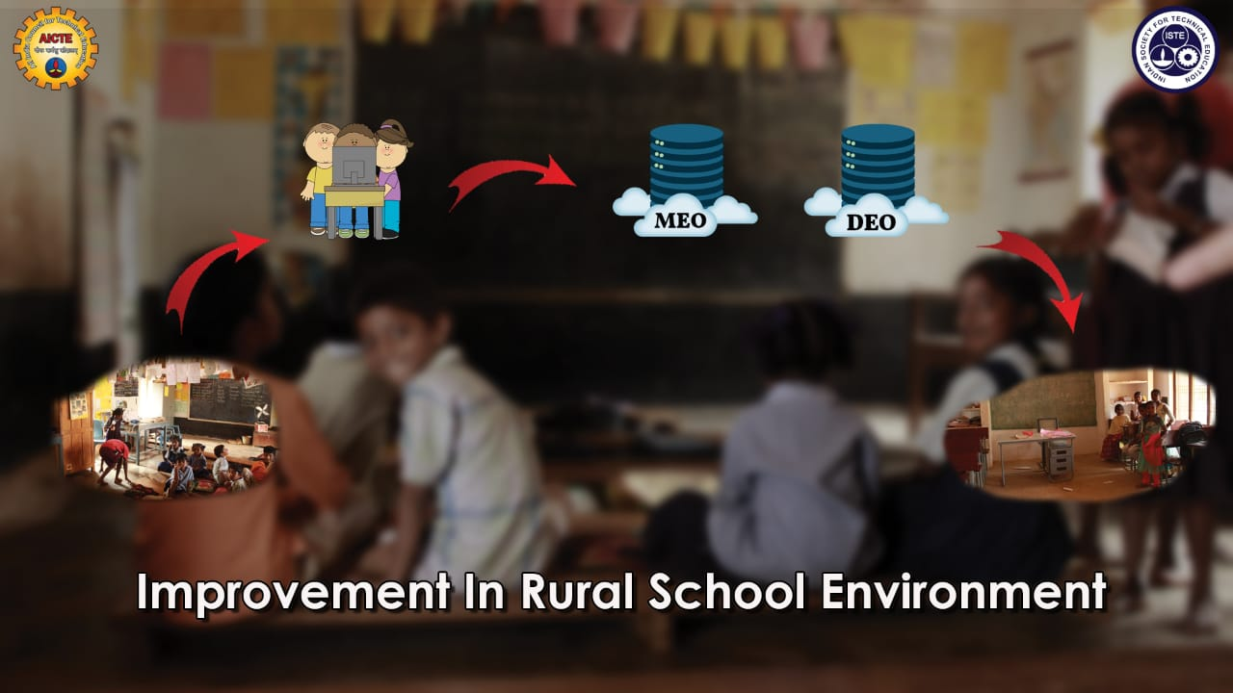

Slide 2
problem
During the year 2015-2016 student’s enrolment in to government schools across 20 Indian states had fell by 13 million , while private schools acquired 17.5 million new students.
The main reason for this down fall is lack of good infrastructure, teachers, facilities and delay in government response.
To resolve this problem, the government is taking some steps and instructing the MEO’s and DEO’s regularly in this regard.
But this communication is going through letters which consumes much time in implementation and also increases paper work.

Slide 3
Solution
The solution for this problem is using less time consuming media to send the information. For that planning to do a website which takes the information regarding infrastructure from the school Head Master(HM) or Incharge Head Master(IHM) and send it to the Mandal Educational officer (MEO).
If the problem isn’t resolved in 15days, it automatically sends to and District Educational officer (DEO).
As a result, the information can be reached in accurate time and the government can also view the information when ever required and respond according to it.

Slide 4
TECHNOLOGIES USED
To develop our website, we’re going to use MEAN stack majorly.
MEAN stack is one such technology, which is considered one of the best for website development. It’s a free and open source Java script software stack. It allows the users to develope efficient isomorphic code. The database used is MongoDB which itself improves the flexibility of MEAN stack.
The main purpose for using MEAN stack is its time saving. As we know that we have to prepare our website in limited time. So we choosed MEAN Stack. Along with MEAN stack, the minor technologies used are HTML,CSS.
To create our website, more efficiently we need CSS scripts which gives an elegant look to it. So, we’re going to use CSS & HTML.

Slide 5
Staff, M.E.O., D.E.O. login pannel

Slide 6
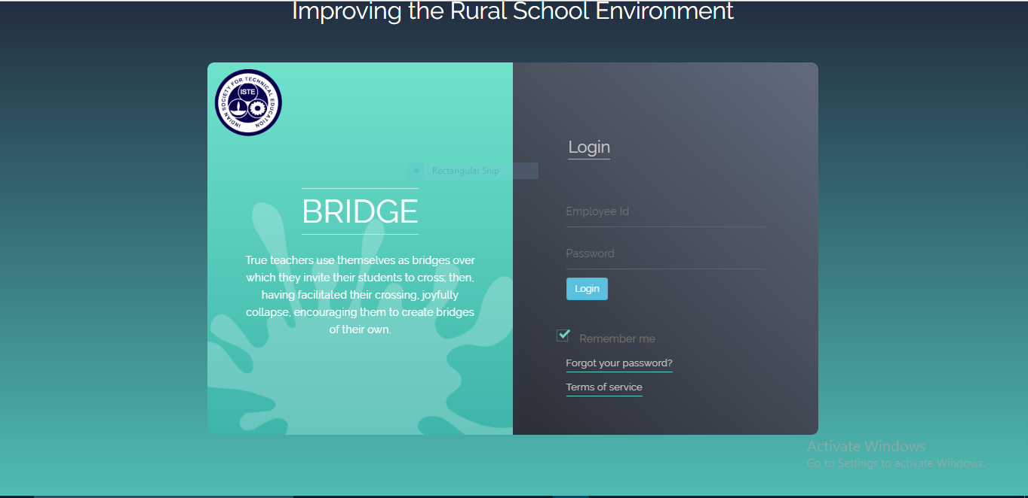

Slide 7
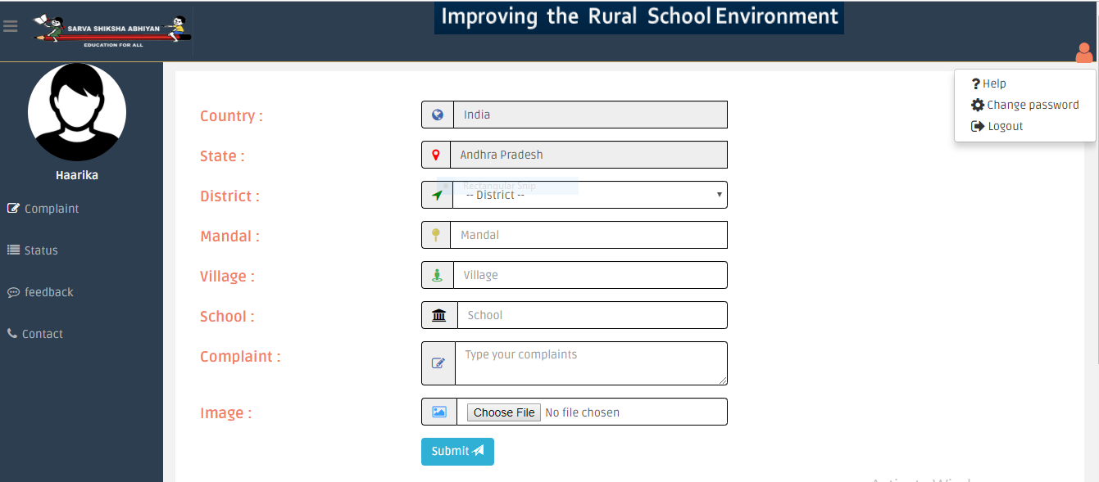

Slide 8
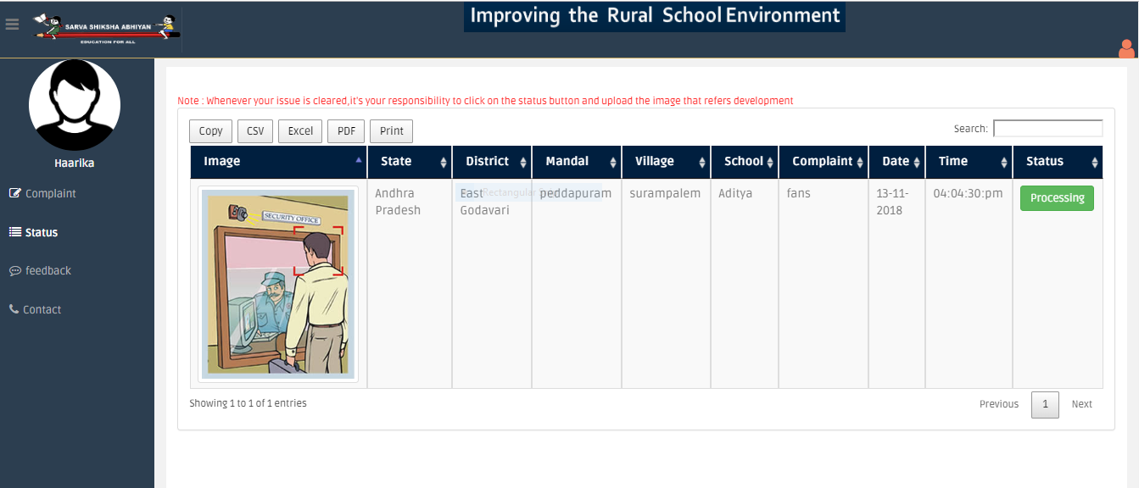

Slide 9
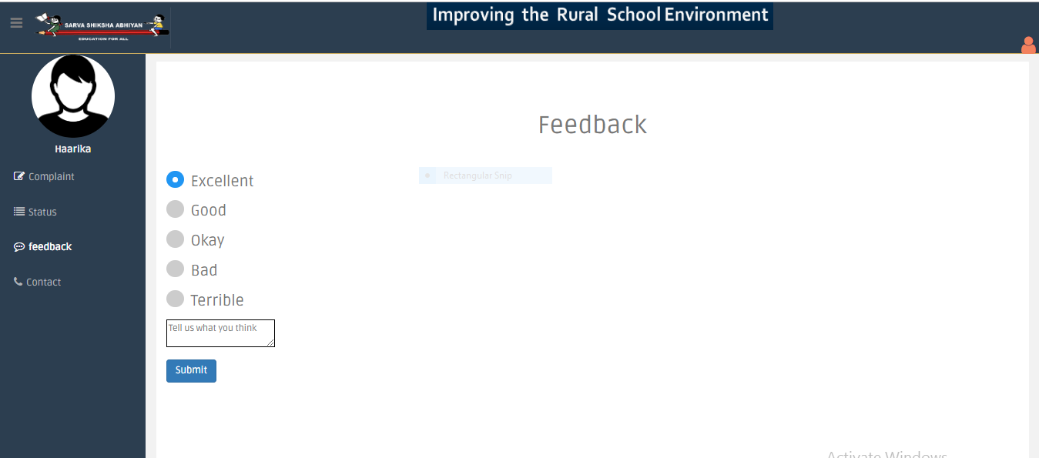

Slide 10
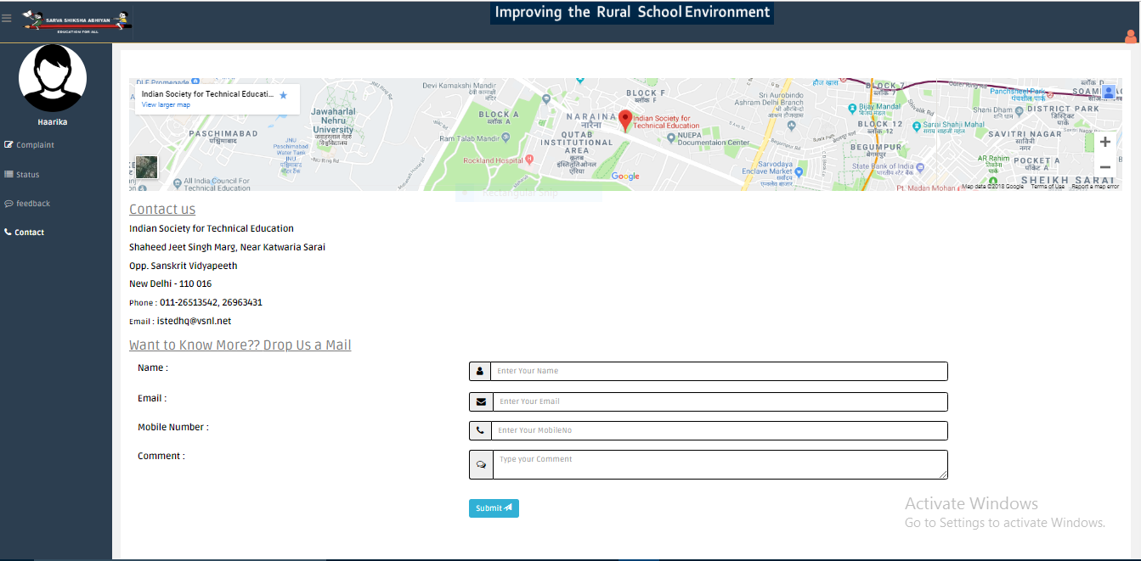

Slide 11
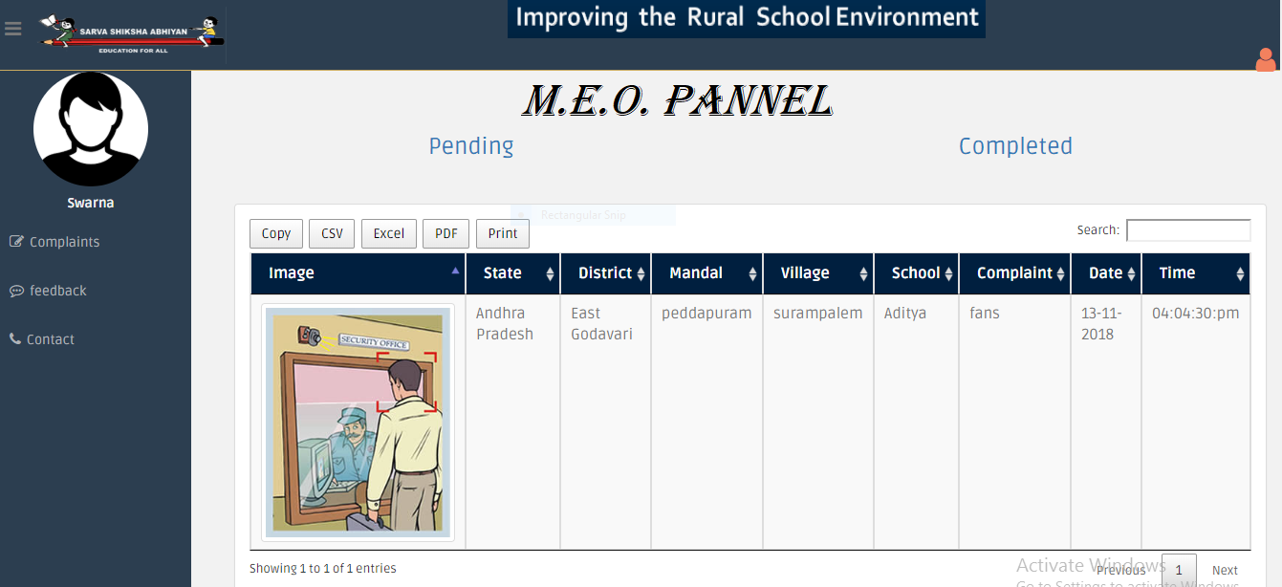

Slide 12
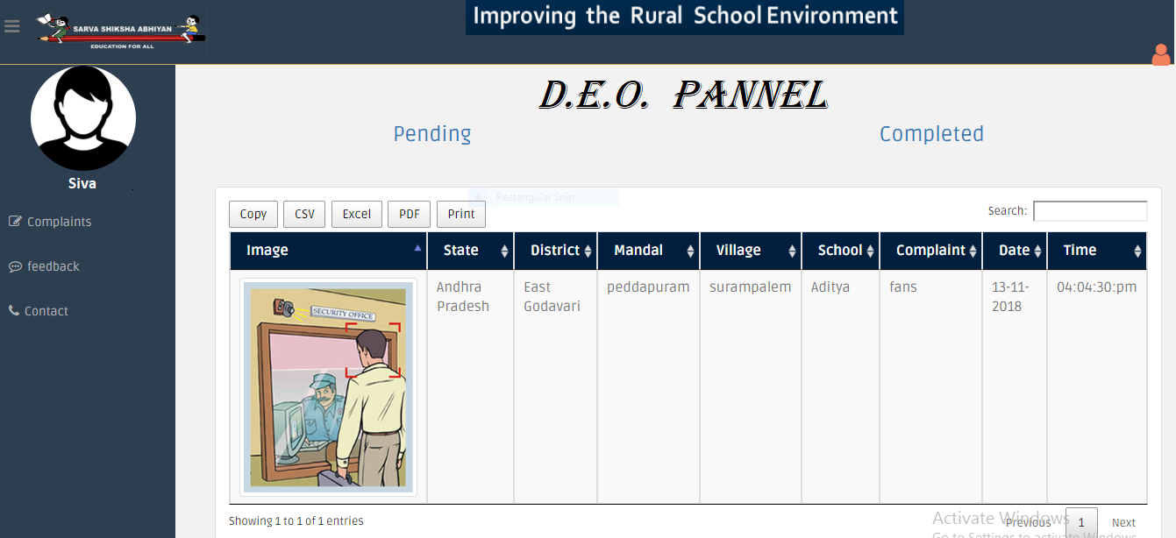

Slide 13
admin pannel

Slide 14
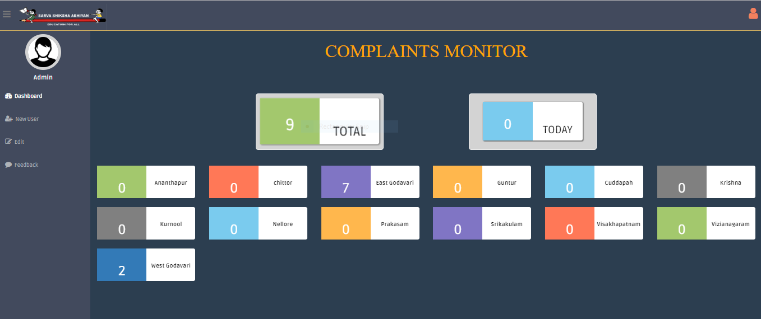

Slide 15
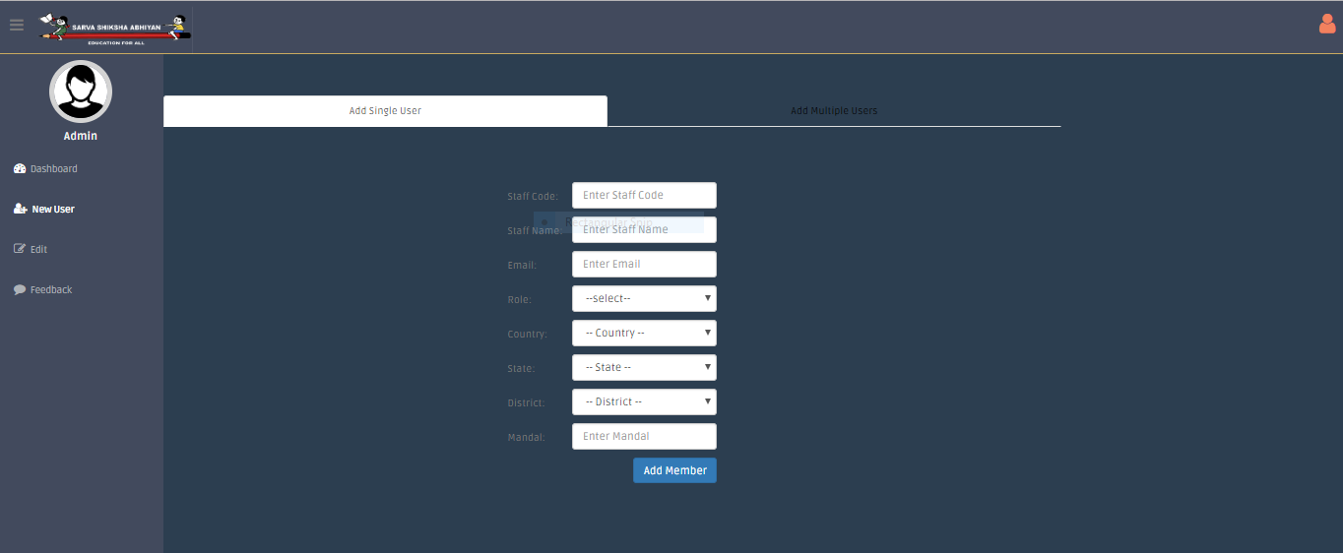

Slide 16
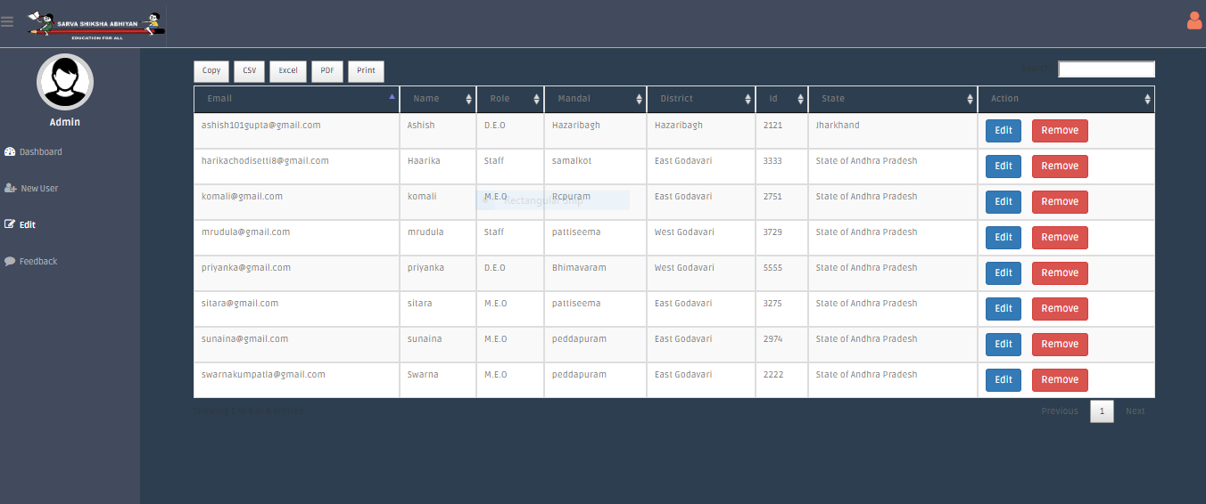

Slide 17
TARGET BENEFICIARY
As today's children are tomorrow’s citizen,we focused on the students for the development of the country.Away from home,schools become the place for students to spend their maximum time.So,schools need to provide them good environment to make them feel free and interested to learn.
Our website's main aim to provide the students with all the infrastructure which they deserve They don’t need to compromise with the infrastructure which is less than they need.It is possible through our website.Although,government is providing more funds for the development of educational institutions,many schools don’t have the proper infrastructure.This happens because of misuse of funds by some people.
So,we are developing a website which directly connects the Head masters of government schools with the respective Mandal Education Officer(M.E.O) and District Education Officer(D.E.O).So that the funds are used effectively.Thus,it is beneficial to government to avoid the misuse of funds by some useless persons and to students to learn effectively with the required.Meanwhile it is reducing paperwork as all the process is done on Internet.Total time to pass the problem's information to higher authorities and getting the help is reduced.

Slide 18

Presented by ;
Ch.Haarika
Ashish Kumar
P.Rachana
K.Swarnambika

Slide 19


