Slide 1

Product Management system
Developed by :
(1) Ashish Maharanidin Gupta

Slide 2
Introduction :
This web application is a dynamic e-commerce platform designed to provide users with a seamless shopping experience. It features a user-friendly interface where customers can browse, purchase, and manage their products efficiently. The platform integrates various functionalities, including user authentication, product display, shopping cart management, and order tracking.
Key Features:
User Authentication: Secure login and registration system to ensure user data privacy and integrity.
Product Display: Dynamic display of products with detailed information, images, and pricing.
Shopping Cart: Users can add products to their cart, view items, and manage their cart before making a purchase.
Order Management: Users can view their purchase history and track orders.

Slide 3

Technical Requirements :
Windows : 7, 8, 8.1, 10, 11 or later
Linux : 64-bit Ubuntu 18.04+, Debian 10+
Storage : Not required.

Slide 4
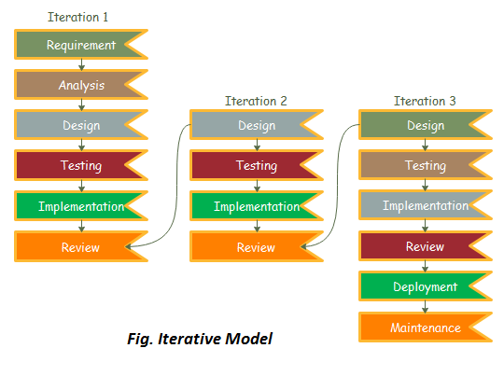
Software development Model :

Slide 5
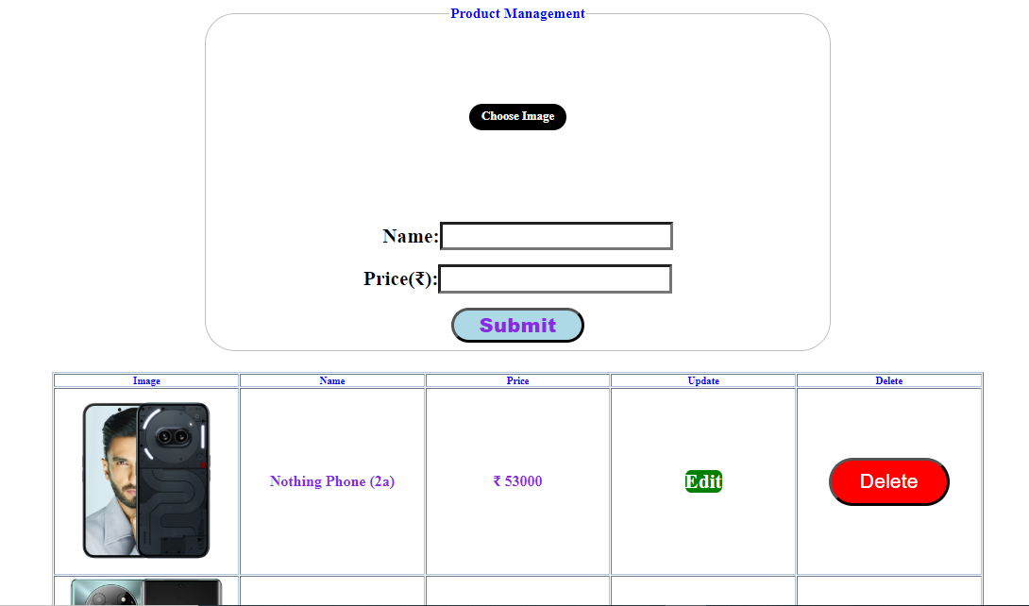
ADMIN OPERATION : The Admin can perform curd operation in this

Slide 6
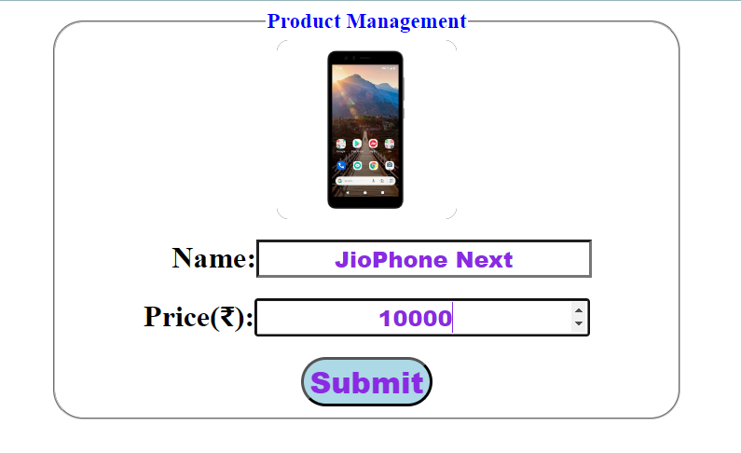
ADMIN OPERATION : The admin can insert the product details in database

Slide 7
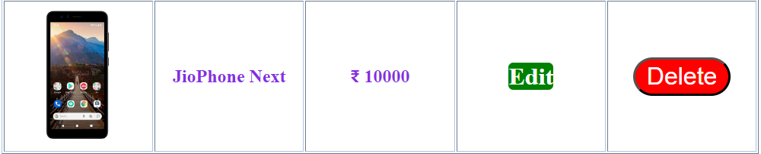
ADMIN OPERATION : the admin can view, edit and delete the product details

Slide 8
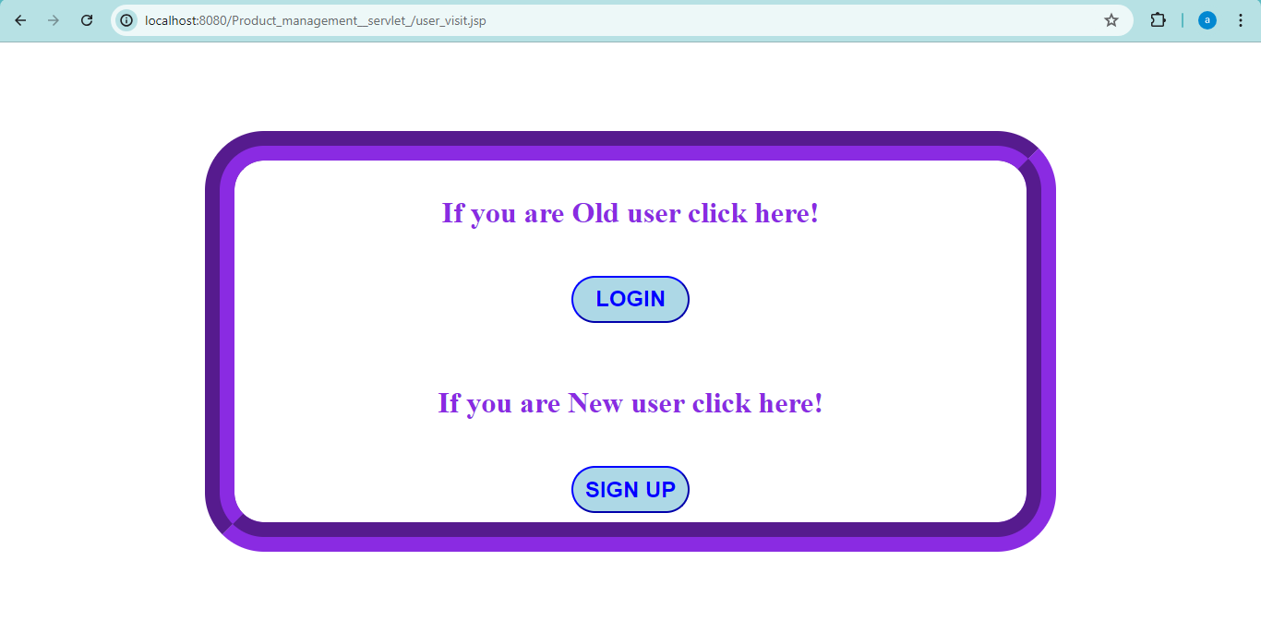
USER OPERATION : User visit page

Slide 9
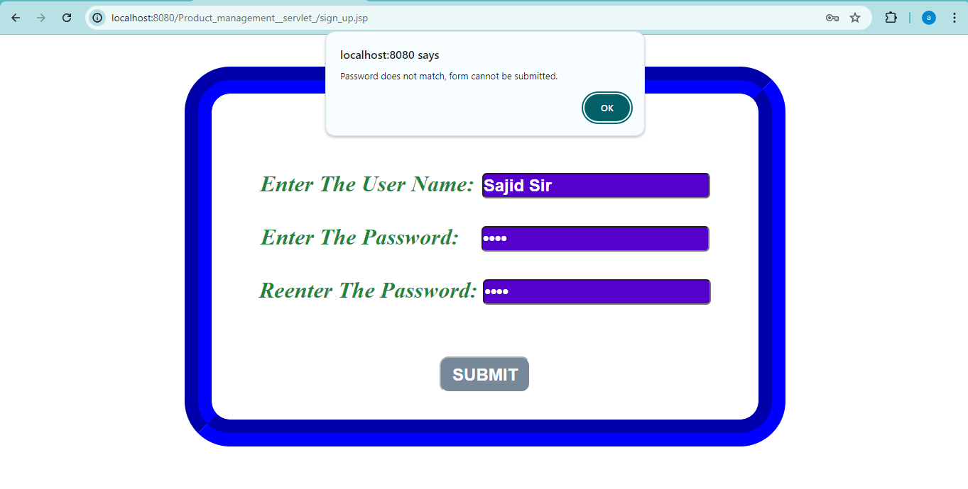
USER OPERATION : SIGN UP Page with unmatched Password

Slide 10
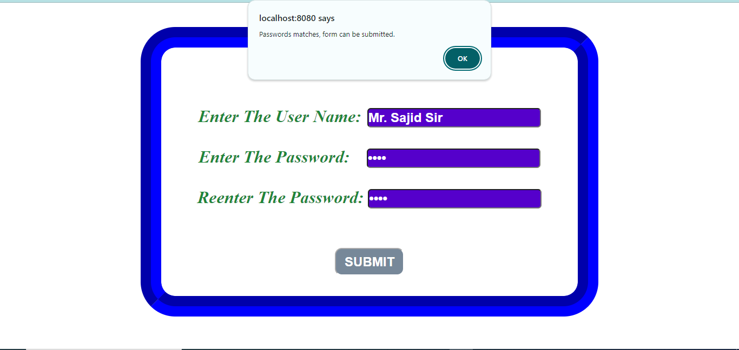
USER OPERATION : SIGN UP Page with matched Password

Slide 11
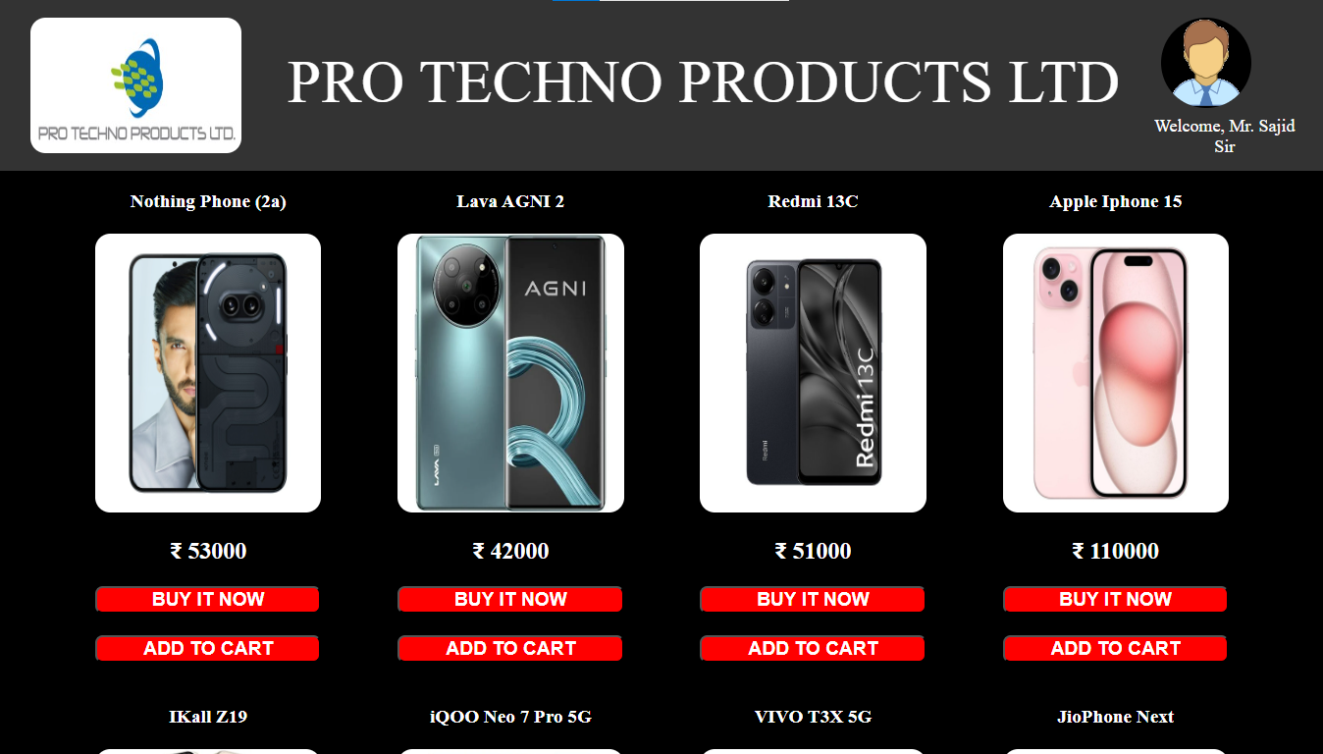
USER OPERATION : User can view the product in main Page

Slide 12
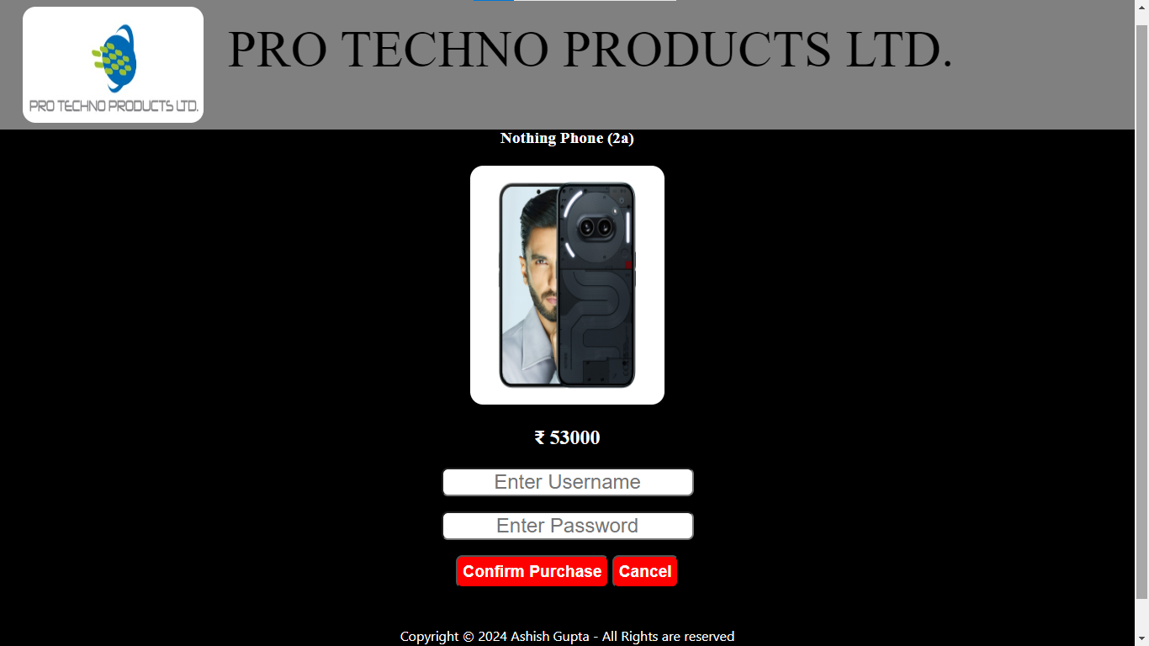
USER OPERATION : User can proceed Purchase operation in this page

Slide 13
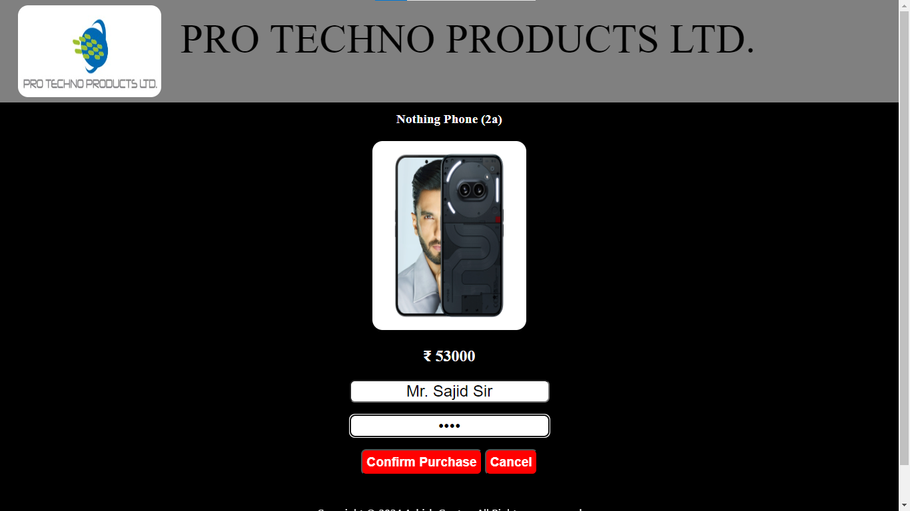
USER OPERATION : User enters his username, password to proceed for purchase operation

Slide 14
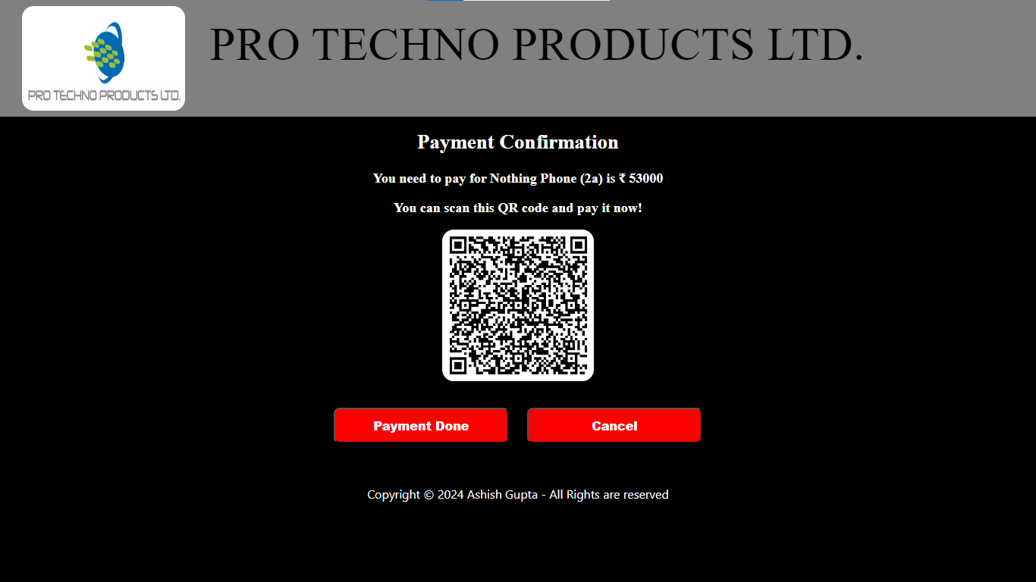
USER OPERATION : User can scan and pay the Product amount

Slide 15

USER OPERATION : after clicking on payment done button the message will be displayed

Slide 16
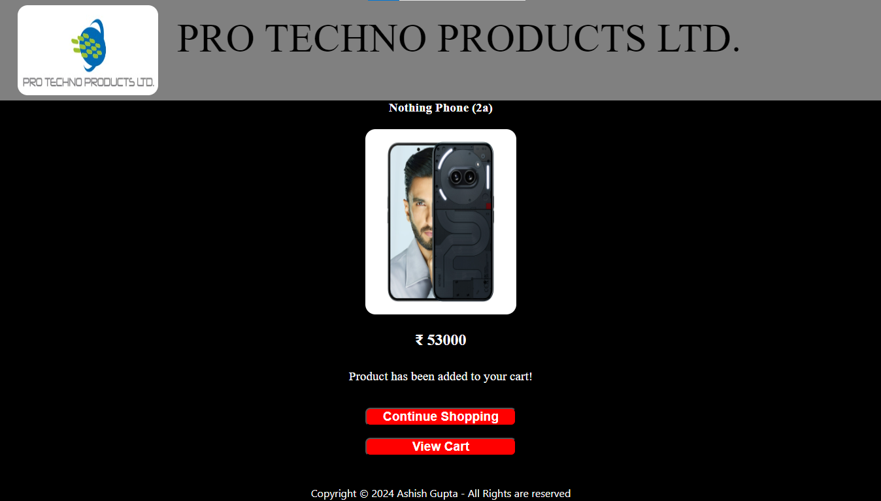
USER OPERATION : ADD To cart page of user

Slide 17
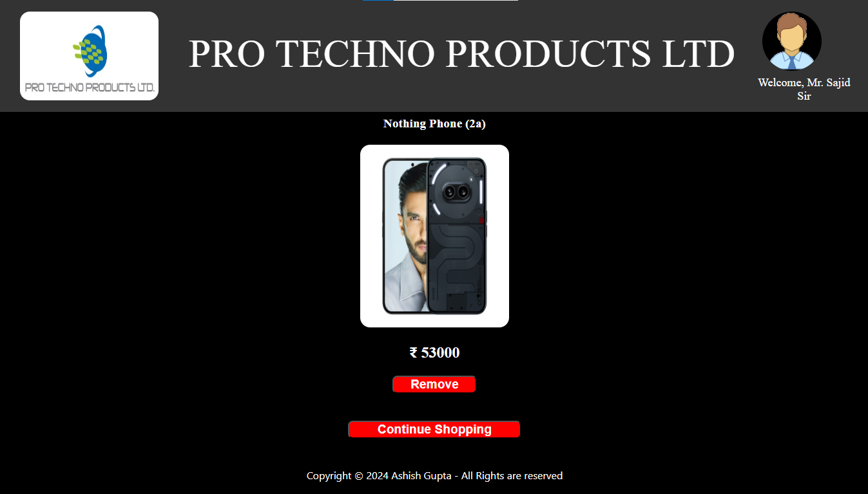
USER OPERATION : ADD To cart view page

Slide 18
USER OPERATION : User data of add to cart is added to the database

Slide 19
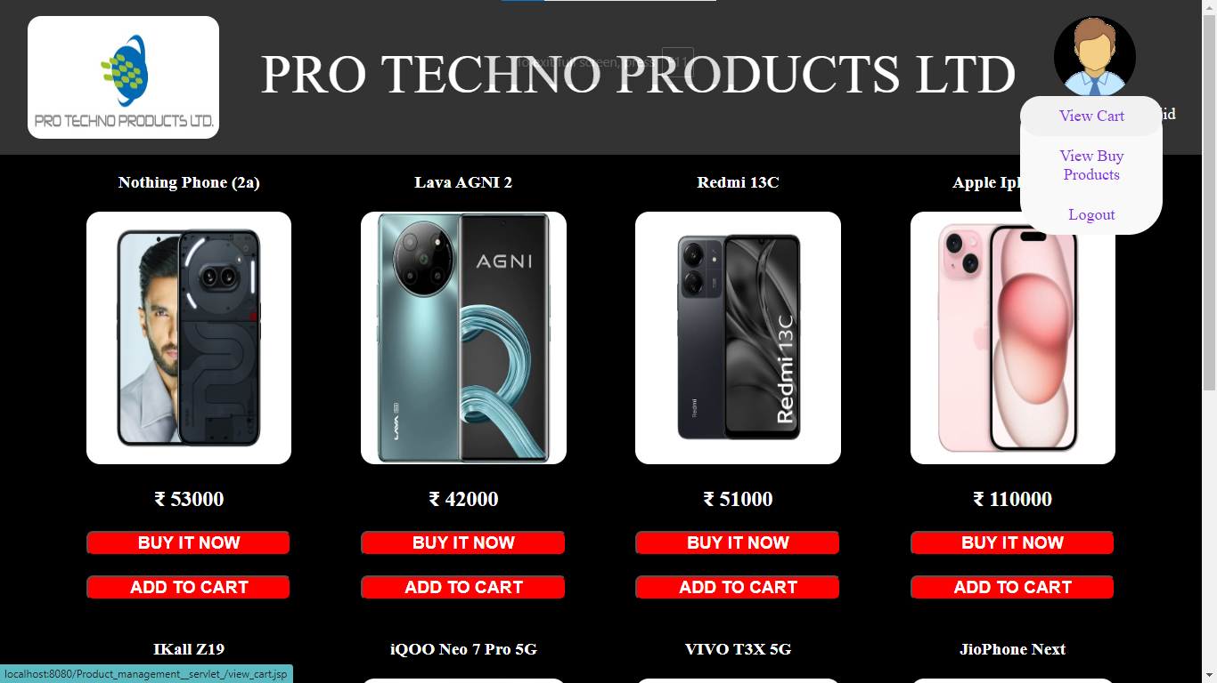
USER OPERATION : The User can view cart and buy products by selecting the options

Slide 20
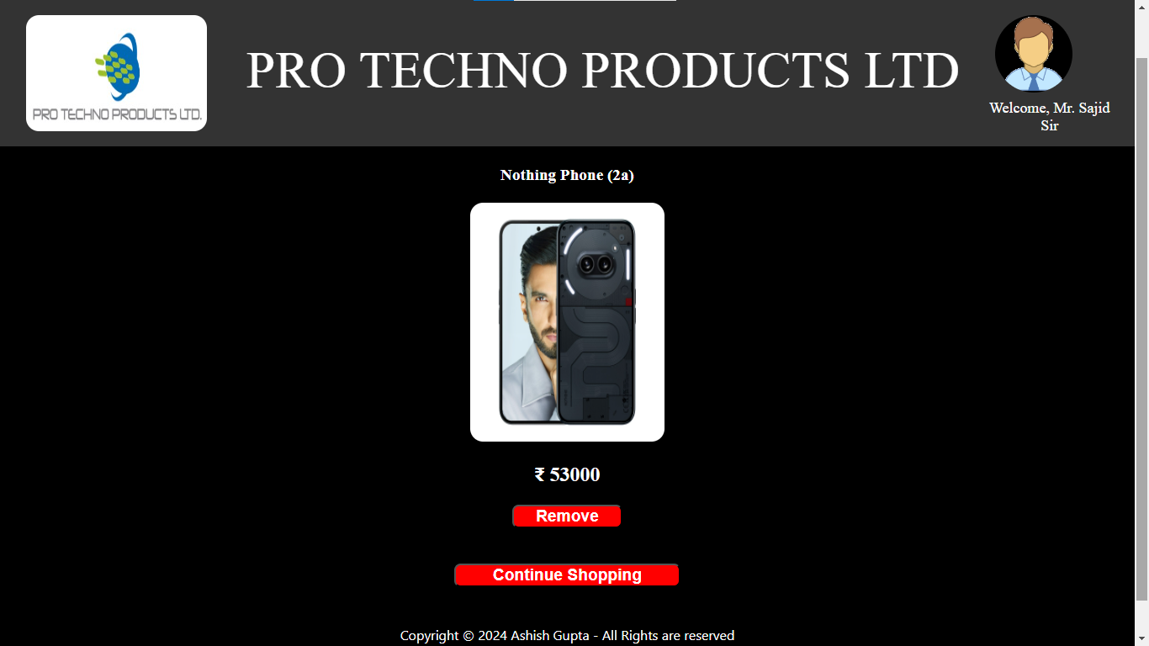
USER OPERATION : Add TO cart page of user

Slide 21
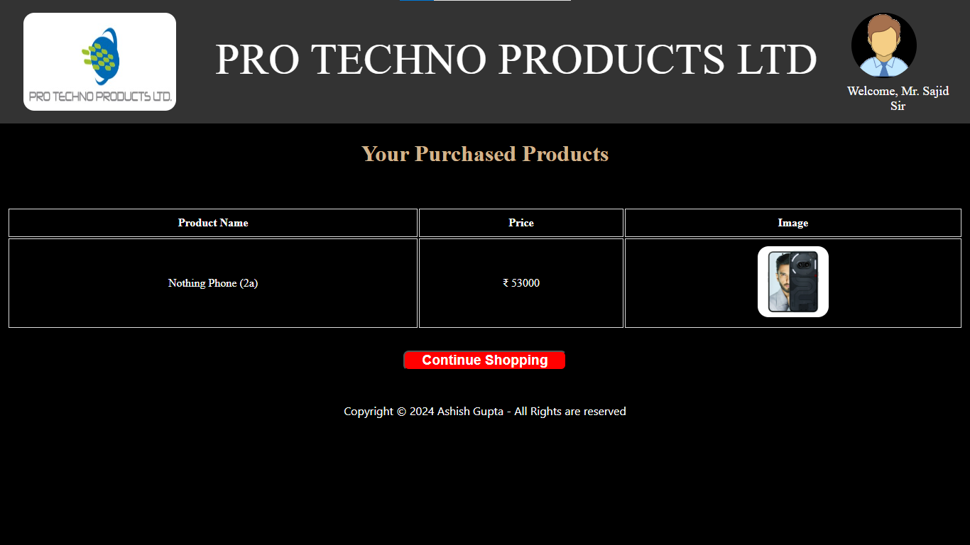
USER OPERATION : Purchased product can view by the user

Slide 22
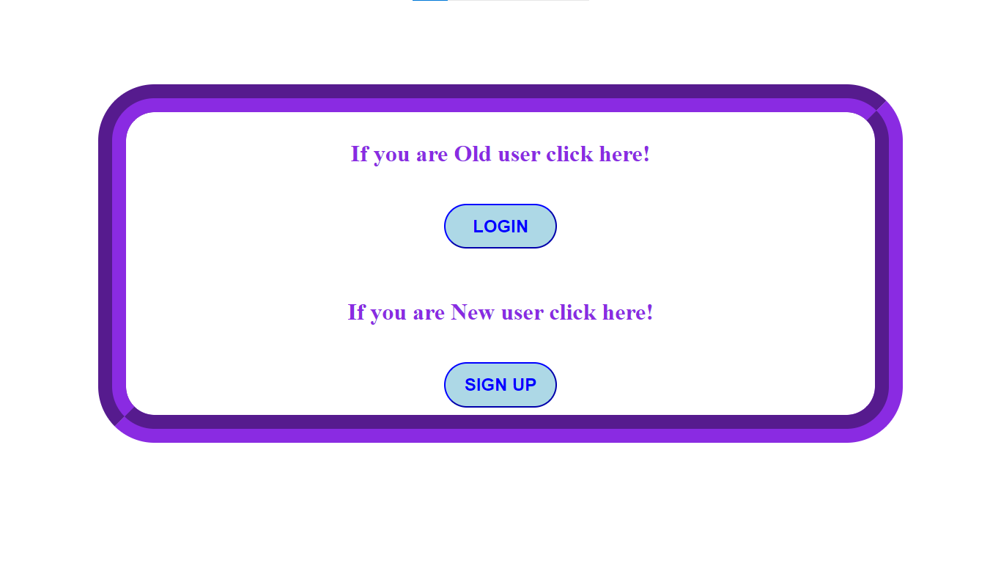
USER OPERATION : after clicking on logout option it will redirected to user visit page

Slide 23
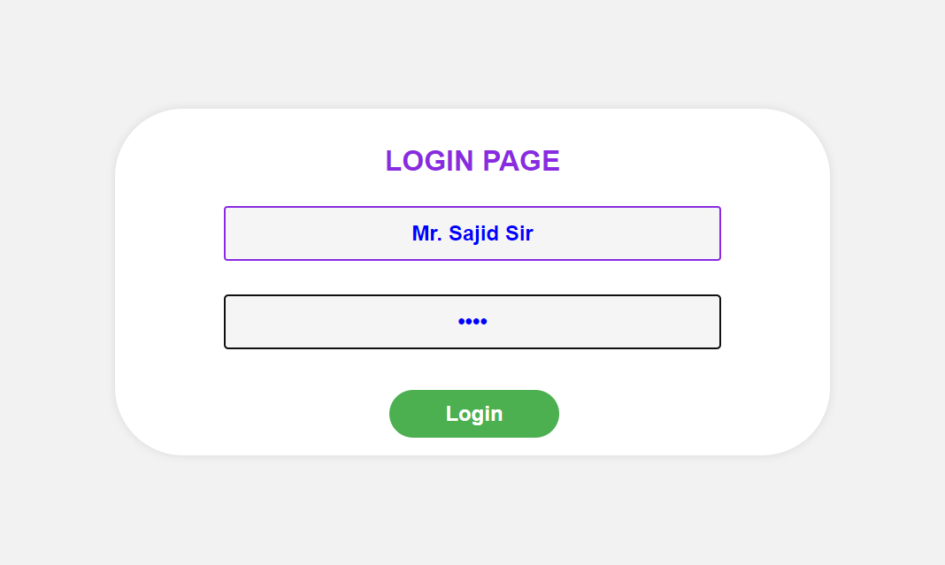
USER OPERATION : User login page

Slide 24

USER OPERATION : User view page after login

Slide 25
conclusion :
This system is easier way to take the orders from customer.
It is easier to examine for admin that, which product sales is more and which product sales is less, which increases his profit revenue.
The admin can easily add, remove, update and view the product details.
This project exemplifies the power of technology to address real-world challenges and improve people's lives.
It provides centralized platform to the user to add the product on cart, to buy the product etc.

Slide 26
Future Enhancement :
This website is currently suitable for large size display devices like laptops, computers etc. in future we are try to implement, and make it conventiable to open in small devices like phones.
This website is stores the image in the database which increases the load on the database and if more user data comes at same times which makes disturp environment for the database, due to it ither database will crash or hang which makes the difficulty for user to access the product, we are try to resolve this problem in future.
This website consumes more internet data to load the product details we are try to reduce the data usage to load the product details.

Slide 27

Thank you
Contact Me: (1) Ashish Gupta (https://rb.gy/dl67ny)

