Slide 1
RAJASTHAN HACKATHON 4.0
TITLE: - AUTOMATIC FAIR COLLECTION SYSTEM
Made By:-
VAJA ASHISH
KALARIYA AYUSH
KALARIYA HARSH
GORASIYA BHARGAV

Slide 2
Index:-
Introduction
Component
Work plan
Advantages
Disadvantages

Slide 3
Introduction:-
This project is totally based on aadharcard.
With the help of it we can store the data of passenger.
This all data scan by scanner and then send to storage.
Then that data will able to get for ticket.
This show we can use aadharcard for easy mass transportation.

Slide 4
Components:-
Raspberry pi
QR Scanner
Android App
Firebase
Connecting Wire
Push Button Switch

Slide 5
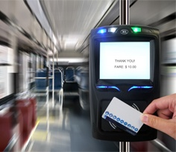
Structure:-

Slide 6
Advantages:-
Easy to use
Save the paper , tree & environment
Time saving
Less corruption
Solve the problem of change money
Disadvantages:-
Internet connection necessary.

Slide 7
THANK-YOU

