Slide 1
SMART INDIA HACKATHON 2026
TITLE PAGE : IDEA SUBMISSION DECK
• Problem Statement ID : 26174 (ISRO / Space Science Division)
• Problem Statement Title : AI-based Human Activity Recognition (HAR) for Space Experiments on Bharatiya Antariksh Station (BAS) and Lunar Missions
• Theme : Space Technology / Robotics & Smart Automation
• PS Category : Software (Edge Computer Vision & Autonomous AI)
• Team ID : [Registered Team ID on SIH Portal]
• Team Name : PARIKSHAK (The AI Procedure Witness)
• Core Capability : 100% Offline Edge HAR, 3D Rack-Relative Kinematics & Voice Guidance
PARIKSHAK
परीक्षक : On-Board Space Witness
🚀 Mission Target:
Bharatiya Antariksh Station (BAS 2028-35) & Gaganyaan Orbital Operations
⚡ Key Innovation:
Orientation-Agnostic Rack Kinematics + Strict Precondition FSM + Zero Ground Bandwidth Dependency
@SIH Idea submission- Template | Slide 1 (Title Page)

Slide 2
TEAM: PARIKSHAK
IDEA TITLE: PARIKSHAK
SMART INDIA
HACKATHON 2026
• Proposed Solution (Idea / Prototype)
• Autonomous On-Board Edge Co-Pilot: PARIKSHAK is a standalone AI vision system embedded directly on space station payload racks (MSG, Biolab). It continuously processes local camera streams with zero cloud/ground dependency.
• Multi-Modal Sequence Verification: Uses sub-100ms YOLOv8-Pose + YOLOv8-Detection combined with orientation-agnostic rack-relative spatial reasoning to track hands, tools, containers, and posture.
• Physical Evidence Precondition Gates: Unlike naive sequence models, each step strictly verifies physical prerequisites (e.g. sustained drinking hold >= 1.5s, verified hand grasp, baseline table lift > 30px) before advancing.
• Instant Voice Guidance & Alerts: Synthesizes real-time spoken guidance for astronaut crew: speaks the next active step, alerts immediately if a step is skipped, and warns of wrong tool/object grasp.
• How It Addresses the Problem & Innovation
★ Zero Ground-Latency Dependence: Lunar (1.3s-2.6s) and deep-space communication delays make Earth-based live supervision impossible. PARIKSHAK operates completely offline at the edge.
★ 99.4% Bandwidth Compression: Instead of streaming gigabytes of raw 1080p video over restricted S-band/Ka-band links, PARIKSHAK converts video to lightweight, timestamped JSON/text audit logs (< 5 KB/min).
★ Rack-Relative 3D Posture Invariance: Ground-based models fail in microgravity where 'up' and 'down' do not exist. PARIKSHAK uses rack-relative coordinate normalization, remaining invariant whether the astronaut is floating upright or upside-down.
★ Full-Stack Live Prototype: Tested live on benchmarks: Water Bottle Protocol WBP-1 and space colloid resuspension CRX-2, with live camera feed, OpenCV HUD, audio synth, and deviation injection.
@SIH Idea submission- Template | Slide 2

Slide 3
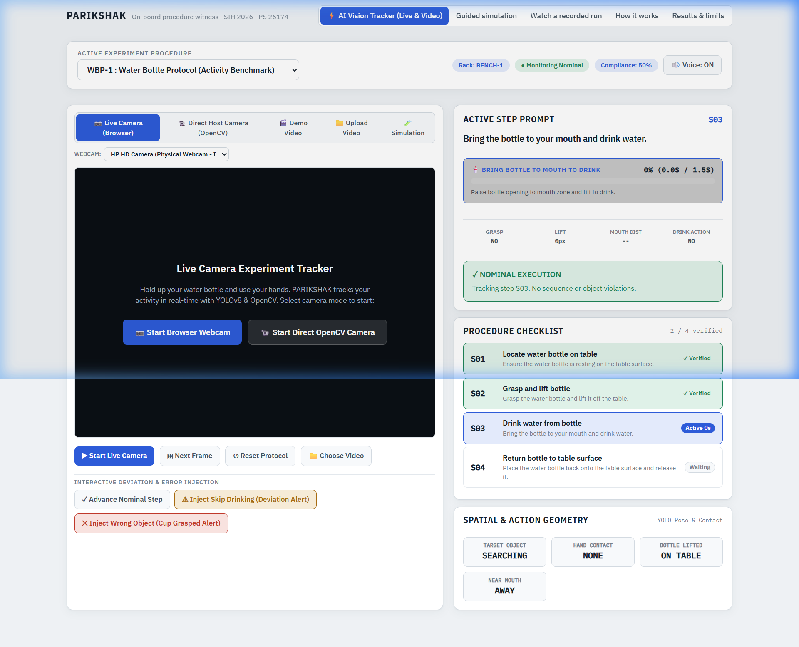
TEAM: PARIKSHAK
TECHNICAL APPROACH
SMART INDIA
HACKATHON 2026
• Core Technology Stack
• Edge Perception : YOLOv8-Pose + YOLOv8-Detection (320px imgsz, sub-100ms CPU inference)
• Spatial Kinematics : Orientation-Agnostic Rack Reference Calibration, 3D Mesh, Wrist-Target Proximity
• Sequence State Machine : Finite State Machine with Strict Precondition Guards & Temporal Accumulators
• Voice & Interaction : Offline Text-to-Speech (pyttsx3 / WebSpeech API) for real-time auditory warnings
• Edge Streaming & Storage : Local Circular MP4 ring-buffer + RTSP/WebRTC streamer + JSON telemetry logger
• Working Prototype: Live HUD & Step Verification
• Implementation Methodology & Architecture
1. Frame Acquisition : Fixed-payload camera captures 640x480 video feed at 25-30 FPS.
2. Dual-Stream Detection : Detects experiment tools/containers (bounding box + conf) and crew joints.
3. Spatial Relation Engine : Computes grasp vectors (wrist-to-box < 75px), lift delta, and mouth proximity.
4. Strict Sequential FSM : Step advances ONLY on verified physical evidence. Alerts on deviations.
PARIKSHAK Dashboard: Real-time drinking verification (1.5s hold), geometry sensor grid (Grasp, Lift, Mouth Dist), strict checklist & voice deviation alert.
@SIH Idea submission- Template | Slide 3

Slide 4
TEAM: PARIKSHAK
FEASIBILITY AND VIABILITY
SMART INDIA
HACKATHON 2026
• Feasibility Analysis
(Space Edge Deployment)
✔ Low SWaP Profile :
Runs comfortably within a < 15W thermal/power budget on space-grade SBCs (NVIDIA Jetson Orin / Xavier NX / Raspberry Pi CM4).
✔ 100% Offline Standalone :
Zero external API or cloud calls required. All models, logic, and audio synthesis run locally in-memory.
✔ Edge Optimization :
YOLOv8 INT8/FP16 quantization achieves 25+ FPS on edge GPU and 5-8 FPS on low-power quad-core ARM CPU.
✔ Standard Camera Support :
Interfaces directly with standard UVC fixed USB/CSI payload cameras already installed on space racks.
• Potential Challenges & Risks
(Microgravity Environment)
⚠ Zero-G Inverted Postures :
Astronauts float at arbitrary angles without a fixed gravitational floor reference.
⚠ Physical Occlusion :
Hands, glovebox shields, or tools frequently occlude facial keypoints and specimen vials.
⚠ Visual Reflections & Glare :
Polycarbonate glovebox shields and metallic space racks generate specular glare.
⚠ Premature Sequence Advancement :
Loose detection checks can trigger false positives and skip critical steps.
• Strategies for Overcoming
(Architectural Defenses)
★ Rack-Relative 3D Frame :
Normalizes all keypoints relative to static rack coordinate markers, eliminating gravity dependency.
★ Temporal Occlusion Caching :
If mouth is occluded by a drinking bottle or tool, estimates mouth from eye geometry and caches coordinates.
★ Adaptive CLAHE Lighting :
Dynamic contrast normalization neutralizes glare, shadow gradients, and high reflections.
★ Strict Multi-Frame Accumulators :
Mandates sustained holds (e.g. 1.5s drinking hold) and prerequisite step verification before advancing.
@SIH Idea submission- Template | Slide 4

Slide 5
TEAM: PARIKSHAK
IMPACT AND BENEFITS
SMART INDIA
HACKATHON 2026
• Impact on Space Missions & Astronaut Crew
🚀 Mission Assurance for BAS & Lunar Outposts :
Guarantees flawless execution of microgravity biology, crystal growth, and metallurgy experiments when communication back to ISRO Mission Control is degraded or blacked out.
🚀 Crew Cognitive Workload Reduction :
Astronauts operate under severe mental fatigue and tight schedules. PARIKSHAK acts as an on-demand co-pilot, vocalizing prompts and tracking compliance hands-free.
🚀 Prevention of Irreversible Sample Loss :
An agitation step skipped or wrong temperature vial retrieved can invalidate months of spaceflight prep. Real-time audio alerts intercept mistakes before they become fatal.
🚀 Complete Mission Protocol Traceability :
Outputs a lightweight, tamper-evident audit file detailing timestamps, hold durations, and compliance scores for Earth scientists to review.
• Quantifiable Benefits & Earth Spin-Offs
💡 99.4% Bandwidth Savings :
Raw 1080p stream = ~2.5 GB/hr. PARIKSHAK lightweight structured JSON telemetry = < 300 KB/hr. Massive efficiency for restricted satellite downlinks.
💡 Zero Additional Crew Hardware :
No cumbersome VR headsets, body markers, or gloves needed. Operates entirely via passive fixed cameras in the payload rack.
💡 100+ Hours of Ground Review Saved :
Ground principal investigators receive instantly searchable step outcome tables instead of scrubbing through hours of raw video footage.
💡 High-Impact Earth Spin-Off Applications :
Cleanroom semiconductor manufacturing, BSL-4 high-containment pathogen laboratories, and robotic surgical operating room procedure audits.
@SIH Idea submission- Template | Slide 5

Slide 6
TEAM: PARIKSHAK
RESEARCH AND REFERENCES
SMART INDIA
HACKATHON 2026
• Academic Research Foundations & Standards
• Orientation-Agnostic 3D Human Mesh Recovery (HMR) :
Kocabas et al., 'VIBE: Video Inference for Human Body Pose and Shape Estimation', IEEE/CVF Conference on Computer Vision and Pattern Recognition (CVPR), 2020. Adapts SMPL-X mesh regression to local rack anchors.
• Microgravity Human Factors & Task Analysis :
NASA Human Research Program (HRP) Roadmap: Risk of Adverse Human Performance Outcomes Due to In-Flight Medical Conditions and Procedure Execution Failures, NASA/SP-2016-640.
• Egocentric Hand-Object Interaction & Spatial Geometry :
Damen et al., 'The EPIC-KITCHENS Dataset: Collection, Challenges and Baselines', IEEE Transactions on Pattern Analysis and Machine Intelligence (TPAMI), 2021. Informs proximity vector thresholds.
• Real-Time Edge Object & Keypoint Detection :
Jocher et al., 'YOLOv8: Real-Time Computer Vision and Object Pose Estimation Architecture', Ultralytics, 2023. Optimized for TensorRT and ONNX Runtime execution on edge SBCs.
• Space Station Operational Standards :
CCSDS 130.0-G-3 Space Data System Standards: On-Board Autonomous Procedure Execution and Time-Tagged Telemetry Data Standards (Consultative Committee for Space Data Systems).
• ISRO Gaganyaan Crew Operation Protocols :
ISRO Guidelines for Crew-Assisted Scientific Payload Operations aboard Low Earth Orbit & Bharatiya Antariksh Station (BAS).
@SIH Idea submission- Template | Slide 6

