Slide 1
SMART INDIA HACKATHON 2026 · IDEA SUBMISSION
PARIKSHAK
An on-board witness that checks every step of an experiment procedure in orbit — and says so when it cannot see.
Problem Statement ID | 26174
Problem Statement Title | AI-based Human Activity Recognition for validating scientific experiment sequences on-board (BAS / lunar missions)
Organisation | Indian Space Research Organisation (ISRO), Department of Space
Theme | Space Technology
PS Category | Software
Team ID | [fill in your team ID]
Team Name | [fill in your team name]

Slide 2
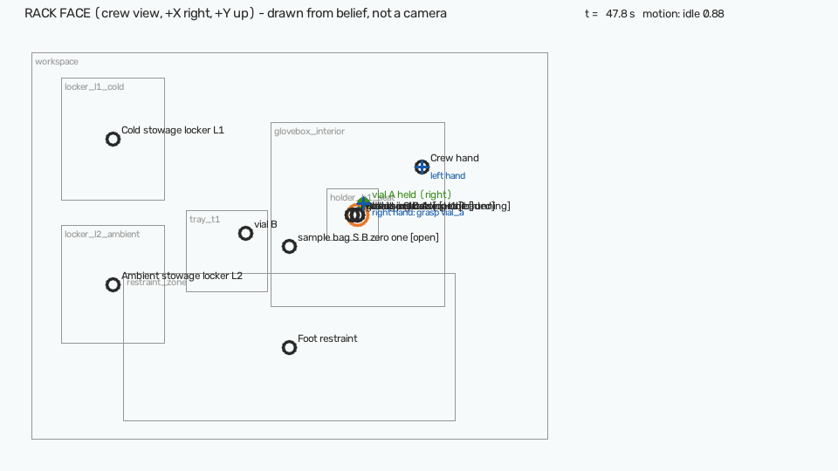
Proposed solution
SIH 2026 · PS 26174 · Space Technology
PARIKSHAK watches the experiment rack through a camera, checks every step against the procedure file, speaks the next step, and alerts only on strong evidence — naming the step and the reason.
How it addresses the problem
Verifies each step independently — the crew no longer self-reports on a tablet.
Catches skipped steps, the wrong object and safety violations within about 2 s.
Says “cannot verify” when blind: an occluded camera never makes an accusation.
Writes a tamper-evident flight record that is downlinked before any video.
CAUTION · SKIP · S08 · 47.8 s
“Step eight, close the glovebox latch, was not completed.”
Why: predicate state_is(latch, closed) never satisfied between 43.0s and 46.2s
Innovation and uniqueness
The experiment is a file
A new procedure is a YAML file. CRX-2 was added with no retraining and no code change.
Unknown is not wrong
Three-valued logic: hidden or unmodelled evidence reads “cannot verify”, never “skipped”.
Up is the rack, not gravity
Geometry is measured in rack coordinates from markers, so orientation in orbit does not matter.
Evidence over time
Each step accumulates evidence with duration priors; an alert needs 0.85 evidence held for 1.5 s.
PARIKSHAK · on-board procedure witness
2 / 6

Slide 3
Technical approach
SIH 2026 · PS 26174 · Space Technology
Camera
Watches the payload rack, 5–10 frames/s
Perception
Rack pose from AprilTags; objects, states and hands
Belief frame
What is seen, with confidence — hidden stays unknown
Procedure engine
Predicates, evidence over time, duration priors, safety rules
Crew & ground
Voice prompt, alert with reason, checklist, hash-chained log
Layer | Working prototype | Flight version (planned)
Perception | OpenCV 5, AprilTag 36h11 markers, PnP rack pose | RT-DETR objects, MediaPipe / RTMPose hands, TensorRT INT8
Reasoning | Procedure language (YAML + JSON Schema), 3-valued predicates, CUSUM evidence, alert policy | Same engine, unchanged
Interface | Guided web app (FastAPI), PySide6 window, pyttsx3 voice | Piper TTS, whisper.cpp / Vosk voice commands
Record | SHA-256 hash-chained log, deterministic trace replay | CFDP downlink package
Compute | Laptop CPU: 13.4 FPS in the slowest 5% of frames | Jetson Orin, within 25 W
Working prototype
Guided web app: choose an experiment, act each step, the engine judges live.
14 recorded scenarios replayed through the engine.
Live webcam mode with printed markers; desktop operator window.
602 automated tests; every build gate green.
Offline by construction: no network path in the on-board code.
python -m demo
PARIKSHAK · on-board procedure witness
3 / 6

Slide 4
Feasibility and viability
SIH 2026 · PS 26174 · Space Technology
Measured on the working prototype
Risks and how we handle them
Measure | Target | CSP-1 · 14 steps | CRX-2 · 8 steps
Step accuracy | ≥ 95% | 98.7% met | 95.6% met
Deviations caught | ≥ 90% | 97.8% met | 97.5% met
False alarms per 45 min | ≤ 1 | 0.85 met | 0.00 met
False alarms, permitted reorders | 0 | 0 met | 0 met
Alert delay, median / 95th pct | ≤ 2 s | 1.6 / 1.6 s met | 1.6 / 1.8 s met
Orbit looks different
Learned parts never use gravity cues; geometry is in the rack frame; fine-tune on MicroG-4M.
False alarms erode trust
Evidence plus persistence; unknown is never wrong; the remaining causes are measured and named.
The crew's body blocks the view
Reads “cannot verify”; duration priors carry state; multi-camera fusion planned.
Degraded synthetic runs — noise, dropped frames, occlusion — each scored against the error injected into it: 130 CSP-1 runs, 70 CRX-2 runs. An alarm counts as false if nothing was injected, or if it concerns a step before the injected one.
Edge compute and power
Already real-time on a laptop CPU; Jetson Orin with TensorRT INT8 for the 25 W budget.
Viability Pure software on standard hardware. It reads the same procedure the crew already follows, is advisory and never commands hardware, and has no network path in the on-board code — a test fails the build if one appears.
PARIKSHAK · on-board procedure witness
4 / 6

Slide 5
Impact and benefits
SIH 2026 · PS 26174 · Space Technology
8 KB
flight record for a 141 s run, against about 70 MB of video
0
false alarms on correct, reordered and blocked-camera runs, in both experiments
1 file
to add a new experiment — no retraining, no code change
13.4 FPS
on a laptop CPU, in the slowest 5% of frames
Crew and mission
ISRO operations
Society and economy
Fewer experiment runs lost to a missed step.
Hands-free guidance: attention stays on the task.
Safety rules catch hazards no checklist can see.
A verifiable record of every run for the principal investigator.
A tiny downlink footprint that fits constrained links.
One system across the payload catalogue — procedures are data.
Indigenous capability for Gaganyaan and Bharatiya Antariksh Station.
Transfers to laboratory, pharma and manufacturing SOP compliance.
Privacy by design: video never has to leave the station.
Why it has to run on board A round trip to the Moon takes about 2.6 s and to Mars 6 to 44 minutes. Ground control cannot watch a step as it happens; the witness has to be on the station.
PARIKSHAK · on-board procedure witness
5 / 6

Slide 6
Research and references
SIH 2026 · PS 26174 · Space Technology
Datasets and benchmarks
Methods and tools
Standards and mission context
MicroG-4M — microgravity human activity (arXiv:2506.02845)
IndustReal — procedure step recognition, WACV 2024 (arXiv:2310.17323)
Assembly101 — mistake detection, CVPR 2022
CaptainCook4D — procedural error taxonomy (arXiv:2312.14556)
EgoPER — error detection in procedural video, CVPR 2024
PREGO — online mistake detection, CVPR 2024
HoloAssist — interactive assistance, ICCV 2023
AprilTag 3 — fiducial markers, IROS 2019
RT-DETR — real-time detection (arXiv:2304.08069)
MediaPipe Hands; RTMPose / MMPose
ByteTrack — multi-object tracking (arXiv:2110.06864)
MS-TCN++ — temporal action segmentation, TPAMI 2020
Page's CUSUM — sequential change detection
Piper TTS; whisper.cpp; OpenCV
NASA-STD-3001 — Space Flight Human-System Standard
CCSDS 727.0-B — CCSDS File Delivery Protocol (CFDP)
ISRO — Gaganyaan and Bharatiya Antariksh Station (isro.gov.in)
Digital Personal Data Protection Act, 2023 (MeitY)
Vision-based mistake analysis in procedural activities: a review (arXiv:2510.19292)
Prototype and documentation run it with python -m demo · full write-up in docs/PROJECT_DOCUMENTATION.md · every figure on these slides is read from runs/ when the deck is built.
PARIKSHAK · on-board procedure witness
6 / 6

