Slide 1

BMI CALCULATOR USING PYTHON
Presented By:
Ashish Kumar Gupta
UID:21mca3030
(Master of Computer Application)
UNIVERSITY INSTITUTE OF COMPUTING
UNDER SUPERVISION OF:
MS. DEEPALI SAINI
(ASSISTANT PROFESSOR)
UNIVERSITY INSTITUTE OF COMPUTING

Slide 2
CONTENT
What is BMI
How to calculate BMI
BMI Categories
Requirements
Flowchart
Screenshot of Output

Slide 3
WHAT IS BMI
BMI (Body Mass Index) is a number calculated from a person's weight and height. BMI is a fairly reliable indicator of body fatness for most people. Additionally, BMI is an inexpensive and easy-to-perform method of screening for weight categories that may lead to health problems. The higher your BMI, the higher your risk for certain diseases such as heart disease, high blood pressure, type 2 diabetes, gallstones, breathing problems, and certain cancers.

Slide 4
The BMI formula
The current BMI calculation divides a person’s weight by their height to the power of 2, or square:
BMI = weight (kg) / height²
According to most criteria accepted around the world:
a BMI of 18.49 or below means a person is underweight
a BMI of 18.5–24.99 means they are of normal weight
a BMI of 25–29.99 means they are overweight
a BMI of 30–39.99 or more means they are obese
a BMI of 40 or more means they are morbidly obese

Slide 5
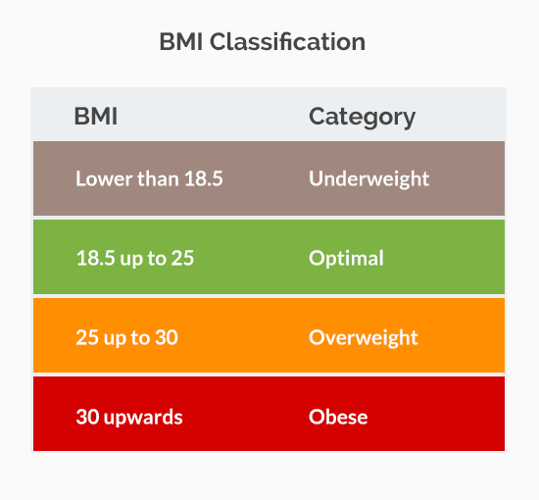

Slide 6
Requirements of project
GUI REQUIREMENT
HTML
CSS
BACKEND REQUIREMENT
JAVASCRIPT
PYTHON

Slide 7
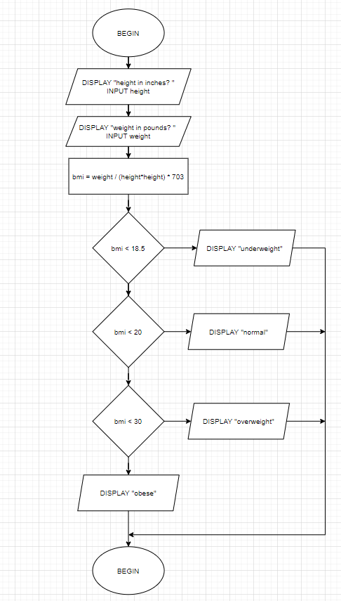
Flow chart:

Slide 8
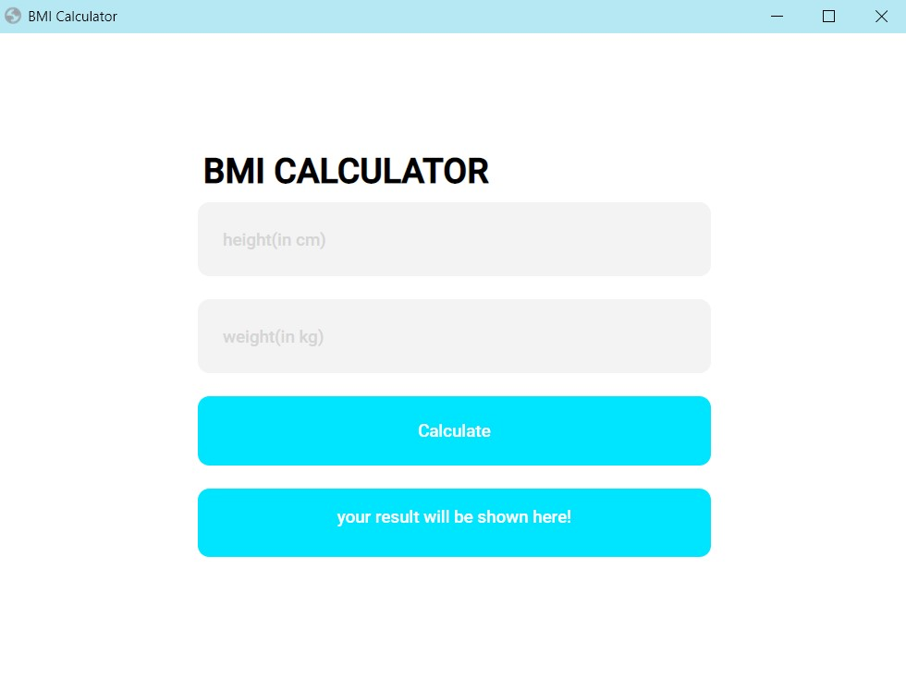
Output screen

Slide 9
Thank you!
GitHub link:-
https://github.com/Ashish473797/bmiCalculator

