Slide 1

Project Area : LOCOMOTION OF QUADRUPED ROBOT Project Topic : QUADRUPED ROBOT
SAINTGITS
COLLEGE OF ENGINEERING
(AUTONOMOUS)
Mini Project Zeroth Review
Presented By :
SANJITH SAJI(MGP22URB085)
SEFIN SURESH(MGP22URB086)
P.ARJUN(MGP22URB077)
S6 RBB
SAINTGITS College of Engineering
Supervisor
Name : Er. CHINN MOHANAN
Designation : Assistant Professor
LEARN . GROW . EXCEL

Slide 2

Contents
Motivation
Literature Survey
Objective
Components
Block Diagram
Road Map
Reference
LEARN . GROW . EXCEL

Slide 3
Motivation
Understanding Robotic Locomotion: The project provides a foundational understanding of how quadruped robots can move, focusing on the basic principles of gait mechanisms and leg articulation.
Educational Value: By building a simple quadruped robot, the project serves as a valuable educational tool for those interested in robotics, mechatronics, and engineering, offering practical experience in system design, programming, and control.
Exploration of Gait Mechanisms: The project investigates basic gait mechanisms for quadruped movement, which is an essential aspect of robotic mobility. It allows the exploration of how coordinated motion in multiple legs can result in controlled, stable locomotion.
Development of Mobility and Control Systems: Developing a functional control system that governs leg movements helps establish the groundwork for more advanced mobility systems in robots, which is crucial for improving their efficiency and adaptability in various environments.
LEARN . GROW . EXCEL

Slide 4
Literature Review
Sl.No | Title | Authors & Publications | Techniques Used and Observations
1 | “Intelligent Control of Multilegged Robot Smooth Motion: A Review" | YONGYONG ZHAO 1 , JINGHUA WANG 1,2, (Member, IEEE), GUOHUA CAO3 , YI YUAN1 , XU YAO1 , AND LUQIANG QI1 | This study presents gait optimization algorithm and motion planning with its core mechanical aspects from different patterns while it is found out that trot gait algorithm is more efficient.
LEARN . GROW . EXCEL

Slide 5
Literature Review (Contd…)
Sl.No | Title | Authors & Publications | Techniques Used and Observations
2 | "ANYmal: A Dynamic Quadruped Robot" | Hutter et al., IEEE Robotics and Automation Letters (RAL), 2017 | ANYmal uses torque-controlled joints for agile locomotion. It is capable of autonomous terrain adaptation and energy-efficient movement, supported by real-time feedback from onboard sensors.
3 | "Cheetah 3: Blind Locomotion" | Kim et al., IEEE/RSJ IROS, 2018 | Cheetah 3 achieved blind locomotion using proprioceptive feedback and model-based control. The robot successfully navigates stairs and obstacles without relying on vision.
LEARN . GROW . EXCEL

Slide 6
Literature Review (Contd…)
Sl.No | Title | Authors & Publications | Techniques Used and Observations
4 | "Vision-Assisted Quadruped Control" | Kolvenbach et al., Robotics and Automation Letters (RAL), 2019 | The sensor integration and perception improve the stability and decision-making of quadruped robots on complex terrains.
5 | BigDog: The Rough-Terrain Quadruped" | Raibert et al., IEEE Robotics and Automation, 2008 | BigDog uses hydraulic actuators and advanced dynamic stability control to navigate rough terrain. The robot successfully carried heavy loads, demonstrating robustness in extreme environments.
LEARN . GROW . EXCEL

Slide 7
Literature Review (Contd…)
Sl.No | Title | Authors & Publications | Techniques Used and Observations
6 | “Dynamic locomotion of quadruped robots.” | K.Y. LEE and J.S.KIM | The sensor integration and perception improve planning of the different available gait algorithms.
LEARN . GROW . EXCEL

Slide 8
Objectives
Develop Basic Movement: Create a simple locomotion system that enables the robot to move forward, backward, and turn.
Ensure Stability: Implement a gait mechanism that allows the robot to move steadily across uneven terrains commonly found in search and rescue environments.
Enable Obstacle Navigation: Design the robot to navigate over obstacles and through narrow spaces, simulating real-world rescue scenarios.
Test in Realistic Conditions: Validate the robot’s performance in different terrains, such as rubble or uneven surfaces, to ensure it can be used in search and rescue missions.
Build a Foundation for Future Enhancements: Lay the groundwork for adding sensors and autonomous navigation to improve the robot’s search and rescue capabilities in future upgrades.
LEARN . GROW . EXCEL

Slide 9
Components
Ultra sonic sensor
Servo motor
IMU
Raspberry pi 4b
Esp32 microcontroller
Servo driver
LiPo Battery
UBEC
PCA9685
3D Printing Filament
LEARN . GROW . EXCEL

Slide 10
Block Diagram
START
System Intialisation
Sensor Integration
Inverse kinematics
Gait Algorithm
Error handling
Completion of task
END
LEARN . GROW . EXCEL

Slide 11
PROPOSED WORKING OF A QUADRUPED ROBOT
Leg Structure: The robot has four legs, each with 3 servos (2 hip motors and 1 knee motor) for movement control.
Movement: The servos control the forward/backward motion, sideways movement, and leg bending for walking and trotting.
Gait Patterns: Pre-programmed gait patterns (e.g., walking, trotting) enable stable locomotion on various terrains.
Sensors: Ultrasonic and IMU sensors detect obstacles and help maintain balance during movement.
Control System: A central control system coordinates leg movements and processes sensor data to adjust motion.
Remote Control: The robot is remotely controlled via wireless communication for real-time operation in search and rescue tasks.
Sensor Integration: Additional sensors (e.g., thermal cameras) can be added for detecting victims and hazards in search and rescue operations.
LEARN . GROW . EXCEL

Slide 12
Duration Name of task | Week 1 | Week 2 | Week 3 | Week 4 | Week 5 | Week 6
Literature Survey |  |  | Completed
Data Collection | Completed | Completed | Completed
Design |  | Completed
Programming |  |  |  | To be Completed | To be Completed
Implementation |  |  |  |  |  | To be Completed

Slide 13
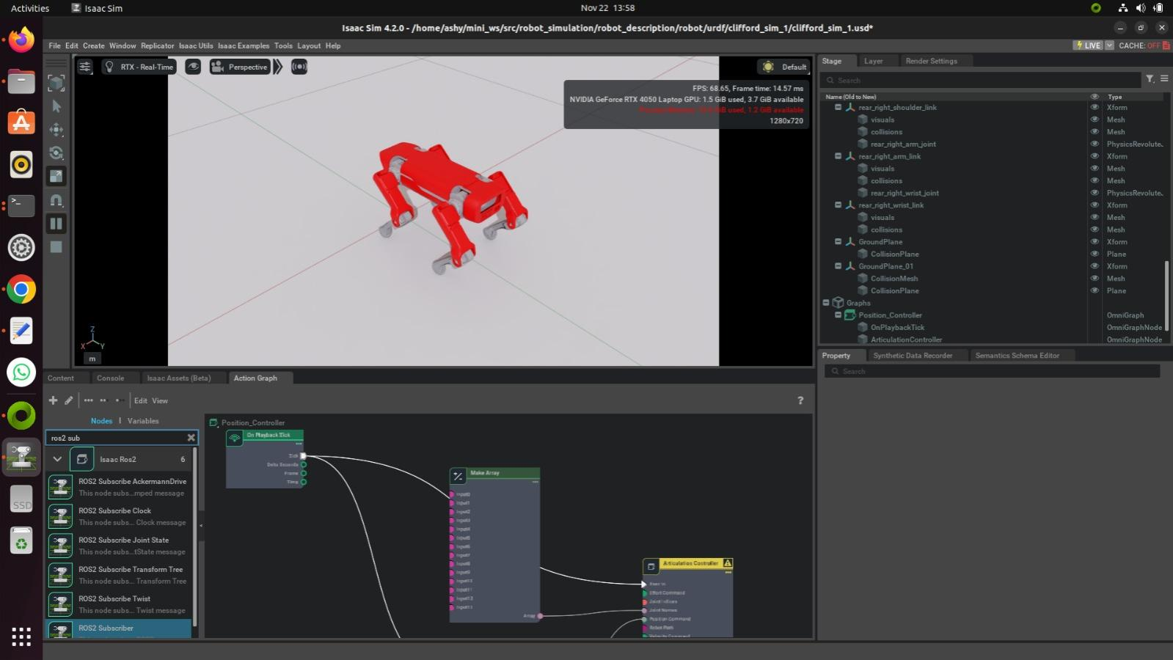

Slide 14
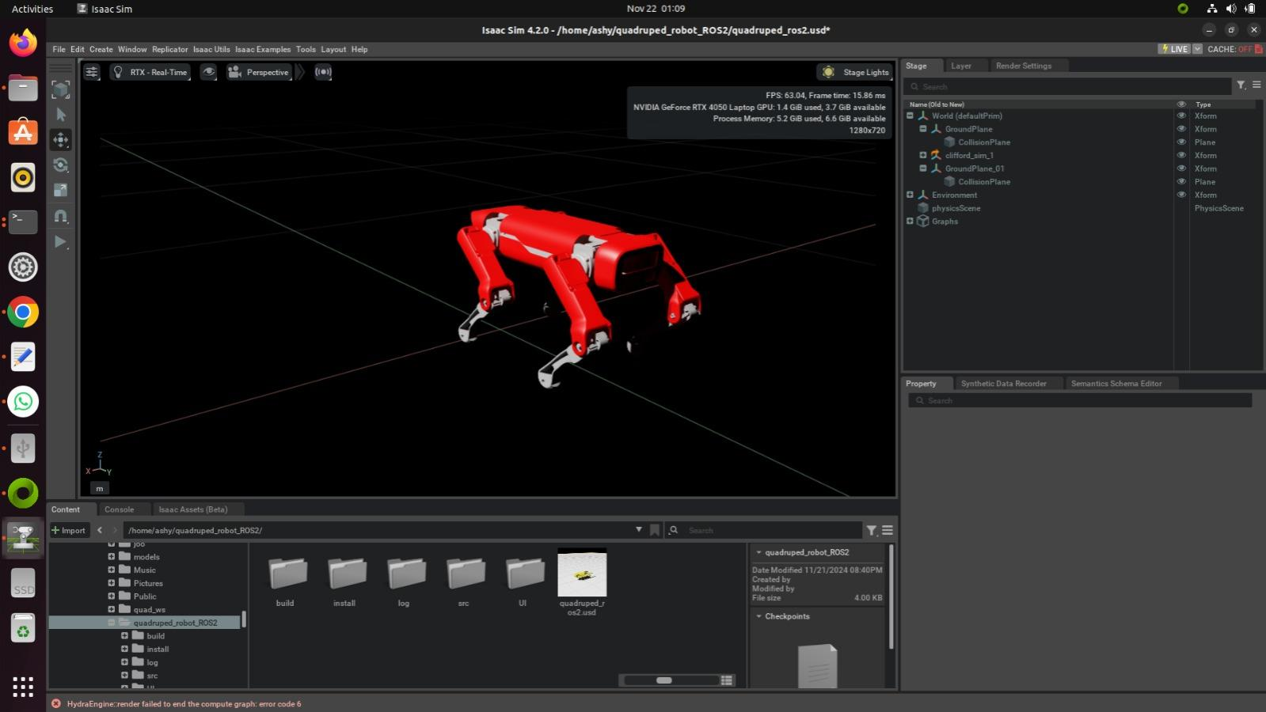

Slide 15
References
"Quadruped Robot Design and Control: A Review" by L. B. Freeman, J. R. S. Gamboa, and D. H. D. Chien.
Boston Dynamics - Spot Robot
"The Roboticists Guide to the Control of Quadruped Robots" by Antonio Bicchi and Lorenzo Marconi.
"Quadruped Robot Locomotion: A Survey" by Sung-Min Kim and Joon Ho Choi.

Slide 16
References
5. "The Development and Control of the Quadruped Robot LAURA" by M. J. Schmidt, J. E. DeRuntz, and R. A. Knepper
6. "Dynamic Locomotion of Quadruped Robots: Theory and Application" by K. Y. Lee, J. S. Kim, and H. Y. Lee

