Slide 1


MOBILE PRICE RANGE PREDICTION
DATA AVENGER
ASHISH KUMAR PANDEY
VIVEK KUMAR SONI

Slide 2
CONTENT OF THE PRESENTATION
PROBLEM STATEMENT
DATA SUMMARY
EXPLORATORY DATA ANALYSIS
DATA CORRELTION
DATA WARANGLING
MACHINE LEARING MODULE
MODEL EXPLANTATION
CHALLENGES
CONCLUSION

Slide 3
PROBLEM STATEMENT
Mobile phones have become great necessity for almost all individuals now days.People want more features and best specification in phone and that too at cheaper cost.The demand of the phone Is so high that there is a huge competition prevailing between mobile manufactures. To stay ahead in race, these companies try to bring in new features and innovation so that people are lured toward buying there brand smartphones.
Price of mobile phones is influenced by different factor .Brand name ,newness of the model,internal memory , ram, sizes, connectivity , are some of the important factor in determining the price.As a business point of view , it become an utmost priority to analyse the factor form time to time and come up with best set of specification and price ranges so that people buy their mobile phones.
Hence,Through this excerise and our predication we will try to help companies estimate price range competition to other manufacturer and also it will be useful for customers to verify the price of mobile

Slide 4
DATA SUMMARY
The content of the data had these features;
Battery power-total energy a battery can store in one time measured in mAh.
Clock speed-speed at which microprocessor execute instruction Fc,Pc Font and primary camera megapixel.
Int memory-Interal memory in Gigabytes.
M_dep-mobile depth in cm.
Mobile wgt of mobile phones.
N_core-No of cores of processor.
Px_height,Px_width access memory in megabytes Sc_h,Sc_w-screen height and width pf mobile
Talk time longest that a single battery charge will last when you are on call.
Blue,3g,4g,dual sim touchscreen wifi some supported and un supported categories

Slide 5
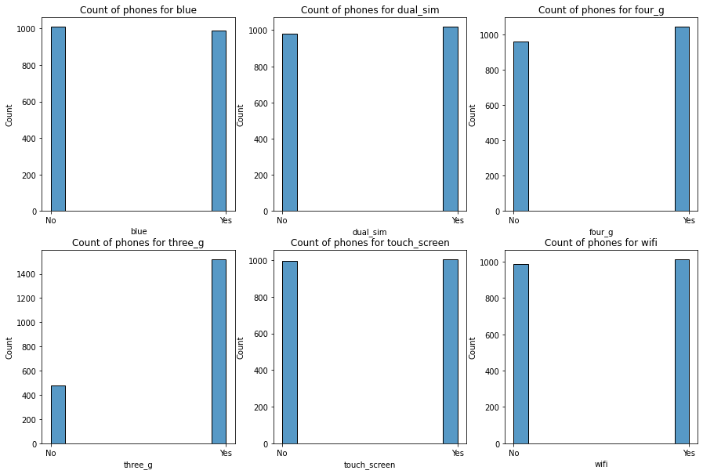
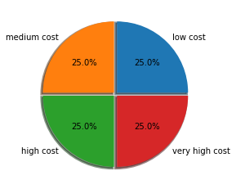
EDA Univariate analysis
Our dependent variable-price range is equally distributed amongst the variable.
Other dichotomus Features have equal no of observation for each category ,except 3g.

Slide 6
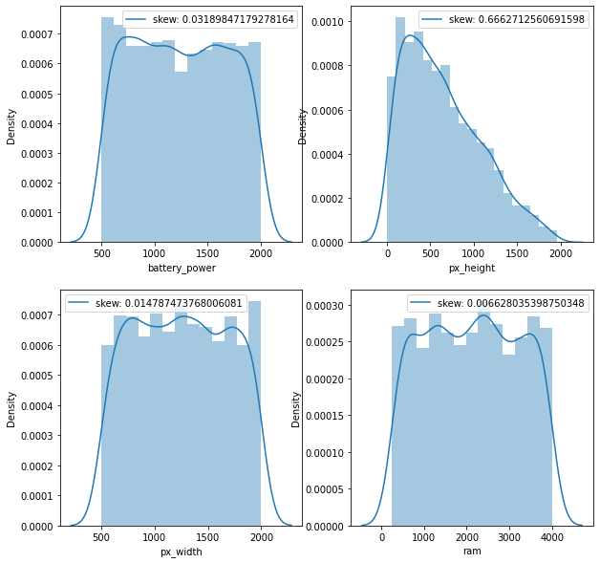
EDA univariate analysis
The count of phones is equally distributed among all the parameters in every variable except pixel height.
The number of phones tends to decrease as we go higher in pixel height, i.e. we can say that the graph is positively skewed.

Slide 7
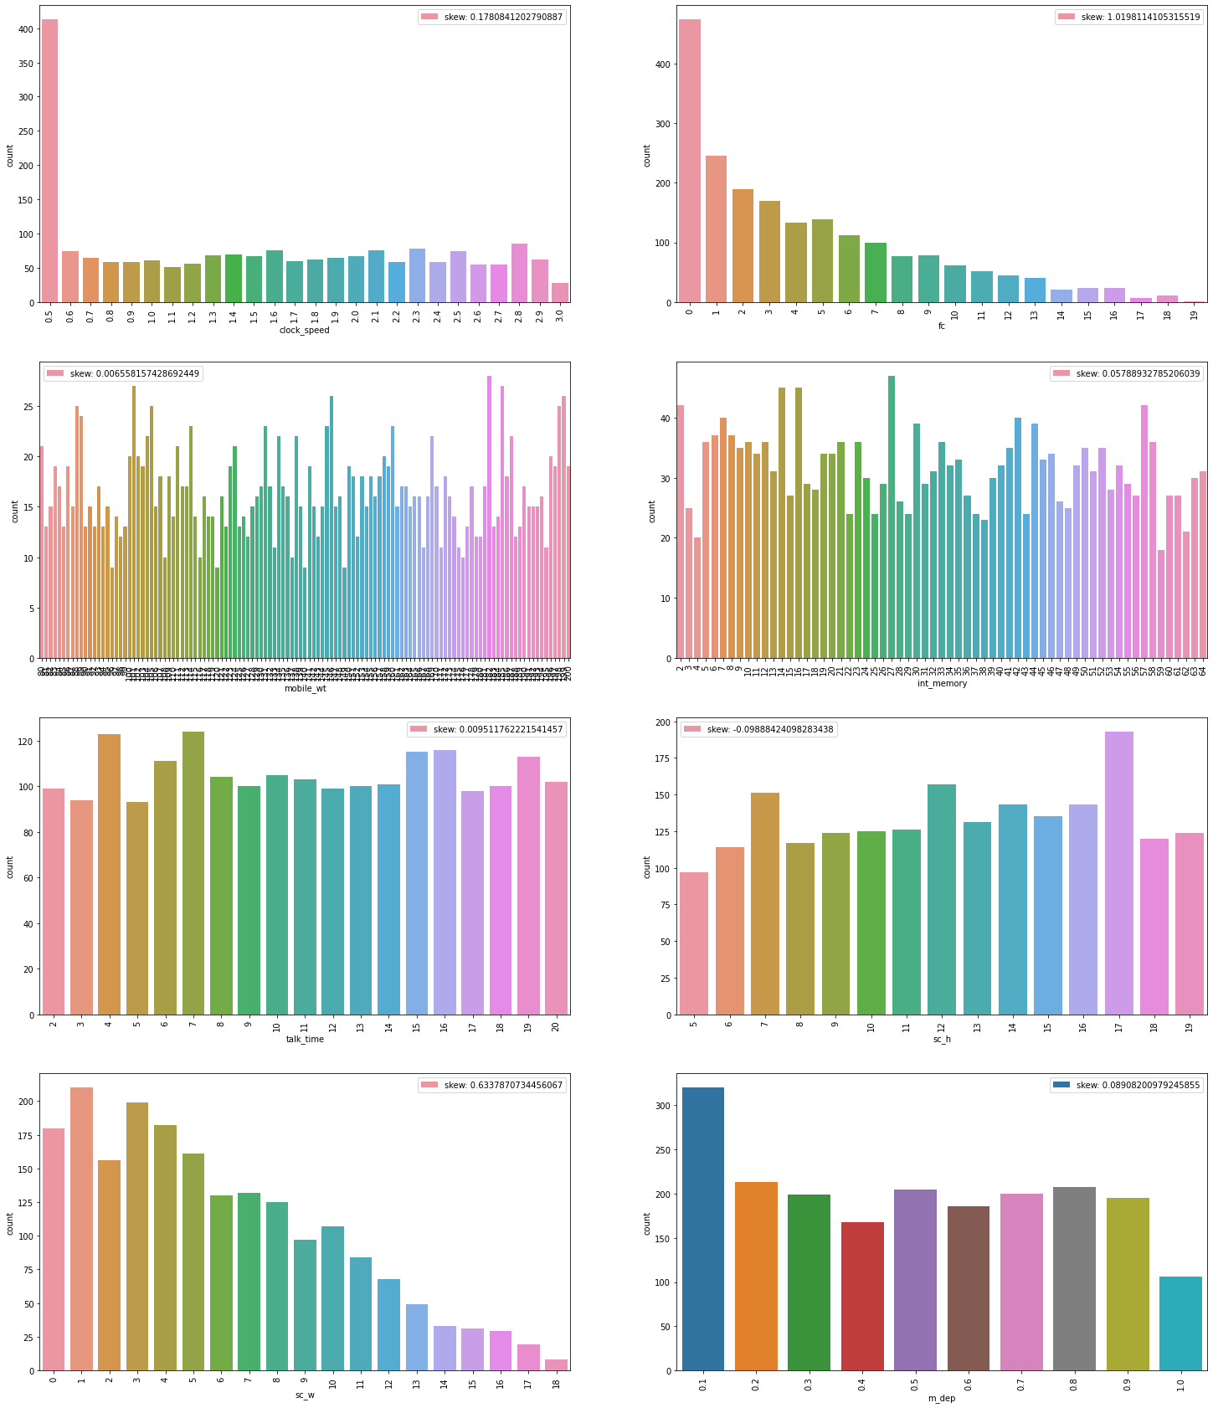
Univariate analysis-Numerical Varibles Analysed descriptive stats using countplot

Slide 8
Univariate analysis-Numerical Variables
The clock speed with 0.5GHz stands out in popularity among other phones. Rest of them have even distribution over the sales.
The phones with higher mega pixeled camera doesn't show a great relevance amongst the customers.
All the rest of features has shown a symmetric skewness in their sales numbers, except for screen width.

Slide 9
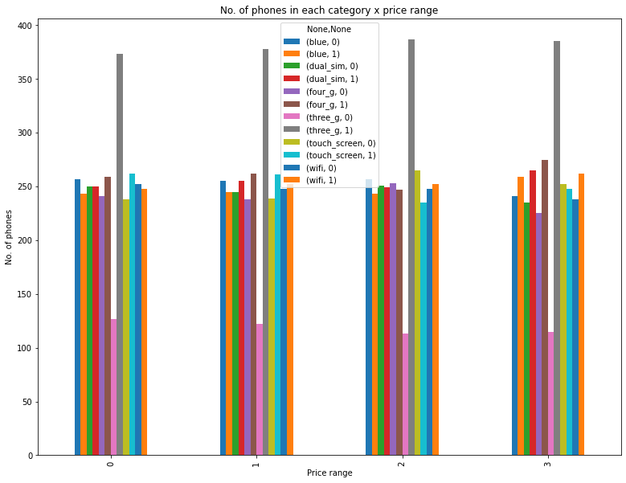
Multivariate analysis Categories Variations Almost equal no of observations for each price range for each categories

Slide 10
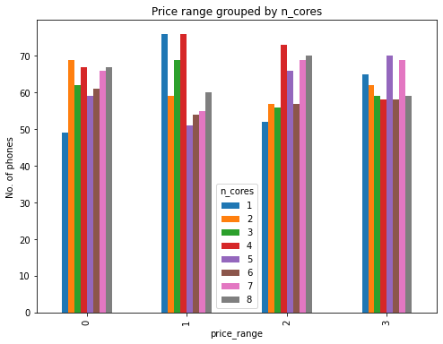
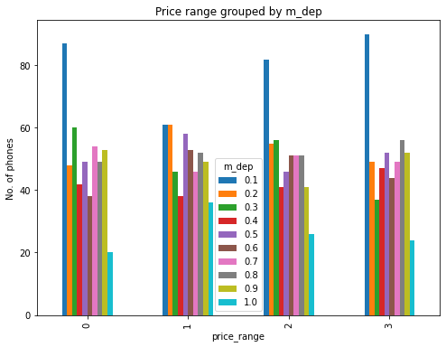
Multivariate analysis n_cores and m_dep 1.count of less n_cores is high for 0 and 1 price range. 2.count of high n_cores is high for 2 and 3 price range. 3.count of phones with less thickness is high and count of phones with high thickness is low.

Slide 11
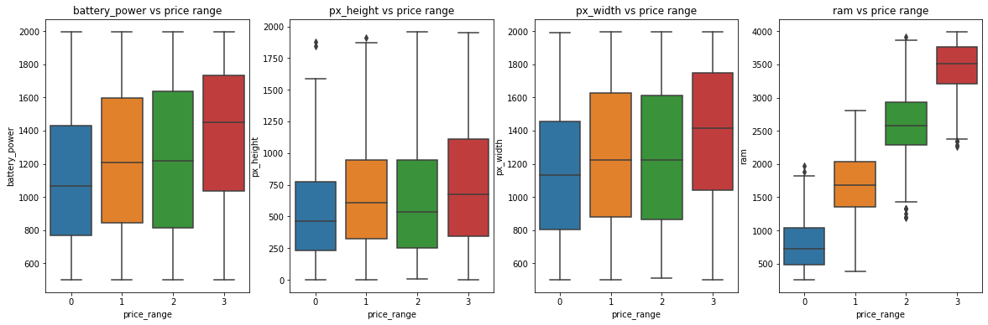
Multivariate analysis Numerical variables Mean values of battery power,px-height,px_width,ram is increasing with increase in price

Slide 12
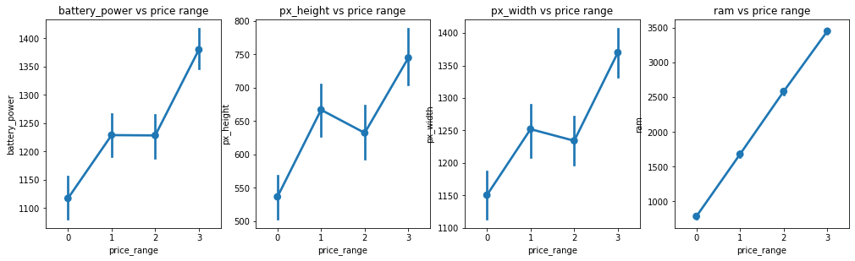
Multivariate analysis -continued
It appears that the values of these variables are rising in lockstep with the rise in prices. Ram is having an immediate effect. The more RAM you have, the more money you'll spend!

Slide 13
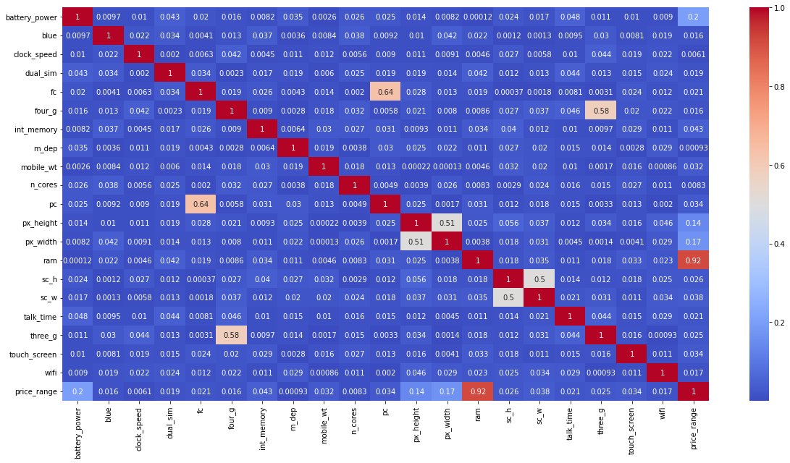
Data Correlation 1. pc is correlated with fc. 2. 3g and 4g are moderately correlated. 3. sc_h and sc_w are moderately correlated. We will try to change them into a single variable. 4. px_width and px_height are moderately correlated. We will try to change them into a single variable 5. ram is highly correlated with our price range. May be one the most important factor in determining the price.

Slide 14
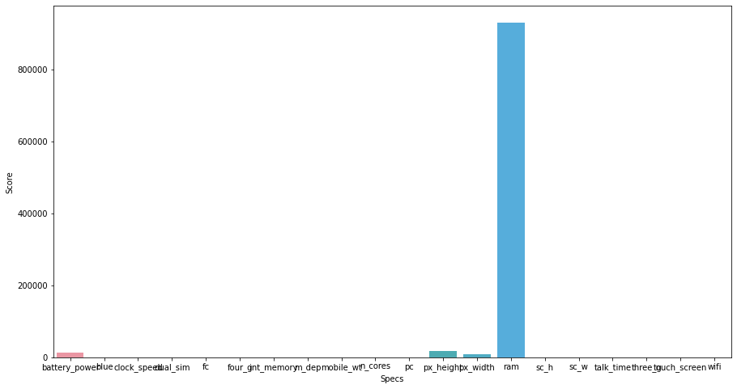
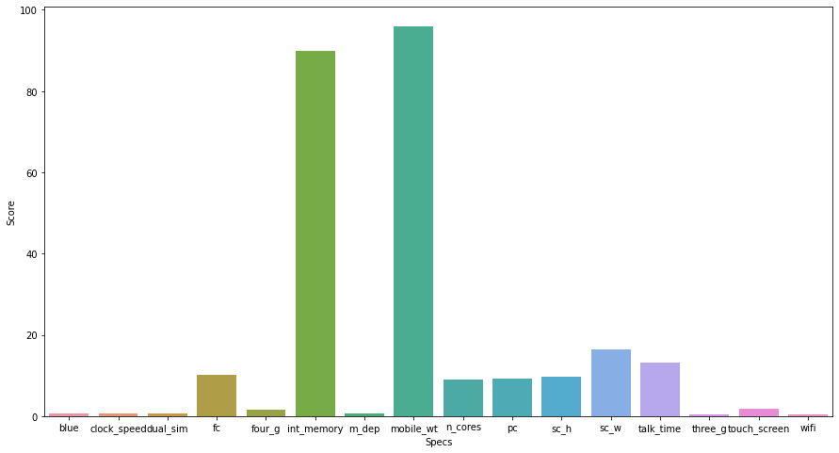
Feature selection
The most important features, as per both graphs are
Ram
Battery Power
Mobile weight
Internal memory
Front Camera megapixels
Number of cores
Primary Camera megapixels
Screen height
Screen width
Talk time

Slide 15
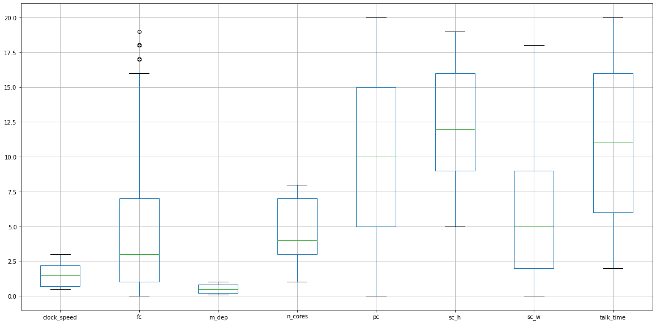
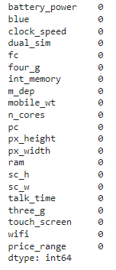
Data Wrangling
1.No null values.
2.Handled outliers.
3.Modified Px_height,Px_width & sc_h,sc_width,single column.

Slide 16
Machine learning model
Algorithms and methods to be used to apply predictive modelling
1.Decision Tree Classifier.
2.Random Forest Classifier.
3.Gradient Boosting Classifier .
4.XGBoost Classifier .
5.K-Nearest Neighbours.

Slide 17
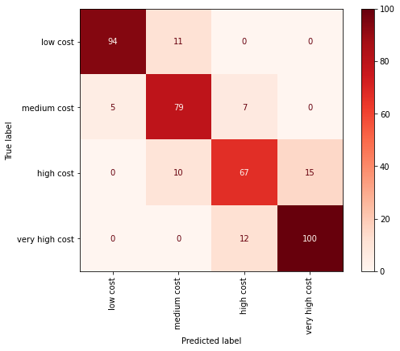
Machine learning models Decision trees
1. The overall accuracy score on our test data is 83%.
2. Prediction accuracy on class 1 (Low Cost) is 93%.
3.Prediction accuracy on class 2 (Medium Cost) is 81%.
4. Prediction accuracy on class 3 (High Cost) is 65%.
5. Prediction accuracy on class 4 (Low Cost) is 100%.
As a result, we can see that the Decision Tree Classifier
has performed good overall, and best in class 4.

Slide 18
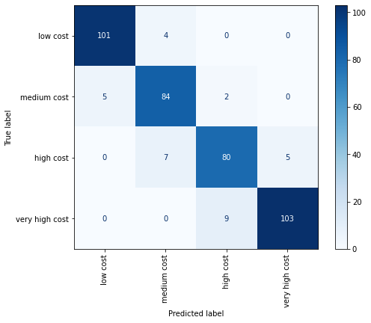
Machine learning models
XG Boost
1. The overall accuracy score on our test data is 92%.
Prediction accuracy on class 1 (Low Cost) is 100%.
3. Prediction accuracy on class 2 (Medium Cost) is 84%.
4. Prediction accuracy on class 3 (High Cost) is 80%.
5. Prediction accuracy on class 4 (Low Cost) is 100%.
As a result, we can see that the Gradient Boosting Classifier has performed good overall, and best in class 1 & class 4.

Slide 19
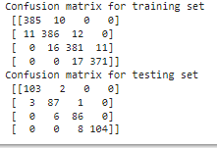
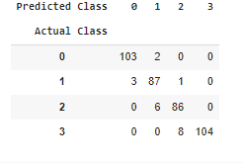
Model selection and validation
Every model we had applied ,except KNN initially overfitted.
Overfitting was tackled using hyperparameter tuning ,there is sill a room for improvement of models.
The best performance was given by KNN with accuracy of 0.95 for both for training and test set at k=11.
The next best model was XG Boost classifer , which gave us the accuracy of 1.0 and 0.91 for the training and test dataset resp.we tried to tune it didn’t solve the problem of overfitting .
The best hyperparameter values that were accepeted here

Slide 20
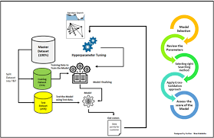
Challenges
The most challenging part in this excerise to find an optimal set of parameter that could give us the best performance.
It took hours to try every combinations in cross validating and finally selecting the best values.
The model could even perform better with even finer tunings.

Slide 21
CONCLUSION
We tried a variety of models, and the table above summarises the results of one set of models. K-Nearest Neighbours has the best overall accuracy of 93 percent.
The optimal accuracy for Random Forest, Decision Tree, Gradient Boosting, and XG boost was 85 percent, 85 percent, 92 percent, and 91 percent, respectively.
However, we'll make XG boost our best model because it provides good overall and individual class accuracy.

Slide 22
Thank you

