Slide 1

INT 428 – AI Essentials | Lovely Professional University
Home Maintenance
Chatbot
Homewise AI – Your Smart Home Repair Assistant
Team Members
Guide
Naja Hindh K | Aquinas M P | Ashish
Dr. Dimple Nagpal
January – April 2026

Slide 2

Introduction
What is Homewise AI?
Built With
An AI-powered home maintenance assistant
Helps users fix everyday household problems
Gives step-by-step repair guidance
Available 24×7 from any browser – no install needed
Python + Streamlit (web interface)
Groq API with Llama 3.3 70B model
Deployed on Streamlit Cloud
Completely free to use

Slide 3

Problem Statement
1
No Quick Help
2
Info is Scattered
3
Professionals are Costly
When something breaks at home, most people don't know what to do or where to start.
Answers are spread across YouTube, forums, blogs — finding the right one wastes hours.
Calling a technician for a minor repair can be expensive, especially in smaller towns.
💡 Homewise AI gives instant, accurate repair guidance — free, simple, and always available.

Slide 4

Objectives
Functional Objectives
Technical Objectives
Provide step-by-step repair guidance
Cover electrical, plumbing & appliances
Include safety warnings in responses
Recommend professionals when needed
Integrate Groq AI API (Llama 3.3 70B)
Design a focused system prompt
Deploy as a public web application
Manage conversation memory across turns

Slide 5

System Overview
User
Streamlit UI
Groq API
Response
Types a home
maintenance question
Chat interface
captures input
Llama 3.3 model
generates answer
Step-by-step
guidance displayed
Session Memory Conversation history is kept throughout the session so follow-up questions work naturally.
No Database Everything runs in-memory — lightweight and fast.

Slide 6





Key Features
Chat Assistant
Cost Estimator
Maintenance Calendar
Step-by-step repair help via AI conversation
Get a rough cost estimate before starting a repair
Schedule and track regular home upkeep tasks
Seasonal Tips
Export Report
Get relevant home care tips for the current season
Download your chat session as a reference file

Slide 7

Technology Used
Technology
Role
Why We Chose It
Python 3.9
Core programming language
Rich AI library support, clean syntax
Streamlit
Web framework & chat UI
Built-in chat components, quick deployment
Groq Cloud API
Generative AI engine
Ultra-fast LPU inference – responses in < 1 sec
Llama 3.3 70B
Large language model
High quality, instruction-following, free tier
Streamlit Cloud
Deployment & hosting
Free, GitHub-integrated, easy secrets management
Git / GitHub
Version control
Collaboration and CI/CD with Streamlit

Slide 8

How It Works
1
User Opens the App
Visits homewiseai.streamlit.app — sees suggested repair questions to click or types their own.
2
Message is Sent
The app packages the system prompt + full chat history + the new question into an API request.
3
AI Generates Answer
Groq's Llama 3.3 model processes the request and returns a structured, step-by-step response in under a second.
4
Response Displayed
The answer appears in the chat. Users can continue asking follow-up questions — the bot remembers the context.

Slide 9

API & AI Usage
Groq API – How We Use It
Model Configuration
OpenAI-compatible REST API (JSON format)
Sends: system prompt + chat history + user query
Receives: AI-generated repair guidance
API key stored securely in Streamlit Secrets
Responses arrive in under 1 second (LPU speed)
Model
Llama 3.3 70B Versatile
Temperature
0.7 — natural, reliable responses
Top-p
0.9 — precise technical vocabulary
Max Tokens
1500 — room for complete guides

Slide 10
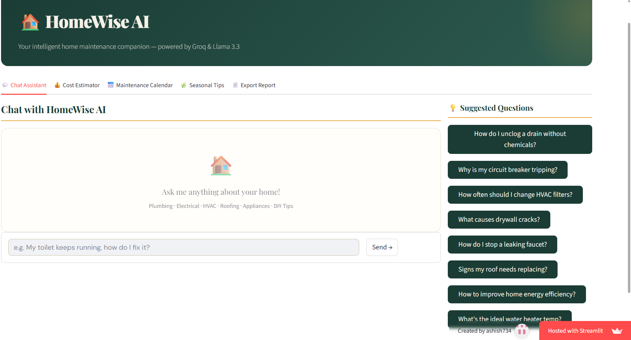
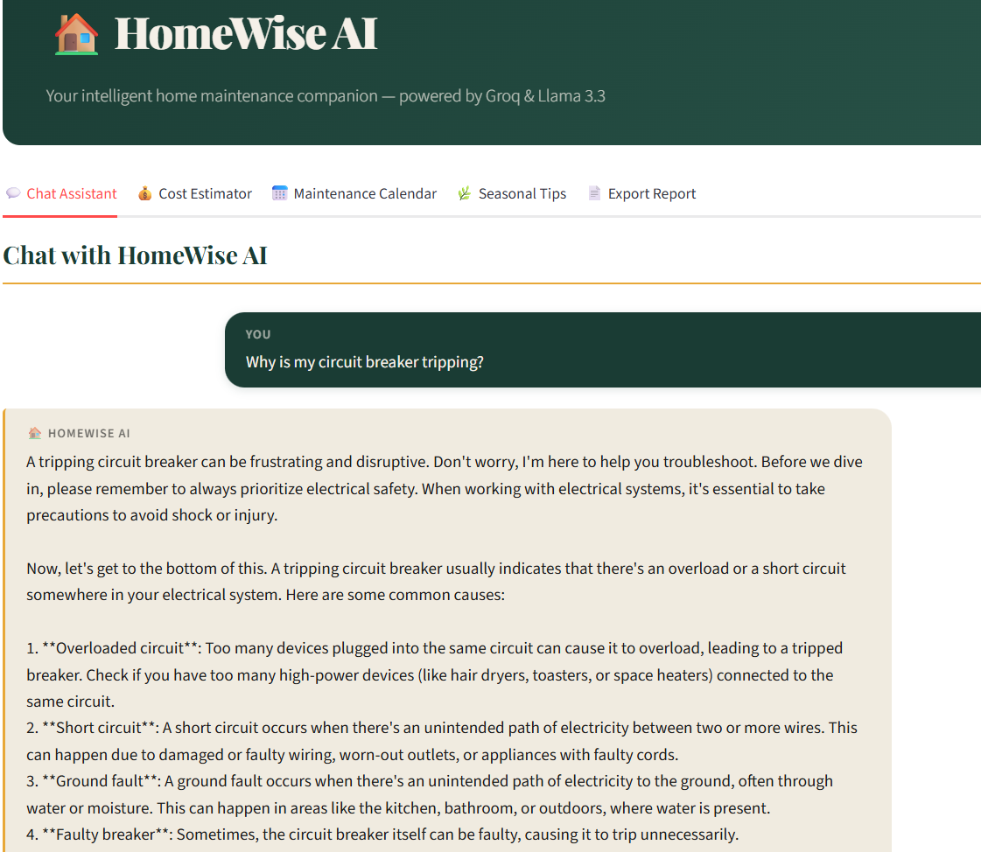
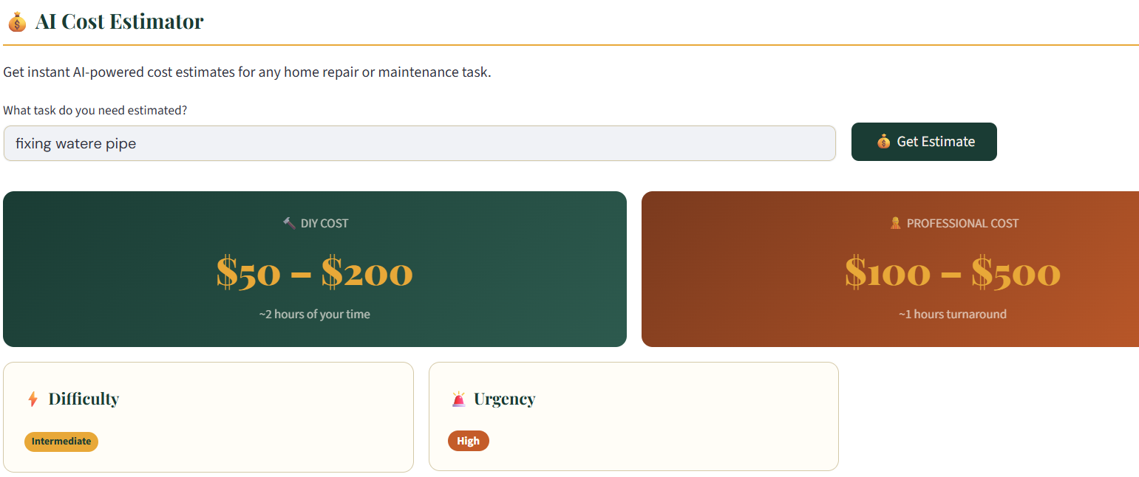
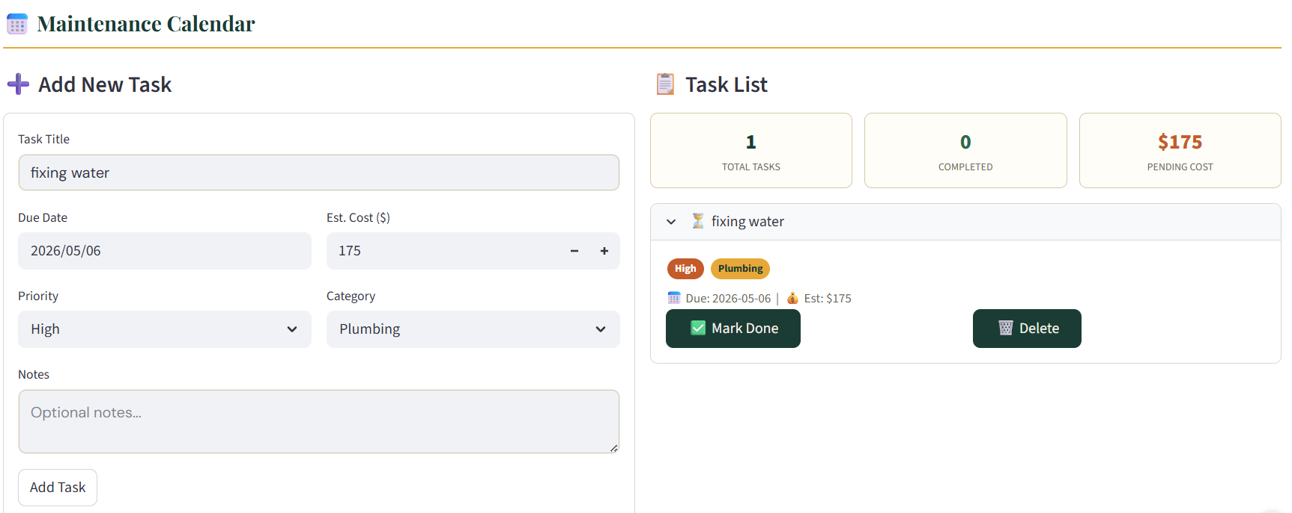
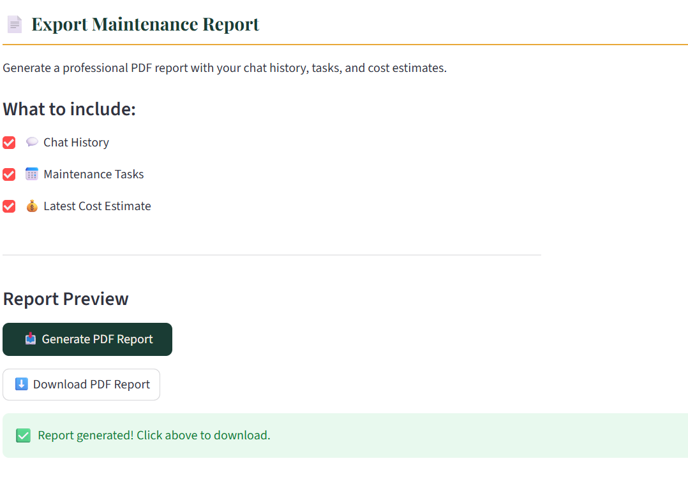
Application Screenshots
📷 Home Screen
& Chat Interface
📷 Repair Guidance
with Safety Tips
📷 Cost Estimator
Feature
📷 Maintenance
Calendar
📷 Export
Report

Slide 11

Advantages
Always Available
Free to Use
24×7 access from any device — no waiting for a technician's schedule.
No charges at the point of use. Saves money on unnecessary service calls.
Safe Guidance
Context-Aware Chat
Safety warnings are built into every repair response by default.
Remembers the conversation — follow-up questions work naturally.
No Installation
Multi-Domain Coverage
Runs in any browser. No apps, no signup, no setup required.
Electrical, plumbing, appliances, and general upkeep — all in one place.

Slide 12
Conclusion
1
Homewise AI is a practical, working AI application built for a real everyday need.
2
It demonstrates how Generative AI, prompt engineering, and Streamlit can be combined quickly and effectively.
3
Users get instant, safe, step-by-step repair guidance — free and accessible from anywhere.
4
The project covers the full AI development stack: design, API integration, deployment, and documentation.
Thank You | INT 428 – AI Essentials | Lovely Professional University

Slide 13
THANK YOU

