Slide 1
Distributed Hash Table
Project Presentation
Ashish Agarwal
Brooke Dalton
Aravind Rokkam

Slide 2
The Problem
Fast Look up in a distributed environment

Slide 3
The Solution - Distributed Hash Table - DHT
A hash table is a data structure that allows you to insert, lookup and delete objects with keys value pairs
A distributed hash table is the similar to a hash table except it is set in a distributed setting
Chord is an example of a DHT

Slide 4
What is Chord?
Chord is a peer to peer distributed distributed hash table(DHT)
Chord specifies how keys are assigned to nodes, and how a node can discover the value for a given key by first locating the node responsible for that key
There is no coordination server
Peers replace Slaves

Slide 5
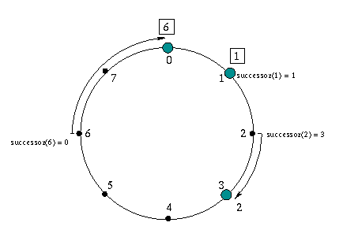
Chord Protocol
There are two types of peer pointers
Successor-Predecessor
Finger table

Slide 6
Chord Lookup
Lookup for id works as following :
If id falls between n and successor(n), successor(n) is returned
Otherwise, Lookup is performed at node n, which is the node in the fingertable that most immediately precedes the id

Slide 7
Chord Lookup
Since each node has finger entries at power of two intervals around the identifier circle, each node can forward a query at least halfway along the remaining distance between the node and the target identifier
Thus O(log(N)) nodes need to be connected

Slide 8
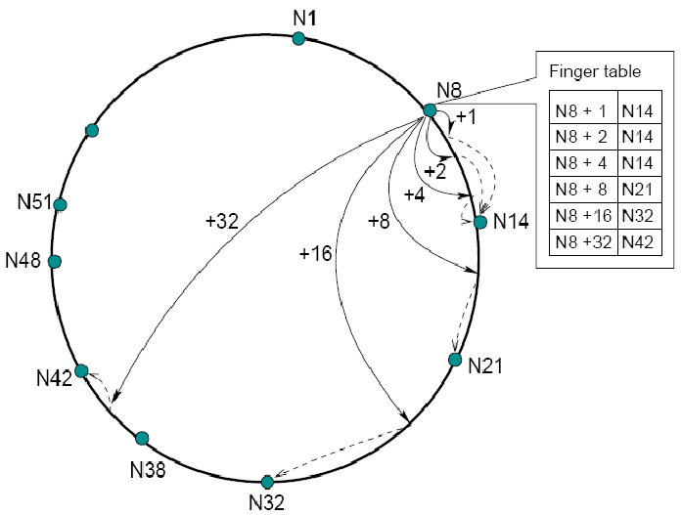
Architecture

Slide 9
Components
Local:
ChordNode: Local node functions and features
Remote:
RemoteServer: Remote Procedures
RemoteClient: To connect to other nodes through RPC
ExpressServer:
To query the cluster for fingers
To put key-value pairs.
To get values for given keys.

Slide 10
Features
Finding successor node recursively using finger table
Finding closest preceding node recursively using finger table
Stabilization Protocol
Notify
Fix fingers
Storing and retrieving Key-Value entries
During node join:
Copying key-value entries
Deleting entries from existing node

Slide 11
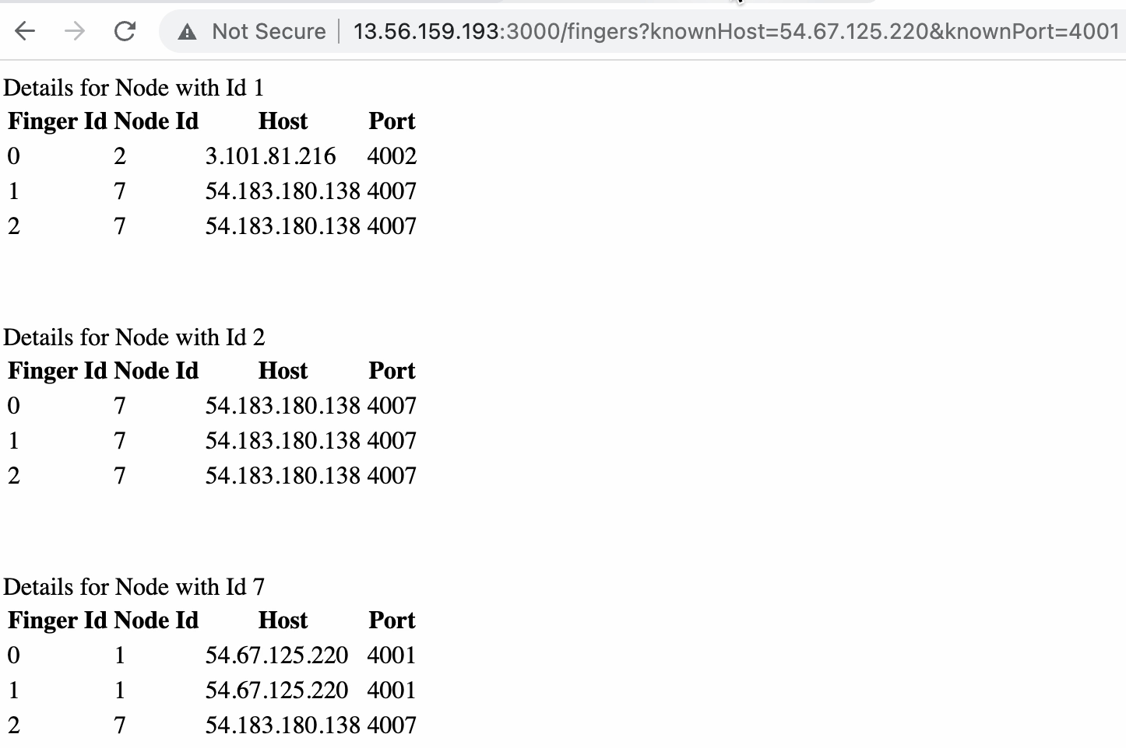
Finger Table

Slide 12
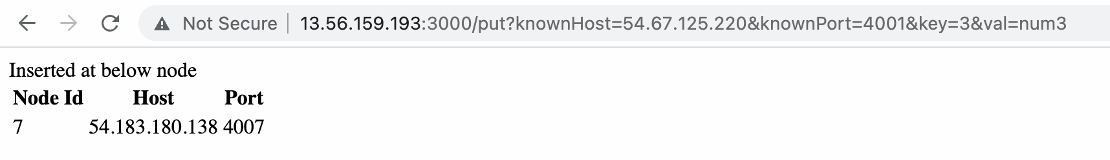
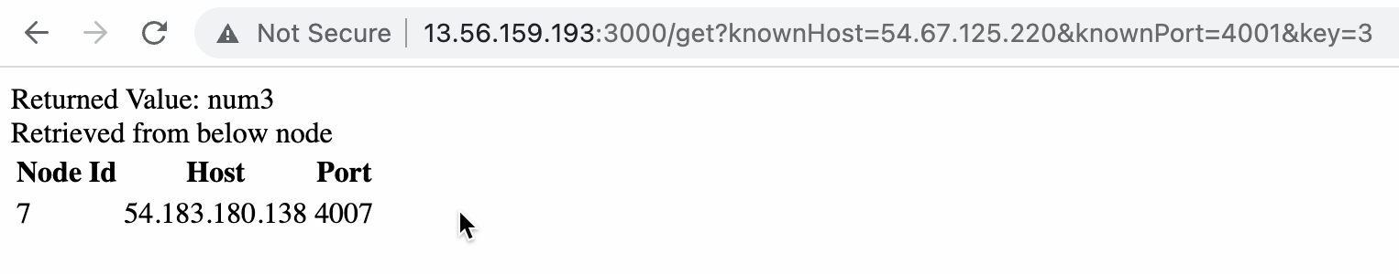
Put
Get

Slide 13
Protocols
Technology Used
Resource Discovery
Agreement Protocols
Distributed Shared Memory
NodeJS
AWS/EC2
Git

Slide 14
Challenges
Connecting to AWS
Connection timeout
Network issues with gRPC

Slide 15
Future Work
Concurrency
Replication

Slide 16
Responsibilities
Ashish Agarwal :
Finding successor node recursively using finger table
Finding closest preceding node recursively using finger table
Stabilization Protocol
Presentation slides
Brooke Dalton:
Notify
Fix fingers
AWS/EC2 implementation
Presentation slides
Aravind Rokkam:
Storing and retrieving Key-Value entries
Presentation Slides
During node join:
Copying key-value entries
Deleting entries from existing node

