Slide 1
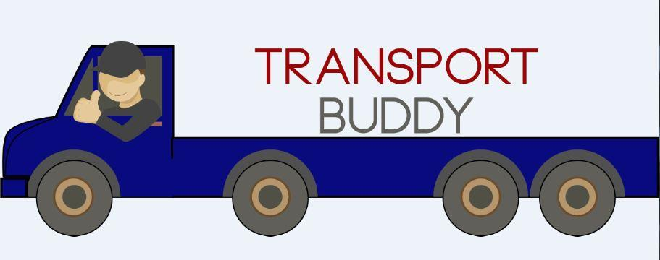
Transport Buddy
Group Members
Ashish Arya 220343120016
Chavan Manoj Balu 220343120028
Mokariya Hiren Vaju 220343120059
More Bhushan Vijay 220343120061
Project Guide – Mrs. Harshita Maheshwari

Slide 2


Contents
Introduction
Project Plan
Users
Modules
Proposed System Model
Screenshot
System Requirements
Advantages
Limitations
Conclusion
Future Scopes
References
PC

Slide 3
Introduction
Transport Buddy is a web application to help Transporters as well as Users.
This application allows a good communication.
It provides Admin, Transporters, and Users login.
Transporters & Admin can add different Vehicles.
The web application is made for the transport companies who use to spend additional fuel and labour charges when the vehicle is returning back to the location after completing a primary trip/scheduled delivery.

Slide 4
Transportation
Transportation - involves the physical movement of people and goods between origin and destination points, thereby creating time and place utilities
Transportation links geographically separated partners and facilities in a company's supply chain
Movement of inventory through trucks, trains, plains, ships, pipelines, fiber optic wires
Transportation connects the supply chain network

Slide 5
Primary goals
In most of the scenarios, we have seen that the transport company owners have to cut down their profit when they do not get any booking when the vehicle is returning back to the location after completing the primary booking.
The objective of this application is to maximize the profit of the transport company owners by utilizing the return trip of their empty vehicle.
The moment a vehicle is allocated a primary booking, we will notify on our website about the return journey of the vehicle along with it’s exact locations. So that the users can book the vehicle on a discounted price, whenever the vehicle is on it’s return trip.

Slide 6
Transportation Components
Inbound - procurement of materials and goods from supplier locations
Outbound - the distribution of materials and good to customer locations
Reverse - product returns, recycling, reuse of materials, and waste disposal

Slide 7
Project Plan
Users
1. Customers: The customers will be given a login to the application to book a vehicle for booking. They have to specify the location and approximate load of the items. They will get a discount whenever they will get the opportunity to book a vehicle on it’s return journey. They will not be given the details of drivers until or unless they have confirmed their booking. Once the booking is confirmed, they will be provided the details of the journey and driver that will include name and phone number of the driver along with the vehicle model and number.
2. Administrator: He/she we will be given a special login so that he/she can check both the phases of the application and can connect between the customers and the drivers after checking all the necessary details such as load, pricing, pick and drop location, total duration and distance.
3. Transport Companies: They can register their vehicle and have to inform us about the details of the vehicle 24 hours prior to the completion of the primary journey of the vehicle. One transport company can register multiple vehicles. We will inform the customer about the pick up by adding 8 hours of the buffer so that the driver can take rest in the mean time and the vehicle will also get a time to cool down.

Slide 8
Modules
1. Customer management: This module will be related to all the functional and non-functional aspects related to a customer who want to book a vehicle. Their registration, login, bookings (upcoming and cancelled), location, price.
2. Driver management: This module will be related to the functionality related to drivers. The drivers will be able to get the details of the available customers along with the location details in a particular radius.
3. Transporter management: This module will handle all the details of the vehicle that transporter/s will register with our application. We will maintain a record of the vehicle details associated with the respective driver.

Slide 9
Proposed System Model
Admin
Transporter
User
Home
Transporter Detail
Users Detail
Vehicles Detail
Booking Request
Log Out
Home
Transporter Detail
Vehicles Category
Booking Request
Log Out
Home
Ride Detail
Ride Booking Request
Log Out

Slide 10
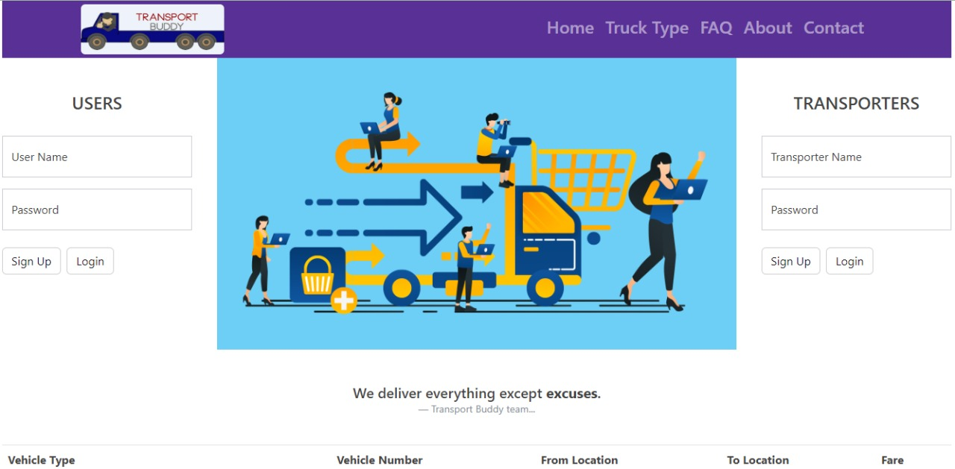
Screenshots
HomePage

Slide 11
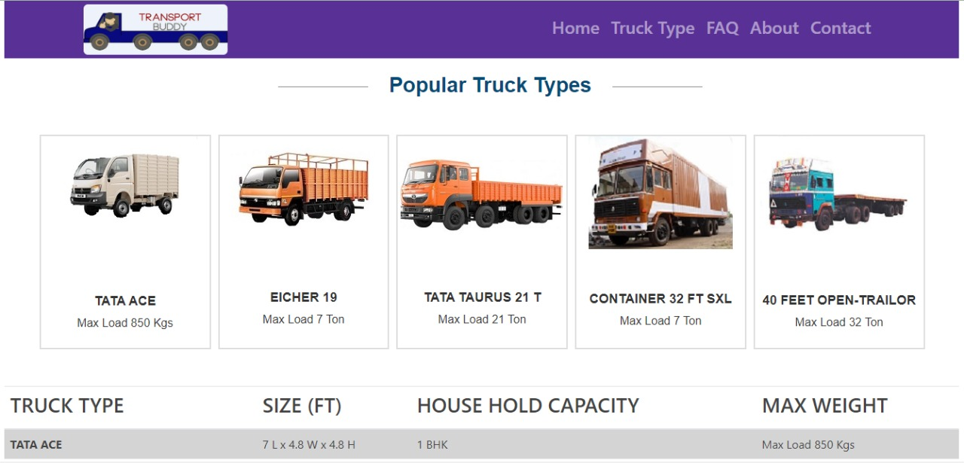
Trucktype

Slide 12
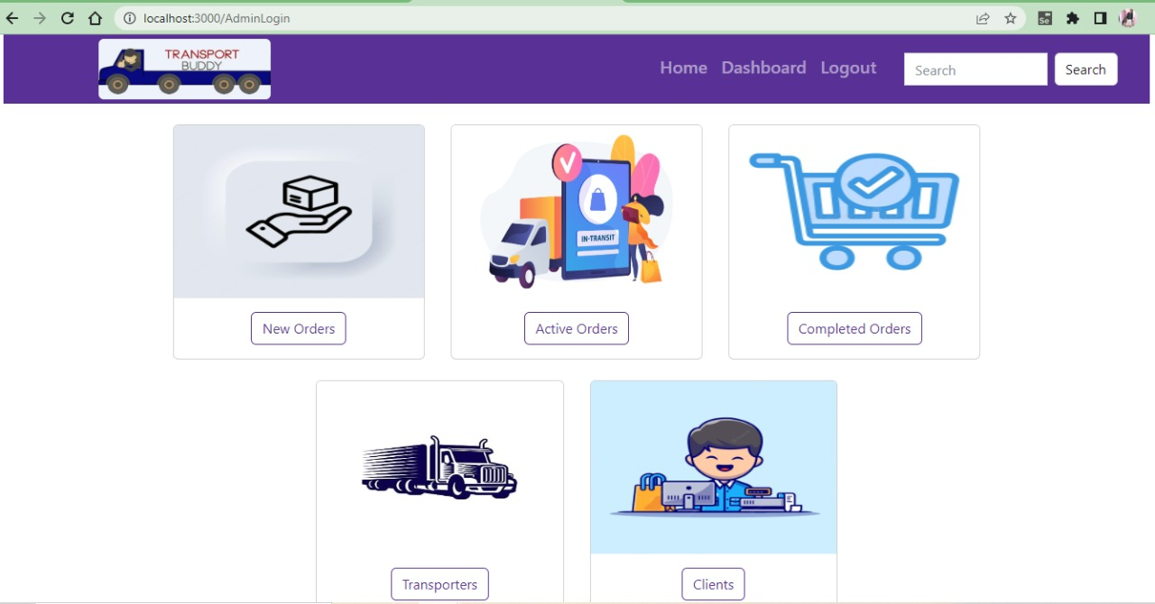
AdminLogin
HomePage

Slide 13
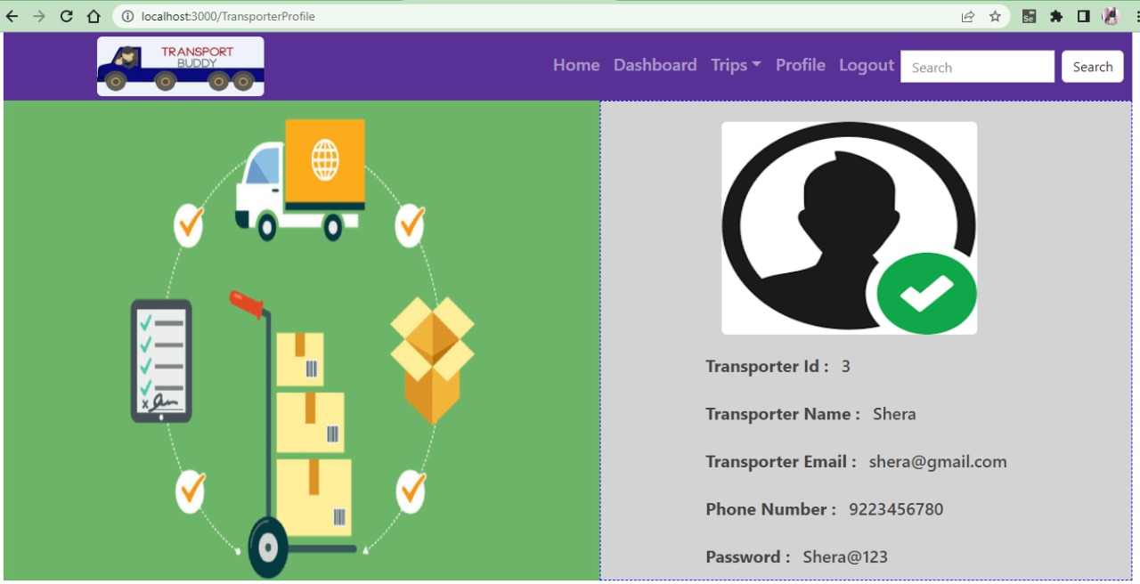
TransporterProfile

Slide 14
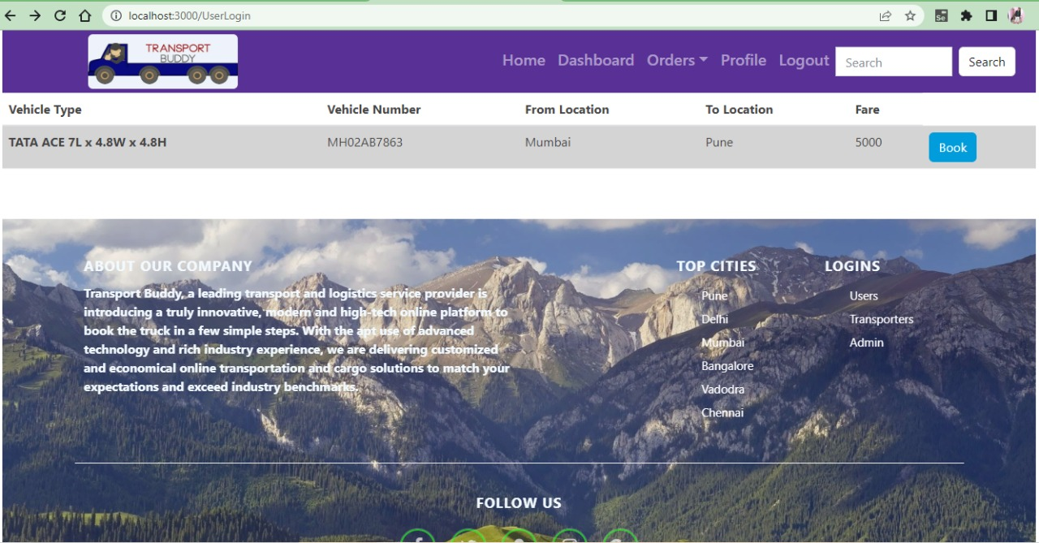
UserLogin

Slide 15
Technology Used
Frontend- React
Backend- Java
Database- MySQL
Others- Bootstrap/HTML/CSS/jQuery

Slide 16
System Requirements
Software Requirements
Windows (All Versions)
Tomcat 8.5
Eclipse, MySQL, XAMMP
Hardware Requirements
Processor – i5
Hard Disk – 128 GB
Memory – 4GB RAM

Slide 17
Rich industry experience Advanced technology On-time, every time Competitive pricing Reliability and safety Hassle-free services
Advantages

Slide 18
Payment gateway can not added. Can’t track Live Tracking.
Limitations

Slide 19
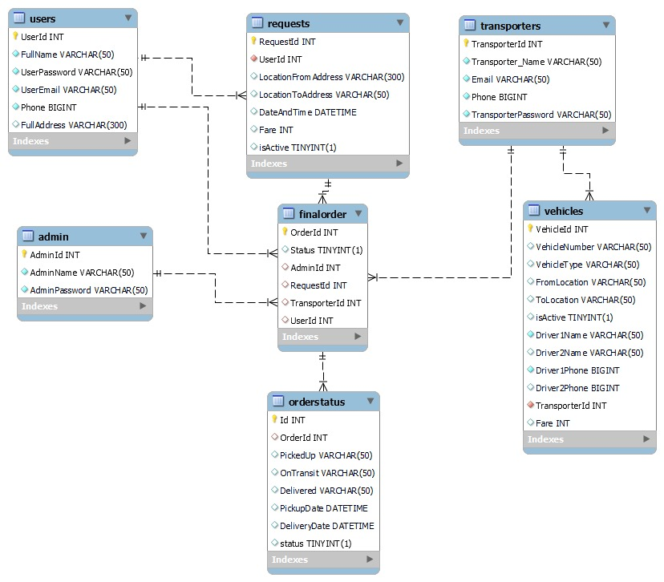
ERD / Database Tables

Slide 20
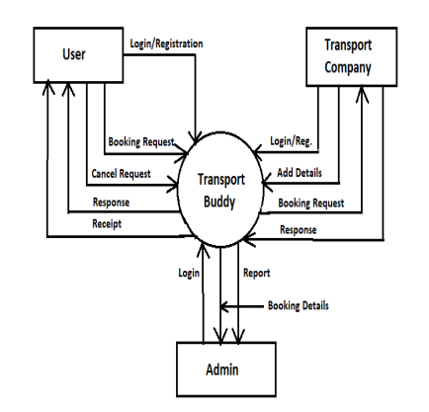
Data Flow Diagram

Slide 21
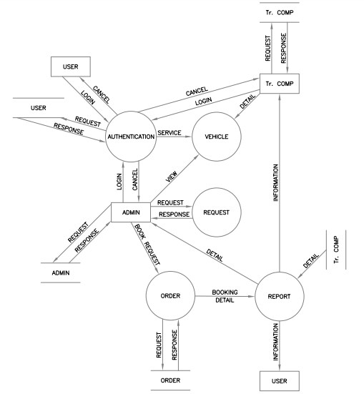

Slide 22
Conclusion
The Transport buddy web system will be designed and developed to overcome the drawbacks of old manual system and meet the requirement of modern age. This system will digitalize the Transportation industry and give more profit to Transporters. It will bring transparency between Admin, transporters and users by removing intermediates. It will save time & energy of everyone using this portal. Lastly it can be improved in future according to rising demand of users.

Slide 23
Future Scope
We can add a module of round trip(primary)
We can implement live tracking feature
Verification of users.
Improvement in design.
Mobile Application
UPI payment
Chat BOT
FS

Slide 24
Refrences
Mr. Saleel Bagde for Database.
Mrs. Harshita Maheshwari for HTML CSS & React also she was our project guide.
Mrs. Mayuri Fakirpure for JAVA.
https://www.stackoverflow.com
https://www.React.com
A special thanks to Infoway Management who arranged extra lab time for us.

Slide 25

Thank you
Have a Safe Transport

