Slide 1
NYC School Violent and Disruptive Incident Reporting (VADIR) incidents
ANALYTICAL PROGRAMMING
By:
Gagan Preet Singh
Ashish Bachuwar
Karina Thapa

Slide 2
Content:
1. Introduction
2. Objective
3. Data Source
4. Data loading and concatenation
5. Data summary
6. Univariate Analysis
7. Bivariate Analysis
9. Data Preparation & Feature Engineering
10. Research Questions
11. Conclusions
12. Values to stakeholders

Slide 3
Introduction
School safety has become a top priority in public education due to incidents like school violence.
Nearly 7,000 school safety events were recorded in NYC public schools in 2009-10.
VADIR incidents encompass a wide range of occurrences, including violent or disruptive behavior, drug and weapon possession, and other offenses that affect the safety and well-being of students and staff in New York City public schools.
Understanding trends and patterns in these events is important to create effective prevention measures.
This analysis examines VADIR INCIDENTS data from NYC Dept. of Ed. for 2009-10 to 2011-12. (2009-2010, 2010-2011, and 2011-2012)

Slide 4
Objective
Understanding the patterns and trends in VADIR incidents is crucial for creating a safe and nurturing learning environment for NYC public schools.
To identify any discrepancies or patterns among school years, neighborhoods and grade organization.
Analyzing this data can help identify areas of concern, evaluate the effectiveness of existing policies, and inform decisions on resource allocation for prevention and intervention programs.

Slide 5
Data Sources
The datasets used in this analysis are from 2 sources via Data.gov and Nyc OpenData in CSV and WebAPI format.
CSV file
Data.gov: 2009-2010 VADIR INCIDENTS
WebAPI
Nyc OpenData: 2010-2011 VADIR INCIDENTS - WebAPI
Nyc OpenData: 2011-2012 VADIR INCIDENTS – WebAPI
Key features of the datasets:
School Information: Each dataset contains the unique identifier (BEDS Code) and name of the schools, as well as the district and borough they are located in.
Incident Categories: The datasets classify incidents into several categories, such as Assault with Serious Physical Injury, Burglary, and Criminal Mischief. Each category has a corresponding count of incidents for the academic year.

Slide 6
Research Questions
What are the trends and patterns in school safety incidents reported in New York city public schools between 2009 and 2012?
What factors are associated with the incidence of school safety incidents in New York city public schools?
How do school safety incidents vary by grade level (elementary, middle, high) ?
Is there a relationship between the size of a school's enrolment and the number of incidents reported?
What would be the pattern of incidents in the coming year, based on the school's characteristics, such as location and student demographics?

Slide 7
Data loading and concatenation
LOADING
Used Jupiter notebook to load the data and for further analysis.
CSV:
Data for 2009-2010 VADIR INCIDENTS, CSV file downloaded from Data.gov and upload on Github.
CSV file from github is then loaded to data frame using pandas library
API:
Data for 2010-2011 & 2011-2012 VADIR INCIDENTS directly downloaded on Jupiter notebook via API using pandas library.
CONCATENATION
All 3 data frames are concatenated to 1 data frame:
Challenges faced:
Data in 2009-2010 was not having county attribute.
Column names were not same daraframe loaded via Github and API

Slide 8
Data summary(datasets and their attributes)
The VADIR dataset has 2977 rows includes 45 attributes, which are divided into nominal categorical attributes and continuous numeric attributes.
8 Attributes are Nominal Categorical
37 Attributes Continuous Numeric
Nominal Categorical Attributes
Continuous Numeric Attributes
Attribute | Detail
school_year | School Year (2009-2010; 2010-2011; 2011-2012)
county | County where the school is located
district | School district where the school is located
school_name | Name of the school
beds_code | Unique identifier for the school in the New York State Education Department's
grade_organization | Grade organization of the school
need_resource_category | Need/resource category of the school
school_type | Type of school
Attrebutes | Details
enrollment | Total enrollment at the school
homicide_with_weapon_s | Number of incidents of homicide with a weapon
homicide_without_weapon_s | Number of incidents of homicide without a weapon
forcible_sex_offenses_with_weapon_s | Number of incidents of forcible sex offenses with a weapon
forcible_sex_offenses_without_weapon_s | Number of incidents of forcible sex offenses without a weapon
other_sex_offenses_with_weapon_s | Number of incidents of other sex offenses with a weapon
other_sex_offenses_without_weapon_s | Number of incidents of other sex offenses without a weapon
robbery_with_weapon_s | Number of incidents of robbery with a weapon
robbery_without_weapon_s | Number of incidents of robbery without a weapon
assault_with_serious_physical_injury_with_weapon_s | Number of incidents of assault with serious physical injury with a weapon
assault_with_serious_physical_injury_without_weapon_s | Number of incidents of assault with serious physical injury without a weapon
arson_with_weapon_s | Number of incidents of arson with a weapon
kidnapping_with_weapon_s | Number of incidents of kidnapping with a weapon
kidnapping_without_weapon_s | Number of incidents of kidnapping without a weapon
assault_with_physical_injury_with_weapon_s | Number of incidents of assault with physical injury with a weapon
assault_with_physical_injury_without_weapon_s | Number of incidents of assault with physical injury without a weapon
reckless_endangerment_with_weapon_s | Number of incidents of reckless endangerment with a weapon
reckless_endangerment_without_weapon_s | Number of incidents of reckless endangerment without a weapon
Attribute | Detail
minor_altercations_with_weapon_s | Number of incidents of minor altercations with a weapon
minor_altercations_without_weapon_s | Number of incidents of minor altercations without a weapon
intimidation_harassment_menacing_or_bullying_with_weapon_s | Number of incidents of intimidation, harassment, menacing, or bullying with a weapon
intimidation_harassment_menacing_or_bullying_without_weapon_s | Number of incidents of intimidation, harassment, menacing, or bullying without a weapon
burglary_with_weapon_s | Number of incidents of burglary with a weapon
burglary_without_weapon_s | Number of incidents of burglary without a weapon
criminal_mischief_with_weapon_s | Number of incidents of criminal mischief with a weapon
criminal_mischief_without_weapon_s | Number of incidents of criminal mischief without a weapon
larceny_or_other_theft_with_weapon_s | Number of incidents of larceny or other theft with a weapon
larceny_or_other_theft_without_weapon_s | Number of incidents of larceny or other theft without a weapon
bomb_threat | Number of bomb threats
false_alarm | Number of false alarms
riot_with_weapon_s | Number of incidents of riot with a weapon
riot_without_weapon_s | Number of incidents of riot without a weapon
weapon_possessionthrough_screening | Number of incidents of weapon possession through screening
weapon_possession_under_other_circumstances | Number of incidents of weapon possession under other circumstances
drug_possession | Number of incidents of drug possession
alcohol_possession | Number of incidents of alcohol possession
other_disruptive | Number of other disruptive incidents

Slide 9
Univariate Analysis
School_year
County
District
grade_organization
Top incidents reported
No incident reported
incident with and without

Slide 10
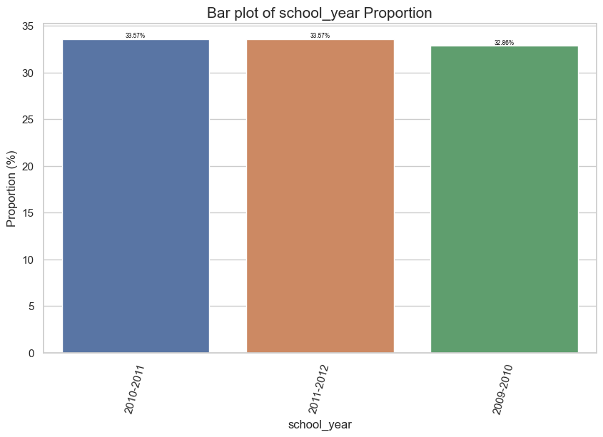
Univariate Analysis: school_year
Both the 2010-2011 and 2011-2012 school years have an equal number of schools in the dataset, accounting for 33.57% of the total
The 2009-2010 school year has a marginally lower representation, constituting 32.86% of the total number of schools.

Slide 11
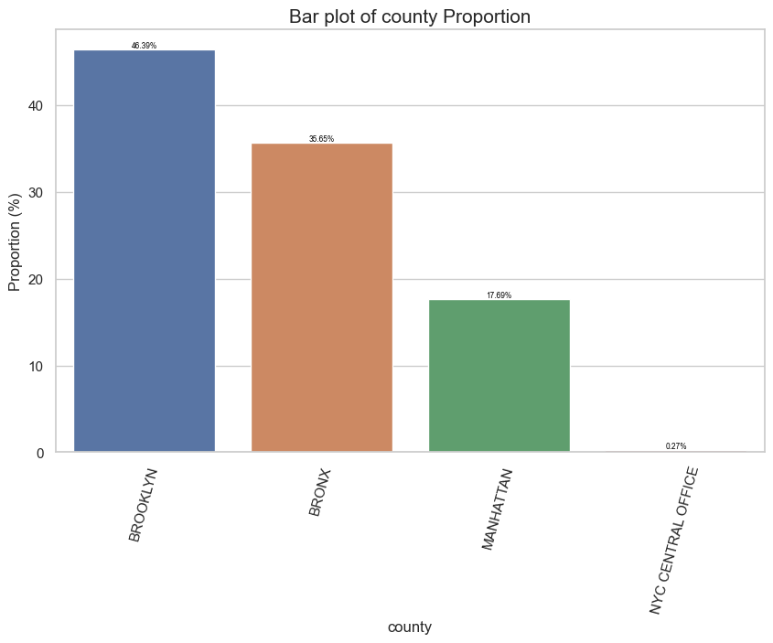
Univariate Analysis: county
The majority of schools in the dataset are located in Brooklyn, which has accounting for almost half of the total number of schools (46.39%).
The Bronx has the second-highest proportion of schools (35.65%), followed by Manhattan (17.69%).
The smallest count of schools is located in NYC Central Office with only 0.27% schools.

Slide 12
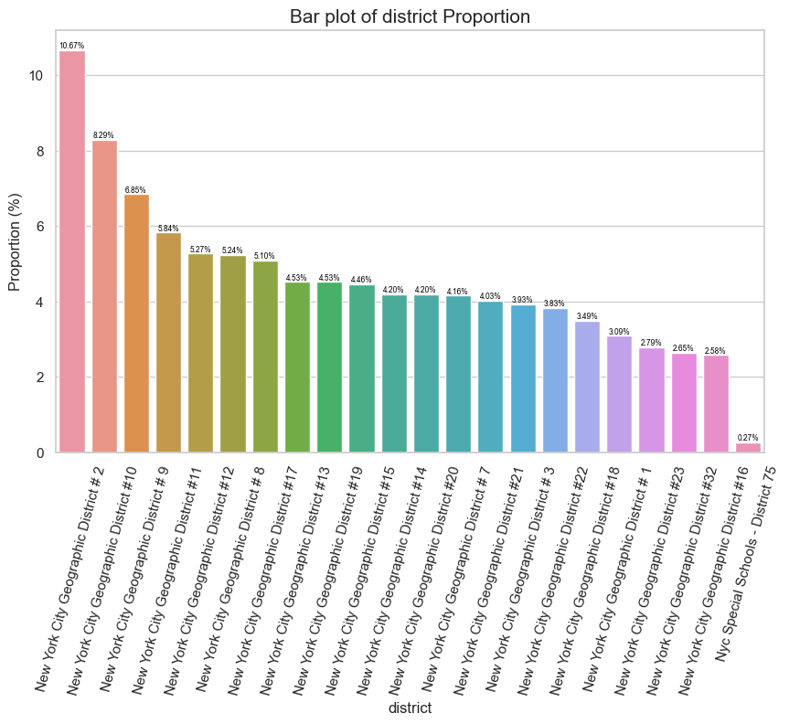
Univariate Analysis: district
Highest number of schools I the dataset:
New York City Geographic District # 2 has the highest number of schools with 10.67%.
Followed by New York City Geographic District #10 with 8.29% schools.
New York City Geographic District #9 with 6.85% schools.
Conversely, the three districts with the lowest number of schools:
New York City Geographic District #32 with 2.65% of schools.
New York City Geographic District #16 with 2.58% schools.
Nyc Special Schools - District 75 with only 0.27% schools in the dataset.

Slide 13
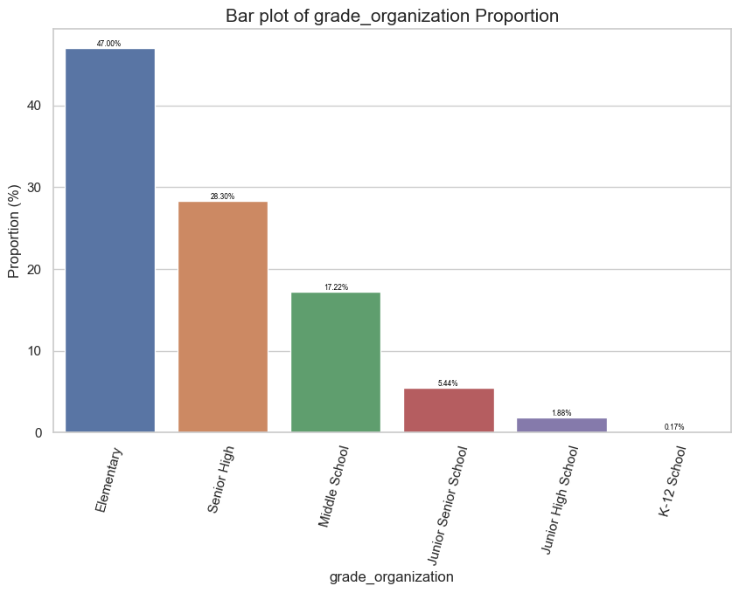
Univariate Analysis: grade_organization
Elementary schools 47.00%.
Senior high schools and middle schools also make up a significant portion of the dataset, with 28.30%, 17.22%..
Junior senior schools, junior high schools, and K-12 schools are relatively less common, with 5.44%, 1.88%, and 0.17%, school respectively.

Slide 14
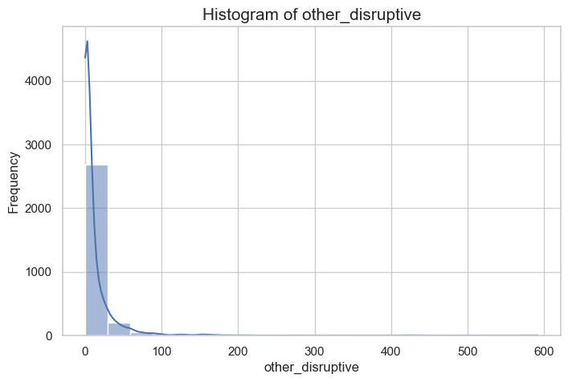
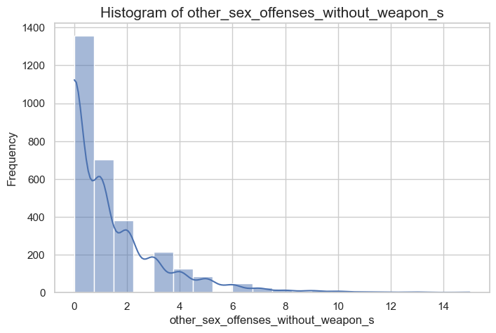
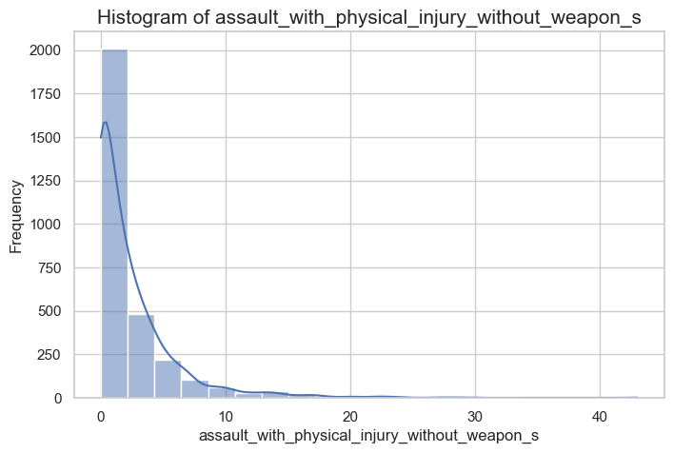
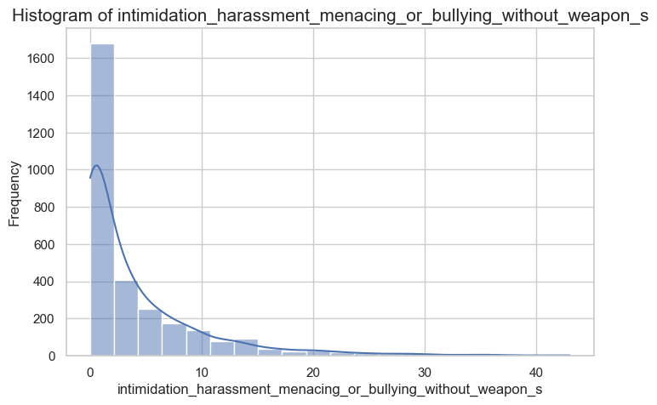
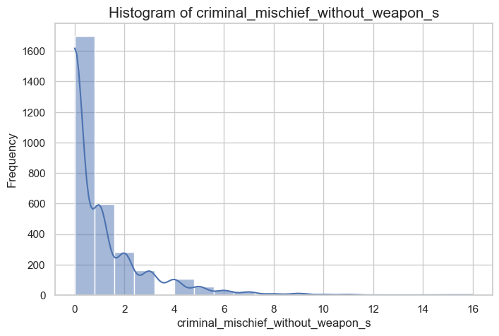
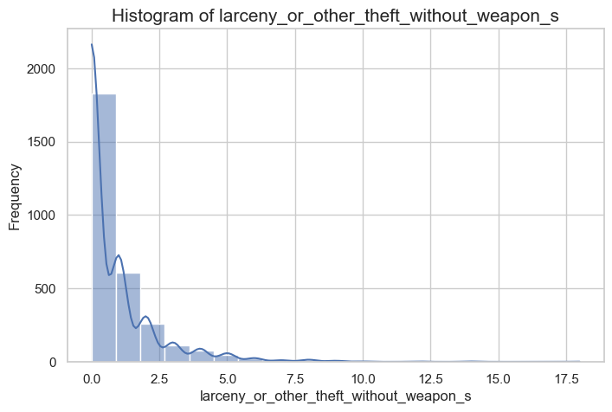
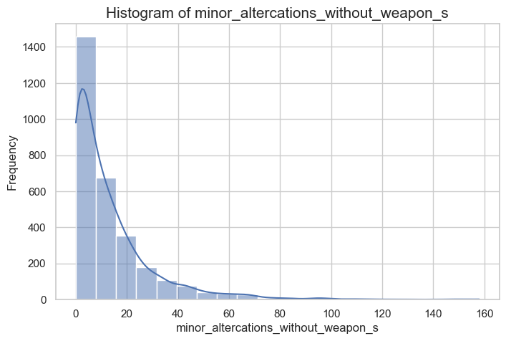
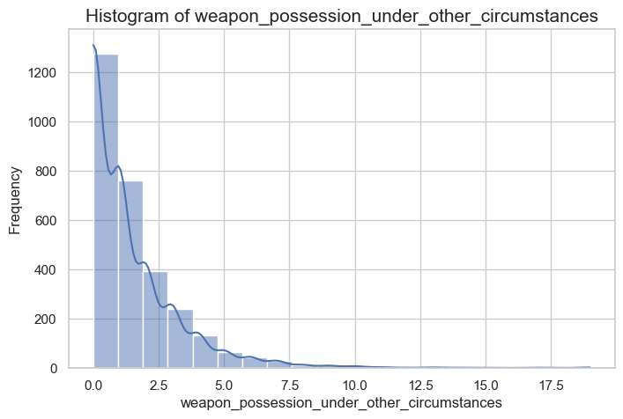
Univariate Analysis: top incidents reported
Top incident
Other Sex Offenses without Weapons
Assault With Physical Injury without Weapons
Minor Altercations without Weapons
Intimidation Harassment Menacing Or Bullying without Weapons
Criminal Mischief without Weapons
Larceny Or Other Theft without Weapons
Weapon Possession Under Other Circumstances
Other Disruptive

Slide 15
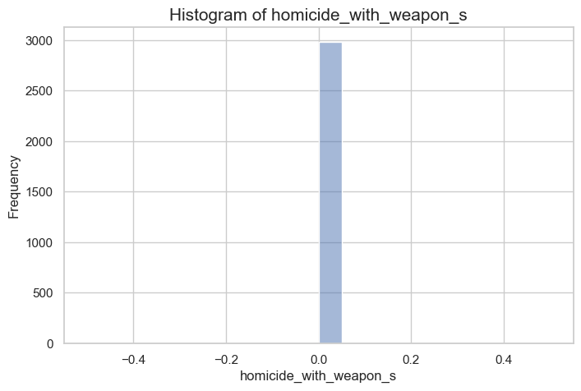
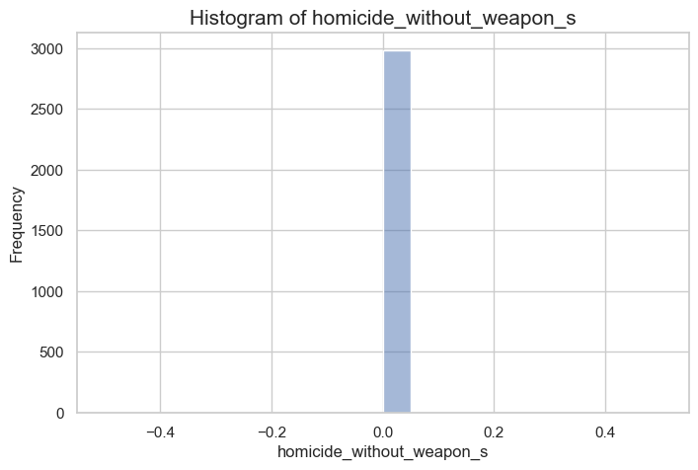
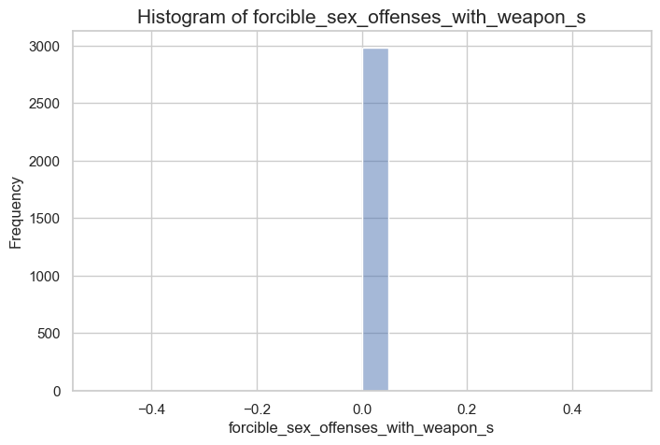
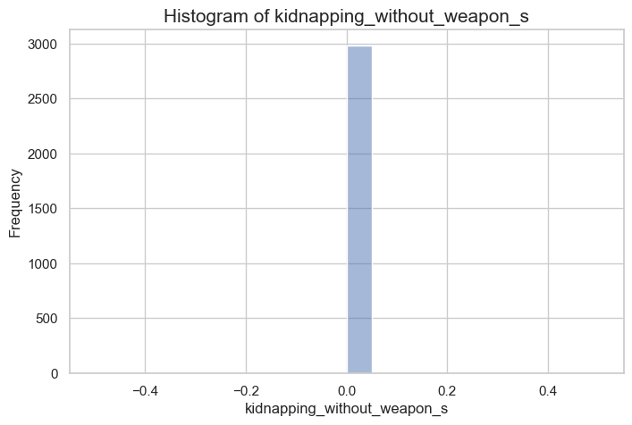
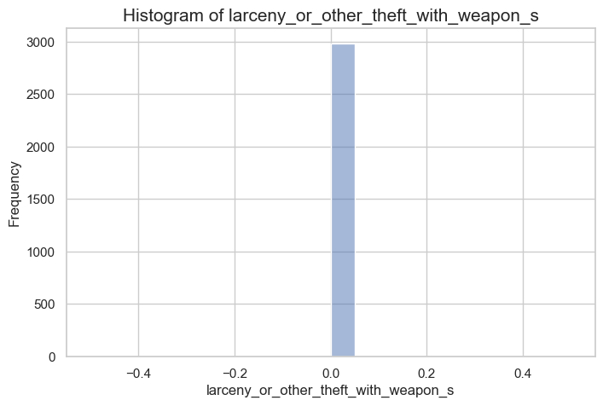
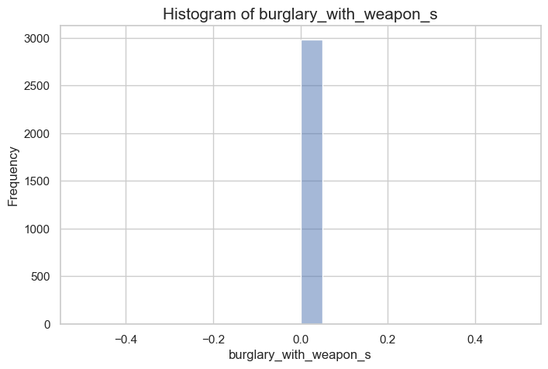
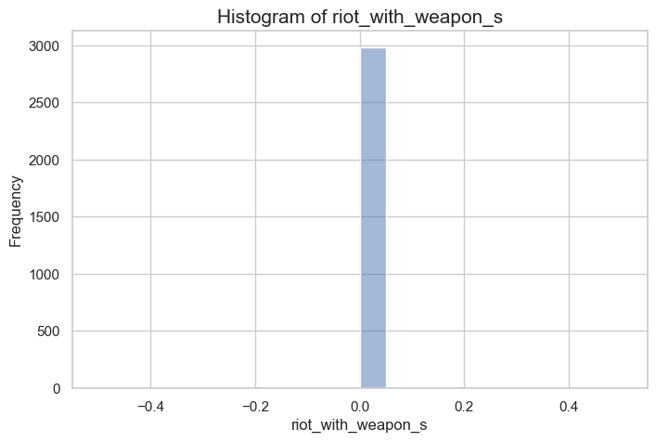
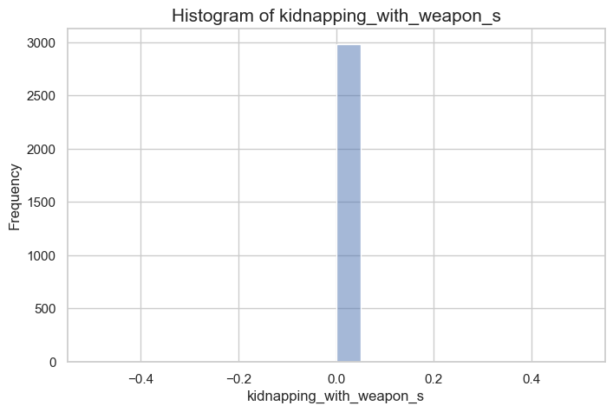
Univariate Analysis: no incident reported
0 incident reported
Homicide With Weapon
Homicide Without Weapon
Forcible Sex Offenses With Weapon
Kidnapping With Weapon
Kidnapping Without Weapon
Burglary With Weapon
Larceny Or Other Theft With Weapon
Riot With Weapon

Slide 16
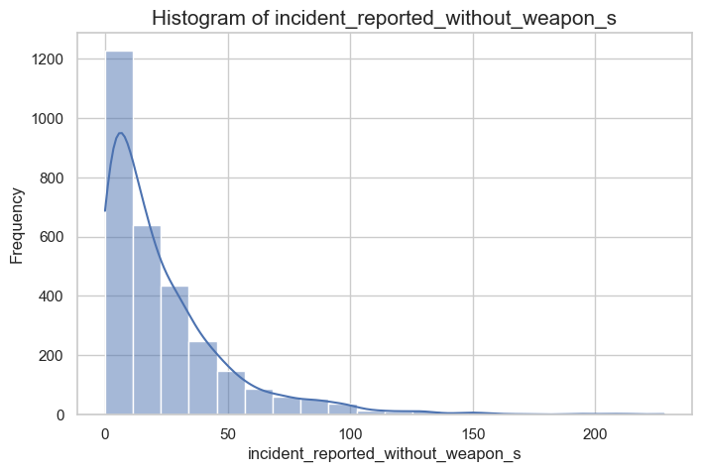
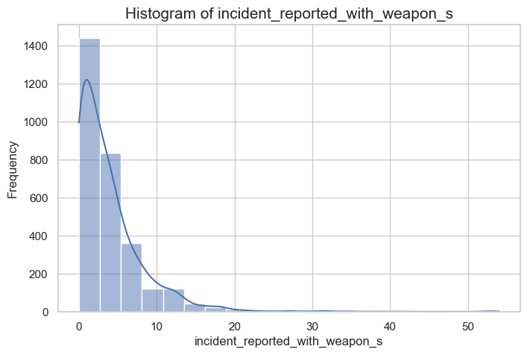
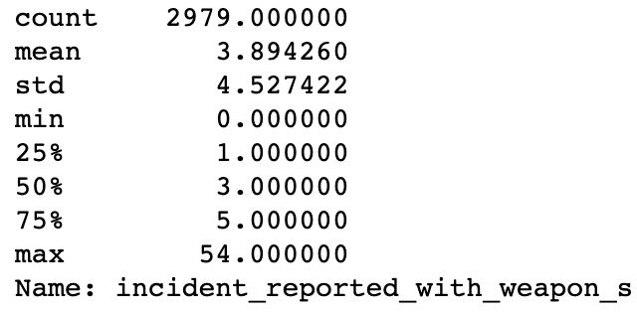
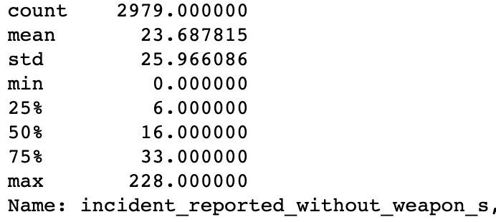
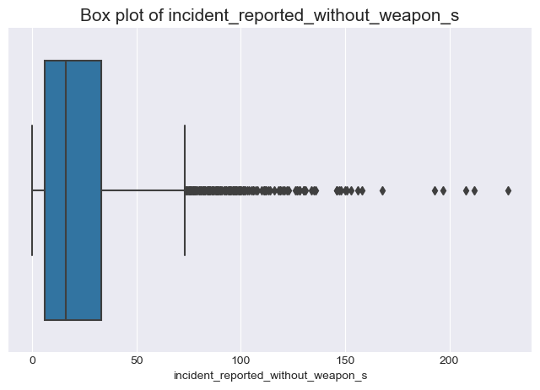
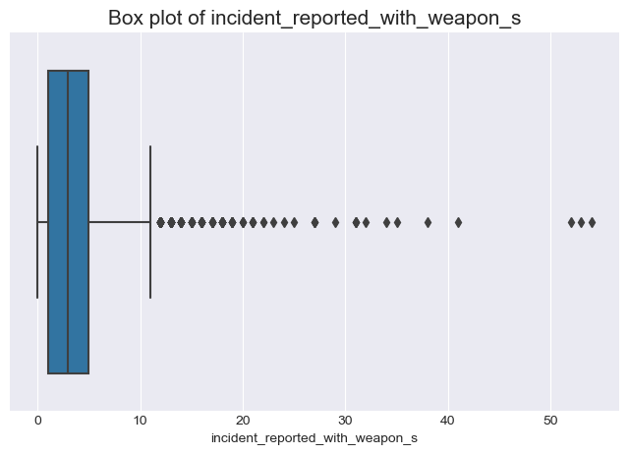
Univariate Analysis: incident with and without
Incidents without weapons occur more frequently than those with weapons
Mean of incidents without weapons: 23.69
Mean of incidents with weapons: 3.89
Median for incidents without weapons: 16
Median for incidents with weapons: 3
Higher standard deviation for incidents without weapons (25.97) compared to those with weapons (4.53)
Larger spread and variability in incidents without weapons

Slide 17
bivariate Analysis
County vs Incident reported with and without weapon
Grade_Organization vs Incident reported with and without weapon
District vs Incident reported with and without weapon

Slide 18
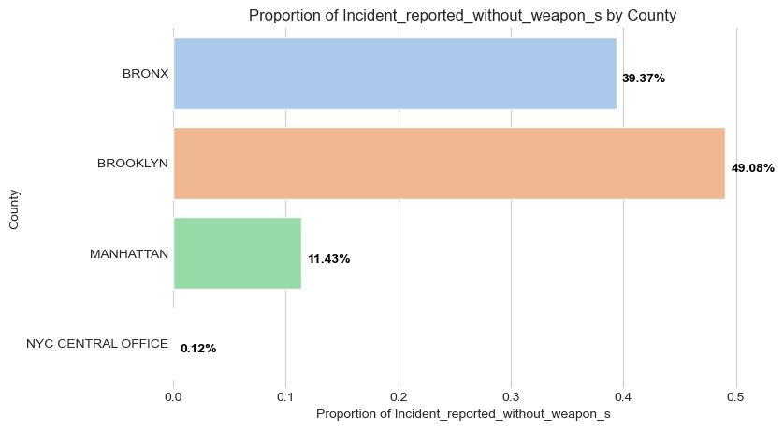
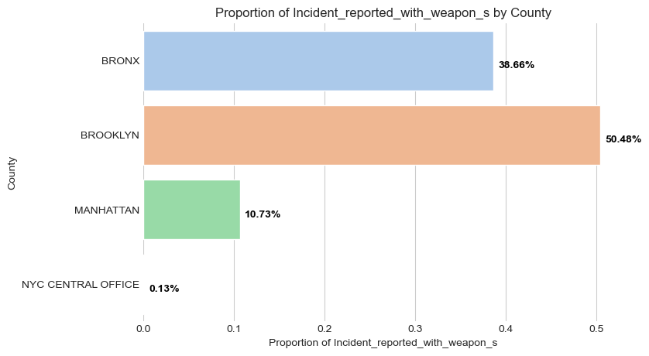
bivariate Analysis
County vs Incident reported with and without weapon
1. BROOKLYN:
Without weapon: 49.08% (lowest)
With weapon: 50.48% (highest)
2. BRONX:
Without weapon: 39.37% (highest)
With weapon: 38.66% (lowest)
3. MANHATTAN:
Without weapon: 11.43% (highest)
With weapon: 10.73% (lowest)
4. NYC CENTRAL OFFICE:
Without weapon: 0.12% (lowest)
With weapon: 0.13% (highest)

Slide 19
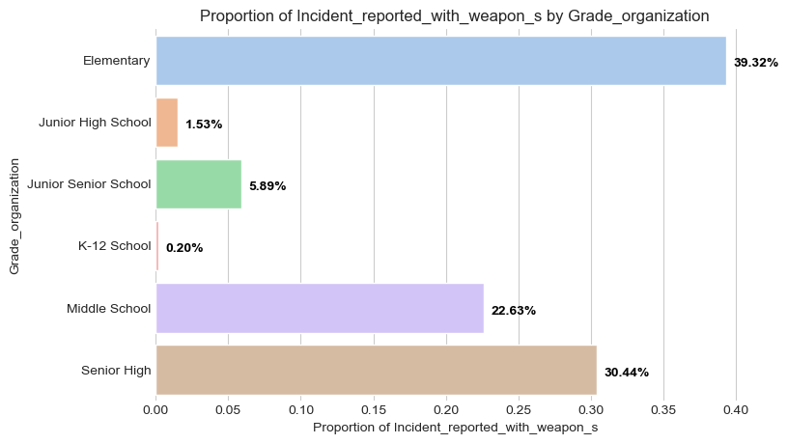
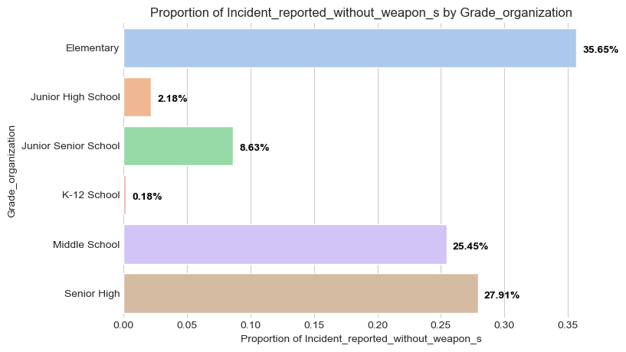
bivariate Analysis
Grade_Organization vs Incident reported with and without weapon
1. Elementary:
Without weapon: 35.65% (lowest)
With weapon: 39.32%
3. Middle School:
Without weapon: 25.45% highest)
With weapon: 22.63% (lowest)
5. Junior High School:
Without weapon: 2.18% (highest)
With weapon: 1.53% (lowest)
2. Senior High:
Without weapon: 27.91% (lowest)
With weapon: 30.44% (highest)
4. Junior Senior School:
Without weapon: 8.63% (highest)
With weapon: 5.89% (lowest)
6. K-12 School:
Without weapon: 0.18% (lowest)
With weapon: 0.20% (highest)

Slide 20
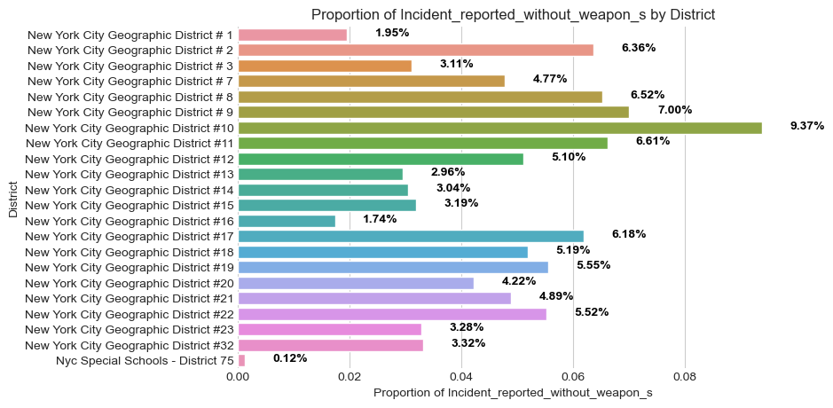
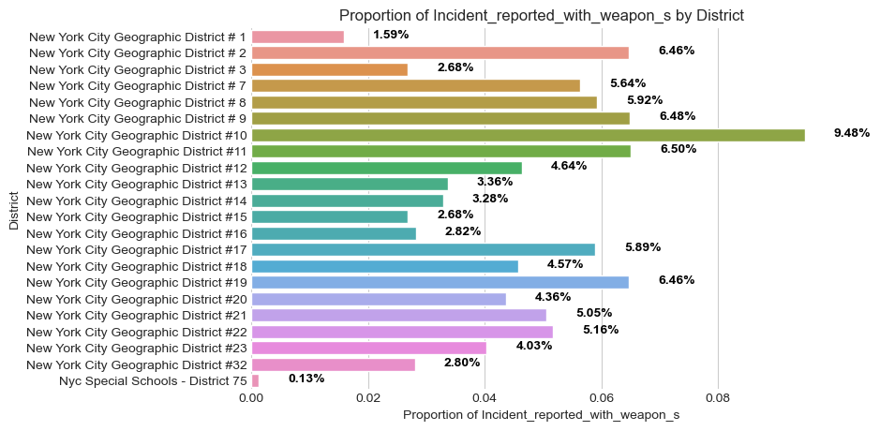
Bivariate Analysis
District vs Incident reported with and without weapon
Incidents reported without weapons by district:
3 Highest:
New York City Geographic District #10: 9.37%
New York City Geographic District #9: 7.00%
New York City Geographic District #8: 6.52%
3 Lowest:
New York City Geographic District #16: 1.74%
New York City Geographic District #23: 2.96%
New York City Geographic District #32: 3.04%
Incidents reported with weapons by district:
3 Highest:
New York City Geographic District #20: 7.43%
New York City Geographic District #10: 9.52%
New York City Geographic District #2: 10.34%
3 Lowest:
New York City Geographic District #16: 1.71%
New York City Geographic District #23: 2.02%
New York City Geographic District #32: 2.61%

Slide 21
Data preparation (for Feature engineering)
Looked at the top reported incidents in the span of 3 years:
Calculated the total value for each column
Got the columns with a total value of 500 or more
Filtered the data Frame to keep only the selected columns (top incident reported)
Created new data frame with top reported incidents
Combined all incidents related to:
drug_possession and alcohol_possession
assault
minor_altercations
intimidation_harassment_menacing_bullying
weapon_possession
Final data frame contains 19 attributes for feature engineering
Created dummies for – ‘grade-organization’, ‘county’ & ‘district’

Slide 22
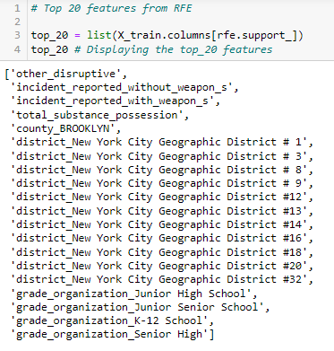
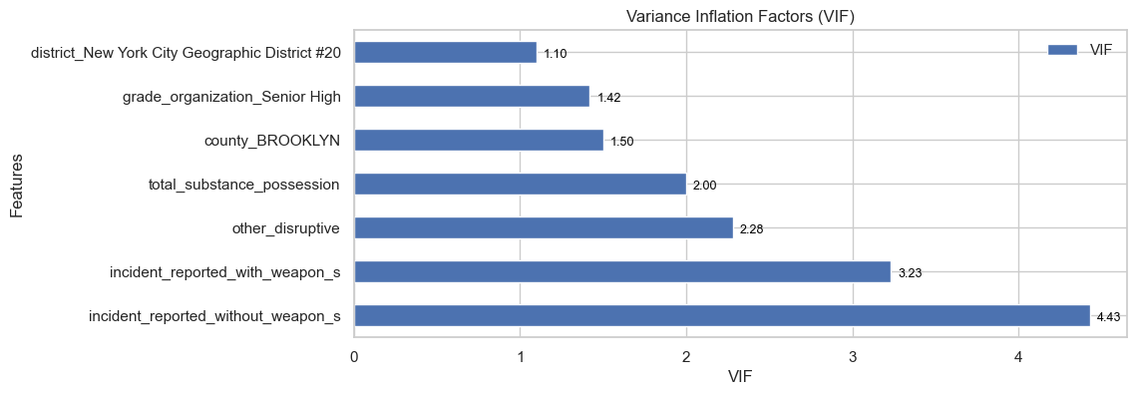
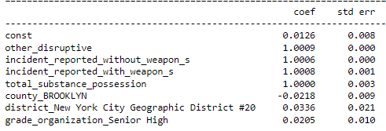
Feature engineering – Linear Regression
Why Linear Regression:
To predict the pattern of incidents
Simple & easy to interpret the relationship
Use RFE to find most important features & remove irrelevant ones
VIF to detect multicollinearity
Model Details: (Including VIF and RFE Features)
Detected high multicollinearity between independent variables
Removed features that has high VIF
Removed features with High p-value
3rd model had good p-values, VIF < 5 & almost all positive coefficients

Slide 23
Research Questions
What are the trends and patterns in school safety incidents reported in New York city public schools between 2009 and 2012?
What factors are associated with the incidence of school safety incidents in New York city public schools?
How do school safety incidents vary by grade level (elementary, middle, high) ?
Is there a relationship between the size of a school's enrolment and the number of incidents reported?
What would be the pattern of incidents in the coming year, based on the school's characteristics, such as location and student demographics?

Slide 24
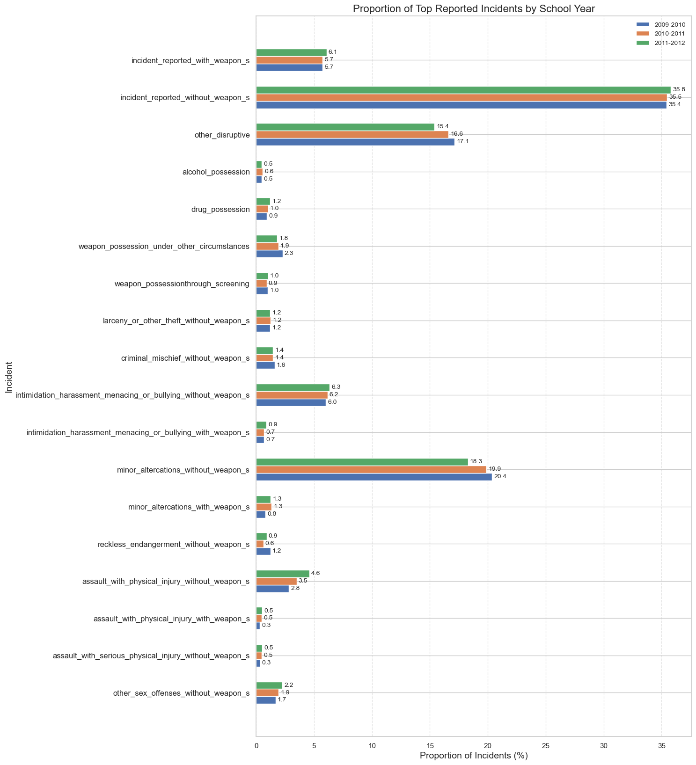
Research Question: What are the trends and patterns in school safety incidents reported in New York City public schools between 2009 and 2012?
Increased proportion for incidents:
"other sex offenses without weapon(s)“
"assault with serious physical injury without weapon(s)“
"assault with physical injury with weapon(s)“
"assault with physical injury without weapon(s)“
“weapon possession through screening“
Decreased in proportion for incidents:
"reckless endangerment without weapon(s)“
"minor altercations without weapon(s)“
"minor altercations with weapon(s)"
"intimidation, harassment, menacing or bullying with & without weapon(s)“
"weapon possession under other circumstances“
"alcohol possession,“
"criminal mischief without weapon(s)"
"other disruptive"

Slide 25
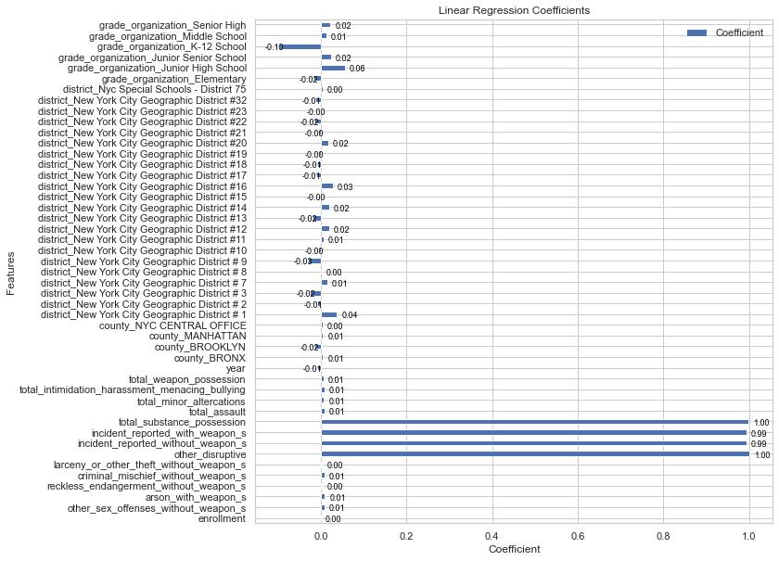
Research Question: What factors are associated with the incidence of school safety incidents in New York City public schools?
Enrollment: There is a positive correlation (0.376) between the enrollment size of a school and the total number of incidents reported. This suggests that schools with larger enrollments may experience more safety incidents.
Strong positive correlations:
Incidents without a weapon: (0.925)
Other disruptive incidents: (0.891)
Minor altercations: (0.886)
Intimidation, harassment, menacing, and bullying: (0.824) - Bullying and harassment are significant factors in school safety incidents.
Moderate positive correlations:
Substance possession: (0.492) - Drug and alcohol possession do contribute to the overall number of safety incidents in schools.

Slide 26
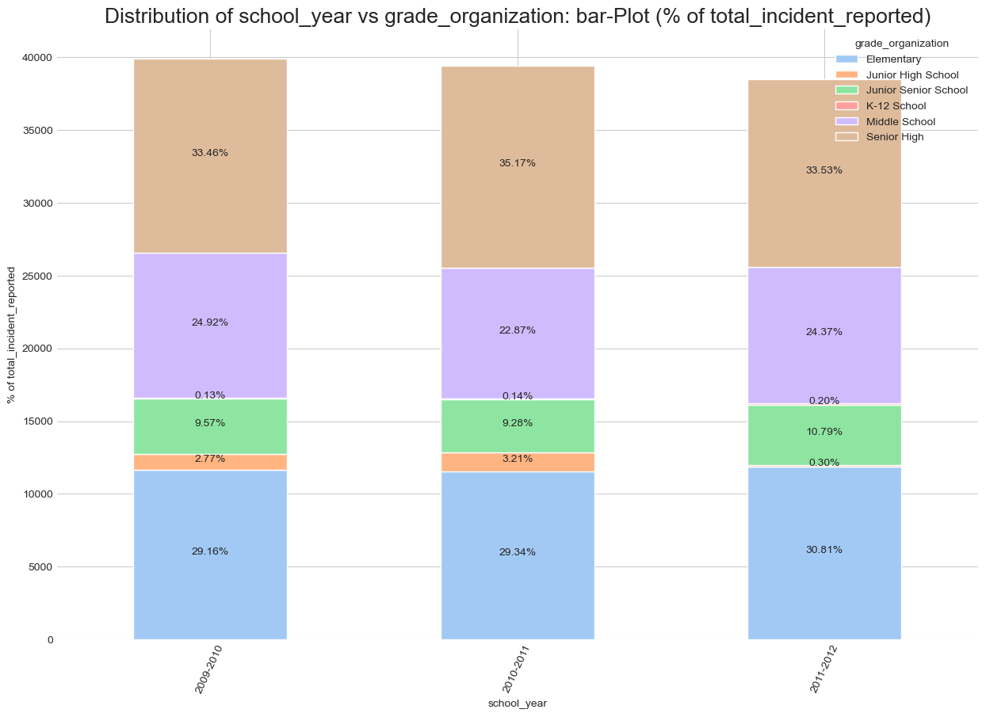
Research Question: How do school safety incidents vary by grade level (elementary, middle, high) ?
Elementary & Senior high schools combined contribute to > 60% of incidents every year
Elementary schools consistently reported the highest percentage of incidents every year – Safety issues.
Senior high schools reported the second highest percentage of incidents every year
Middle schools declined initially from 25% to 22% in 2010-2011 and then increased to 24% in 2011-2012.
Junior high schools and K-12 schools reported a very small percentage of total incidents, less than 5% combined each year.

Slide 27
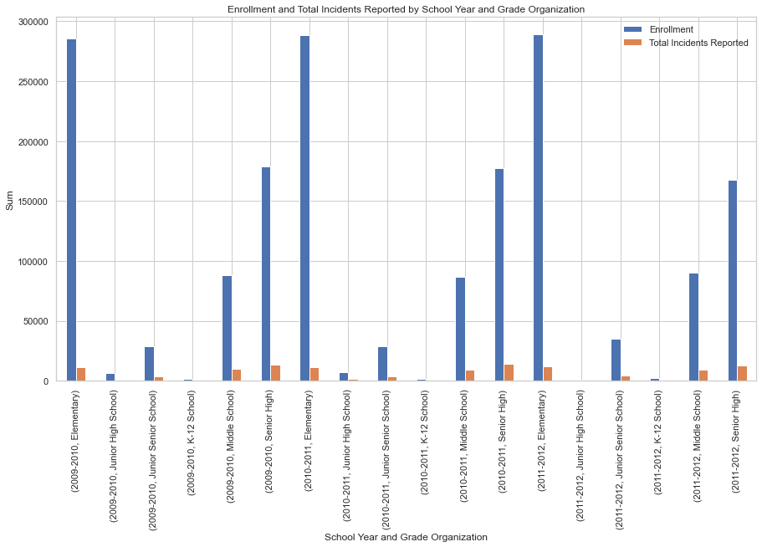
Research Question: Is there a relationship between the size of a school's enrolment and the number of incidents reported?
Schools with highest proportions of incidents to student enrollment across 3 years:
1) Junior high schools
2) Junior-senior schools
3) Middle schools
The proportions increased over time for junior high schools (16.63% to 9.71%) and junior-senior schools (13.38% to 11.91%).
Elementary schools and Senior high schools maintained relatively stable proportions of incidents to enrollment over 3 years,
Specialized K-12 schools saw a decrease in incident proportions.

Slide 28

Research Question: What would be the pattern of incidents in the coming year, based on the school's characteristics, such as location and student demographics?
Variables with coefficients close to ‘1’: Likely to continue
‘other_disruptive’ (1.000819)
‘incident_reported_without_weapon_s’ (0.996523)
‘incident_reported_with_weapon_s’ (0.994852)

Slide 29
Conclusions: Univariate & Bivariate
Univariate & Bivariate:
Majority of schools do not experience disruptive behavior violence, or substance abuse Incidents involving weapons are rare
Incidents without weapons, such as reckless endangerment and assault with physical injury, were more common
Serious violent incidents involving weapons are extremely rare or nonexistent
False alarms drained resources, requiring regular drills and monitoring for abuse
Disparities in enrollment, incidents, and false alarms across counties, districts, grade levels, and schools
Elementary schools faced disproportionate challenges, requiring early intervention and tailored support
High schools saw higher incident rates relative to enrollment and risks from student travel

Slide 30
Conclusions Research Questions
Research Questions:
Location and demographics alone cannot determine incident patterns, as suggested by the small coefficients associated with these factors.
Incidents with and without weapons will continue to contribute to the total number of incidents, as their respective coefficients are close to 1.
High-risk, high-need schools in the Bronx and Brooklyn require more support to address socio-economic and demographic factors influencing safety issues.
Early intervention through counselling and behavior development programs may help curb issues like bullying before they escalate, especially in elementary and high schools.
There were notable trends in incident rates from 2009 to 2012, requiring ongoing monitoring and targeted interventions.
Significant disparities in incident rates across districts and school types suggest the need for tailored policies and resource allocation.

Slide 31
VALUE TO STAKEHOLDERS
Targeted resource allocation: Disparities in incident rates across districts and schools should call for targeted funding and programs tailored to local needs.
Integrated policy approaches: Comprehensive solutions are needed to address the root causes of behavioral and safety issues, not just reactively discipline. Policies around education, mental health, community partnership and equity should be integrated.
Focus on positive cultures: Promoting inclusive school cultures where students feel empowered and supported is key to enabling healthy learning environments.
Balance prevention and intervention: A balanced approach is needed between monitoring severe incidents and security risks and broader preventive education to curb issues before they arise or escalate.
Regular data monitoring: Policymakers and administrators should track data regularly over multiple years to determine ongoing trends and identify new issues as they emerge. Partnership and transparency are key to finding comprehensive solutions to match the unique needs of each school community.

Slide 32
Any Questions?

Slide 33
Thank you

