Slide 1


Wolfgang Unger 3.2018

Slide 2
Amazon Elastic Container Service (Amazon ECS) is a highly scalable, fast, container management service that makes it easy to run, stop, and manage Docker containers on a cluster of Amazon EC2 instances.

Slide 3
Components
ECR – Elastic Container Registry
ECS – Elastic Container Services ( Cluster)
ECS2 Instances
Images ( Docker)
Task Definition
Service

Slide 4
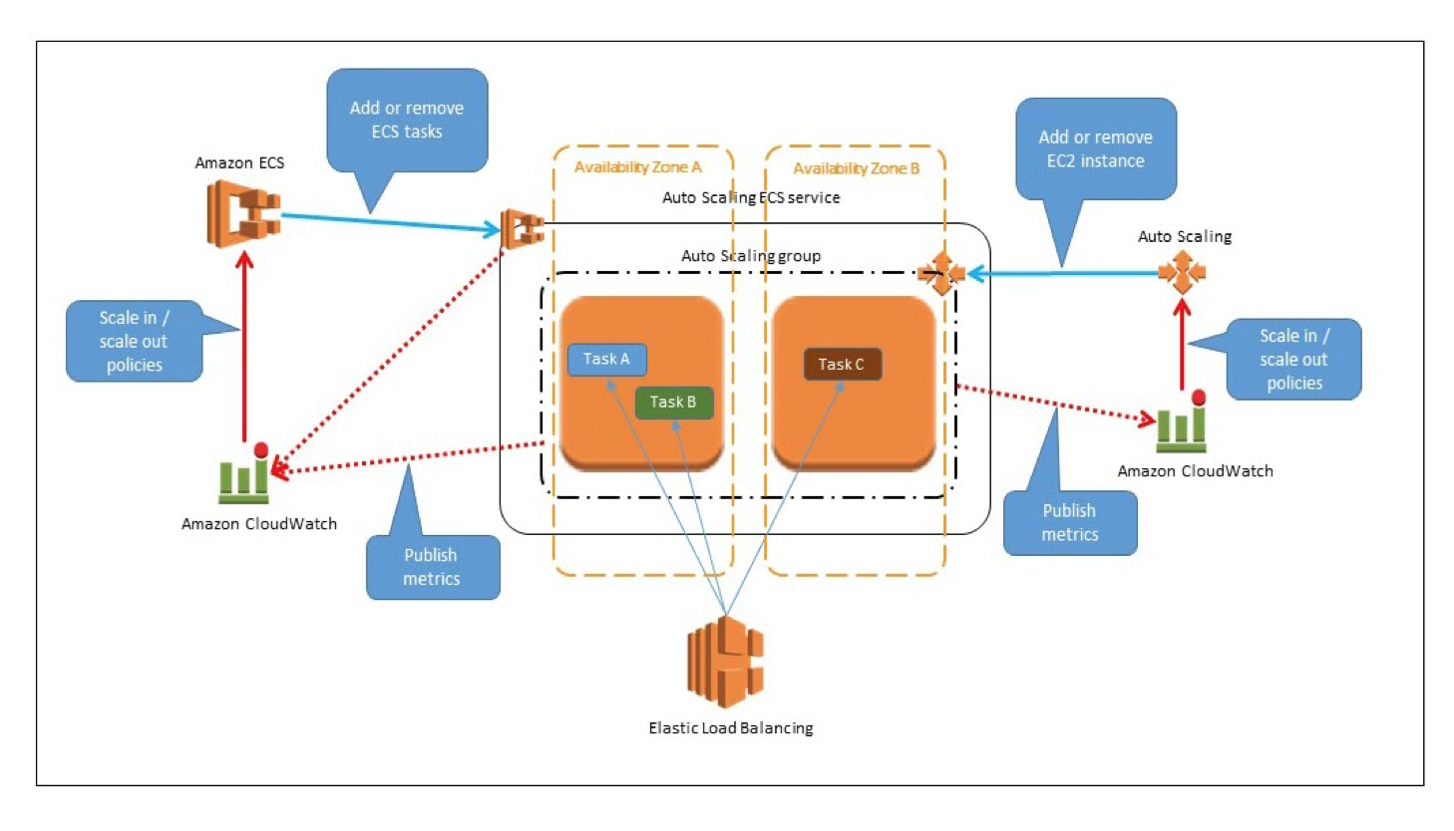
Architecture

Slide 5
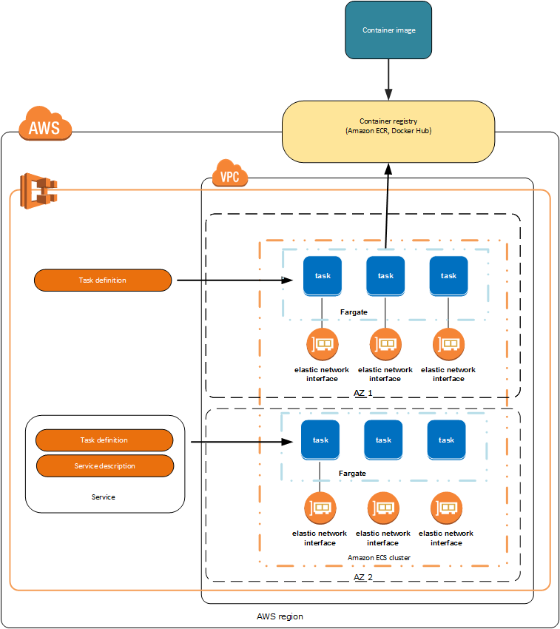
Architecture

Slide 6
Getting started
Required Infrastructure :
Create VPC
Create ECR
Create ECS ( Cluster : EC2 Instances, LoadBalancers, Security Groups, NATs etc)
CloudWatch Alarms for Scaling
Create Docker Image
Push Docker Image to ECR
Create Task Definition ( based on Docker Image)
Create Service ( based on Task Definition)
CloudWatch Alarms for Scaling

Slide 7
Docker Image and task defintion
Create and tag docker Image:
docker build -f src/main/docker/Dockerfile -t 0….xxx.dkr.ecr.eu-west-3.amazonaws.com/ecs-repository:spring-boot .
$(aws ecr get-login --region eu-west-3 --no-include-email)
docker push 0…xxx.dkr.ecr.eu-west-3.amazonaws.com/ecs-repository:spring-boot

Slide 8
Docker Image and task definition
Task Definition (Cloud Formation):
Resources:
TaskDefinition:
Type: AWS::ECS::TaskDefinition
Properties:
Family: !Ref AWS::StackName
NetworkMode: bridge
ContainerDefinitions:
- Name: !Ref AWS::StackName
Essential: true
Image: 0…xxx.dkr.ecr.eu-west-3.amazonaws.com/ecs-repository:spring-boot
Memory: 800
PortMappings:
- ContainerPort: 8080
LogConfiguration:
LogDriver: awslogs
Options:
awslogs-group: !Ref AWS::StackName
awslogs-region: !Ref AWS::Region

Slide 9
Service
Service Parameter:
VPC
Cluster
Task
Desired Count
Max Count
Optional:
Path ( Health Check)
Port (Container)
….

Slide 10
Service (CloudFormation)
Service (Cloud Formation):
Resources:
Service:
Type: AWS::ECS::Service
DependsOn: ListenerRule
Properties:
Cluster: !Ref Cluster
Role: !Ref ServiceRole
DesiredCount: !Ref DesiredCount
TaskDefinition: !Sub '${TaskDefinitionArn}'
LoadBalancers:
- ContainerName: !Sub '${TaskDefinition}'
ContainerPort: !Sub '${ContainerPort}'
TargetGroupArn: !Ref TargetGroup

Slide 11
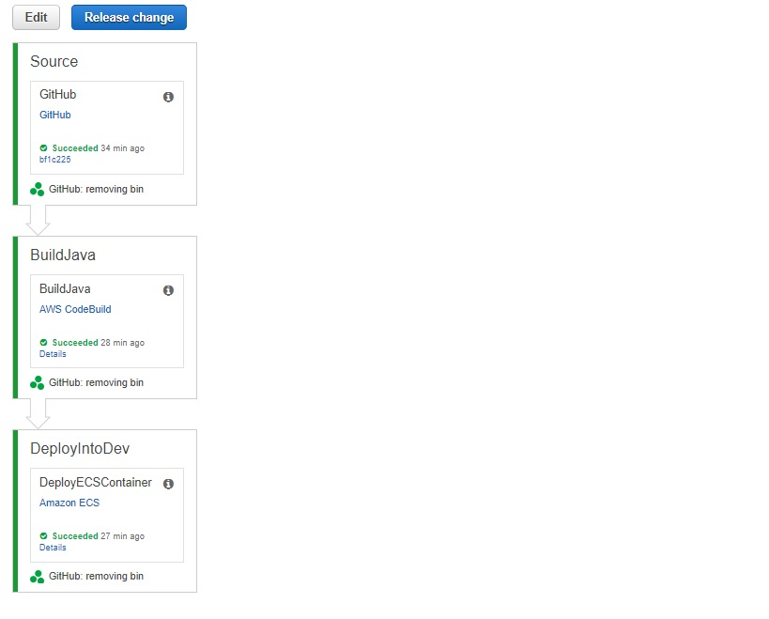
Code build / code pipeline

