Slide 1
Data Mining
-- Ashish Chandra jha

Slide 2
Basic Revision
1. What is Data Mining
Ans. Data Mining is the process of discovering hidden patterns in large amount of data. It’s end goal is to create a predictive model which provides appropriate insights of the data. These insights will further help to target customers at minimum cost, risk and fraud control etc.
According to SAS : Data Mining as advanced methods for exploring and modeling relationships in large amounts of data
Popular Data Mining Techniques
CRISP-DM (Cross-industry standard process for data mining)
KDD (Knowledge Discovery in Databases)
SEMMA (Sample, Explore, Modify, Model, Assess)

Slide 3
SEMMA

Slide 4
Introduction
The SEMMA process was developed by the SAS Institute. The acronym SEMMA stands for Sample,
Explore, Modify, Model, Assess, and refers to the process of conducting a data mining project. The SAS
Institute considers a cycle with 5 stages for the process:
1. Sample – This stage consists on sampling the data by extracting a portion of a large data set big enough to contain the significant information, yet small enough to manipulate quickly. This stage is pointed out as being optional.
2. Explore – This stage consists on the exploration of the data by searching for unanticipated trends and anomalies in order to gain understanding and ideas.

Slide 5
Continued…
3. Modify – This stage consists on the modification of the data by creating, selecting, and transforming the variables to focus the model selection process.
4. Model – This stage consists on modeling the data by allowing the software to search automatically for a combination of data that reliably predicts a desired outcome.
5. Assess – This stage consists on assessing the data by evaluating the usefulness and reliability of the findings from the data mining process and estimate how well it performs.

Slide 6
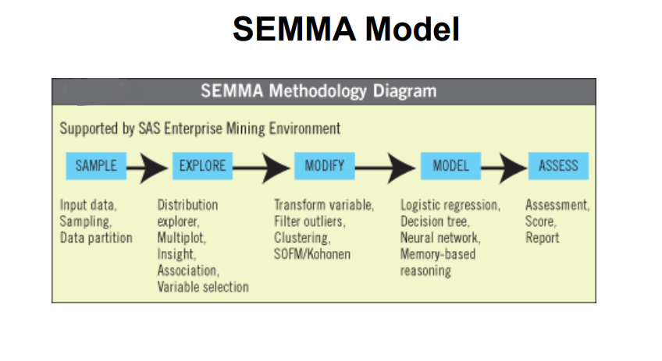

Slide 7
Pros of SEMMA
SEMMA offers an easy to understand process, allowing an organized and adequate development and maintenance of DM projects.
It thus confers a structure for his conception, creation and evolution, helping to present solutions to business problems as well as to find de DM business goals. (Santos & Azevedo, 2005)

Slide 8
Thank You

