Slide 1
BHARTI INFOTECH AND SERVICES
Bilaspur , Chhattisgarh
Introduction to Arduino

Slide 2
Open Source electronic prototyping platform based on flexible easy to use hardware and software.
  Getting started
  Download & install the Arduino environment (IDE) (not needed in lab)
  Connect the board to your computer via the USB cable
  If needed, install the drivers (not needed in lab)
  Launch the Arduino IDE
  Select your board
  Select your serial port
  Open the blink example
  Upload the program

Slide 3
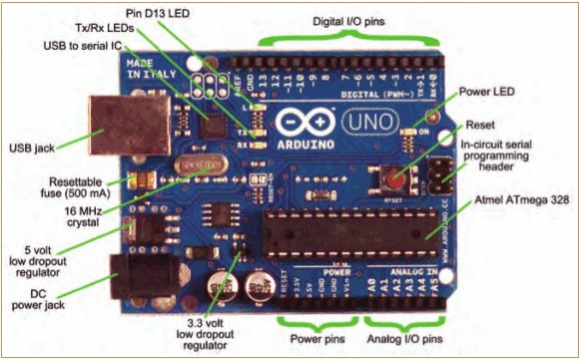
Arduino Uno

Slide 4
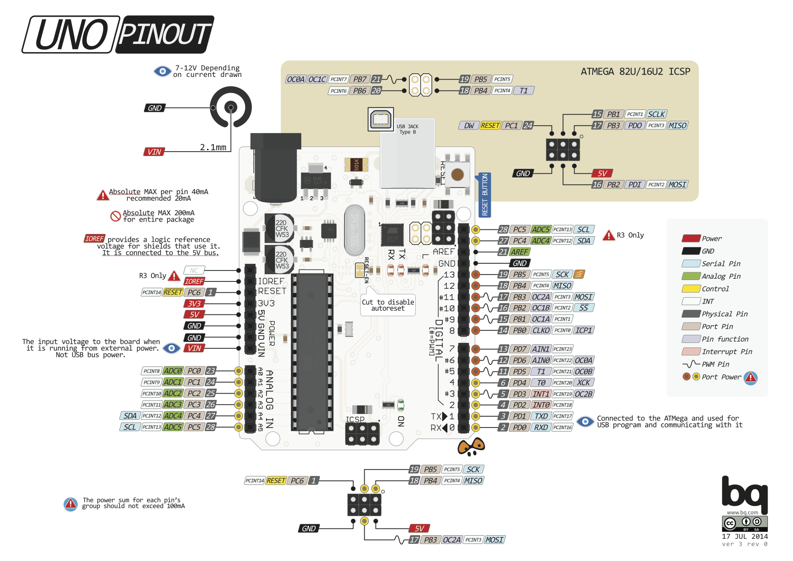

Slide 5
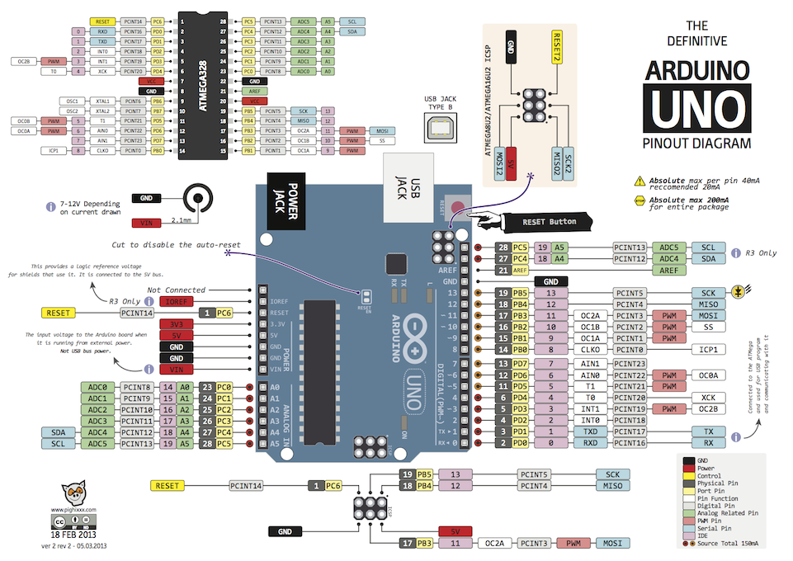

Slide 6
Bare minimum code
void setup() {
// put your setup code here, to run once:
}
void loop() {
// put your main code here, to run repeatedly:
}
Bare minimum code
setup : It is called only when the Arduino is powered on or reset. It is used to initialize variables and pin modes
loop : The loop functions runs continuously till the device is powered off. The main logic of the code goes here. Similar to while (1) for micro-controller programming.

Slide 7
Pin Mode
A pin on arduino can be set as input or output by using pinMode function.
pinMode(13, OUTPUT); // sets pin 13 as output pin
pinMode(13, INPUT); // sets pin 13 as input pin
Reading/writing digital values
digitalWrite(13, LOW); // Makes the output voltage on pin 13 , 0V
digitalWrite(13, HIGH); // Makes the output voltage on pin 13 , 5V
int buttonState = digitalRead(2); // reads the value of pin 2 in buttonState

Slide 8
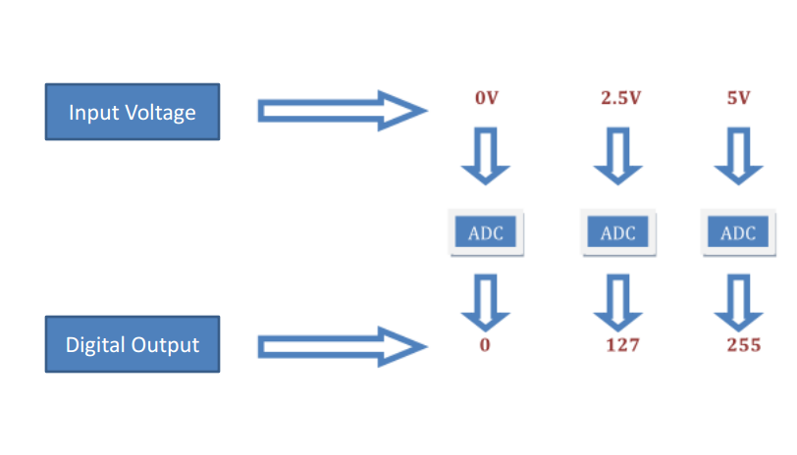
Analog to Digital Coversion
What is analog ?
It is continuous range of voltage values (not just 0 or 5V)
Why convert to digital ?
Because our microcontroller only understands digital.
Converting Analog Value to Digital

Slide 9
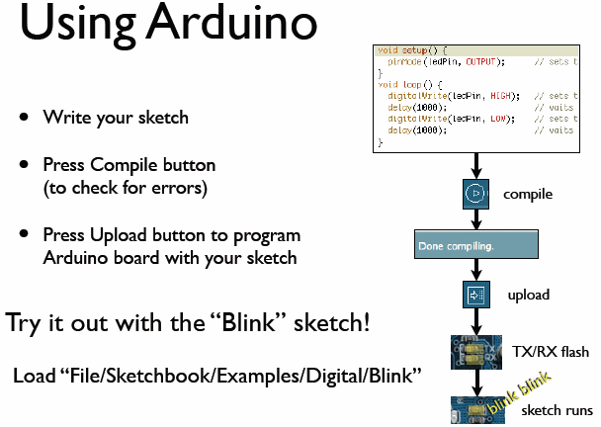

Slide 10
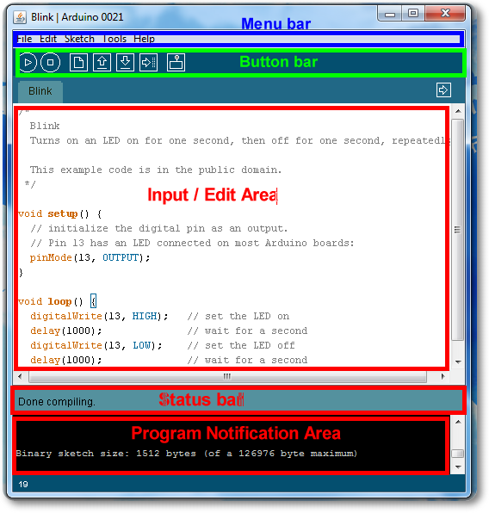
Arduino IDE

Slide 11
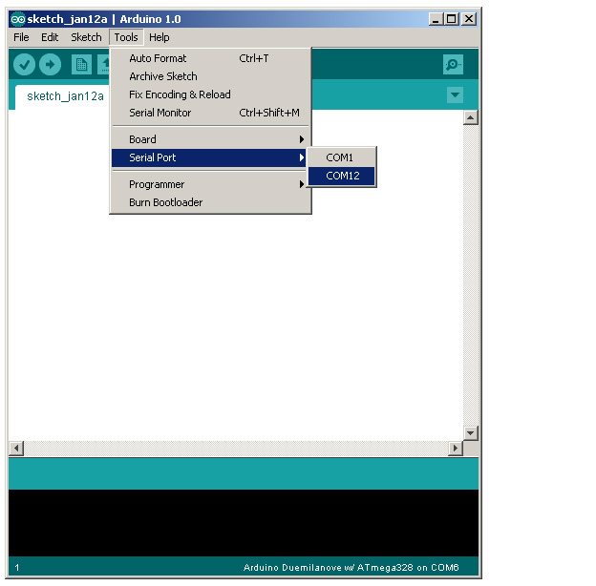
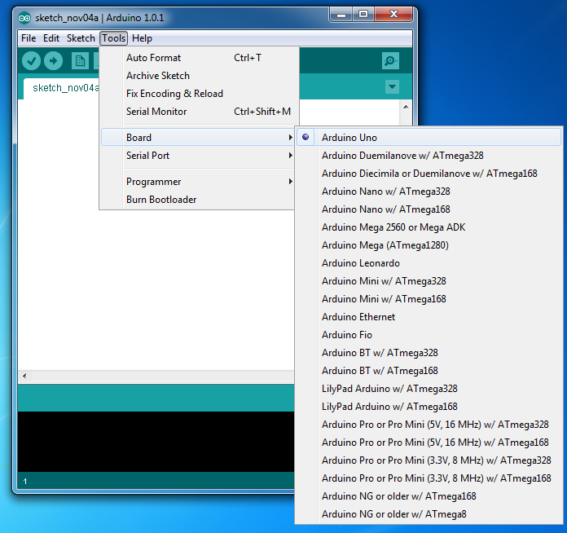
Select Serial Port and Board

Slide 12
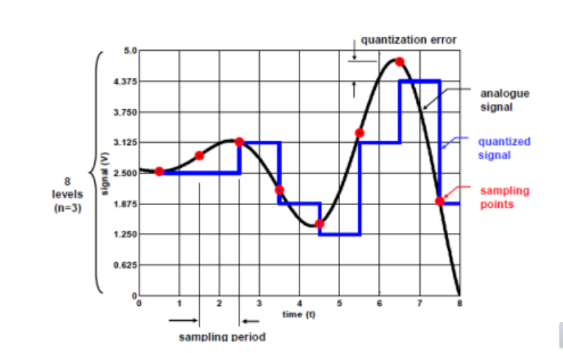
Quantanization the signal

Slide 13
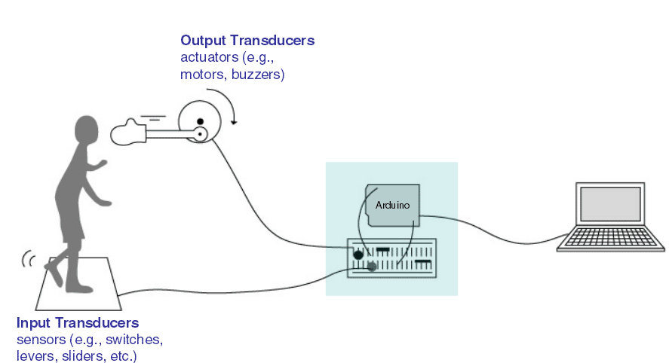
Input/Output
Image from Theory and Practice of Tangible User Interfaces at UC Berkley

Slide 14
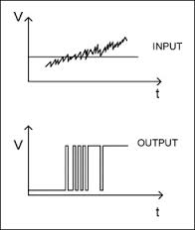
Digital Input/Output
Digital IO is binary valued—it’s either on or off, 1 or 0
Internally, all microprocessors are digital, why?
Electronic stuff
Output pins can provide 40 mA of current
  Writing HIGH to an input pin installs a 20KΩ pullup
1
0

Slide 15
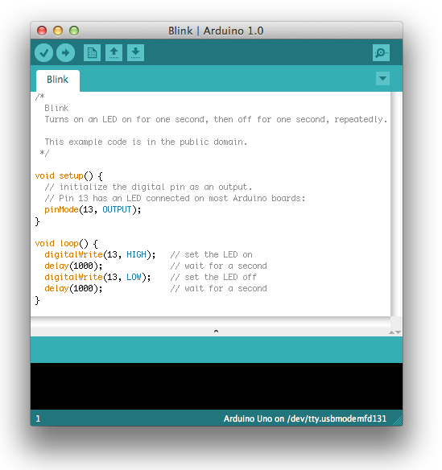
Our First Program

Slide 16
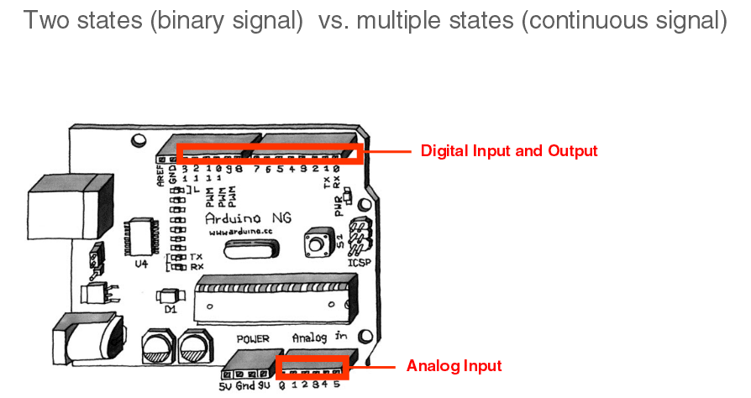
IO Pins

Slide 17
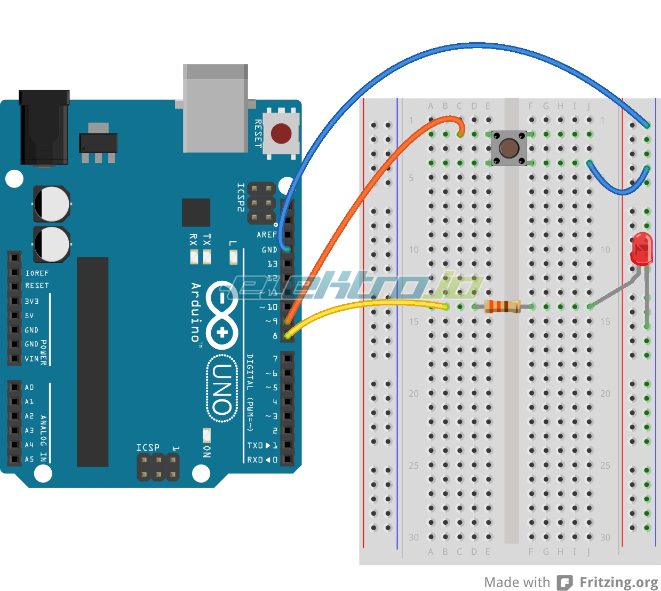
Digital IO
Use a push-button to turn ON/Off LED

Slide 18
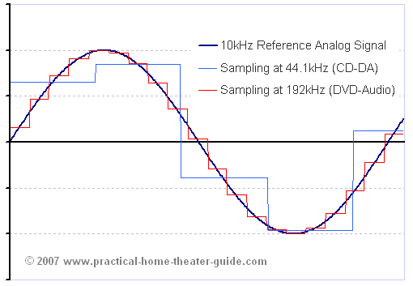
Analog Input
Think about music stored on a CD---an analog signal captured on digital media
  Sample rate
  Word length

Slide 19
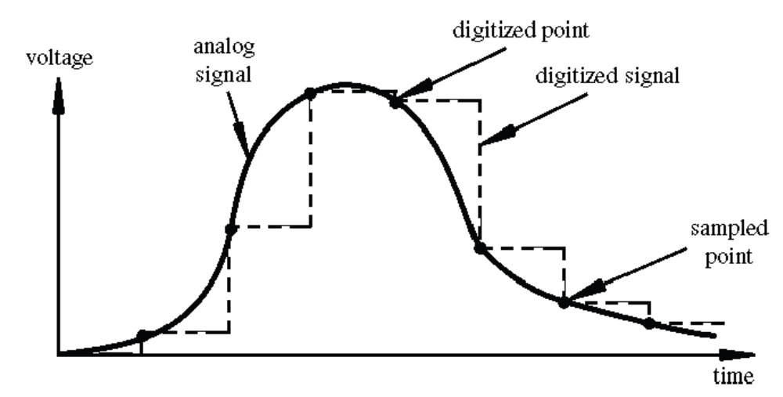
Arduino Analog Input
Resolution: the number of different voltage levels (i.e., states) used to discretize an input signal
Resolution values range from 256 states (8 bits) to 4,294,967,296 states (32 bits)
The Arduino uses 1024 states (10 bits)
Smallest measurable voltage change is 5V/1024 or 4.8 mV
Maximum sample rate is 10,000 times a second
Image credit: Tod Kurt

Slide 20
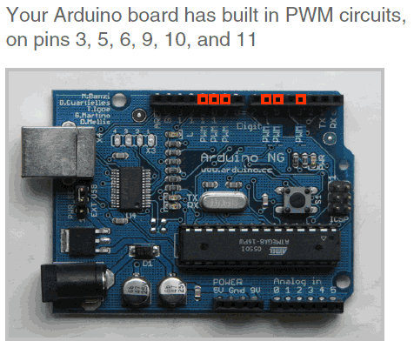
PMW Pins
Command: analogWrite(pin,value)
value is duty cycle: between 0 and 255
Examples:
analogWrite(9, 128)
for a 50% duty cycle
analogWrite(11, 64)
for a 25% duty cycle

Slide 21
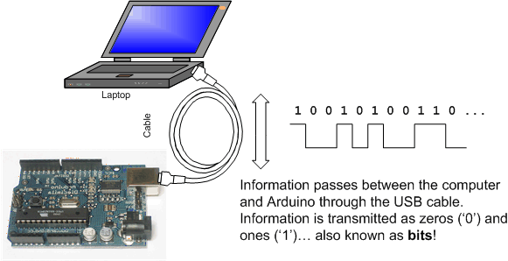
Serial Communication

Slide 22
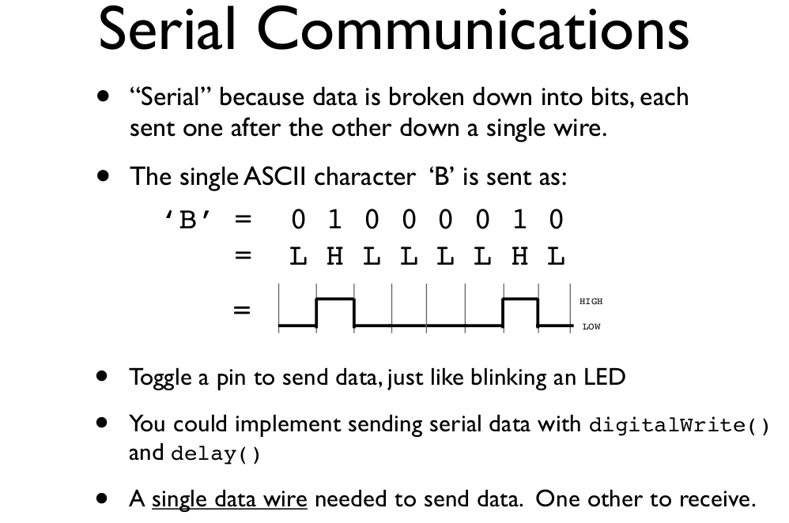
todbot.com/blog/bionicarduino

Slide 23
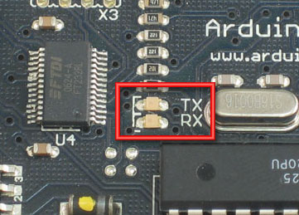
Serial Communication
Compiling turns your program into binary data (ones and zeros)
Uploading sends the bits through USB cable to the Arduino
The two LEDs near the USB connector blink when data is transmitted
  RX blinks when the Arduino is receiving data
  TX blinks when the Arduino is transmitting data
todbot.com/blog/bionicarduino

Slide 24
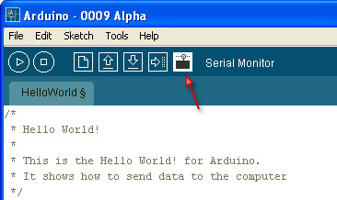
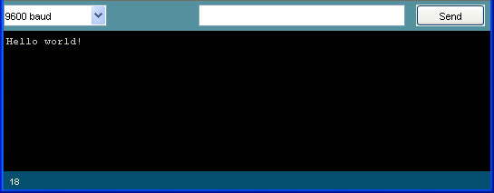
Open the Serial Monitor and Upload the Program

Slide 25
Some Commands
Serial.begin()
- e.g., Serial.begin(9600)
Serial.print() or Serial.println()
- e.g., Serial.print(value)
Serial.read()
Serial.available()
Serial.write()
Serial.parseInt()

Slide 26
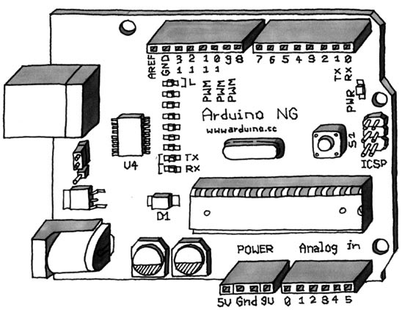
Example program
Serial-to-USB chip---what does it do?
The LilyPad and Fio Arduino require an external USB to TTY connector, such as an FTDI “cable”.
In the Arduino Leonardo a single microcontroller runs the Arduino programs and handles the USB connection.

Slide 27
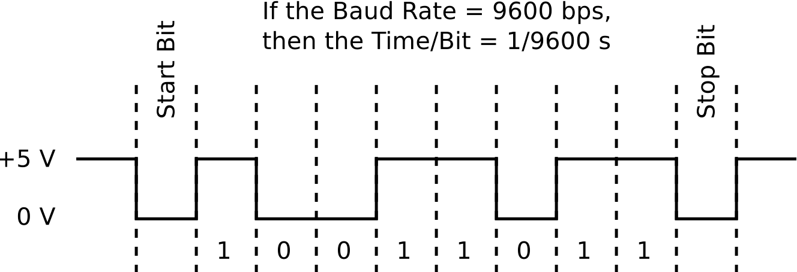
Two different communication protocols
Serial (TTL):

Slide 28
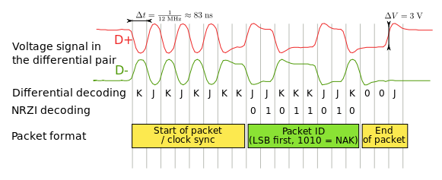
USB Protocol
Image from http://en.wikipedia.org/wiki/USB

Slide 29
Serial Communication
Modify your program from in-class exercise 2-part 2 to control the intensity of the LED attached to pin 9 based on keyboard input.
Use the Serial.parseInt() method to read numeric keyboard input as an integer.
An input of 9 should produce full intensity and an input of 0 should turn the LED off.

Slide 30
ADC Example
// These constants won't change. They're used to give names to the pins used:
const int analogInPin = A0; // Analog input pin that the potentiometer is attached to
const int analogOutPin = 9; // Analog output pin that the LED is attached to
int sensorValue = 0; // value read from the pot
int outputValue = 0; // value output to the PWM (analog out)
void setup() {
// initialize serial communications at 9600 bps:
Serial.begin(9600);
}
void loop() {
// read the analog in value:
sensorValue = analogRead(analogInPin);
// map it to the range of the analog out:
outputValue = map(sensorValue, 0, 1023, 0, 255);
// change the analog out value:
analogWrite(analogOutPin, outputValue);
// print the results to the serial monitor:
Serial.print("sensor = " );
Serial.print(sensorValue);
Serial.print("\t output = ");
Serial.println(outputValue);
// wait 2 milliseconds before the next loop
// for the analog-to-digital converter to settle
// after the last reading:
delay(2);
}

