Slide 1
BHARTI INFOTECH AND SERVICES
Bilaspur , Chhattisgarh
Introduction to Relay

Slide 2
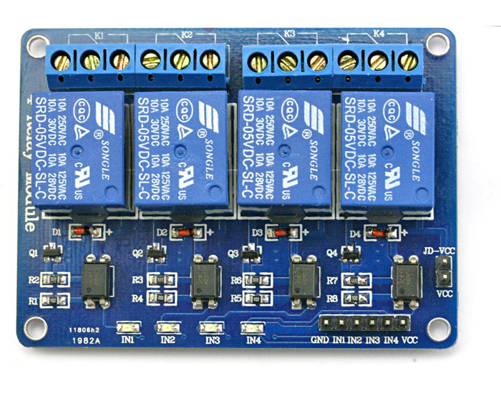
10
Relay Board
A 4 – channel relay board is used in this project to control four different loads. It has all the necessary components and connections like base current limiting resistor, flyback diode, LED indicators and header for connecting it to other devices.
Caution: We should be very careful when using a relay with AC mains.

Slide 3
The Arduino 4 Relays Shield is a solution for driving high power loads that cannot be controlled by Arduino's digital IOs, due to the current and voltage limits of the controller.
The Shield features four relays, each relay provides 2 pole changeover contacts (NO and NC); in order to increase the current limit of each output the 2 changeover contacts have been put in parallel. Four LEDs indicate the on/off state of each relay.
Summary
Operating Voltage 5V
Coil current consumption 140 mA (with all releays on, about 35 mA
each)
Single pole chargeover contact @ 30 V DC 2A
maximum current
Maximum load voltage 48 V
Maximum switching capacity 60 W

Slide 4
Power
The shield doesn't need external power: it will be provided by the base board, through the 5V and 3.3V pins of the Arduino board used as base.
Input and Output
The relays are controlled by the following Arduino board pins:
Relay 1 = Arduino pin 4
Relay 2 = Arduino pin 7
Relay 3 = Arduino pin 8
Relay 4 = Arduino pin 12

Slide 5
The on-board connectors are
2 TinkerKit Inputs: IN2 and IN3 (in white), these connectors are routed to the Arduino A2 and A3 analog input pins
2 TinkerKit Outputs: OUT5 and OUT6 (in orange), these connectors are routed to the Arduino PWM outputs on pins 5 and 6
2 TinkerKit TWI: these connectors (4-pin in white) are routed on the Arduino TWI interface. Both connect to the same TWI interface to allow you to create a chain of TWI devices.

Slide 6
Compatibility
The shield is compatible with all the Arduino boards, 5V and also 3.3V standards
Physical Characteristics
The maximum length and width of the 4 Relays Shield PCB are 2.7 and 2.1 inches respectively. Four screw holes allow the Shield to be attached to a surface or case. Note that the distance between digital pins 7 and 8 is 160 mil (0.16"), not an even multiple of the 100 mil spacing of the other pins.

Slide 7
