Slide 1
BHARTI INFOTECH AND SERVICES
Bilaspur , Chhattisgarh
Introduction to Sensors

Slide 2
Introduction
To be useful, systems must interact with their environment. To do this they use sensors and actuators
Sensors and actuators are examples of transducers
A transducer is a device that converts one physical quantity into another
- examples include:
a mercury-in-glass thermometer (converts temperature into displacement of a column of mercury)
a microphone (converts sound into an electrical signal).
We will look at sensors in this lecture and at actuators in the next lecture.

Slide 3
Almost any physical property of a material that changes in response to some excitation can be used to produce a sensor
- widely used sensors include those that are:
resistive
inductive
capacitive
piezoelectric
photoresistive
elastic
thermal.

Slide 4
Describing Sensor Performance
Range
maximum and minimum values that can be measured
Resolution or discrimination
smallest discernible change in the measured value
Error
difference between the measured and actual values
random errors
systematic errors
Accuracy, inaccuracy, uncertainty
accuracy is a measure of the maximum expected error

Slide 5
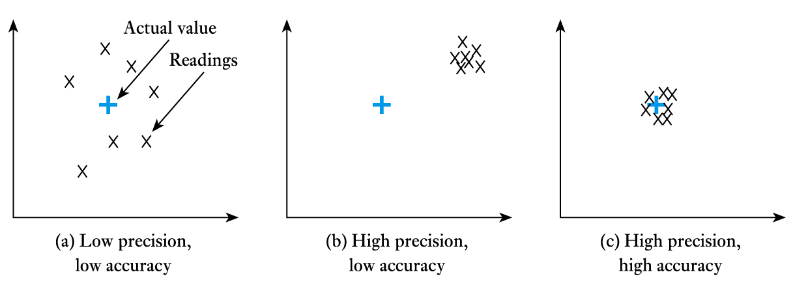
Precision
- a measure of the lack of random errors (scatter)

Slide 6
Linearity
- maximum deviation from a ‘straight-line’ response
- normally expressed as a percentage of the full-scale value
Sensitivity
- a measure of the change produced at the output for a given change in the quantity being measured

Slide 7
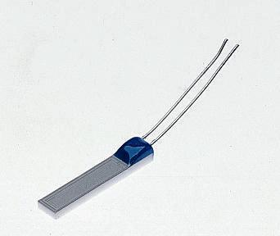
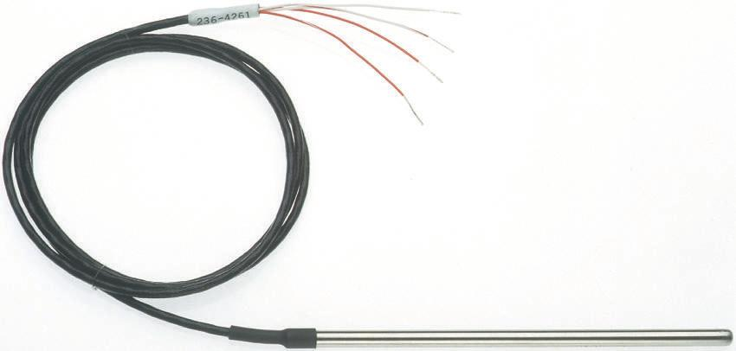
Temperature sensors
Resistive thermometer
- typical devices use platinum wire (such a device is called a platinum resistance thermometers or PRT)
- linear but has poor sensitivity
A typical PRT element
A sheathed PRT

Slide 8
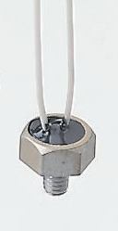
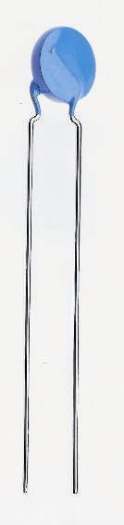
Thermistors
use materials with a high thermal coefficient of resistance
Sensitive but highly non-linear
A typical disc thermistor A threaded thermistor

Slide 9
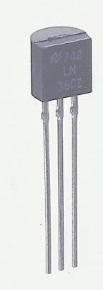
pn junctions
a semiconductor device with the properties of a diode (we will consider semiconductors and diodes later)
inexpensive, linear and easy to use
limited temperature range (perhaps -50°C to 150 °C) due to nature of semiconductor material
pn-junction sensor

Slide 10
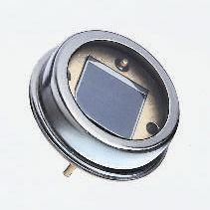
Light Sensors
Photovoltaic
light falling on a pn-junction can be used to generate electricity from light energy (as in a solar cell)
small devices used as sensors are called photodiodes
fast acting, but the voltage produced is not linearly related to light intensity
A typical photodiode

Slide 11
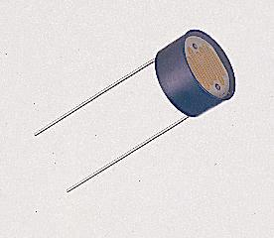
Photoconductive
such devices do not produce electricity, but simply change their resistance
photodiode (as described earlier) can be used in this way to produce a linear device
phototransistors act like photodiodes but with greater sensitivity
light-dependent resistors (LDRs) are slow, but respond like the human eye
A light-dependent resistor (LDR)

Slide 12

Force Sensors
Strain gauge
stretching in one direction increases the resistance of the device, while stretching in the other direction has little effect
can be bonded to a surface to measure strain
used within load cells and pressure sensors
Direction of sensitivity
A strain gauge

Slide 13
Displacement Sensors
Potentiometers
resistive potentiometers are one of the most widely used forms of position sensor
can be angular or linear
consists of a length of resistive material with a sliding contact onto the resistive track
when used as a position transducer a potential is placed across the two end terminals, the voltage on the sliding contact is then proportional to its position
an inexpensive and easy to use sensor

Slide 14
Motion Sensors
Motion sensors measure quantities such as velocity and acceleration
can be obtained by differentiating displacement
differentiation tends to amplify high-frequency noise
Alternatively can be measured directly
some sensors give velocity directly
e.g. measuring frequency of pulses in the counting techniques described earlier gives speed rather than position
some sensors give acceleration directly
e.g. accelerometers usually measure the force on a mass

Slide 15
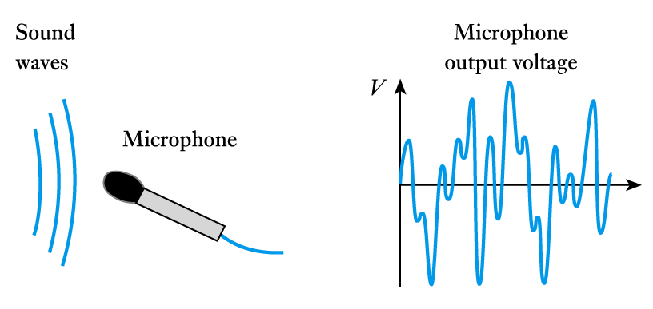
Sound Sensors
Microphones
a number of forms are available
e.g. carbon (resistive), capacitive, piezoelectric and moving-coil microphones
moving-coil devices use a magnet and a coil attached to a diaphragm – we will discuss electromagnetism later

Slide 16
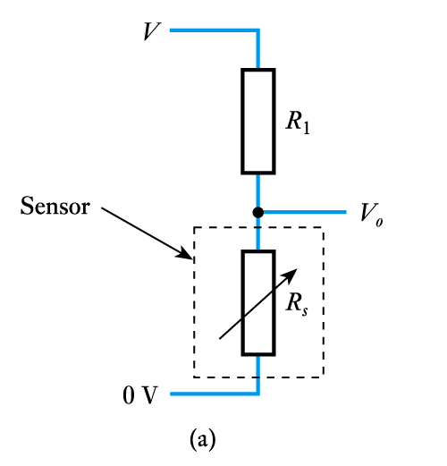
Sensor Interfacing
Resistive devices
can be very simple
e.g. in a potentiometer, with a fixed voltage across the outer terminals, the voltage on the third is directly related to position
where the resistance of the device changes with the quantity being measured, this change can be converted into a voltage signal using a potential divider – as shown
the output of this arrangement is not linearly related to the change in resistance

Slide 17
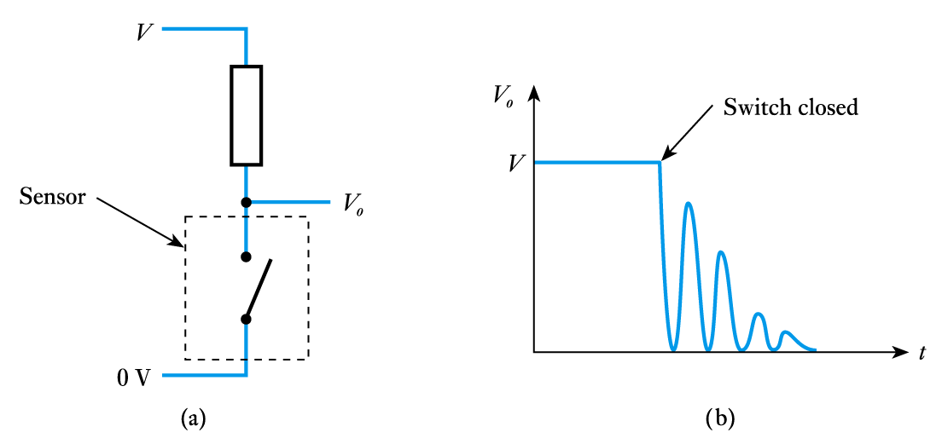
Switches
- switch interfacing is also simple
can use a single resistor as below to produce a voltage output
all mechanical switches suffer from switch bounce

Slide 18
Capacitive and inductive sensors
sensors that change their capacitance or inductance in response to external influences normally require the use of alternating current (AC) circuitry
such circuits need not be complicated
we will consider AC circuits in later lectures

