Slide 1

Semantic Keyword Extraction and Corpus Indexing Framework
A High-Performance Java-Based Document Search & Indexing System

Slide 2

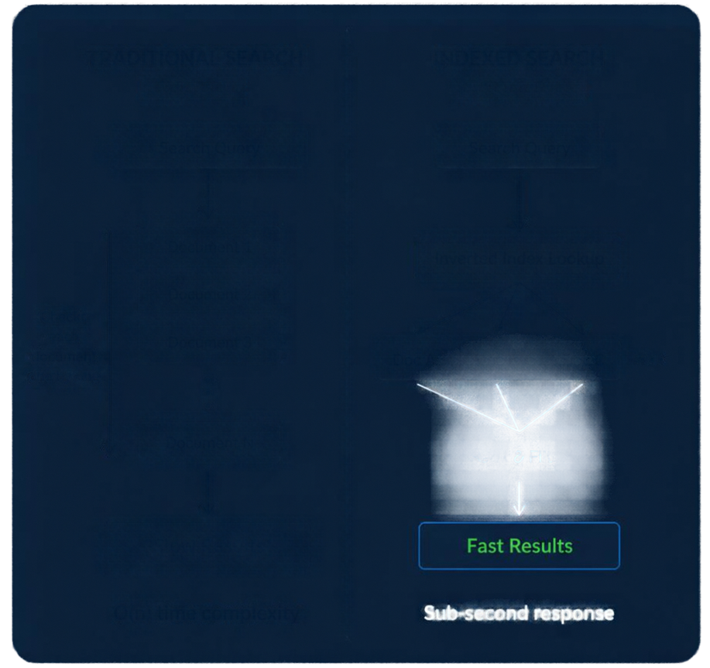














Problem Statement & Motivation
TRADITIONAL SEARCH
INDEXED SEARCH
Linear Scan
Inverted Index
Linear scanning cannot keep up with today’s large document collections or user expectations.
Search Query
Search Query
SLOW
Document 1
Inverted Index Lookup
Traditional text search is Q(n) and scales poorly as data grows.
Document 2
LIMITED
Document 3
Doc A
Doc B
Doc C
Exact-match only misses context and user intent.
NEEDED
Document N
Rank & Filter
Instant, semantic-aware results across millions of documents.
Slow Results
Fast Results
SOLUTION
Build an inverted index engine with semantic expansion and efficient pattern matching.
O(n) time complexity
Sub-second response

Slide 3
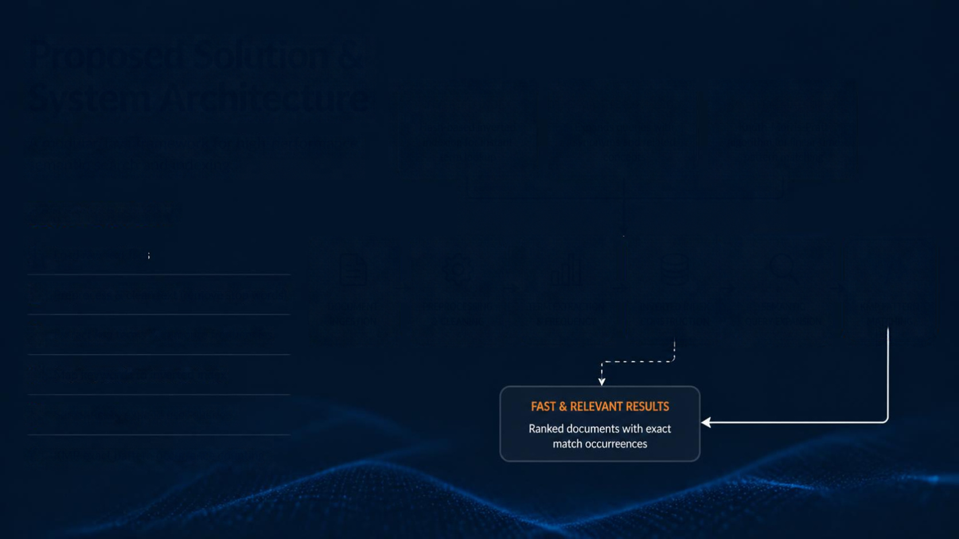



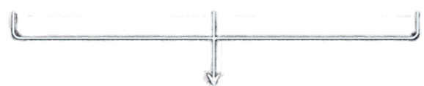

















Proposed Solution & System Architecture
INHERITED INDEX
SEMANTIC EXPANSION
PATTERN MATCHING
Hash-based inverted indexing for instant term lookup
Expands queries with synonyms and related concepts
Knuth-Morris-Pratt algorithm for linear-time pattern matching
A modular Java framework for high-performance semantic search and indexing.
CORE WORKFLOW
1
Load raw text files
2
Preprocessing & clean text (remove stop words)
DOCUMENT INGESTION
PREPROCESSING & CLEANING
TERM EXTRACTION & FREQUENCY
INVERTED INDEX CONSTRUCTION
SEMANTIC QUERY EXPANSION
KMP PATTERN MATCHING
3
Extract key terms & compute frequencies
4
Map keywords to inverted index
5
Semantically expand user queries
FAST & RELEVANT RESULTS
Ranked documents with exact match occurrences
6
KMP exact pattern occurrence counting

Slide 4







Key Java Components & Class Overview
Document,java
Stores text
and metadata
class Document {
String id; String text; MapString,String meta;
}
TextPreprocessor,java
Removes noise and stop words
class TextPreprocessor {
SetString> stopWords = new HashSet<(),
List<String clean(String input);
}
KeywordExtractor,java
Ranges keywords by frequency
class KeywordExtractor {
MapString, Integer > freq = new HashMap<();
List<Map Entry<String Integer > topK(int k);
}
InvertedIndex,java
Maps keywords to document ID lists
class InvertedIndex {
Map<String, List<Integer > index;
List<Integer get(String term) // O(1) lookup
}
KMPMatcher,java
Implements KMP string matching
class KMMatcher {
int[] buildPS(String pattern);
List<Integer search(String text, String pattern);
}
SemanticExpander,java
Expands queries via synonym linking
classSemanticExpander {
MapStringSet(String >> synonyms;
Set<String expand(String query);
}

Slide 5





















Data Structures & Algorithms (DS&A)
DATA STRUCTURES
KMP ALGORITHM SPOTLIGHT
HashMap<String, List/Document>>
for inverted index (fast lookup)
HashSet<String>
for stop word checks (O(1) membership)
Time complexity O(n + m) where n=text length, m=pattern length
Uses Longest Prefix Suffix (LPS) array to skip unnecessary comparisons
Avoids backtracking, improving performance over naive search
LPS ARRAY CONSTRUCTION
Pattern
A
B
A
A
B
A
LPS
0
0
1
0
2
3
KMP MATCHING PROCESS
Compare characters
On mismatch, use LPS to shift
Skip unnecessary comparisons
Continue until match or end

Slide 6
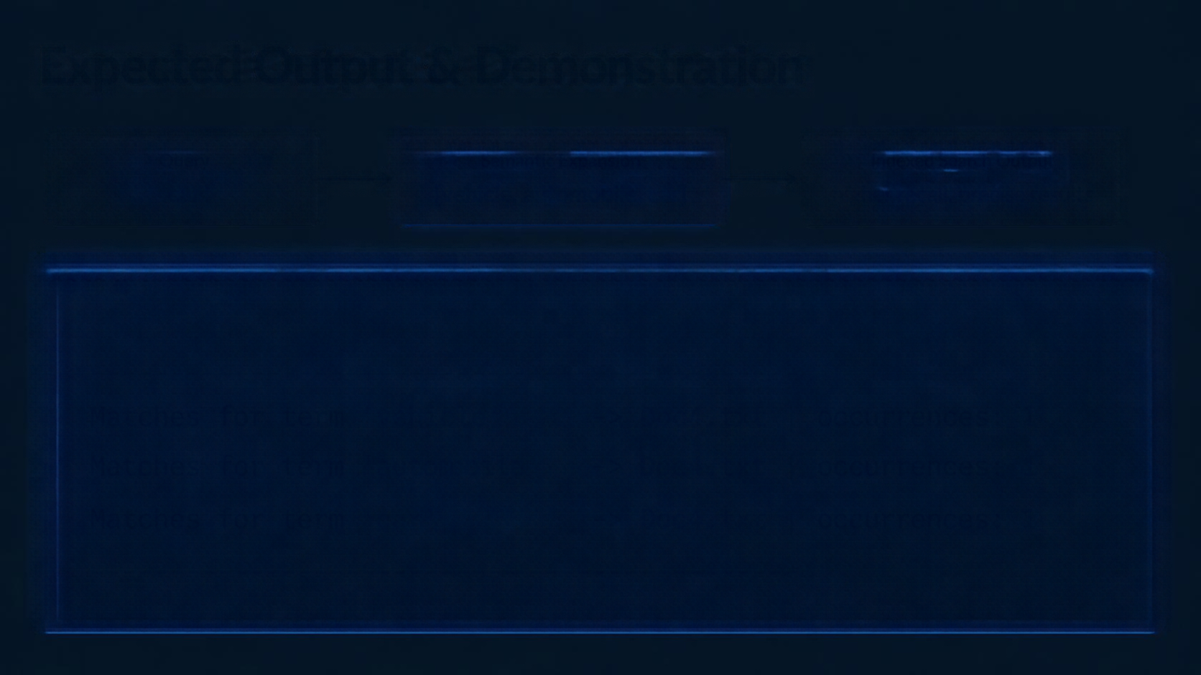

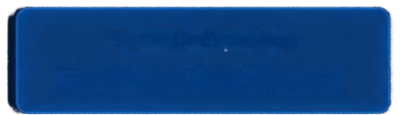




Expected Output & Demonstration
Query
Semantic Expansion
Indexed Search Output
car
[vehicle, automobile, car]
higher recall, precise results
SEARCI RESULTS
'vehicle'
Doc4.txt
|
occurrences:
Matches for
->
1
'automobile'
Doc4.txt
|
occurrences:
Matches for
->
1
'car'
Doc4.txt
|
occurrences:
Matches for
->
1

Slide 7













Conclusion & Future Scope
WHAT WE ACHIEVED
WHAT’S NEXT
Delivered high-efficiency search with semantic awareness
Support multi-format files (PDF, DOCX)
Built a modular Java framework with robust data structures and algorithms
Integrate persistent storage (SQLite / MySQL)
Incorporate TF-ID weighting for relevance scoring
01
02
03
04
Foundation Complete
Storage Integration
Relevance Enhancement
Expansion & Scale
Semantic indexing engine and core search ready
Persistent storage and data durability
TF-ID based scoring and ranking improvements
Multi-format support and scalability growth
Thank you.

