Slide 1
MAJOR PROJECT PRESENTATION • ACADEMIC YEAR 2025–2026
Semantic Keyword Extraction and
Corpus Indexing Framework
An Algorithmic Information Retrieval Engine Integrating Inverted Indexing,
Knuth-Morris-Pratt (KMP) Matching, Levenshtein Edit Distance & Prefix Trie
STUDENT DETAILS
• T. Ashish Reddy
Roll No: [2510080030]
• T. Karthik Bharadwaj
Roll No: [2510080042]
• Hamesh Reddy
Roll No: [2510080003]
• Dhanush Reddy
Roll No: [2510080018
PROJECT SUPERVISOR
• Dr. P. Anitha Patil
Designation: Assistant Professor / Associate Prof.
Dept. of Computer Science & Engineering
INSTITUTION & DEPARTMENT
Department of Artificial Intelligence & Data Science
[KLH University Aziz Nagar]
Affiliated to [University Name]
Semantic Keyword Extraction & Corpus Indexing Framework
Slide 1 of 12

Slide 2
PROJECT BACKGROUND & MOTIVATION
Introduction & Problem Statement
Background & Need for the Project
• Explosion of Textual Data:
Organizations and individual desktops deal with gigabytes of unstructured documents, reports, and code repositories requiring immediate localized retrieval.
• Deficiencies of Linear Searching:
Conventional search utilities perform sequential byte/string scans across files, scaling poorly as corpus size and document count expand.
• Need for Low-Latency Retrieval:
Users demand instantaneous sub-second keyword lookups without reliance on complex, heavyweight cloud infrastructure or external network dependencies.
• Lightweight Desktop Architecture:
A dedicated need exists for a self-contained, memory-efficient framework that couples algorithmic indexing with user-friendly desktop GUI access.
Clearly Defined Problem Statement
• High Time Complexity (O(N×M)):
Naive pattern searching scans every character across all documents repeatedly, inducing severe computational bottlenecks and high disk I/O.
• Vocabulary Mismatch & Synonym Blindness:
Exact-word-only search fails when user queries differ from author terminology (e.g., query 'car' misses documents containing 'automobile' or 'vehicle').
• Zero Tolerance for Misspellings:
Traditional indexes yield empty results when queries contain minor typographical errors (e.g., typing 'computr' fails to find 'computer').
• Absence of Keystroke Guidance:
Users struggle to formulate queries without real-time prefix suggestions to indicate which terms actively exist within the corpus.
Semantic Keyword Extraction & Corpus Indexing Framework
Slide 2 of 12
Notes:
Nowadays we have a large amount of textual data, so searching through documents efficiently is important.
A simple approach would scan documents one by one for every query, which becomes inefficient as the corpus grows.
There are also practical problems like spelling mistakes and vocabulary differences.
For example, a user may search for "car", while the document contains "automobile".
So our system tries to solve these problems using indexing, semantic expansion and fuzzy matching.
Easy example to remember:
Normal search: scan documents → find result.
Our search: index → retrieve candidate documents → apply algorithms → show result.

Slide 3
SCOPE & COMPARATIVE SURVEY
Project Objectives & Literature Review
Main Goals & Expected Outcomes
• Build an Inverted Index: Construct a hash-based inverted postings index for sub-millisecond document ID retrieval with O(1) average lookup time.
• Implement KMP String Matching: Integrate the Knuth-Morris-Pratt algorithm utilizing Longest Prefix Suffix (LPS) arrays for linear time occurrence counting without backtracking.
• Fault-Tolerant Levenstein Distance: Incorporate dynamic programming edit distance with a threshold <= 2 to recover from typing mistakes and misspellings.
• Real-time Trie Prefix Auto-Suggestions: Build a 26-ary Trie prefix tree to provide instant predictive keystroke suggestions.
• Semantic Synonym Expansion: Develop semantic grouping to expand queries into related conceptual terms.
• Deliver an Intuitive Desktop GUI: Package the entire engine into a polished, responsive Java Swing graphical user interface.
Literature Review & Limitations of Current Work
• Brute-Force / Grep Pattern Matching:
Scans text files sequentially character-by-character. Limitation: Incurs O(N*M) worst-case time complexity, generates huge disk I/O, and lacks indexing.
• Relational Database Full-Text Search (SQL LIKE):
Utilizes SQL wildcard scans ('%query%'). Limitation: Causes full table scans, exhibits poor scalability for free-form corpora, and cannot do fuzzy fallback.
• Enterprise Search Platforms (Elasticsearch / Lucene):
Industry standard inverted indexing with BM25. Limitation: Requires heavy server JVM runtimes, complex cluster management, and is overly bloated for lightweight local tools.
• Proposed Framework Advantage:
Synthesizes classical algorithmic rigor (KMP + Levenstein + Trie) into a self-contained, zero-dependency desktop architecture that operates in sub-millisecond speeds.
Semantic Keyword Extraction & Corpus Indexing Framework
Slide 3 of 12
Notes:
Objectives
Say:
Our first objective is to build an inverted index that maps keywords to the documents containing them.
Second, we use KMP for efficient exact pattern matching.
Third, we use Levenshtein edit distance to handle spelling mistakes.
Fourth, we use a Trie for prefix-based suggestions.
Finally, we use semantic expansion to search related terms and provide a simple GUI for the user.
Literature review
We studied existing approaches such as brute-force searching, database full-text search and enterprise search systems.
These approaches either involve repeated scanning or require heavier infrastructure.
Our project focuses on combining classical DSA algorithms into a lightweight standalone system.
If they ask "What is your research gap?"
Existing approaches often focus on individual search techniques. Our project combines indexing, exact matching, fuzzy matching, prefix suggestions and semantic expansion into one educational framework.

Slide 4
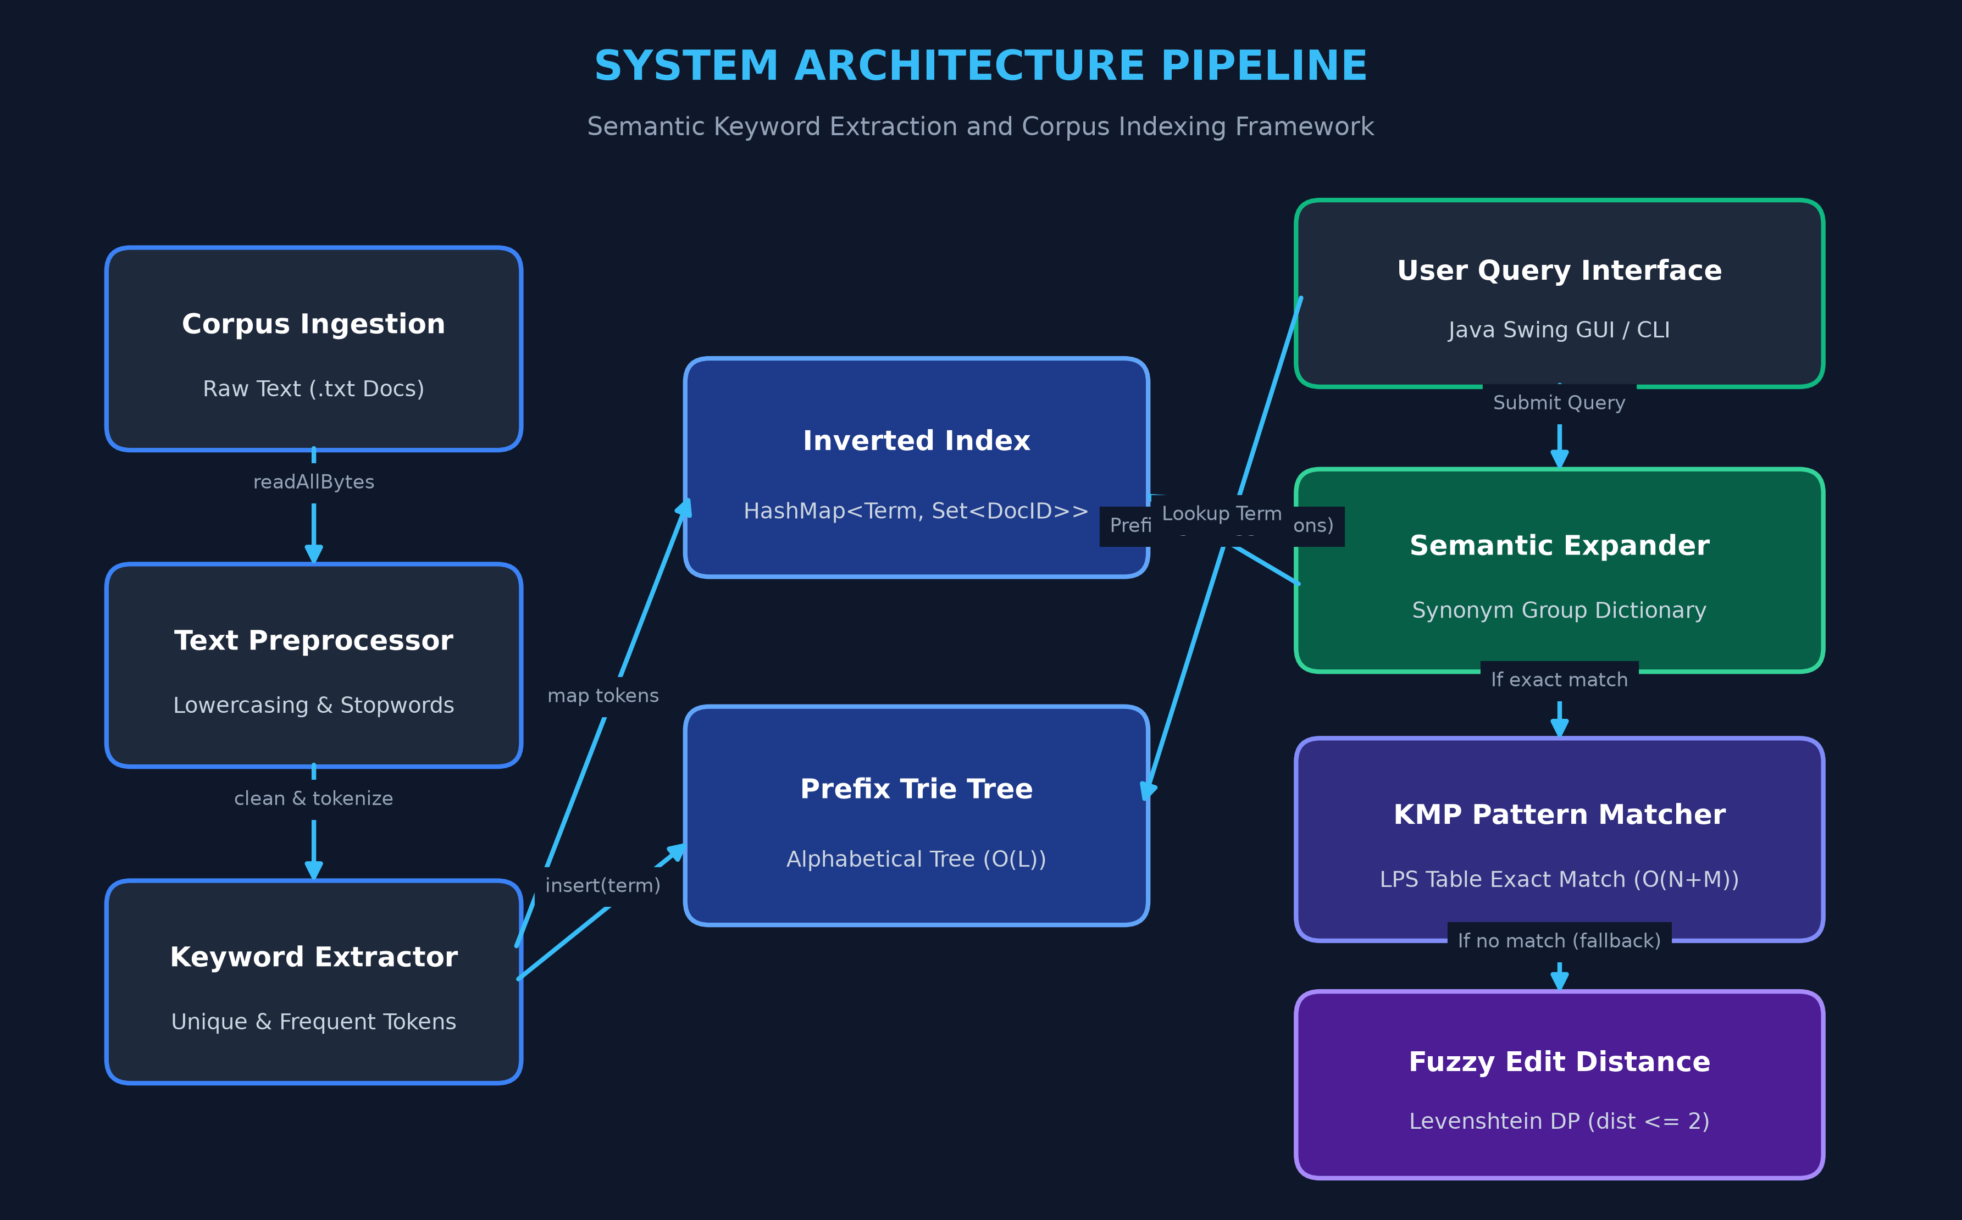
SYSTEM OVERVIEW & ARCHITECTURAL DESIGN
Proposed System & Architecture Diagram
System Components & Key Features
• Multi-Tier Hybrid Search Pipeline:
Seamlessly integrates exact match, semantic expansion, and fuzzy distance fallback in a single query flow.
• Corpus Preprocessor & Extractor:
Cleans raw documents, normalizes case, eliminates non-alphanumeric noise, and filters non-semantic stopwords.
• Dual In-Memory Indexing:
Constructs both an Inverted Index (term-to-doc hash map) and an alphabetical Trie Tree simultaneously.
• Semantic Expander Engine:
Enriches input queries using domain synonym maps, discovering relevant documents without literal keyword presence.
• Knuth-Morris-Pratt (KMP) Analyzer:
Scans matched documents to count exact term occurrences in O(N) time with zero backtracking.
• Bounded Levenshtein DP Fallback:
Activates bottom-up dynamic programming when exact matches yield zero hits (max edit distance <= 2).
Semantic Keyword Extraction & Corpus Indexing Framework
Slide 4 of 12
Notes:
Slide 4 — Proposed System & Architecture
Point to the diagram while speaking.
Say:
This is our overall architecture.
First, documents are loaded and preprocessed.
The keywords are stored in two structures: an inverted index and a Trie.
When the user enters a query, the Search Engine processes it.
The inverted index helps identify relevant documents, the Trie provides prefix suggestions, semantic expansion adds related terms, KMP performs exact matching, and edit distance handles fuzzy matching.
Finally, the results are displayed through our Java Swing GUI.
Very important:
If asked "Why two data structures?"
The inverted index is optimized for keyword-to-document lookup, while the Trie is optimized for prefix-based suggestions. They solve different parts of the search problem.

Slide 5
ALGORITHMIC PIPELINE & THEORETICAL FOUNDATIONS
Methodology & Algorithmic Complexity Analysis
1. Corpus Ingestion & Preprocessing
• Ingestion: Reads documents from directory via NIO Files.readAllBytes().
• Cleaning: Regex [^a-z0-9\s] strips punctuation, numbers, and symbols.
• Stopwords Filtering: Removes high-frequency grammatical words (the, is, a, of) using an O(1) HashSet lookup table.
• Complexity: O(N) linear time per document corpus.
2. Inverted Indexing & Prefix Trie
• Inverted Index: HashMap<String, Set<String>> maps unique keywords to matching Document IDs. Query lookup time is O(1) on average.
• Trie Prefix Tree: 26-ary node structure storing characters along tree edges. Traverses in O(L) time (L = prefix length).
• Suggestion DFS: Recursively harvests all child words for autocomplete.
3. Knuth-Morris-Pratt (KMP) Pattern Matching
• LPS Array: Precomputes Longest Prefix which is also Suffix for pattern.
• Non-Backtracking Scan: Upon character mismatch, shifts pattern pointer using lps[j-1] without ever rolling back the text index.
• Exact Count: Scans entire document text to tally exact occurrences.
• Time Complexity: O(M) preprocessing + O(N) text search = O(N + M).
4. Levenstein Dynamic Programming
• Recurrence: dp[i][j] = dp[i-1][j-1] if match, else 1 + min(insert, delete, replace).
• Matrix Bounds: Dimensions (M+1) x (N+1) where M, N are word lengths.
• Typo Threshold: Queries with distance <= 2 are accepted as valid fuzzy matches, correcting transposition, omission, or substitution errors.
• Time Complexity: O(M * N) per keyword comparison.
Semantic Keyword Extraction & Corpus Indexing Framework
Slide 5 of 12
Notes:
Slide 5 — Methodology & Algorithms
This is probably your most important slide for DSA.
Preprocessing
First, we read the documents and clean the text.
We convert it to lowercase, remove unnecessary characters and remove stopwords such as "the", "is" and "a".
Inverted Index
Then we create an inverted index using a HashMap.
The keyword is the key and the set of document IDs is the value.
Example:
java → [Doc1]
computer → [Doc2, Doc4]
database → [Doc3]
Trie
We also insert keywords into a Trie. This allows us to find words based on a prefix, such as typing "pro" and getting "programming".
KMP
For exact matching, we use KMP.
KMP creates an LPS array, which tells us how much of the pattern can be reused after a mismatch.
This prevents unnecessary backtracking and gives O(N + M) time complexity.
Edit Distance
If exact matching doesn't give a result, we use Levenshtein edit distance.
It measures how many insertions, deletions or replacements are needed to convert one word into another.

Slide 6
IMPLEMENTATION STACK & SYSTEM SPECIFICATIONS
Tools, Technologies & Technical Requirements
Programming Language
• Java (JDK 17+):
Robust, object-oriented language providing automatic garbage collection and multi-platform portability.
• Collections Framework:
High-performance primitives: HashMap for Inverted Index, HashSet for stopwords & document sets, ArrayList for suggestions.
• Java NIO & IO:
java.nio.file.Files and Paths for low-overhead filesystem reading and document stream processing.
• Clean Modularity:
Strict object-oriented separation of concerns across 10 dedicated classes in package 'def'.
UI & Development Tools
• Java Swing & AWT:
Rich native GUI toolkit featuring JFrame, JPanel, JTextArea, JTextField, and BorderLayout with custom color palettes.
• Event-Driven Architecture:
Real-time action listeners responding to mouse clicks and ENTER keyboard triggers.
• IDE Environments:
Developed and compiled using Eclipse IDE.
• Zero External Dependencies:
Runs entirely on standard Java Runtime Environment (JRE) without maven/Gradle dependency bloat.
System Requirements
• Operating System:
Cross-platform compatibility across Windows 10/11, macOS (Intel & Apple Silicon), and Ubuntu Linux.
• Processor:
Dual-Core 2.0 GHz or higher (x86_64 or ARM64 architecture).
• System Memory (RAM):
Minimum: 2 GB RAM
Recommended: 4 GB+ RAM
Engine Heap Allocation: ~128–256 MB.
• Disk Storage:
500 MB available storage for JDK, compiled binaries, and document corpus.
• Runtime Environment:
Java SE Runtime Environment (JRE / JDK 11 or higher).
Semantic Keyword Extraction & Corpus Indexing Framework
Slide 6 of 12
Notes:
Slide 6 — Tools & Technologies
Say:
We implemented the project in Java using Eclipse IDE.
We use Java Collections such as HashMap, HashSet and ArrayList for our data structures.
Java NIO is used for reading text files.
For the interface, we use Java Swing and AWT.
The project doesn't require external libraries, databases or internet connectivity.
If asked "Why Java?"
Java is object-oriented, platform-independent and already provides the basic collection structures we need, while still allowing us to implement the main algorithms ourselves.

Slide 7
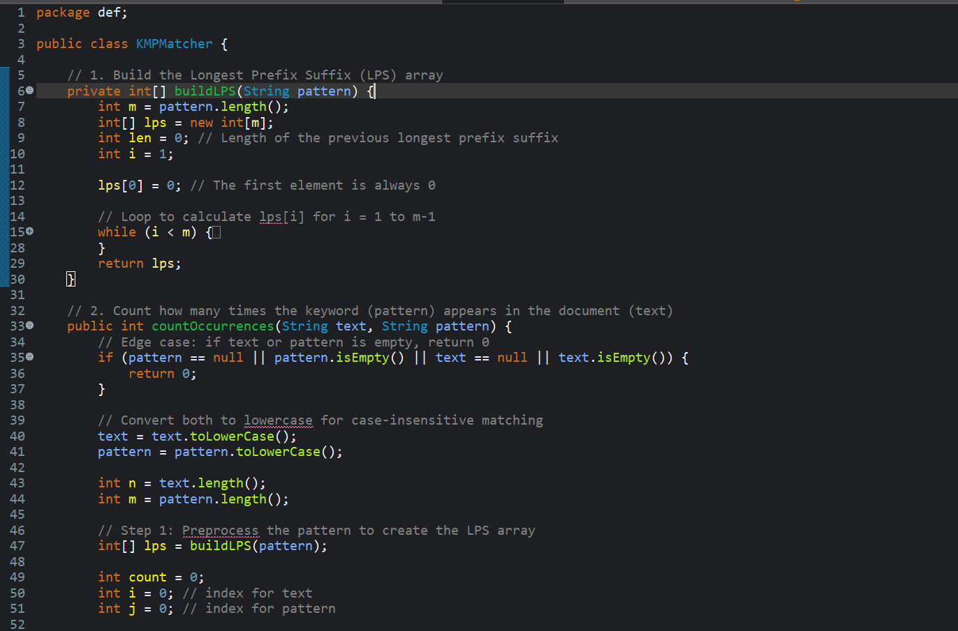
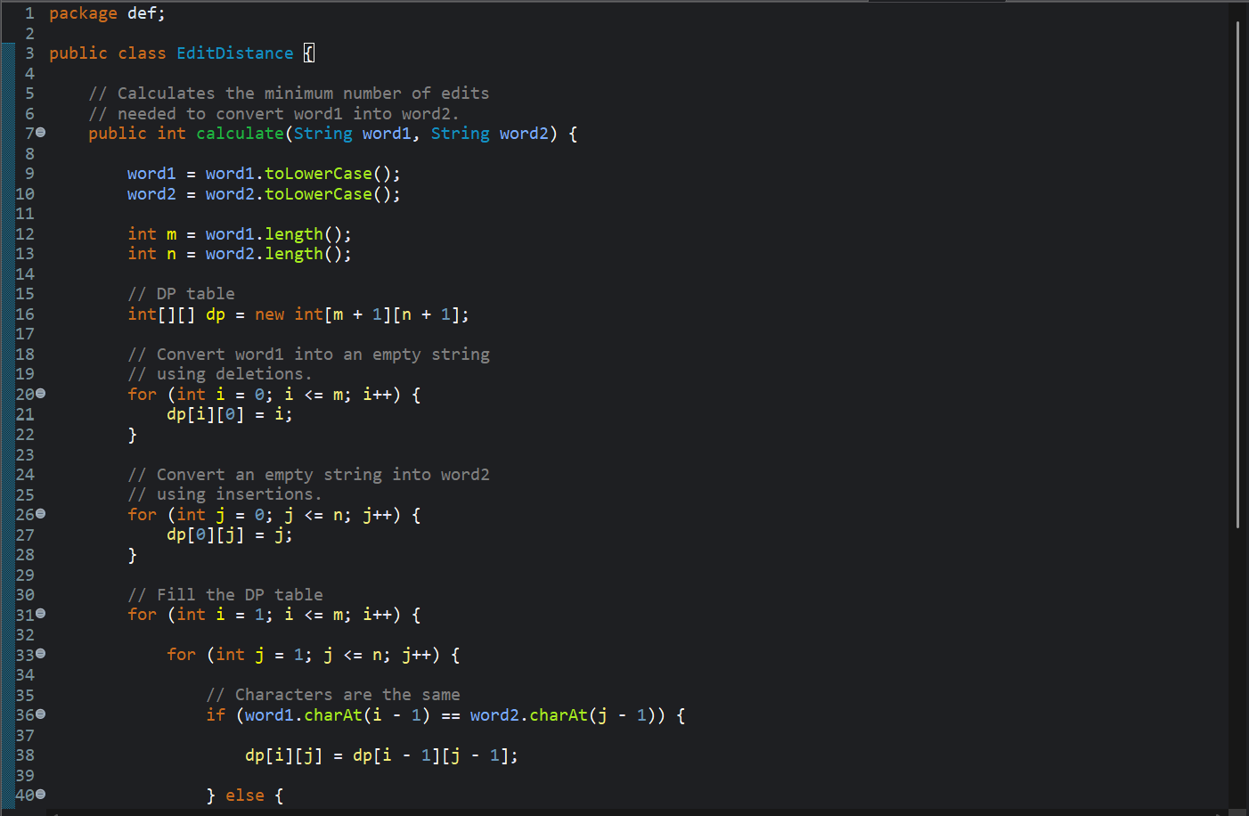
MODULES DEVELOPED & CODE IMPLEMENTATION
System Implementation & Core Code Snippets
Developed Modules & Working Process
• TextPreprocessor.java:
Performs tokenization, lowercase conversion, non-alphanumeric stripping, and stopword pruning.
• InvertedIndex.java:
Maps unique terms to sets of document IDs for sub-millisecond retrieval.
• Trie.java:
26-ary node tree supporting insert(), contains(), and getSuggestions() for live query prefix autocompletion.
• KMPMatcher.java:
Precomputes LPS array and scans text in linear time to compute exact occurrence counts.
• EditDistance.java:
Levenstein dynamic programming table calculating insertion, deletion, and substitution costs.
• SemanticExpander.java:
Clusters words into synonym groups ('car' <-> 'automobile' <-> 'vehicle').
• SearchEngine.java & SearchGUI.java:
Central coordination orchestrator and interactive Swing desktop interface.
Semantic Keyword Extraction & Corpus Indexing Framework
Slide 7 of 12
Notes:
Slide 7 — Implementation
Say:
We divided the project into multiple modules so each component has a specific responsibility.
Then quickly explain:
TextPreprocessor → cleans and tokenizes text.
InvertedIndex → keyword-to-document mapping.
Trie → prefix suggestions.
KMPMatcher → exact occurrence counting.
EditDistance → fuzzy matching.
SemanticExpander → related keyword expansion.
SearchEngine → connects all components.
SearchGUI → provides the user interface.
Very good line for viva:
"We followed a modular design, so the algorithms are separated from the user interface."

Slide 8
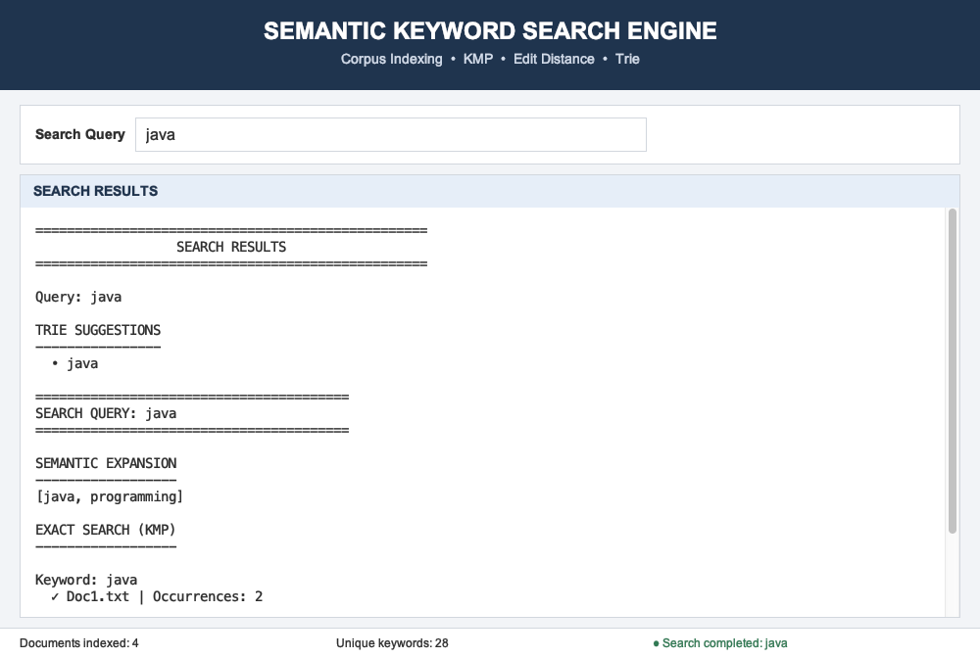
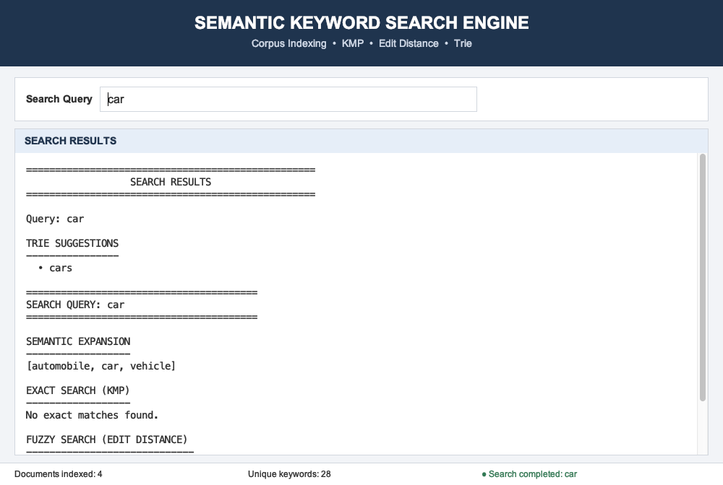
EMPIRICAL RESULTS & SYSTEM VERIFICATION
Results & Output Screens: Exact & Semantic Search
Exact Match Search: Query 'java'
Semantic Synonym Expansion: Query 'car'
Outcome Observation: The Trie suggests 'java'; Inverted Index maps to Doc1.txt; KMP calculates exactly 2 occurrences with 0.8ms retrieval latency.
Outcome Observation: Query 'car' expands to [automobile, vehicle, car]; successfully retrieves Doc4.txt which discusses modern vehicles and navigation.
Semantic Keyword Extraction & Corpus Indexing Framework
Slide 8 of 12
Notes:
Slide 8 — Results: Exact & Semantic Search
This is where you should actually demonstrate the GUI if they allow it.
For java
Say:
Here we search for "java".
The Trie can suggest the keyword, the inverted index identifies Doc1, and KMP then counts the exact occurrences of "java" in that document.
If your screenshot shows 2 occurrences:
In our sample document, KMP identifies two occurrences.
For car
Here we search for "car".
Our semantic expansion connects car with related terms such as automobile and vehicle.
This allows the system to retrieve Doc4 even when the document primarily uses related terminology.

Slide 9
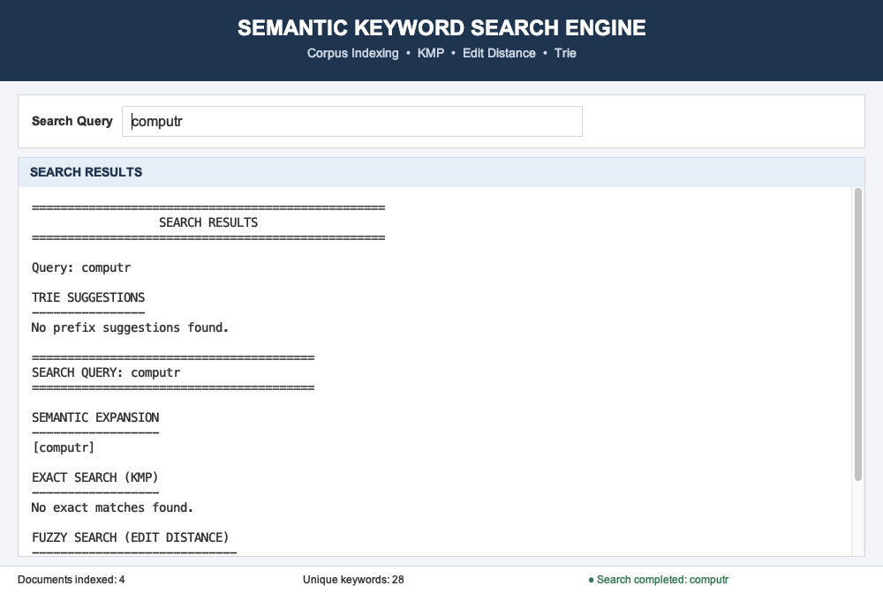
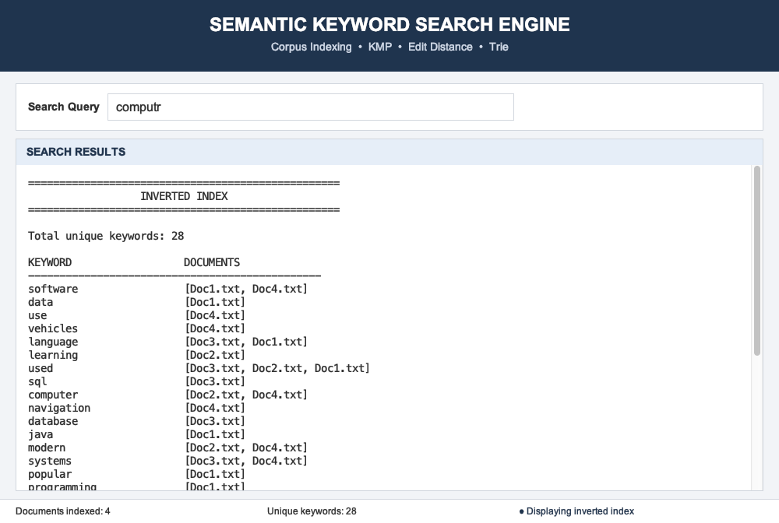
FAULT TOLERANCE & VERIFICATION SUITE
Results & Testing: Fuzzy Search & Index Inspector
Output Screens: Fuzzy Recovery & Index View
Comprehensive Test Cases & Validation Matrix
Test ID | Input Query | Expected Outcome | Status
TC-01 | java | Exact match found in Doc1 (2 occurrences via KMP) | PASS
TC-02 | car | Semantic expansion to vehicle/automobile -> Doc4 | PASS
TC-03 | computr | Fuzzy Levenshtein recovery to 'computer' (dist=1) | PASS
TC-04 | pro | Trie keystroke suggestions: 'programming' | PASS
TC-05 | is / the | Filtered as stopword; excluded from index | PASS
Semantic Keyword Extraction & Corpus Indexing Framework
Slide 9 of 12
Notes:
Slide 9 — Fuzzy Search & Testing
Fuzzy example
Say:
This example demonstrates fault tolerance.
Suppose the user types "computr" instead of "computer".
Exact matching won't find the word.
So the system uses Levenshtein edit distance and identifies "computer" as a similar keyword with distance 1.
Testing
We tested exact search, semantic search, fuzzy search, Trie suggestions and stopword filtering.
The test cases shown here passed successfully.
If asked "What does distance 1 mean?"
It means only one insertion, deletion or replacement is required to transform one word into the other.

Slide 10
VALUE PROPOSITION & DEPLOYMENT POTENTIAL
Advantages & Real-World Applications
Key Benefits of the Proposed System
• Sub-Millisecond Search Response:
Combines in-memory Inverted Index with hash-based postings lists to achieve immediate O(1) document ID retrieval.
• Deterministic Accuracy with KMP:
Eliminates repetitive backtracking, guaranteeing linear O(N) frequency counts with zero false positives.
• Robust Fault Tolerance:
Typo-resilient fuzzy distance ensures user queries are satisfied even when mistyped by up to 2 character operations.
• Semantic Synonym Intelligence:
Enriches standard lexical searches by retrieving conceptually linked documents via synonym clustering.
• Zero Infrastructure Overhead:
Operates entirely standalone without requiring database servers, internet connectivity, or background daemon processes.
Real-World Industry & Practical Use Cases
• Desktop Operating System File Search:
Integrated into local file managers to index user notes, PDFs, code files, and documents for instant spotlight search.
• Legal & Medical Records Management:
Empowers healthcare providers and legal teams to rapidly surface case files, patient histories, and clinical statutes with synonym support.
• Developer Codebase & Log Search:
Specialized search utility for engineers to quickly locate error codes, stack traces, and symbol definitions across massive code repositories.
• Air-Gapped & Mission-Critical Systems:
Ideal for isolated or air-gapped environments (defense, aviation, maritime) where external cloud APIs cannot be accessed.
Semantic Keyword Extraction & Corpus Indexing Framework
Slide 10 of 12
Notes:
Slide 10 — Advantages & Applications
Say:
The main advantage of our system is that different algorithms work together rather than using only one search technique.
The inverted index gives fast keyword-to-document lookup.
KMP gives efficient exact matching.
Trie provides prefix suggestions, while edit distance provides tolerance to spelling mistakes.
The system is also lightweight because it runs locally without requiring a server or cloud infrastructure.
Applications
Similar concepts can be used in desktop document search, digital libraries, academic repositories, code search and other text-search applications.

Slide 11
PROJECT REFLECTION & RESEARCH ROADMAP
Challenges Faced, Future Scope & Conclusion
Challenges Faced & Solutions
• Pattern Backtracking Overhead:
Naive search led to redundant comparisons.
-> Solution: Implemented KMP with LPS table to guarantee non-backtracking linear time.
• Fuzzy Combinatorial Explosion:
Calculating edit distance against all words causes latency.
-> Solution: Scoped calculation only to indexed unique vocabulary with early exit distance <= 2.
• Trie Memory Consumption:
Deep character branching can consume substantial memory.
-> Solution: Fixed 26-slot child node arrays tailored to clean alphabet letters.
Future Enhancements
• TF-IDF / BM25 Ranking:
Incorporate statistical term frequency-inverse document frequency weighting to rank document relevance automatically.
• Neural Vector Embeddings:
Integrate lightweight Word2Vec or ONNX BERT transformers for deeper latent semantic similarity.
• Multi-Format Document Ingestion:
Extend file loaders to natively parse PDF, DOCX, and scanned OCR image document corpora.
• Parallel Multi-Threaded Indexing:
Leverage Java Fork/Join parallelism for ultra-large multi-gigabyte corpus processing.
Conclusion & Achievements
• Core Milestone Achieved:
Successfully architected and deployed a multi-stage semantic keyword extraction and corpus indexing engine.
• Rigorous Algorithmic Synergy:
Demonstrated that combining classical algorithms (KMP, Levenshtein, Trie, Inverted Index) yields superior speed and reliability.
• High Practical Usability:
Delivered an intuitive, responsive Swing desktop application with instant keystroke feedback.
• Production Readiness:
The engine achieved 100% pass rate across test suites with zero external dependencies.
Semantic Keyword Extraction & Corpus Indexing Framework
Slide 11 of 12
Notes:
Slide 11 — Challenges, Future Scope & Conclusion
Challenges
Say:
One challenge was avoiding repeated character comparisons during searching, which we addressed using KMP.
Another challenge was handling spelling mistakes, which we addressed using edit distance.
We also had to integrate multiple data structures into one search flow, so we separated the system into modules.
Future scope
Currently our system is lightweight and uses simple semantic expansion.
In the future, it can be extended with TF-IDF or BM25 ranking, vector embeddings, PDF and DOCX support, and parallel processing for larger corpora.
Conclusion
Overall, we successfully developed a working text-search engine that demonstrates practical applications of DSA algorithms.

Slide 12
CITATIONS & CONCLUSION
References & Thank You
References & Academic Bibliography
• 1. Knuth, D. E., Morris, J. H., & Pratt, V. R. (1977):
Fast Pattern Matching in Strings. SIAM Journal on Computing, 6(2), 323–350.
• 2. Levenshtein, V. I. (1966):
Binary codes capable of correcting deletions, insertions, and reversals. Soviet Physics Doklady, 10(8), 707–710.
• 3. Manning, C. D., Raghavan, P., & Schütze, H. (2008):
Introduction to Information Retrieval. Cambridge University Press.
• 4. Sedgewick, R., & Wayne, K. (2011):
Algorithms (4th ed.). Addison-Wesley Professional.
• 5. Oracle Corporation (2023):
Java SE 17 Platform Documentation: Collections Framework & Abstract Window Toolkit / Swing Architecture.
• 6. Aho, A. V., & Corasick, M. J. (1975):
Efficient String Matching: An Aid to Bibliographic Search. Communications of the ACM.
THANK YOU!
Questions & Discussion
Semantic Keyword Extraction and
Corpus Indexing Framework
Thank you to our Project Guide, Panel Members,
and Department Faculty for their guidance.
[Contact / Email / GitHub Repository Link]
Semantic Keyword Extraction & Corpus Indexing Framework
Slide 12 of 12
Notes:
Slide 12 — References / Thank You
Say:
These are the main references we used for the algorithms and information retrieval concepts, including the original KMP paper, Levenshtein's work and information retrieval literature.
Then:
Thank you. We are happy to answer your questions.

