Slide 1

Information Technology Department Birla Vishvakarma Mahavidyalaya Engineering College (As Autonomous Institution) AY:2021-22, Semester VII
End semester exam presentation of Project-1
Subject Code: 4IT31
Title: Trading bot
Group: G5
Submitted by Faculty Guide
18IT445 Ashishkumar Dobariya Prof. K.G. Patel
18IT446 Mayur Jiyani
18IT447 Ritul Bathani

Slide 2

Contents
Abstract
OUR APPROACH
Applications
Conclusion
Future Work
REFERENCES
UI

Slide 3
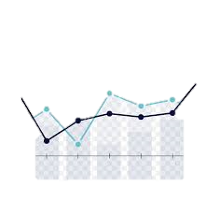
Abstract
Trading bot is a bot that executing orders using automated pre-programmed trading instructions accounting for variables such as time and price. This type of trading attempts to leverage the speed and computational resources of computers relative to human traders. In the twenty-first century, algorithmic trading has been gaining traction with both retail and institutional traders.

Slide 4
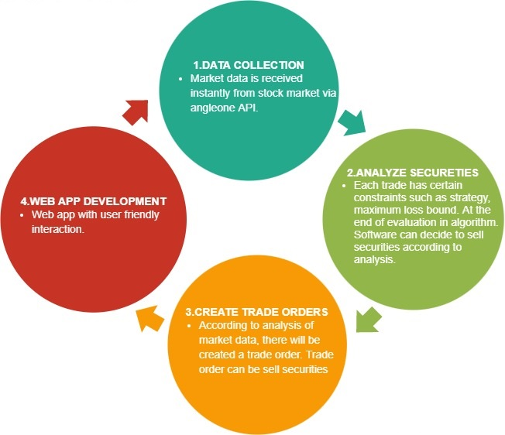
OUR APPROACH

Slide 5

Module description
User module
This module provides functionality of user. To use this system user has to login to system. After that user can define new trade according to his/her choice like adding different type of data and manage their portfolio.
System module
This module receives market data according to user’s need and it analyses secureties according to trade strategy, create trade orders and mange trade orders.

Slide 6
Literature
one of the premier services and facility provided by the firm. The Algo trading platform of 5Paisa has been applauded for its abundance of features and type of strategies which helps the investors to earn well.
The 5Paisa Algo Trading features include –
The infrastructure of the Algo trading system offered by 5Paisa is advanced and has some cutting-edge technologies in it
APIs are there for the .NET, C++, and other programming languages
There is assistance feature for the strategy coding
You can develop and personalize strategies on this platform
Assistance available for the stock exchange approval
For testing strategies, there is a live paper trading facility available as well.

Slide 7
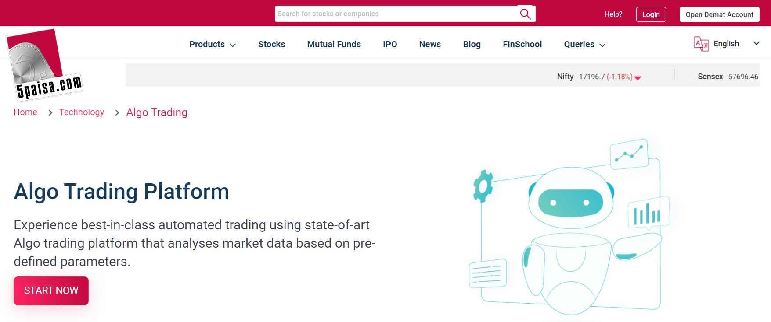
Figure: 5paisa trading platform

Slide 8
Applications
It is blessing for busy person who want to earn passive income through stock market.
Conclusion
Trading bot is a very competitive field in which technology is a crucial factor. With the help of the bot the trade activity becomes faster. But after all it is totally depends on the technology. There are lots of example of crashing in the market but by using this bot we can avoid such a huge losses by predefine risk.
Future Work
The future plan is to come up with a more trading strategies. We are also thinking to make the bot more user friendly and more attractive.

Slide 9
REFERENCES
The resources listed below are references used in requirement analysis: IEEE Standard Documents:
• [1] IEEE. IEEE STD 830-1998 IEEE Recommended Practice for Software Requirements Specifications. IEEE Computer Society, 1998.
• [2] StarUML 5.0 User Guide. (2005). Retrieved from http://staruml.sourceforge.net/docs/user-guide(en)/toc.html
• [3] Hull, J. (2009). Options, futures, and other derivatives; seventh edition (7th edition). Upper Saddle River, N.J.: Prentice Hall.
• [4] Using Genetic Algorithms To Forecast Financial Markets. (n.d.). Retrieved November 30, 2014, from http://www.investopedia.com/articles/financialtheory/11/using-genetic-algorithms-forecast-financial-markets.asp
• [5] Binary option. (2014, November 29). Retrieved November 30, 2014, from http://en.wikipedia.org/wiki/Binary_option
• [6] RELEASE: Fraudadv_binaryoptions. (n.d.). Retrieved November 30, 2014, from http://www.cftc.gov/PressRoom/PressReleases/fraudadv_binaryoptions

Slide 10
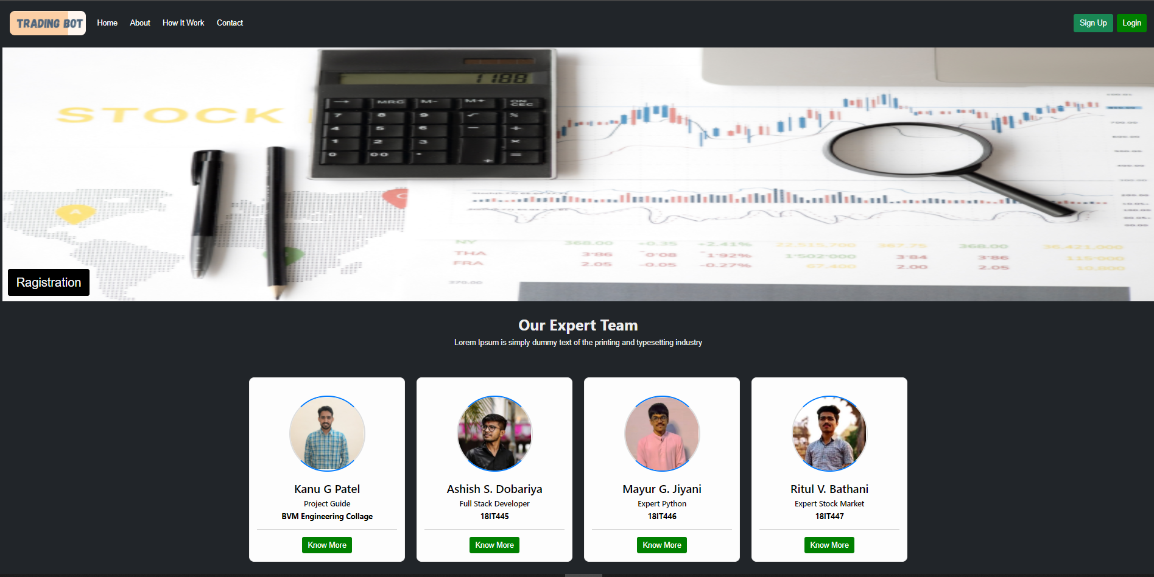
UI Homepage:-

Slide 11
Here above image shows home page of the system. In header section, in menu bar we have Home, About, How it works and Contact link and in right hand side Sign Up and Login button is there. At middle section we have information of expert team. In footer section contact information and social media connect icon is there.

Slide 12
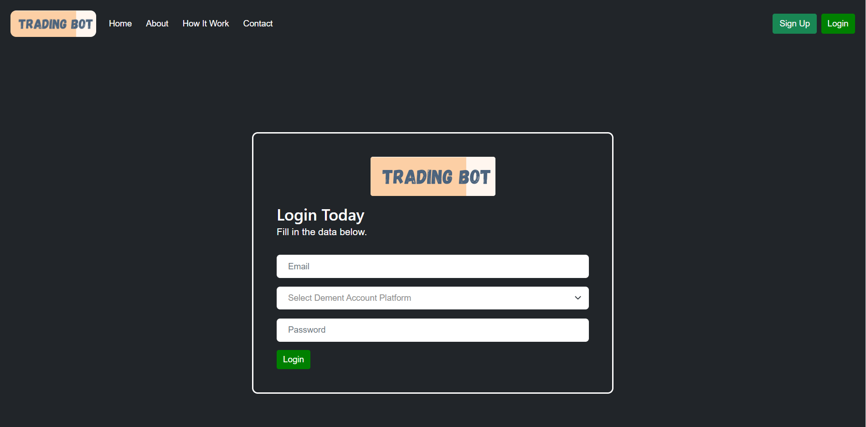
Login
Above image represents login page. After clicking on Login button user redirect to above page. Here user has to enter email, password and have to add demat account platform. If user has not registered than has to register first to access the system.

Slide 13
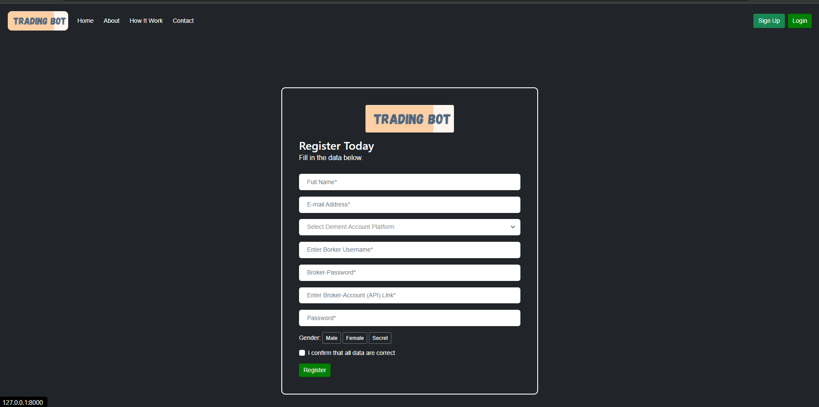
Registration
Above image show register page. Here has to submit the input fields. First is to add full name, second is email address, then has to select demat account platform like zerodha, angel one, 5paisa etc. Next field is Broker username which is provided by broker. Then password, at the end after selecting gender has to click on Register button.

Slide 14
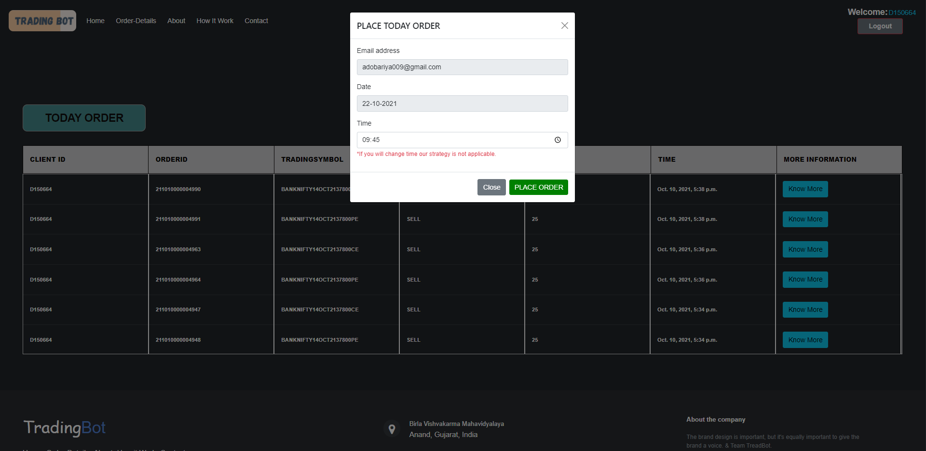
Today order
Above image shows Trade book of the system. In table format there is a field like client id, order id, trading symbol, transaction type like buy or sell, then quantity (number of share) then next field is time when trade is take placed and last field is More information to know more information about order.

Slide 15
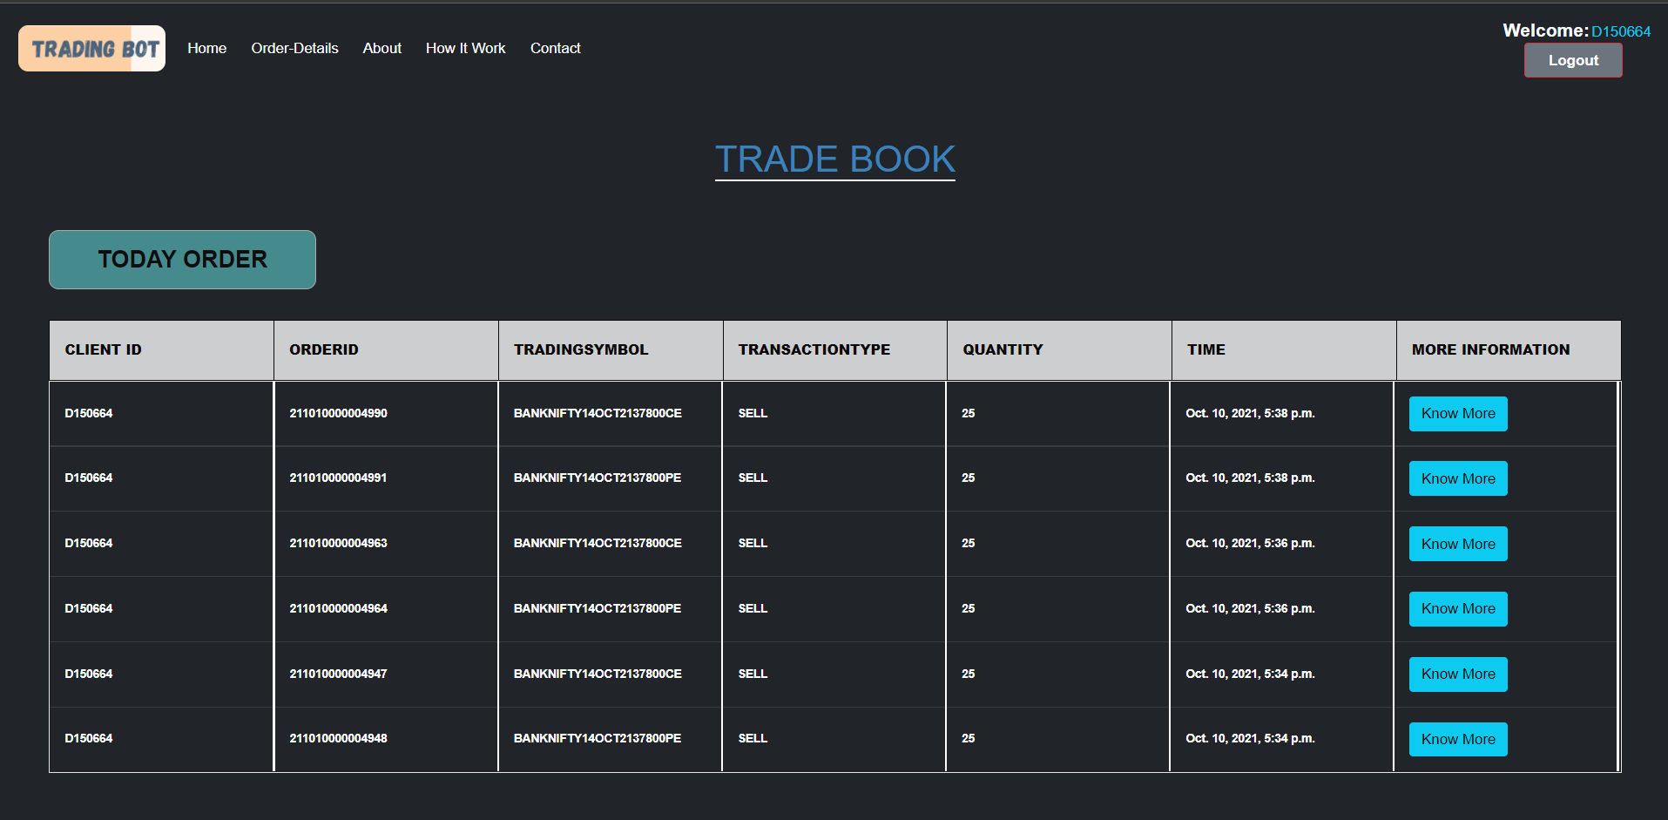
Trade Book

Slide 16
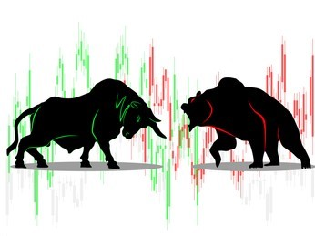
Thank you!

