Slide 1
REVIEW 2 ·
Personalized Federated Learning for
Intrusion Detection in Resource-Constrained
IoT Networks
Ashish Tiwary – 23BPS1001
Avishi Prasad - 23BCE1395

Slide 2
AGENDA
What We'll Cover
01
02
Domain & Problem Statement
Literature Review
03
04
Research Gaps
Proposed Methodology
05
06
System / Module Design
Evaluation Plan
2

Slide 3
DOMAIN OVERVIEW
IoT's Expanding Attack Surface
27B
125B
9
IoT devices online in 2017
Projected IoT devices by 2030
Major attack classes: DDoS, DoS, Probe, R2L, U2R, Malware, Bot, Scan, Unauthorized
Why IOT Security is Challenging:
IoT devices are heterogeneous and have different traffic patterns.
Devices have limited CPU, memory, energy and bandwidth.
IoT networks generate potentially sensitive traffic data.
Centralized ML requires transferring raw data to a server.
Heavy DL models may be impractical for edge devices.
3

Slide 4
PROBLEM STATEMENT
The Gap Between Privacy, Personalization & Performance
Strength: High detection accuracy , CNN-BiLSTM and other DL models learn complex patterns
Limitation: Requires centralized collection of raw traffic , Privacy exposure , High communication cost , Computationally expensive
Centralized DL-IDS
Strength: Raw data remains at clients , Collaborative learning , FedAvg / FedAvgM reduce need for centralized data
Limitation: One global model is shared across clients , IoT traffic is non-IID, Global model may not fit every device
Vanilla Federated Learning
Resource-Constrained Devices
Constraints: Limited CPU , Limited memory , Limited energy , Limited bandwidth
Problem: existing FL-based IDS solutions do not jointly optimize for privacy, per-device personalization, and resource-efficiency in IoT networks.
4

Slide 5
MOTIVATION
Why Personalization Matters in IoT-FL
Lock
Camera
Sensor
•
IoT clients have non-IID traffic distributions.
•
Different devices face different attack surfaces.
Global Model
•
FedAvg learns an average global representation.
•
Global-only models can underperform on device-local/minority attacks.
Gateway
Router
Thermo-
stat
Global knowledge + Local adaptation = Personalized IDS
Personalized FL for IoT Intrusion Detection | Review 1
5

Slide 6
RESEARCH OBJECTIVES
What This Research Sets Out to Do
1
2
3
4
Design
Optimize
Preserve
Evaluate
a personalized federated learning framework for IoT intrusion detection that adapts the global model per client.
for resource-constrained edge devices via lightweight local models and reduced communication overhead.
data privacy by keeping raw traffic on-device and sharing only model updates.
against benchmark IoT/IDS datasets under realistic non-IID conditions, comparing to FedAvg/FedAvgM baselines.
6

Slide 7
LITERATURE REVIEW — FOUNDATIONS
Two Base Papers Anchoring This Work
Zahid & Bharati (2025)
Khraisat et al. (2025)
Enhancing cybersecurity in IoT systems: a hybrid deep learning approach for real-time attack detection
Federated learning for intrusion detection in IoT environments: a privacy-preserving strategy (PEIoT-DS)
Method: CNN + BiLSTM hybrid, LASSO feature selection, SMOTE class balancing
Method: FedAvg vs. FedAvgM aggregation with a deep autoencoder, SMPC + differential privacy
Result: 99.9% / 99.8% / 98.0% accuracy on KDDCup99, NSL-KDD, CIC-IDS-2017
Result: 95.05% accuracy on N-BaIoT (9 devices), FedAvgM converges faster (17 vs 24 rounds)
Gap: centralized training — no privacy preservation, no federated / personalized element
Gap: single global model — no per-device personalization; non-IID handling is basic
Paper 1 → Strong IDS model Paper 2 → Privacy-preserving Federated IDS
Our work → Personalized + Resource-aware Federated IDS
7

Slide 8
LITERATURE REVIEW — PERSONALIZED FL FOR IDS
Personalized & Non-IID-Aware Federated IDS
Study (Year)
Approach
Key Gap Addressed
Study (Year)
Approach
Key Gap Addressed
Personalized federated learning-based IDS: poisoning attack and defense
PFL-based IDS; studies poisoning attacks and defenses in personalized aggregation
Security of personalization itself is under-studied
Robust PFL for IoT IDS (2025), Computers & Security
PFL with FedAMP-style attentive message passing across heterogeneous clients
Global fairness vs per-client accuracy trade-off
PP-HFFL (2025), fog-assisted
Hierarchical fog + PFL with differential privacy on RT-IoT2022 & CIC-IoT2023
Communication cost of hierarchical fog layer
Sentinel (2025/26), arXiv
Dynamic knowledge distillation for personalized FL-IDS in heterogeneous IoT nets
Distillation overhead on constrained clients unresolved
PROTEAN (2025), arXiv
Prototype-based knowledge sharing for non-IID federated IDS
Prototype exchange privacy risk not fully quantified
G-PFL-ID (2026), IoT journal
Graph-driven PFL, unsupervised DeepSVDD + FedReg on IoT-23 / N-BaIoT
Unsupervised setting sacrifices some detection precision
8

Slide 9
LITERATURE REVIEW — LIGHTWEIGHT / RESOURCE-AWARE FL
Lightweight & Resource-Constrained FL-IDS
Study (Year)
Approach
Key Gap Addressed
Study (Year)
Approach
Key Gap Addressed
Belarbi et al. (2023), GLOBECOM
Federated DBN/DNN IDS; shows up to 50% accuracy drop under non-IID
Confirms non-IID as the core open problem
Cross-Layer FL-IDS (2023), PMC
K-means clustering + semi-supervised sampling for constrained IoT clients
Precision/recall trade-off from summary-statistic sharing
Lightweight FL botnet detection (2025), arXiv
Compares lightweight ML (DT, KNN, SVM, LR) under FL for botnet detection
Limited to shallow models; no deep personalization
EAFRA/6G-CPS framework (2025/26), Sci.Rep.
Energy-adaptive federated reinforcement aggregation for edge-centric 6G IoT
Reinforcement-tuned aggregation adds design complexity
Secure FL-IDS on ESP32 (2026), MDPI Future Internet
Hardware-validated lightweight cryptography (SPECK/SIMON) for MCU-class FL
Crypto overhead on ultra-constrained MCUs still notable
FL-IDS Resource-Constrained IoT (2026), TechRxiv
Lightweight FL-IDS tailored to resource-bound IoT deployments
Personalization not addressed alongside efficiency
9

Slide 10
LITERATURE REVIEW — AGGREGATION, HETEROGENEITY & SECURITY
Aggregation Strategies & Data Heterogeneity
Study (Year)
Approach
Key Gap Addressed
Study (Year)
Approach
Key Gap Addressed
Alsaleh et al. (2025), Sensors
Heterogeneity-aware semi-decentralized FL + BiLSTM for lightweight IoT IDS
Semi-decentralized coordination overhead
Anwer et al. (2025), Ad Hoc Networks
FL + LSTM for advanced IIoT intrusion detection
Industrial heterogeneity not client-personalized
Karunamurthy et al. (2025), Sci. Reports
Optimized FL aggregation for IoT intrusion detection
Optimization targets global, not per-client, accuracy
FedP3E (2025), arXiv
Privacy-preserving prototype exchange for non-IID malware detection, cross-silo FL
Cross-silo assumptions weaker for cross-device IoT
FL-enabled lightweight WSN-IDS (2025), Sci.Direct
Lightweight GRU under FL for DDoS detection in smart-city WSNs
Single attack-type focus (DDoS only)
Hamad et al. (2025), IEEE Access
Systematic review of FL approaches for IoT intrusion detection
Survey — highlights personalization + efficiency as open gaps
10

Slide 11
SYNTHESIS
Research Gaps This Work Targets
1
No joint optimization
2
Non-IID accuracy loss
Personalization, privacy, and resource-efficiency are studied in isolation, rarely together
Global-only FL (FedAvg/FedAvgM) loses up to ~50% accuracy under realistic device heterogeneity
3
Constrained-device blind spot
4
Limited real IoT validation
Most personalized FL methods (distillation, prototypes, graphs) assume capable client hardware
Many approaches are validated on generic benchmarks (MNIST/CIFAR) rather than IoT-specific traffic
11

Slide 12
PROPOSED METHODOLOGY
System Overview: Personalized Resource-Aware FL-IDS
IoT Client
Data
Local
Preprocessing
+ Feature Select
Lightweight
Personalized
Local Model
Encrypted
Model Update
Central
Aggregator
(FedAvgM + P)
Personalized global model redistributed each round
Privacy-First
Personalization Layer
Resource-Awareness
Raw traffic never leaves the device — only encrypted, differentially-private model updates are shared.
A lightweight adaptation step (e.g., fine-tuning head / prototype alignment) tailors the global model to each client's traffic.
Model compression, quantization, and adaptive local-epoch scheduling keep training within edge-device budgets.
12

Slide 13
PROPOSED METHODOLOGY
Personalization & Training Strategy
1. Local Feature Engineering
2. Base Global Model
Per-device statistical/flow features (as in N-BaIoT / CIC-IDS-2017 style) with LASSO-based selection to cut dimensionality before training.
A compact CNN encoder + shallow classifier head, sized for edge inference — far lighter than the CNN-BiLSTM baseline.
3. Personalization Step
4. Heterogeneity Handling
After each FedAvgM round, each client fine-tunes only the classifier head (or applies a prototype/meta-learning adaptation) on local data — global encoder stays shared.
Client clustering / similarity-weighted aggregation groups devices with similar traffic before averaging, reducing non-IID drift.
5. Resource Budgeting
6. Privacy Layer
Local epochs, batch size, and update frequency are adapted per device based on a simple compute/energy profile.
Differential privacy noise + secure aggregation on all transmitted updates, following the SMPC/DP pattern used in PEIoT-DS.
13

Slide 14
SYSTEM DESIGN
Module Architecture
IoT Client Module
2
Personalization Module
3
Privacy Module
1
Data capture, local preprocessing, feature extraction, lightweight local model
Local fine-tuning / prototype adaptation applied after each global update
Differential privacy noise injection + secure aggregation (SMPC) before transmission
4
Aggregation Server Module
5
Resource Monitor Module
6
Evaluation Module
FedAvgM-based aggregation with similarity-weighted, cluster-aware combination
Tracks per-device compute/energy budget; adjusts local epochs & update frequency
Accuracy, precision, recall, F1, FPR, convergence rounds, communication cost
14

Slide 15
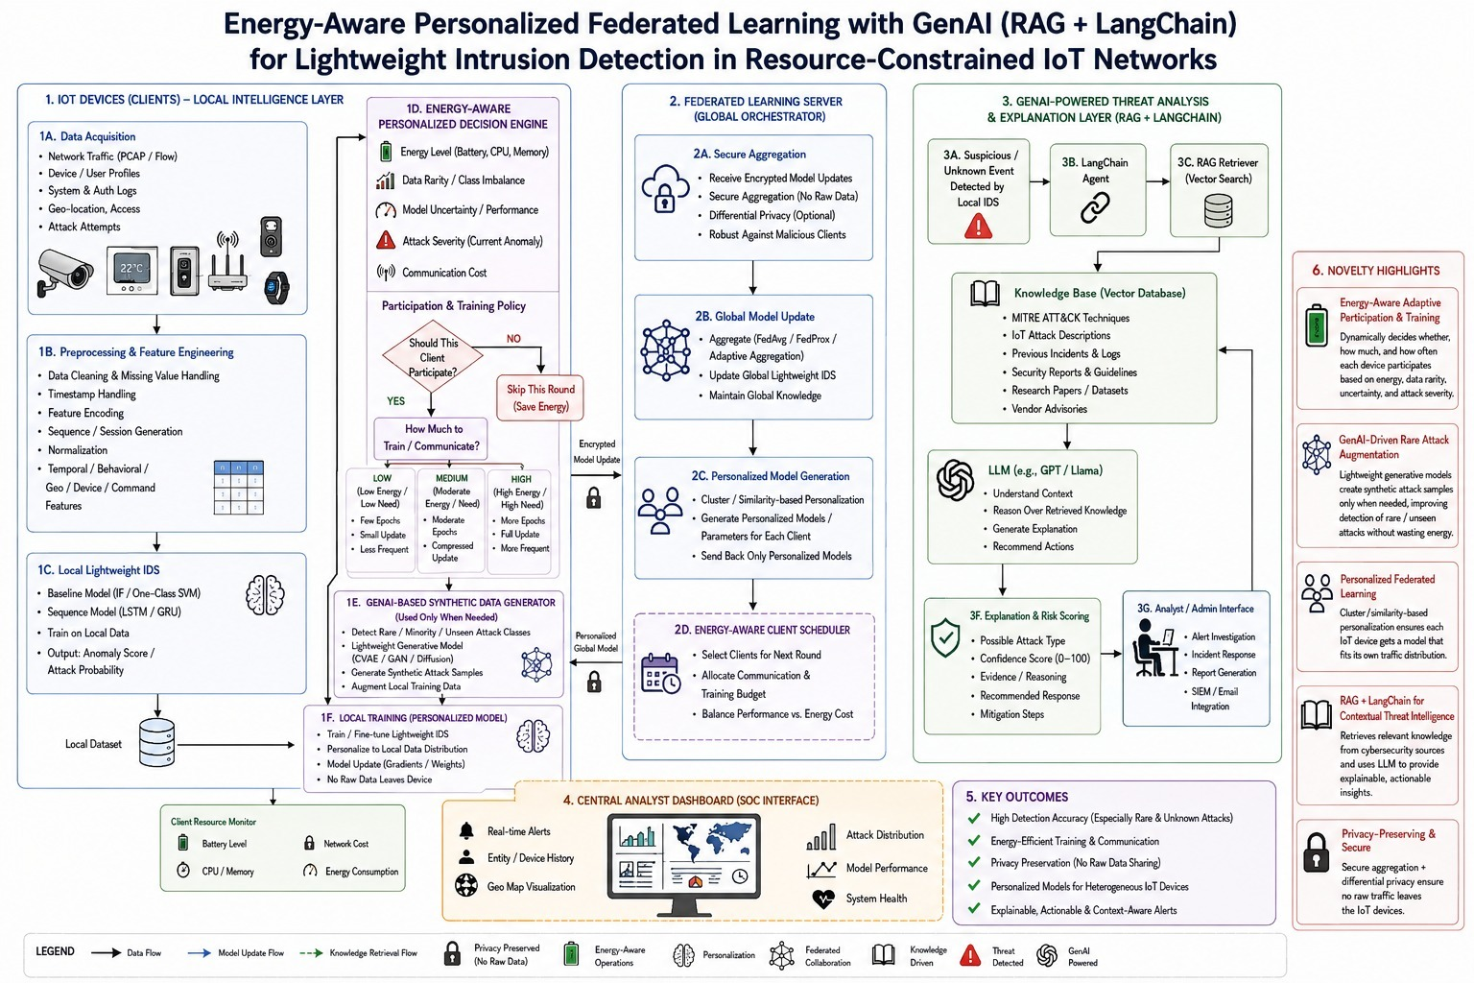
Architecture
4
14

Slide 16
EVALUATION PLAN
Datasets & Metrics
Benchmark Datasets
Evaluation Metrics
•
N-BaIoT — 9 real IoT devices, Mirai/BASHLITE/Gafgyt botnet traffic — natural non-IID split
•
Accuracy, Precision, Recall, F1-score (per class)
•
CIC-IDS-2017 / NSL-KDD / KDDCup99 — Baseline comparison against the centralized CNN-BiLSTM hybrid
•
False Positive Rate (FPR) and AUC-ROC
•
TON_IoT / Bot-IoT (stretch goal) — Modern IoT-specific traffic for generalization testing
•
Rounds-to-convergence vs FedAvg / FedAvgM baselines
•
Communication payload per round (KB/client)
•
Local training time & memory footprint on constrained hardware
Baseline comparison target: outperform FedAvg (94.05% acc / 5.1% FPR) and FedAvgM (95.05% acc / 3.9% FPR) on N-BaIoT while reducing per-device accuracy variance — the core signature of successful personalization.
15

Slide 17
EXPECTED CONTRIBUTIONS
Novelty of This Work
1
A federated IDS that personalizes per client without sacrificing the privacy guarantees of FedAvg/FedAvgM
2
A lightweight local model architecture designed explicitly for resource-constrained IoT hardware
3
A similarity/cluster-aware aggregation strategy that mitigates non-IID accuracy loss
4
An empirical comparison against the two base papers' centralized-hybrid and vanilla-FL approaches on shared datasets
16

Slide 18
REFERENCES
Key References (selected)
• Zahid, M., Bharati, T.S. (2025). Enhancing cybersecurity in IoT systems: a hybrid deep learning approach for real-time attack detection. Discover IoT, 5
• Khraisat, A. et al. (2025). Federated learning for intrusion detection in IoT environments: a privacy-preserving strategy. Discover IoT, 5:72.
• Thein, T.T., Shiraishi, Y., Morii, M. (2024). Personalized federated learning-based IDS: poisoning attack and defense. FGCS, 153, 182-192.
• McMahan, B. et al. (2017). Communication-efficient learning of deep networks from decentralized data. AISTATS / PMLR.
• Hsu, T-M.H., Qi, H., Brown, M. (2019). Measuring the effects of non-identical data distribution for federated visual classification. arXiv:1909.06335.
• Hamad, N.A. et al. (2025). Systematic Analysis of FL Approaches for Intrusion Detection in IoT. IEEE Access, 13.
• Full list of 18–20 recent papers with methodology, gap, and links: see companion reference sheet.
17

Slide 19
Thank You
Questions & Discussion
Personalized Federated Learning for Intrusion Detection
in Resource-Constrained IoT Networks

