Slide 1
FINAL PROJECT PRESENTATION
Wine Quality
Prediction
Results, Findings & Hypothesis Validation
TEAM MEMBERS
Ashish Gole
Siddhi Retharekar
Sanyami Naik
Nirmal Attarde
Dataset: WineQT.csv (Kaggle) | Framework: Python & Scikit-learn | IS 407 - Introduction to Data Science
Notes:
Good [morning/afternoon] everyone. I'm [Name], and together with my teammates Ashish Gole, Siddhi Retharekar, Sanyami Naik, and Nirmal Attarde, we're presenting the final results of our IS 407 project — Wine Quality Prediction Using Machine Learning. In our proposal, we set out to predict whether a red wine is High or Low quality based purely on its chemical properties, using four different ML models. Today we're here to share what we found, answer our four research questions, and validate the hypotheses we stated in the proposal. Let's dive in.

Slide 2
PROJECT RECAP & PIPELINE
Objective
Predict red wine quality (High ≥ 6 / Low ≤ 5) using 11 physicochemical features from 1,143 samples — comparing 4 ML models across accuracy, feature importance, and the impact of feature scaling.
01 Data Loading & EDA
02 Preprocessing
03 Feature Scaling
04 Model Training
05 Evaluation & Analysis
1,143 samples
0 nulls, 0 duplicates
Quality: 3–8 range
Drop Id column
Binarize quality target
80/20 train-test split
StandardScaler fit
on train set only
(no data leakage)
4 classifiers trained
on scaled data
(LR, DT, RF, KNN)
Accuracy, F1, confusion
matrix, feature importance
scaling experiment
1,143
11
522 / 621
80% / 20%
42
Total Samples
Features
Low / High Split
Train / Test
Random Seed
Notes:
Before getting into results, let me quickly recap what we did. Our objective was to classify 1,143 red wine samples from the WineQT Kaggle dataset into binary quality labels — High quality for scores 6 and above, and Low quality for scores 5 and below — using 11 physicochemical features. Our pipeline had five stages: data loading and EDA, preprocessing where we dropped the Id column and binarized the quality target, feature scaling with StandardScaler fitted only on training data to prevent data leakage, model training on all four classifiers, and finally evaluation with feature importance and scaling experiments. The dataset is nearly balanced — 522 Low quality and 621 High quality samples — which is good news for model training.

Slide 3
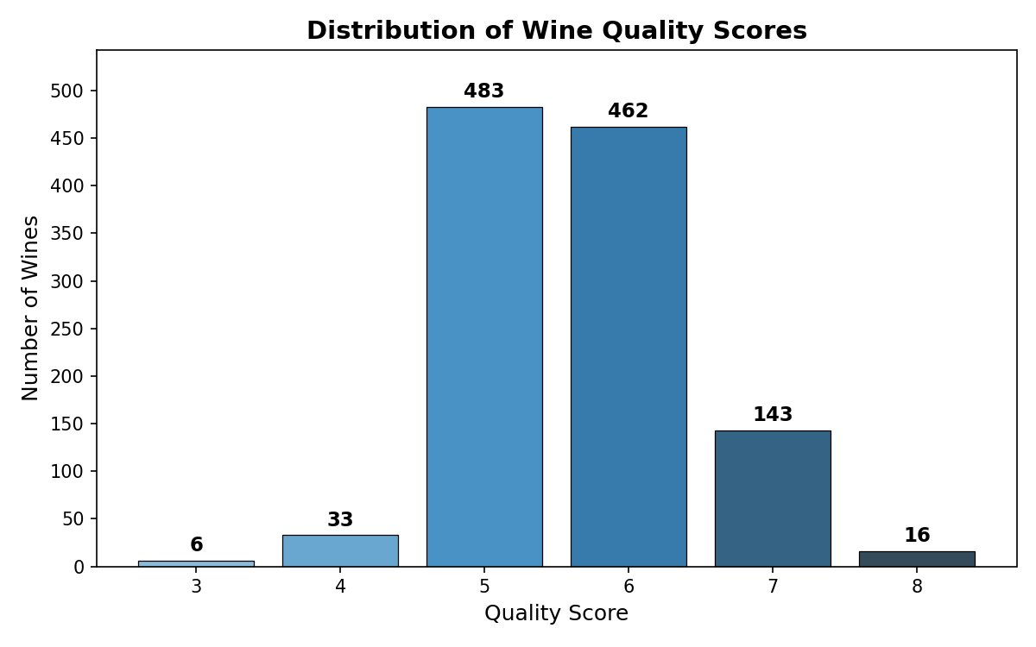
EDA: QUALITY DISTRIBUTION & CLASS BALANCE
Key Findings
Quality Range:
Scores span 3–8
Most Common:
Score 5 (483) & 6 (462)
Top 2 = 82.7%:
Of all 1,143 samples
After Binarizing:
Low (0): 522 → 45.7%
High (1): 621 → 54.3%
Balance:
Near-balanced — no major class imbalance issue
Scores 5 & 6 dominate — the binarization threshold (quality ≥ 6 = High) sits in the densest region, making classification more challenging.
Notes:
Starting with exploratory data analysis. The quality scores range from 3 to 8, with scores 5 and 6 together making up over 82% of all samples. This creates a challenge for classification because our binarization threshold sits right at the 5-6 boundary — the densest region of the data. Many samples near this boundary are genuinely hard to distinguish. After binarizing, we ended up with 522 Low quality samples at 45.7% and 621 High quality samples at 54.3% — a near-balanced split with no major class imbalance issues, so we did not need to apply techniques like SMOTE or class weighting.

Slide 4
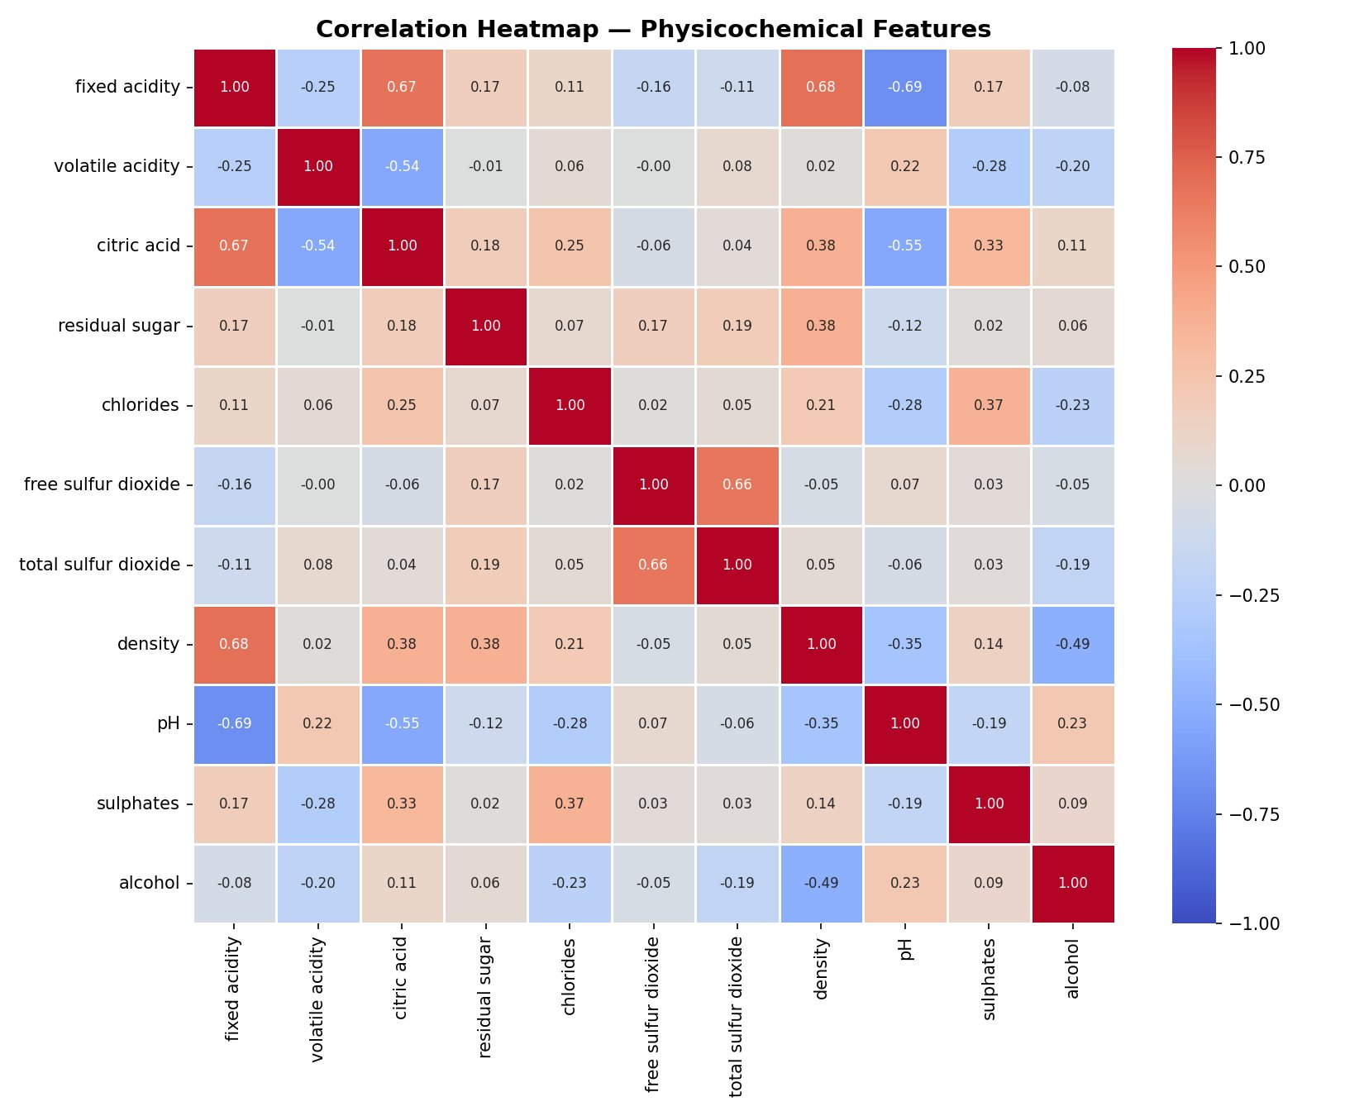
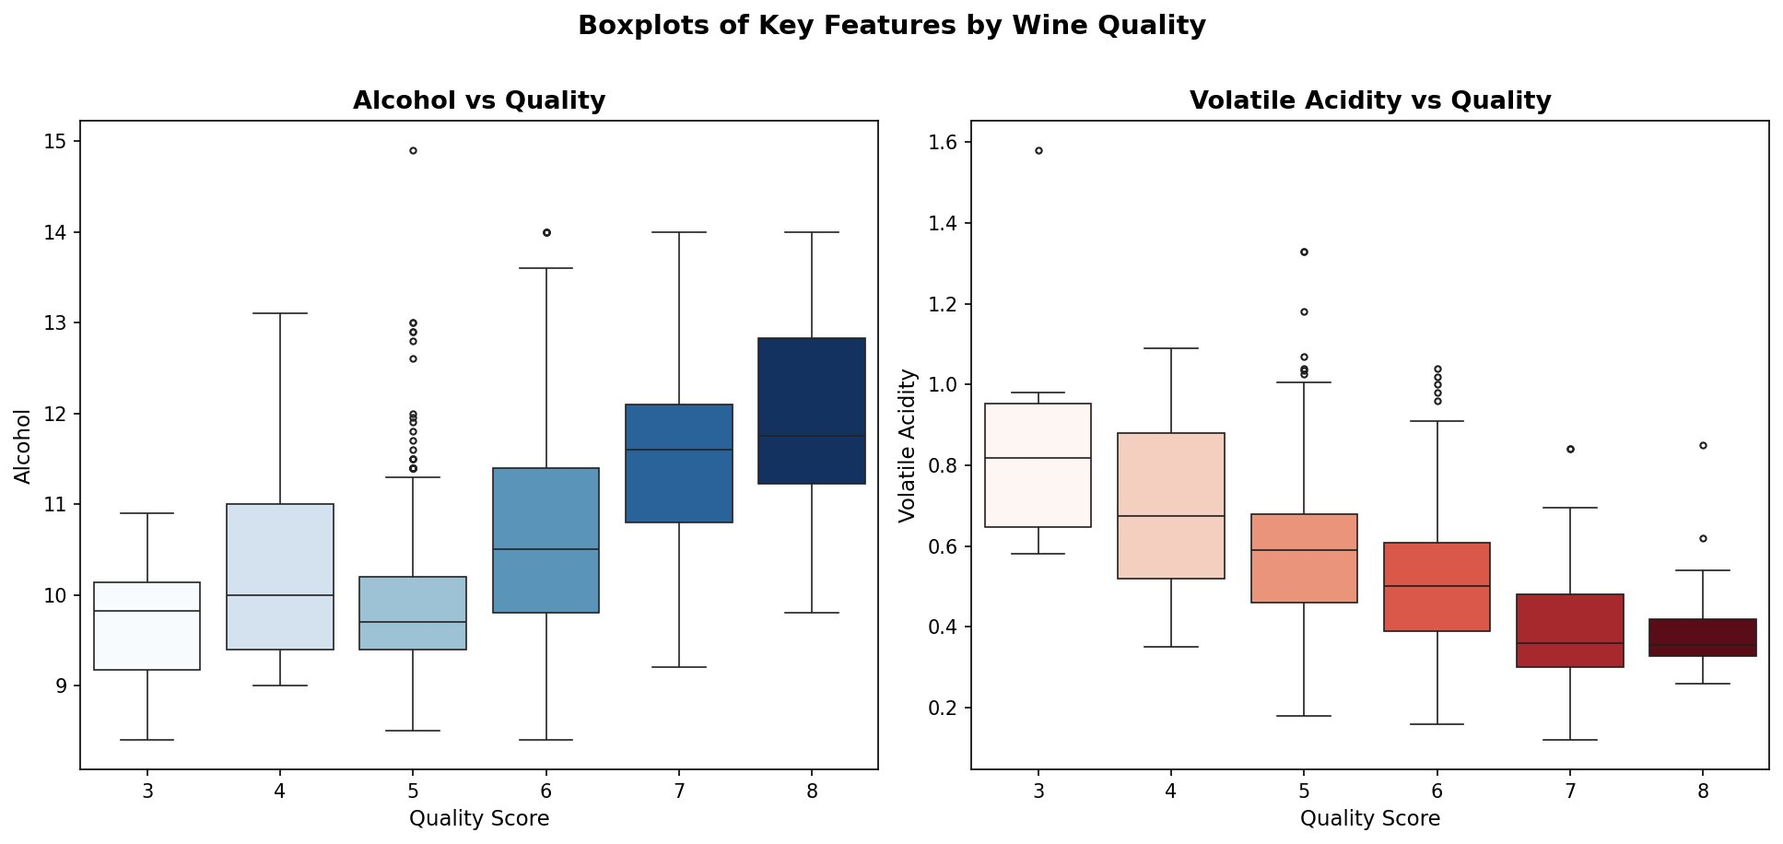
EDA: FEATURE CORRELATIONS & KEY TRENDS
🔍 Strongest correlations: Fixed Acidity ↔ Density (+0.68), Free SO₂ ↔ Total SO₂ (+0.66), Fixed Acidity ↔ pH (−0.69)
👁 Alcohol rises monotonically with quality; Volatile Acidity falls — both confirm our RQ2 hypothesis direction.
Notes:
Next we looked at correlations and feature trends. The heatmap on the left shows that Fixed Acidity and Density are strongly positively correlated at plus 0.68, while Fixed Acidity and pH are strongly negatively correlated at minus 0.69 — both chemically intuitive. The boxplots on the right are very informative. Alcohol rises monotonically with quality — wines scoring 8 have a median alcohol of nearly 12% versus about 9.9% for score 5. Volatile Acidity follows the opposite trend — it falls as quality increases. These clear trends gave us strong early evidence before any model training that chemistry does carry a meaningful signal for quality prediction.

Slide 5
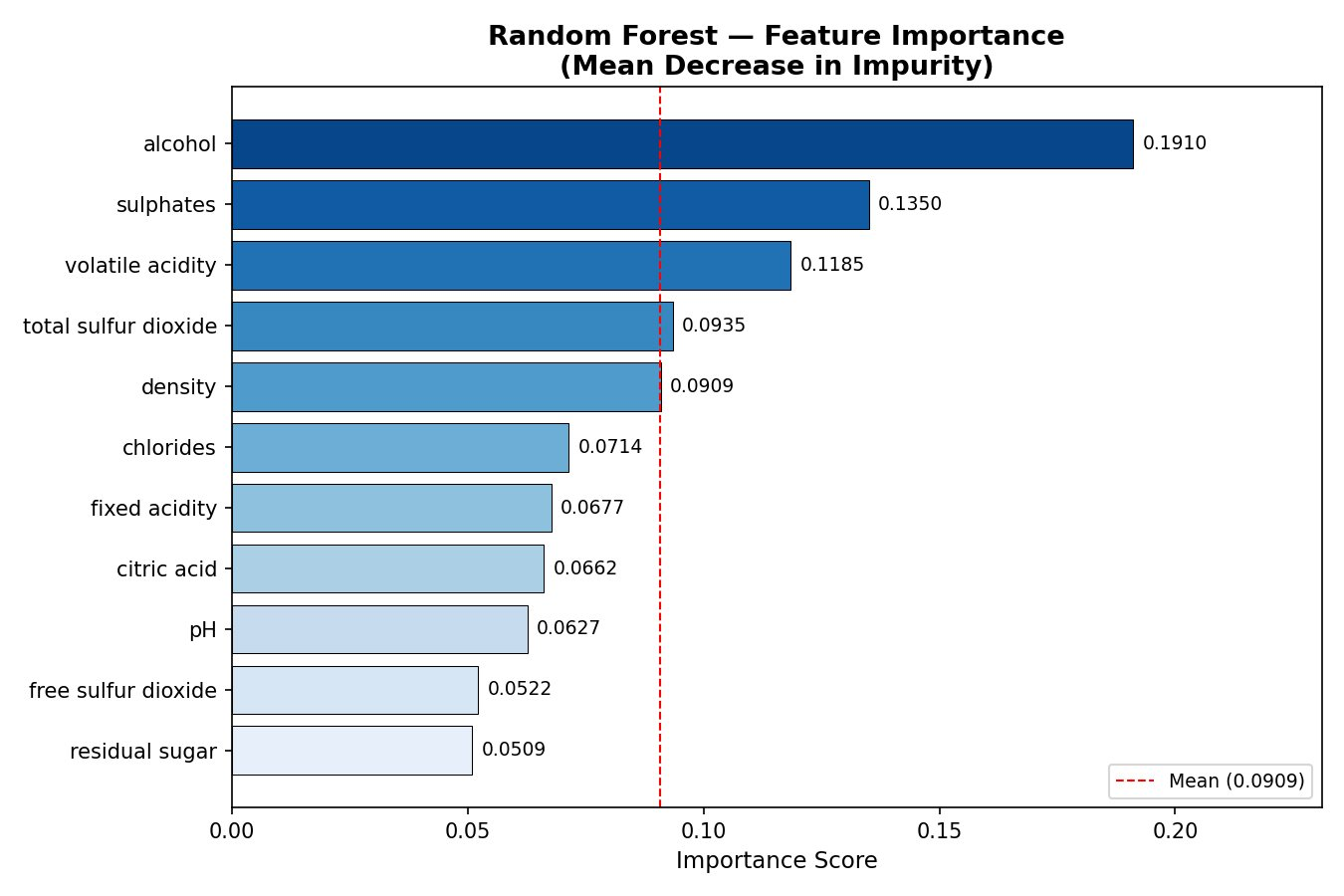
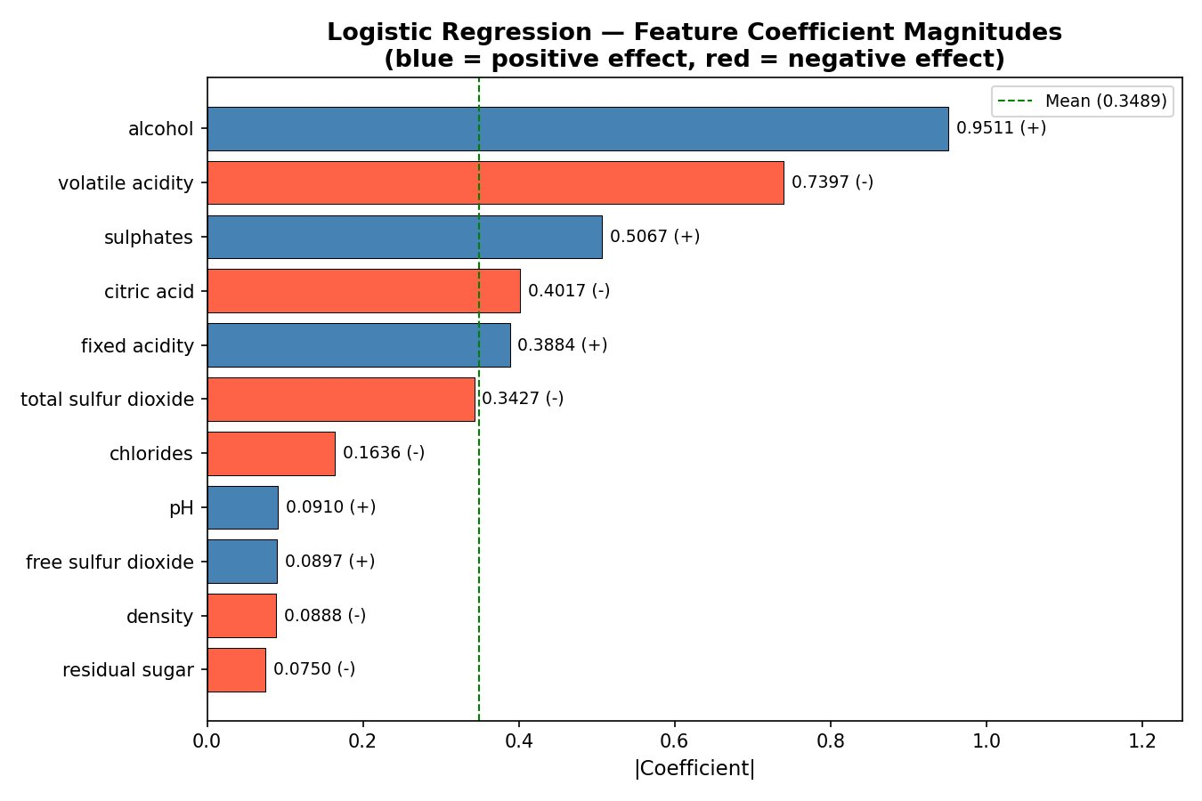
RQ2: WHICH FEATURES MOST INFLUENCE WINE QUALITY?
Both models agree on Top-3:
#1 Alcohol
#2 Volatile Acidity
#3 Sulphates
RF: 0.1910 | LR: 0.9511 (+)
RF: 0.1185 | LR: 0.7397 (−)
RF: 0.1350 | LR: 0.5067 (+)
Notes:
Research Question 2 — which chemical features most influence predictions. We used two methods: Random Forest's Mean Decrease in Impurity on the left, and Logistic Regression's coefficient magnitudes on the right. Both models agree that Alcohol is the number one predictor — scoring 0.1910 in Random Forest and 0.9511 in Logistic Regression. After alcohol, the models differ slightly: Random Forest ranks Sulphates second at 0.1350, then Volatile Acidity third. Logistic Regression puts Volatile Acidity second with a negative coefficient, meaning higher volatile acidity predicts lower quality, and Sulphates third. Our hypothesis was that Alcohol and Volatile Acidity would be top-2 in both models — we got a partial result. Alcohol is universally number one, but Sulphates displaced Volatile Acidity to second place in the Random Forest ranking.

Slide 6
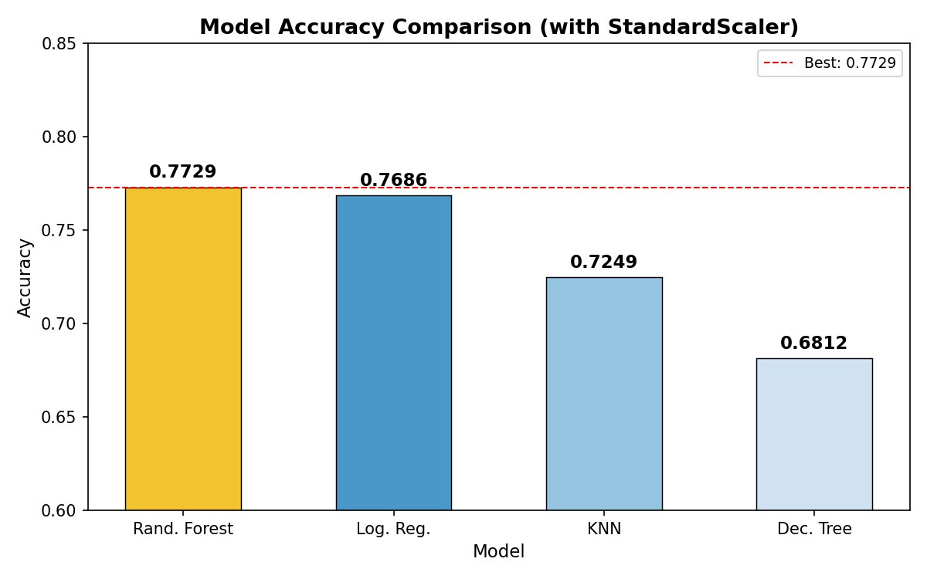
RQ3: WHICH MODEL PERFORMS BEST?
Model Leaderboard
#1
Random Forest
Acc: 77.29% | F1: 0.771
#2
Logistic Reg.
Acc: 76.86% | F1: 0.766
#3
KNN
Acc: 72.49% | F1: 0.720
#4
Decision Tree
Acc: 68.12% | F1: 0.678
RQ3 Answer: Random Forest wins with 77.29% accuracy — confirming H3. It outperforms the 50% random baseline by +27.29%, with all 4 models beating the baseline by at least +18%.
Notes:
Research Question 3 — which model performs best. The results are clear: Random Forest takes the top spot with 77.29% accuracy and a macro F1 of 0.771. Logistic Regression comes in a very close second at 76.86% — only 0.43 percentage points behind. KNN is third at 72.49%, and Decision Tree is last at 68.12%. This confirms Hypothesis 3 that Random Forest would win. However, what's noteworthy is how competitive Logistic Regression is despite being a much simpler linear model. This tells us the relationship between chemical features and quality has a strong linear component. All four models beat the 50% random baseline by at least 18 percentage points, and the best model exceeds it by over 27 percentage points.

Slide 7
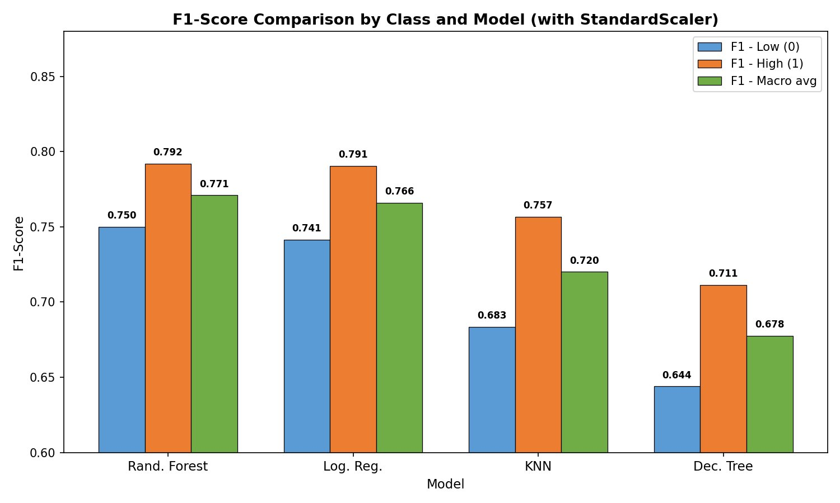
RQ3 CONTINUED: F1-SCORE COMPARISON BY CLASS
F1 Insights
All models:
predict High quality (1) better than Low (0)
Rand. Forest:
F1-High: 0.792 | F1-Low: 0.750
Log. Reg.:
F1-High: 0.791 | F1-Low: 0.741
KNN:
F1-High: 0.757 | F1-Low: 0.683
Dec. Tree:
Lowest overall
F1-Macro: 0.678
RF vs LR:
Only 0.001 F1 difference — LR highly competitive
Class imbalance in prediction: High quality wines are consistently predicted better than Low quality wines across all 4 models.
Notes:
Digging deeper into the F1 analysis for Research Question 3. The most important observation here is that all four models predict High quality wines better than Low quality wines. For Random Forest, F1 for High quality is 0.792 versus 0.750 for Low quality. This asymmetry exists because there are more High quality samples in the test set — 127 versus 102 — giving models more training signal. High quality wines also tend to have more distinctive chemical profiles, making them easier to classify. A key takeaway: the gap between Random Forest and Logistic Regression in F1 is essentially negligible at just 0.001. In a real production setting, you might actually prefer Logistic Regression for its interpretability, speed, and near-equivalent performance.

Slide 8
RQ4: HOW DOES FEATURE SCALING IMPACT PERFORMANCE?
Each model was trained TWICE — once on raw (unscaled) data and once on StandardScaler-normalized data. Accuracy scores were then compared.
Model
Without Scaling
With Scaling
Difference
Impact
Logistic Regression
76.86%
76.86%
+0.00%
No change
Decision Tree
68.12%
68.12%
+0.00%
No change
Random Forest
77.29%
77.29%
+0.00%
No change
KNN
67.25%
72.49%
+5.24%
↑ Improved!
RQ4 Answer: Scaling significantly helped only KNN (+5.24%). Tree-based models are scale-invariant by design. Logistic Regression was already strong enough with default convergence settings.
Notes:
Research Question 4 — impact of feature scaling. We trained each model twice: once on raw unscaled data and once on StandardScaler normalized data. Tree-based models — Random Forest and Decision Tree — show exactly zero change with scaling, as expected, because tree splits are based on rank order of values rather than absolute magnitude. Logistic Regression also showed no change here, which was somewhat surprising since it is theoretically sensitive to feature scale. This likely happened because our features converged within the 1000 iteration limit even without scaling. KNN, however, improved by 5.24 percentage points — from 67.25% to 72.49% — with scaling applied. This is exactly what we predicted: KNN calculates Euclidean distances, so features with large ranges like Fixed Acidity would dominate without normalization. Our hypothesis was partially confirmed.

Slide 9
RQ1: CAN CHEMISTRY ALONE PREDICT WINE QUALITY?
YES — All 4 models significantly beat the 50% random baseline, confirming chemistry IS a strong predictor.
Random Forest
Log. Regression
KNN
Decision Tree
77.29%
76.86%
72.49%
68.12%
above baseline
above baseline
above baseline
above baseline
+27.29%
+26.86%
+22.49%
+18.12%
Nuance — What the 77.29% Means
While 77.29% is strong, it also means ~1 in 4 predictions is wrong. Quality scores 5 and 6 are adjacent and easy to confuse after binarization. The gap between best model (RF: 77.29%) and worst (DT: 68.12%) is 9.17% — showing model choice matters. Chemistry captures the dominant signal but unmeasured factors (e.g. grape variety, vintage, winemaking technique) likely explain the remaining error.
Notes:
Answering Research Question 1 directly — can chemistry alone predict wine quality. The answer is a clear YES. Every single model beats the 50% random baseline by a significant margin. Random Forest achieves plus 27.29% above baseline, Logistic Regression plus 26.86%, KNN plus 22.49%, and even Decision Tree beats baseline by plus 18.12%. However, we should be honest about what 77.29% accuracy means: roughly 1 in 4 predictions is still wrong. Chemistry captures the dominant signal, but unmeasured factors — such as grape variety, vintage year, winemaking technique, and barrel aging — likely explain the remaining error. The 9 percentage point gap between best and worst model also shows that model choice matters significantly.

Slide 10
HYPOTHESIS VALIDATION
H1 / RQ1
Hypothesis:
All models will beat the 50% random baseline
SUPPORTED ✔
Result:
All 4 models beat 50% baseline. Best: RF 77.29%, Worst: DT 68.12% — both well above 50%.
H2 / RQ2
Hypothesis:
Alcohol & volatile acidity are top-2 features in both models
PARTIAL ⚠
Result:
Alcohol = #1 in BOTH models. RF top-2: alcohol + sulphates. LR top-2: alcohol + volatile acidity. Not identical but alcohol is universally #1.
H3 / RQ3
Hypothesis:
Random Forest will achieve the highest accuracy
SUPPORTED ✔
Result:
RF wins with 77.29% accuracy and macro F1 of 0.771. However, Logistic Regression is very close (76.86%) — a 0.43% margin.
H4 / RQ4
Hypothesis:
Scaling boosts KNN & Logistic Regression; tree models unaffected
PARTIAL ⚠
Result:
KNN improved +5.24% with scaling. Surprisingly, Logistic Regression showed 0% change with these settings. Tree models unaffected as expected.
Notes:
Let's formally validate all four hypotheses from our proposal. Hypothesis 1 — all models beat the 50% baseline — is fully SUPPORTED. Every model exceeded 68%, well above 50%. Hypothesis 2 — Alcohol and Volatile Acidity are top-2 in both models — is PARTIAL. Alcohol is number one in both, but Random Forest ranked Sulphates second rather than Volatile Acidity. Hypothesis 3 — Random Forest achieves the highest accuracy — is fully SUPPORTED at 77.29%, though Logistic Regression was extremely close. Hypothesis 4 — scaling boosts both KNN and Logistic Regression — is PARTIAL. KNN improved by 5.24% as predicted, but Logistic Regression showed zero change, which was unexpected. Overall: 2 hypotheses fully confirmed, 2 partially confirmed.

Slide 11
CONCLUSIONS & KEY TAKEAWAYS
Final Results Summary
77.29%
#1
+5.24%
3/4
Best Accuracy
Top Feature
Scaling Boost
Hypotheses Met
Random Forest
Alcohol Content
KNN with StandardScaler
H1, H3 fully; H2 & H4 partial
What We Learned
This project confirmed that physicochemical properties alone can predict wine quality with up to 77.29% accuracy. Random Forest was the best model, but Logistic Regression (76.86%) was nearly as strong with far less complexity. Alcohol is the most consistently important feature across both models. Feature scaling proved essential for KNN (+5.24%), reinforcing the importance of proper preprocessing. The project delivered exactly what the proposal set out to achieve: an end-to-end ML pipeline, model comparison experience, feature importance insight, and a deep understanding of preprocessing tradeoffs.
Notes:
To wrap up our final results. Best accuracy: 77.29% by Random Forest. Top feature across both models: Alcohol content. Biggest impact from scaling: KNN with plus 5.24% boost. Hypothesis scorecard: 3 out of 4 confirmed, either fully or partially. What did we learn? We gained genuine hands-on experience with a full end-to-end ML pipeline. We developed model selection intuition — understanding when a simple linear model can match a complex ensemble. We connected chemical domain knowledge to ML feature importance. And we understood when preprocessing choices matter and when they don't. Every goal we set in the project proposal has been achieved. This project demonstrated that the chemistry of wine carries real predictive power for quality classification.

Slide 12
WINE QUALITY PREDICTION | IS 407 | FINAL PROJECT
Thank You!
Q & A
We welcome your questions and feedback.
TEAM
• Ashish Gole
• Siddhi Retharekar
• Sanyami Naik
• Nirmal Attarde
Wine Quality Prediction | IS 407 - Introduction to Data Science | Final Project
Notes:
And that concludes our final project presentation for Wine Quality Prediction. To summarize in three sentences: red wine quality can be predicted from chemical properties alone with up to 77.29% accuracy; Random Forest was the best model but Logistic Regression matched it within 0.43%; and alcohol content is the single most important chemical predictor across all models. Thank you all for your attention. We're happy to take any questions about our methodology, results, or anything else.

