Slide 1

Optical character recognition(OCR)

Slide 2







OCR Applications
BANK
The most frequent use of OCR is to handle cheques: a handwritten cheque is scanned, its contents converted into digital text, the signature verified and the cheque cleared in real time, all with human involvement.
LAW
Reams and reams of affidavits, judgements, filings, statements, wills and other legal documents, especially the printed ones, can be digitized, stored, databased and made searchable using the simplest of OCR readers
Hospital
Having one’s entire medical history on a searchable, digital store means that things like past illnesses and treatments, diagnostic tests, hospital records, insurance payments etc can be made available in one unified place
Optical Music Recognition
This is basically OCR applied to musical notation. By scanning sheet music, not only are the notations available digitally, but they can also be converted by specialist applications into sound
Automatic License Plate Detection
IT is a technology that uses optical character recognition on images to read vehicle registration plates to create vehicle location data.

Slide 3
OPENCV(Open Source Computer Vision Library)
The library has more than 2500 optimized algorithms, which includes a comprehensive set of both classic and state-of-the-art computer vision and machine learning algorithms.
These algorithms can be used to detect and recognize faces, identify objects, classify human actions in videos, track camera movements, track moving objects, extract 3D models of objects, produce 3D point clouds from stereo cameras, stitch images together to produce a high-resolution image of an entire scene
Find similar images from an image database, remove red eyes from images taken using flash, follow eye movements, recognize scenery and establish markers to overlay it with augmented reality, etc.

Slide 4
Process (Steps)

Slide 5
Reading and Displaying Image
To read the original image, simply call the imread function of the cv2 module, passing as input the path to the image, as a string.
image = cv2.imread('C:/Users/N/Desktop/Test.jpg’)
Now, to display the images, we simply need to call the imshow function of the cv2 module. This function receives as first input a string with the name to assign to the window, and as second argument the image to show.
cv2.imshow(‘Test image’, image)
Finally, we will call the waitKey function, which will wait for a keyboard event. Nonetheless, if we pass the value 0, then it will wait indefinitely until a key event occurs.Finally, once the user pressed a key, we call the destroyAllWindows function, which will destroy the previously created windows.
cv2.waitKey(0)
cv2.destroyAllWindows()

Slide 6
Image Pre-Processing
Converting to Grayscale
Noise removal
Thresholding
Dilation
Erosion
Skew correction

Slide 7
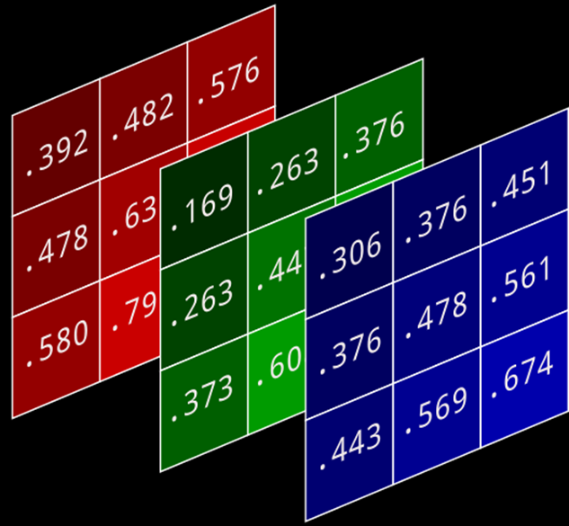
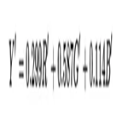
Gray Scale
Grayscale image only has shades of black and white. It doesn't have any color information like chrominance.
Gray scale image is usually 8bit image with each pixel having 256 combinations of shades of gray.
Whereas color image usually is a 24-bit image with 8bits of Red, 8 bits of Green, 8bits for blue information. Combination of these three basic colors can create 16,777,216 color combinations for a pixel

Slide 8
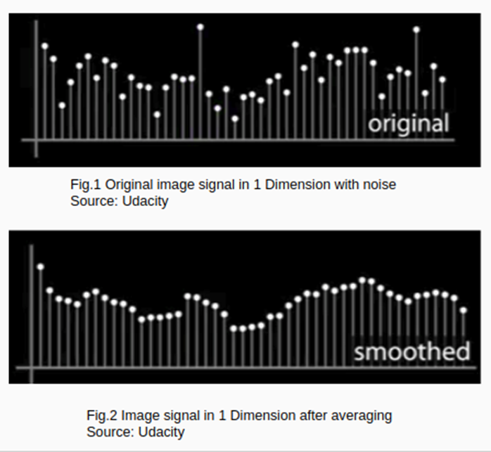
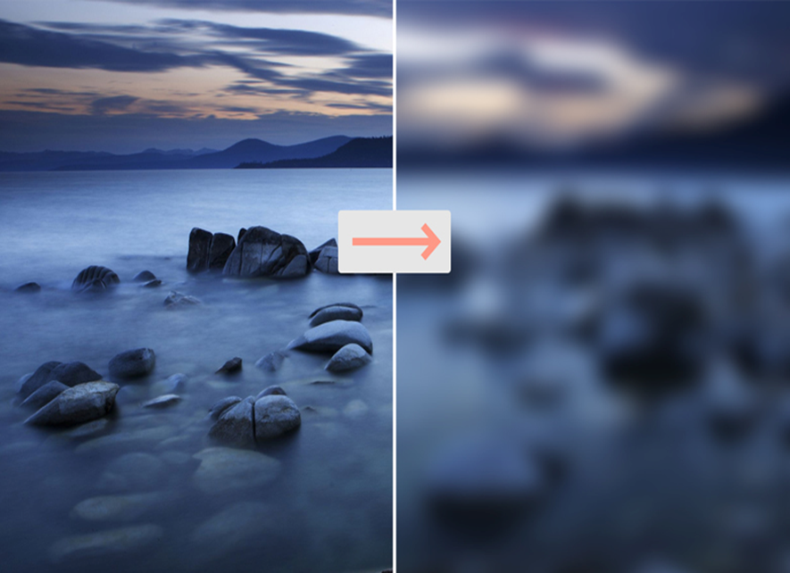
Filtering
Basic Filter
Gaussian Filter

Slide 9
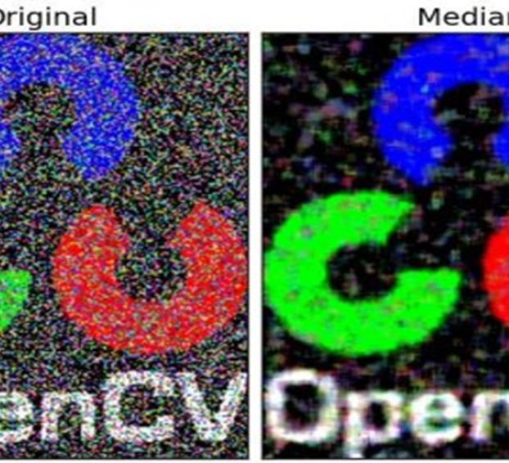
MedianBlur
The Median Filter is a non-linear digital filtering technique, often used to remove noise from an image or signal. This is highly effective in removing salt-and-pepper noise.
The median filter works by moving through the image pixel by pixel, replacing each value with the median value of neighboring pixels. The pattern of neighbors is called the "window", which slides, pixel by pixel, over the entire image.
The median is calculated by first sorting all the pixel values from the window into numerical order, and then replacing the pixel being considered with the middle (median) pixel value.

Slide 10
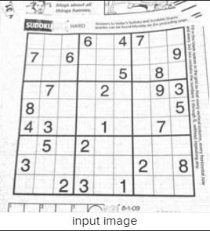
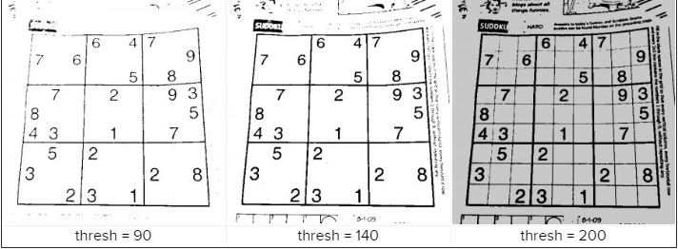
Thresholding
Thresholding is a basic method for image segmentation, used to separate regions of objects from the background. The simplest form of thresholding compares each pixel intensity value with a determined threshold value.
Each pixel below a specific threshold limit is assigned a value like “black” or “white” respectively, if the pixel intensity is above the threshold limit.

Slide 11
Different Threshold Techniques
Simple Thresholding : The global value of threshold was used which remained constant throughout.
Adaptive thresholding : The threshold value is calculated for smaller regions with different threshold values for different regions with respect to the change in lighting.
Otsu’s thresholding : It is an adaptive thresholding way for binarization in image processing. By going through all possible threshold values (from 0 to 255), it can find the optimal threshold value of input image.

Slide 12



Dilation and Erosion
Erosion: In the Erosion, it erodes away the boundaries of foreground objects. It is used to remove small white noises from the images
Dilation : It increases the white region in the image or size of foreground object increases
Original
Erosion
Dilation

Slide 13


Dilation and Erosion
OPENING : Opening is just another name of erosion followed by dilation. It is useful in removing noise. Here we use the function, cv2.morphologyEx()
CLOSING : Closing is reverse of Opening, Dilation followed by Erosion. It is useful in closing small holes inside the foreground objects, or small black points on the object.

Slide 14
Skew Correction
Grab the (x, y) coordinates of all pixel values that are greater than zero, then use these coordinates to compute a rotated bounding box that contains all coordinates
coords = np.column_stack(np.where(thresh > 0))
angle = cv2.minAreaRect(coords)[-1]
Rotating the image to correct for the skew.
(h, w) = image.shape[:2]
center = (w // 2, h // 2)
M = cv2.getRotationMatrix2D(center, angle, 1.0)
rotated = cv2.warpAffine(image, M, (w, h),
flags=cv2.INTER_CUBIC, borderMode=cv2.BORDER_REPLICATE)

Slide 15
Pytesseract
We will use the Python-Tesseract, or simply PyTesseract, library which is a wrapper for Google's Tesseract-OCR Engine.
Different Functions:
Image_to_string : Simple image to string
Image_to_boxes : Get bounding box estimates
Image_to_data : Get verbose data including boxes, confidences, line and page numbers
Image_to_osd : Get information about orientation and script detection

Slide 16
Regex – Pattern Matching
To find PAN NO:
re.findall(r’\w{4}[a-zA-Z]\d{3}[0-9]\w{0}[A-Z]', text)
To find Date:
re.findall(r'\d{2}[-/|-]\d{2}[-/|-]\d{4}', text)

Slide 17

THANK YOU
ASHISH.GP10@GMAIL.COM
https://www.linkedin.com/in/ashish-gupta-405b1b47/
7022450444

