Slide 1

MID-TERM EVALUATION · PROJECT 16
Anomaly Detection Using Machine Learning for Advanced Persistent Threats (APT)
A hybrid Random Forest + XGBoost ensemble, re-implemented and evaluated on the APT-specific DAPT2020 dataset
PRESENTED BY
Ashish Jain (2025202029)
Ameya Purohit (2025202006)
Chaitanya Shah (2025202033)
Based on: Saini N., Bhat Kasaragod V., Prakasha K., Das A.K. Concurrency and Computation: Practice and Experience, 35(28), e7865, 2023
Notes:
[ 0:40 on this slide | clock 0:00 -> 0:40 of 20:00 ]
Good morning. We are Ashish Jain, Ameya Purohit and Chaitanya Shah, and we are presenting Project 16: anomaly detection using machine learning for Advanced Persistent Threats, or APTs.
Our reference paper is Saini and colleagues, published in 2023 in Concurrency and Computation: Practice and Experience. It proposes a hybrid Random Forest plus XGBoost model for detecting APT attacks.
In this mid-term evaluation we will show that we implemented the complete method, moved it to a dataset that genuinely contains APT attacks, and tested whether the paper's claims hold up.
TRANSITION: Here is how the talk is organised.

Slide 2
Agenda
01
Background
The paper, what makes an APT different, and why its datasets fall short
Four parts, one question: does the paper's hybrid model really detect APTs?
02
Data & method
DAPT2020, the pipeline, the hybrid model and a flaw in the protocol
03
Results
Six results on real APT traffic, including 15 models and 5 random seeds
04
Conclusions
What we have shown so far and the plan for the final evaluation
Anomaly detection for Advanced Persistent Threats | Mid-term evaluation
2
Notes:
[ 0:40 on this slide | clock 0:40 -> 1:20 of 20:00 ]
Four parts. First, background: the paper, what makes an APT different, and why the paper's datasets are a problem. Second, data and method: the DAPT2020 dataset, the pipeline, the hybrid model, and a flaw in the paper's evaluation. Third, six results. Fourth, conclusions and the plan for the final evaluation.
One question runs through all of it: does the paper's hybrid model really detect APTs?

Slide 3
01
Background
The paper, what makes an APT different, and why its datasets fall short
Notes:
[ 0:10 on this slide | clock 1:20 -> 1:30 of 20:00 ]
Let's start with the background.

Slide 4
01 · BACKGROUND
The paper: a hybrid ensemble for APT detection
What the paper claims
CONCURRENCY AND COMPUTATION: PRACTICE AND EXPERIENCE · 2023
A hybrid ensemble machine learning model for detecting APT attacks based on network behavior anomaly detection
98.92%
0.52%
accuracy on
CSE-CIC-IDS2018
false positive
rate
Neeraj Saini, Vivekananda Bhat Kasaragod, Krishna Prakasha, Ashok Kumar Das
4
13
Manipal Institute of Technology · IIIT Hyderabad
public intrusion
datasets
baseline models,
including CNN and MLP
doi.org/10.1002/cpe.7865
Our task: implement it fully, test it on a genuine APT dataset, and check whether the claims hold.
Anomaly detection for Advanced Persistent Threats | Mid-term evaluation
4
Notes:
[ 1:10 on this slide | clock 1:30 -> 2:40 of 20:00 ]
The paper combines two tree-based models, Random Forest and XGBoost, using a Python library called combo.
It compares this hybrid against thirteen other models, from K-nearest neighbours and SVMs to CNN and MLP, on four public intrusion-detection datasets: CSE-CIC-IDS2018, CIC-IDS2017, NSL-KDD and UNSW-NB15.
The headline claim: 98.92 percent accuracy with a false positive rate of only 0.52 percent on CSE-CIC-IDS2018, and the hybrid beats every other model.
Our task: implement the method completely, test it on a genuine APT dataset, and check whether the claims hold. Keep the false positive rate in mind; in a security operations centre, false alarms are what analysts drown in.
TRANSITION: To see why the dataset matters, we first need to be clear about what an APT is.

Slide 5







01 · BACKGROUND
An APT is a campaign, not a single attack
STAGE 1
STAGE 2
STAGE 3
STAGE 4
Reconnaissance
Establish foothold
Lateral movement
Data exfiltration
Scan and map the target: ports, pages, accounts
Exploit a weakness and plant a backdoor
Spread inside the network, escalate privileges
Quietly send the stolen data out
Low and slow
Blends in
Persistent
Few packets, spread over days or months
Deliberately resembles normal traffic
Aims for long-term access and data theft
Anomaly detection for Advanced Persistent Threats | Mid-term evaluation
5
Notes:
[ 1:00 on this slide | clock 2:40 -> 3:40 of 20:00 ]
An Advanced Persistent Threat is a campaign, not a single attack. It moves through stages: reconnaissance, where the attacker maps the target; establishing a foothold, for example through SQL injection and a backdoor; lateral movement inside the network; and finally data exfiltration.
APTs are hard to detect because they are low and slow, they deliberately blend in with normal traffic, and they aim for long-term access.
So to claim we detect APTs, the test data must contain this kind of multi-stage campaign.
TRANSITION: That is exactly where the paper falls short.

Slide 6


01 · BACKGROUND
The paper's datasets contain no APT campaigns
USED IN THE PAPER
USED IN THIS WORK
CIC-IDS2017 / 2018
NSL-KDD
UNSW-NB15
DAPT2020
Built around an APT campaign
Flows labelled with the APT stage
Attack types
DoS, brute force, botnet, web
DoS, probe, R2L, U2R
Fuzzers, exploits, DoS
Recon → foothold → lateral → exfiltration
Same flow features as CIC-IDS (CICFlowMeter)
Traffic recorded
2017–2018
1998 (via KDD'99)
2015
2019
DAPT2020: Myneni et al., 2020 · kaggle.com/datasets/sowmyamyneni/dapt2020
Anomaly detection for Advanced Persistent Threats | Mid-term evaluation
6
Notes:
[ 1:20 on this slide | clock 3:40 -> 5:00 of 20:00 ]
This table compares the paper's datasets, on the left, with the one we used, on the right.
None of the paper's datasets was built around an APT campaign, and none labels flows with an APT stage. Their attacks are generic and isolated: DoS, brute force, botnets, probes, exploits. NSL-KDD is even based on traffic from 1998.
DAPT2020 was published in 2020 by researchers at Arizona State University specifically for APT research. A red team ran a full campaign over five days, and every flow is labelled with its stage.
Crucially, it uses the same 76 CICFlowMeter features as CIC-IDS2017 and 2018, the paper's main datasets, so the paper's method runs on it unchanged and our results are directly comparable.

Slide 7
02
Data & method
DAPT2020, the paper's pipeline and hybrid model, and a flaw in its evaluation protocol
Notes:
[ 0:10 on this slide | clock 5:00 -> 5:10 of 20:00 ]
Part two: the data and our method.

Slide 8
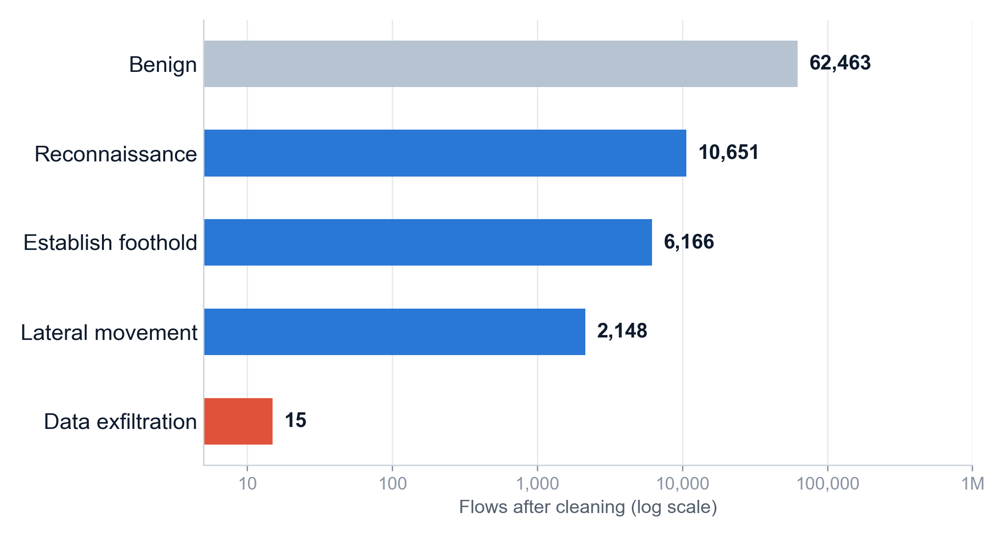
02 · DATA & METHOD
DAPT2020: five days of a staged APT attack
86,691
labelled network flows
76
CICFlowMeter flow features
5 days
public web server +
private network
Grey: benign · Blue: APT stages · Red: data exfiltration, only 15 flows in the whole dataset
Anomaly detection for Advanced Persistent Threats | Mid-term evaluation
8
Notes:
[ 0:55 on this slide | clock 5:10 -> 6:05 of 20:00 ]
DAPT2020 contains 86,691 labelled network flows with 76 features each, captured over five days from a public web server and a private network.
The chart shows the flows per stage after cleaning, on a logarithmic axis. Benign traffic dominates with 62,463 flows; reconnaissance has 10,651, foothold 6,166, lateral movement 2,148, and data exfiltration, in red, only 15.
So the most damaging stage of an APT is also the one with the least data.
TRANSITION: Before using the data, we had to fix several problems in it.

Slide 9




02 · DATA & METHOD
Four data problems we found and fixed
2,314
3 → 1
5,248
15
flows recovered
benign labels unified
duplicate flows removed
exfiltration flows
One CSV file has no header row; a naive loader drops 94% of Lateral Movement
BENIGN, Benign and Normal all mean normal traffic
Plus 12 constant columns, as the paper prescribes
The most critical APT stage is barely represented
Sanity check: after the fix, benign = 63,712 flows, matching the count reported for DAPT2020 in later work (ISeCure, 2025).
Anomaly detection for Advanced Persistent Threats | Mid-term evaluation
9
Notes:
[ 1:00 on this slide | clock 6:05 -> 7:05 of 20:00 ]
We found four problems.
The most serious: one of the ten CSV files has no header row. A standard loader treats its first flow as the header, which loses 2,314 flows: 94 percent of all Lateral Movement.
Second, benign traffic is labelled in three different ways, which we unified. Third, 5,248 duplicate flows and 12 constant columns, removed as the paper prescribes. Fourth, only 15 exfiltration flows.
Sanity check: after the fix we count 63,712 benign flows, which matches the figure other researchers report for DAPT2020.
TRANSITION: With clean data, we implemented the paper's pipeline.
HAND-OFF POINT (Speaker 2, from 7:05): pipeline, hybrid model, experiments and the first two results.

Slide 10





02 · DATA & METHOD
We implemented the paper's pipeline step by step
01
02
03
04
05
06
Clean
Balance
Split
Select
Train
Evaluate
Drop IP, port and time identifiers; remove NaN, duplicates, constants
SMOTETomek: synthetic minority flows + Tomek-link cleaning
70% training / 30% test, stratified by class
Pearson filter (|r| > 0.9), then top 30 by mutual information
Hybrid RF + XGBoost and 13 baseline models
Accuracy, precision, recall, F1, TNR, FPR, FNR, AUC
FEATURES
TARGET
TOOLS
68 → 36 (Pearson) → 30 (mutual information)
Benign = 0, any APT stage = 1
Python, scikit-learn, imbalanced-learn, XGBoost, PyTorch
Anomaly detection for Advanced Persistent Threats | Mid-term evaluation
10
Notes:
[ 1:10 on this slide | clock 7:05 -> 8:15 of 20:00 ]
We followed the paper's Section 3.2 and Algorithm 1 step by step.
One, clean: drop identifiers such as IP addresses, ports and timestamps, and remove missing values, duplicates and constant columns.
Two, balance with SMOTETomek, which creates synthetic minority samples and removes borderline pairs. It is highlighted in red; we will come back to it.
Three, split 70 percent training, 30 percent test.
Four, select features: drop features more than 90 percent correlated with another, then keep the top 30 by mutual information.
Five, train the hybrid and 13 baselines. Six, evaluate with the paper's eight metrics.
The most informative feature is dst port, exactly as in the paper.
TRANSITION: Now let's look inside the hybrid model.

Slide 11


02 · DATA & METHOD
The hybrid: Random Forest and XGBoost, combined
Random Forest
WHAT WE FOUND IN THE CODE
'Average' is really
an OR rule
Bagging · 100 trees
majority vote
30 flow
features
Aggregator
combo · 'average'
combo's predict() averages the two models' 0/1 labels and outputs APT when the average is ≥ 0.5.
So a flow is flagged as APT if either model flags it.
XGBoost
Benign / APT
Effect: more attacks caught, more false alarms. We also test a soft-vote version (average of probabilities).
Boosting · 100 trees
learning rate 1.0 · depth 4
Anomaly detection for Advanced Persistent Threats | Mid-term evaluation
11
Notes:
[ 1:10 on this slide | clock 8:15 -> 9:25 of 20:00 ]
Random Forest uses bagging: 100 independent trees that vote. XGBoost uses boosting: 100 trees built one after another, with learning rate 1.0 and depth 4, as in the paper. We apply the depth limit to XGBoost only, since Random Forest trees are normally grown fully.
The paper combines them with combo's "average" aggregator. When we read the library's source code, we found that its prediction step averages the two models' 0-or-1 labels and outputs APT when the average is at least 0.5. With two models, that is an OR rule: a flow is flagged if either model flags it. More attacks caught, but more false alarms.
We reproduce this exactly, and also test a soft-vote version that averages probabilities.
TRANSITION: While reproducing the paper, we found a more serious issue in how it evaluates the model.

Slide 12



02 · DATA & METHOD
A flaw in the paper: it balances before it splits
The paper
All flows
SMOTETomek adds synthetic APT flows
Split 70 / 30
Test set contains synthetic flows
Our fix
leakage-free
All flows
Split 70 / 30
SMOTETomek on training data only
Test set is real traffic only
Why it matters
Synthetic flows leak into the test set
An unrealistic 50/50 test set
SMOTE creates them by interpolating real flows, some of which are in training, so testing partly repeats training.
Real traffic here is 77% benign; a balanced test set makes false alarms look rarer than they are.
Anomaly detection for Advanced Persistent Threats | Mid-term evaluation
12
Notes:
[ 1:20 on this slide | clock 9:25 -> 10:45 of 20:00 ]
The paper balances the data with SMOTETomek before splitting it, and says so explicitly in Section 3.2.
That causes two problems. First, SMOTE creates synthetic attack flows by interpolating between real ones, so after the split the test set contains synthetic flows built from flows the model trained on. Second, the test set becomes fifty-fifty, while real traffic here is 77 percent benign; a balanced test set makes false alarms look rarer than they are.
Our fix changes only the order: split first, balance the training data only. The test set is untouched real traffic. Any difference between the two protocols comes from the order of these two steps, and in the results we will separate the two problems.
TRANSITION: This gives us our experimental design.

Slide 13
02 · DATA & METHOD
Three experiments, fifteen models, five seeds
REPLICATION
CORRECTION
EXTENSION
Paper protocol
Leakage-free protocol
APT-stage classification
Exactly the published pipeline: balance the data, then split
Split first, balance the training data only; repeated over 5 random seeds
Predict the stage of every flow, leakage-free, which the paper's datasets cannot support
Benign vs APT
Benign vs APT
5 classes
PROPOSED
CLASSICAL MACHINE LEARNING
DEEP LEARNING
Hybrid RF + XGBoost (OR rule, as published)
Hybrid, soft-vote variant
KNN · Decision tree · SVM · Kernel SVM · Random forest · XGBoost · Gradient boosting · AdaBoost · Naive Bayes · Logistic regression
CNN · ANN · MLP, trained on the GPU for up to 200 epochs with early stopping
Anomaly detection for Advanced Persistent Threats | Mid-term evaluation
13
Notes:
[ 0:40 on this slide | clock 10:45 -> 11:25 of 20:00 ]
Three experiments. A replication with exactly the paper's protocol. A correction: the same pipeline, leakage-free, repeated over five random seeds for the key models. And an extension the paper's datasets cannot support: predicting the APT stage of each flow.
Fifteen models in total: the hybrid as published, a soft-vote variant, ten classical models and three deep learning models.

Slide 14
03
Results
Six results on real APT traffic: 15 models, three experiments and five random seeds
Notes:
[ 0:10 on this slide | clock 11:25 -> 11:35 of 20:00 ]
Part three: the results.

Slide 15
03 · RESULTS
On real APT traffic, false alarms rise about 13×
PAPER'S CLAIM
OUR REPLICATION
LEAKAGE-FREE (REALISTIC)
CSE-CIC-IDS2018 (Table 7)
DAPT2020, paper protocol
DAPT2020, balance after split
98.92%
96.99%
94.28%
accuracy
accuracy
accuracy
F1-score
98.90%
F1-score
97.06%
F1-score
88.85%
False positive rate
0.52%
False positive rate
5.44%
False positive rate
6.78%
Takeaway: the hybrid still ranks APT flows very well (AUC 99.08%), but raises about 13× more false alarms than claimed, and on a realistic test set its F1 is 8.2 points lower.
Anomaly detection for Advanced Persistent Threats | Mid-term evaluation
15
Notes:
[ 1:10 on this slide | clock 11:35 -> 12:45 of 20:00 ]
First, the paper's model on real APT traffic.
On the left, the paper's claim: 98.92 percent accuracy, false positive rate 0.52 percent. In the middle, our replication with the paper's own protocol: accuracy 96.99 percent, false positive rate 5.44 percent. On the right, the realistic leakage-free version: accuracy 94.28, F1 88.85, false positive rate 6.78 percent.
The hybrid still ranks APT flows very well, AUC 99.1 percent, but raises about 13 times more false alarms than claimed. APT traffic is designed to look normal, so it is much harder than the paper's DoS and brute-force attacks.
TRANSITION: F1 is 8.2 points lower on the realistic test set. Where does that gap come from?

Slide 16
03 · RESULTS
Most of the inflation comes from the 50/50 test set
AS THE PAPER WOULD REPORT IT
SAME PREDICTIONS, REAL CLASS RATIO
LEAKAGE-FREE
Balanced test set with synthetic flows
Re-scored at 23% APT / 77% benign
Real flows only, real class ratio
97.06%
−5.6 pts
91.49%
−2.6 pts
88.85%
class ratio
leakage
F1 · precision 94.8%
F1 · precision 84.7%
F1 · precision 81.4%
The 50/50 test set: 5.6 points
Synthetic-flow leakage: 2.6 points
Real traffic here is 77% benign. On a balanced test set there are far fewer benign flows to raise false alarms on, so precision looks higher: 94.8% vs 84.7% for the same predictions.
70% of the APT flows in the paper-protocol test set are synthetic. The model misses 0.34% of them, but 1.12% of real APT flows.
Anomaly detection for Advanced Persistent Threats | Mid-term evaluation
16
Notes:
[ 1:05 on this slide | clock 12:45 -> 13:50 of 20:00 ]
We took the paper-protocol predictions and re-scored them at the real class ratio. That is exact: recall and false positive rate don't depend on the class mix, so precision and F1 can be recomputed.
On the left, as the paper would report it: F1 97.06 percent. Same predictions at the real ratio: 91.49. So 5.6 of the 8.2 points come purely from testing on a fifty-fifty set: precision drops from 94.8 to 84.7 percent.
The remaining 2.6 points are the leak: 70 percent of the APT flows in the paper's test set are synthetic, and the model misses only 0.34 percent of those, versus 1.12 percent of real ones.
Both effects come from balancing before splitting; the misleading class ratio accounts for about 68 percent of the gap, leakage for the rest.
TRANSITION: Is this specific to the hybrid? Here are all fifteen models.
HAND-OFF POINT (Speaker 3, from 13:50): remaining results, conclusions and Q&A.

Slide 17
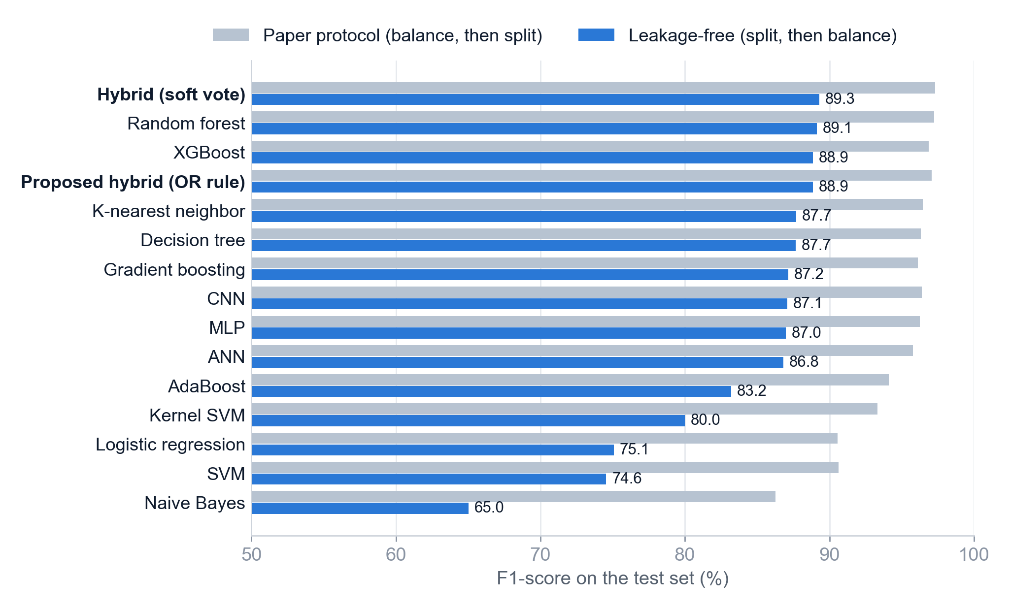


03 · RESULTS
All 15 models look worse on a realistic test set
Every model drops
F1 falls 8.0–21.2 points; for the hybrid, 5.6 of 8.2 come from the class ratio
Tree ensembles lead
Soft vote 89.3%, Random Forest 89.1%, XGBoost 88.9%, OR hybrid 88.9%
Deep learning doesn't help
CNN 87.1%, MLP 87.0%, consistent with the paper's own Table 7
Anomaly detection for Advanced Persistent Threats | Mid-term evaluation
17
Notes:
[ 0:55 on this slide | clock 13:50 -> 14:45 of 20:00 ]
Grey bars: the paper's protocol. Blue bars: leakage-free, sorted by the realistic F1.
Every model scores lower on the realistic test set, by 8.0 to 21.2 F1 points. We measured the breakdown for the hybrid; the same two mechanisms apply to every model, so this is a property of the evaluation, not of the hybrid.
The ranking is stable: the tree ensembles lead, and deep learning does not help on these tabular features, which matches the paper's own table. Simple models collapse: Naive Bayes raises alarms on 32 percent of benign flows.
TRANSITION: The paper claims the hybrid beats everything. Let's test that directly.

Slide 18



03 · RESULTS
The published hybrid doesn't beat its parts
Model | F1 | Recall | False positive rate | AUC
Proposed hybrid (OR rule, as published) | 88.82 ± 0.18 | 96.93 ± 0.38 | 6.48 ± 0.14 | 99.02 ± 0.03
Hybrid, soft vote | 89.21 ± 0.24 | 95.09 ± 0.47 | 5.50 ± 0.16 | 99.02 ± 0.03
Random Forest | 89.00 ± 0.21 | 94.63 ± 0.22 | 5.47 ± 0.12 | 98.83 ± 0.02
XGBoost | 89.01 ± 0.25 | 94.68 ± 0.51 | 5.49 ± 0.17 | 98.95 ± 0.06
Leakage-free test set, mean ± standard deviation over 5 random seeds (%)
OR hybrid: no gain
Soft vote edges ahead
OR rule = more alarms
F1 88.82% vs Random Forest 89.00% and XGBoost 89.01%
Best mean F1 (89.21%); ahead of XGBoost and the OR hybrid on 5/5 seeds, Random Forest on 4/5
Highest recall (96.9%), but FPR 6.5% vs 5.5% for Random Forest
Anomaly detection for Advanced Persistent Threats | Mid-term evaluation
18
Notes:
[ 1:10 on this slide | clock 14:45 -> 15:55 of 20:00 ]
We compare the hybrid with its own components over five random splits: mean and standard deviation.
The paper's OR hybrid scores F1 88.82, against 89.00 for Random Forest and 89.01 for XGBoost. So the published hybrid does not beat its own parts. The OR rule catches the most APT flows, recall 96.9 percent, but also raises the most false alarms, 6.5 percent.
The soft vote, averaging probabilities instead, has the best mean F1, 89.21: ahead of XGBoost and the OR hybrid on 5 of 5 seeds and of Random Forest on 4 of 5. It's a small gain, about 0.2 points, so combining the models helps only a little, and only with the right combination rule.
TRANSITION: Because DAPT2020 labels stages, we can go further than the paper.

Slide 19
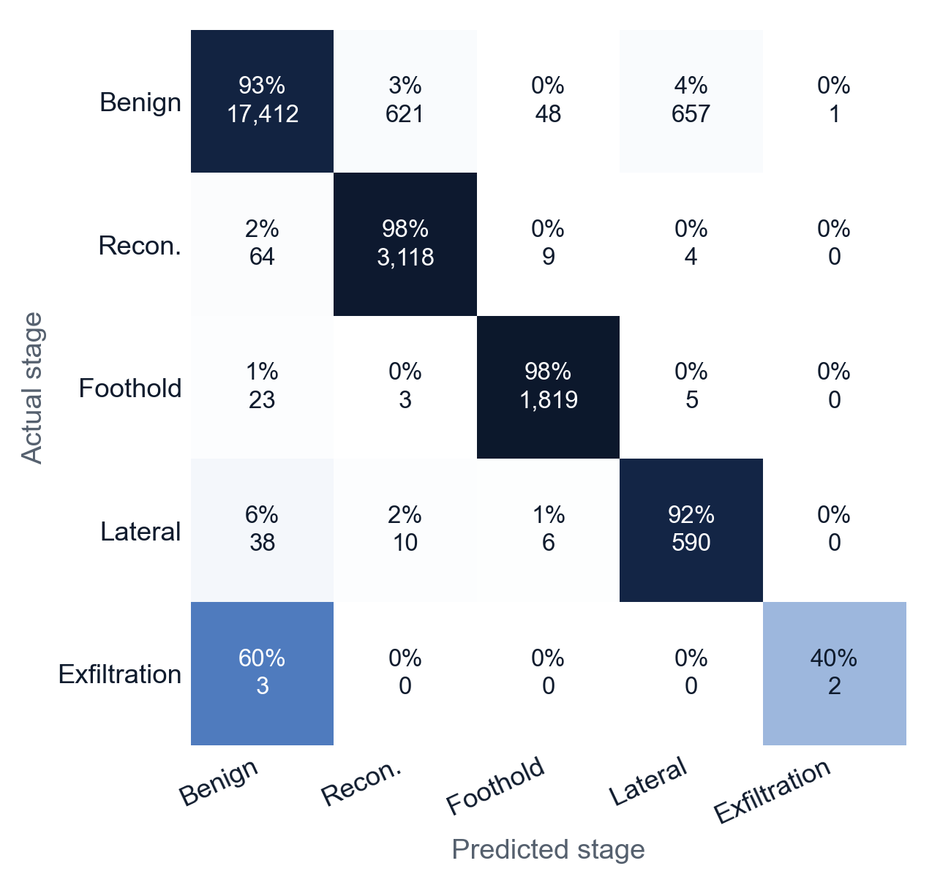
03 · RESULTS
APT stages can be told apart, except exfiltration
Recall per stage · hybrid, soft vote
Reconnaissance
97.6%
3,118 of 3,195 test flows
Establish foothold
98.3%
1,819 of 1,850
Lateral movement
91.6%
590 of 644
Data exfiltration
2 of 5
only 15 flows in the whole dataset
Don't rank models on macro F1 here: one exfiltration flow moves it by several points. Without that class: RF 86.1%, XGBoost 86.2%, soft vote 86.3%.
Anomaly detection for Advanced Persistent Threats | Mid-term evaluation
19
Notes:
[ 1:00 on this slide | clock 15:55 -> 16:55 of 20:00 ]
Here the model predicts which APT stage each flow belongs to; rows are actual stages, columns predicted ones.
Reconnaissance is recognised 97.6 percent of the time, establishing a foothold 98.3 percent, and lateral movement 91.6 percent. Data exfiltration is the weak point: 2 of 5 test flows.
With only 5 exfiltration flows in the test set, one flow shifts macro F1 by several points, so we don't rank models on it. Without exfiltration, Random Forest, XGBoost and the soft vote are within half a point of each other.
TRANSITION: Finally, where do the errors come from?

Slide 20
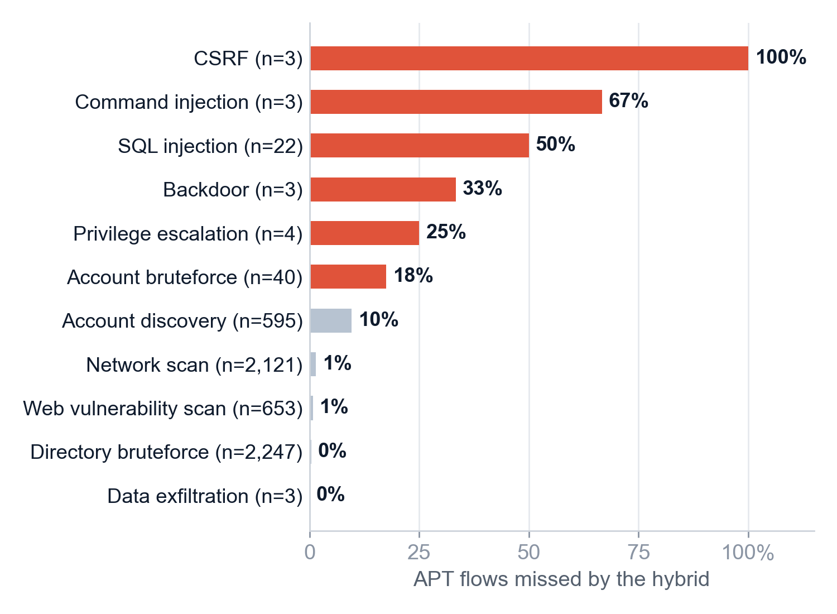
03 · RESULTS
Errors: possible label noise, and real weak spots
Missed APT flows by activity · most misses: Account Discovery (57 of 127)
50.6%
of false alarms are benign-labelled flows involving the attacker's hosts: possible label noise, but not proof, since those hosts also appear on attack-free Monday
42.2%
of false alarms fall on Monday, when no attacks are labelled at all: genuine false alarms on normal traffic
Anomaly detection for Advanced Persistent Threats | Mid-term evaluation
20
Notes:
[ 1:00 on this slide | clock 16:55 -> 17:55 of 20:00 ]
False alarms first. 50.6 percent of them are flows labelled benign that involve the attacker's own hosts. That may be label noise, but it's not proof: those hosts also appear on Monday, when no attacks are labelled. And 42.2 percent of false alarms fall on Monday itself, so they are genuine false alarms on normal traffic.
Missed attacks, on the right. Rare, low-volume steps such as CSRF, command injection, privilege escalation and SQL injection have the highest miss rates. But by count, most misses are Account Discovery: 57 of 127. That is a clear target for improvement.

Slide 21
04
Conclusions
What we have shown so far, and the plan for the final evaluation
Notes:
[ 0:10 on this slide | clock 17:55 -> 18:05 of 20:00 ]
Part four: conclusions.

Slide 22
04 · CONCLUSIONS
What we have shown so far
01
It works on APT data, but not as claimed
02
Balancing before splitting inflates scores
AUC ≈ 99%, but the false positive rate is ≈ 7%, not 0.52%
F1 97.1% → 88.9%: 5.6 points from the 50/50 test set, 2.6 from leakage
03
The published hybrid doesn't beat its parts
04
Trees beat deep learning here
A soft vote does slightly better: best mean F1 over 5 seeds, by about 0.2 points
CNN, ANN and MLP do not outperform tree ensembles on flow features
05
APT stages can be identified
06
Weak spots are known
Recon 98%, foothold 98%, lateral 92%; exfiltration has too little data
Most misses are account discovery; rare steps (SQLi, CSRF, privilege escalation) are missed most often
Anomaly detection for Advanced Persistent Threats | Mid-term evaluation
22
Notes:
[ 0:55 on this slide | clock 18:05 -> 19:00 of 20:00 ]
To summarise. One: the method works on real APT data, but not as claimed: AUC about 99 percent, but a false positive rate of about 7 percent rather than 0.52.
Two: balancing before splitting inflates the reported scores: about two thirds through the fifty-fifty test set and one third through leakage.
Three: the published OR hybrid does not beat its parts; a soft vote is slightly better on average.
Four: tree ensembles beat deep learning here.
Five: APT stages can be identified, except exfiltration, which has too little data.
Six: the weak spots are account discovery and rare, quiet attack steps.

Slide 23




04 · CONCLUSIONS
Plan for the final evaluation
STEP 1
STEP 2
STEP 3
STEP 4
Second APT dataset
Time-based evaluation
Improve the hybrid
Explainability
Validate on Unraveled (2023) or SCVIC-APT-2021
Train on earlier days, test on later days: an unseen campaign
Tune model weights and threshold; handle rare stages better
SHAP analysis of the hybrid, as in the paper's Figures 25–26
Already in place: reproducible code for every experiment, results for all 15 models, figures and a full written report.
Anomaly detection for Advanced Persistent Threats | Mid-term evaluation
23
Notes:
[ 0:40 on this slide | clock 19:00 -> 19:40 of 20:00 ]
For the final evaluation we propose four steps: validate on a second APT dataset such as Unraveled or SCVIC-APT-2021; a time-based evaluation, training on earlier days and testing on later ones; improving the hybrid, for example with soft voting and a tuned decision threshold; and SHAP explanations, as in the paper.
All code, results and figures are already in place and reproducible.

Slide 24
REFERENCES
References
N. Saini, V. Bhat Kasaragod, K. Prakasha, A. K. Das. A hybrid ensemble machine learning model for detecting APT attacks based on network behavior anomaly detection. Concurrency and Computation: Practice and Experience, 35(28):e7865, 2023. doi:10.1002/cpe.7865
S. Myneni, A. Chowdhary, A. Sabur, S. Sengupta, G. Agrawal, D. Huang, M. Kang. DAPT 2020 – Constructing a benchmark dataset for advanced persistent threats. Deployable Machine Learning for Security Defense (MLHat 2020), Springer CCIS, 2020. doi:10.1007/978-3-030-59621-7_8
DAPT2020 dataset. kaggle.com/datasets/sowmyamyneni/dapt2020
N. V. Chawla, K. W. Bowyer, L. O. Hall, W. P. Kegelmeyer. SMOTE: Synthetic minority over-sampling technique. Journal of Artificial Intelligence Research, 16:321–357, 2002.
G. E. Batista, R. C. Prati, M. C. Monard. A study of the behavior of several methods for balancing machine learning training data. ACM SIGKDD Explorations, 6(1):20–29, 2004.
L. Breiman. Random forests. Machine Learning, 45:5–32, 2001.
T. Chen, C. Guestrin. XGBoost: A scalable tree boosting system. Proceedings of ACM SIGKDD, 2016.
DSRL-APT-2023: A new synthetic dataset for advanced persistent threats. The ISC International Journal of Information Security (ISeCure), 17(2):107–116, 2025. (DAPT2020 benign count)
Anomaly detection for Advanced Persistent Threats | Mid-term evaluation
24
Notes:
[ 0:10 on this slide | clock 19:40 -> 19:50 of 20:00 ]
Our main references are listed here: the paper, the DAPT2020 dataset paper, and the core methods.

Slide 25
Thank you
Questions and discussion
On real APT traffic the hybrid ranks threats well (AUC ≈ 99%), but raises ≈ 7% false alarms, and the paper's protocol inflates its reported results.
Notes:
[ 0:10 on this slide | clock 19:50 -> 20:00 of 20:00 ]
Thank you for listening. We are happy to take questions.
----- LIKELY QUESTIONS (Q&A, not part of the 20 minutes) -----
Q: Isn't most of the drop just the class ratio, not leakage?
A: Yes, and we show it: about 5.6 of the 8.2 F1 points come from the fifty-fifty test set and about 2.6 from synthetic-flow leakage. Both are caused by balancing before splitting.
Q: Are you sure the paper balances before splitting?
A: Yes. Section 3.2: "After converting it into balanced dataset, the CSE-CIC-IDS2018 dataset has been divided into two parts: training and testing." Its Figure 11 has 15,583 test rows, 30 percent of the balanced total.
Q: Why is your false positive rate so much higher?
A: APT traffic is built to look normal. 42 percent of false alarms are on attack-free Monday traffic, so they are real errors. 51 percent involve attacker hosts labelled benign, which may be label noise.
Q: How do you know the hybrid is an OR rule?
A: We read combo's source: SimpleClassifierAggregator.predict() averages the base models' labels and applies ">= 0.5". We also ran the library itself and it matched our implementation on every test flow.
Q: Did you find other problems in the paper?
A: The CNN, ANN and MLP rows are identical in Table 7 (CSE-CIC-IDS2018) and Table 9 (NSL-KDD), and the CNN row is internally inconsistent: with recall 98.21 and TNR 99.51 on a balanced test set, precision should be about 99.5, not 98.25. Also, Table 7's XGBoost has a higher false positive rate than the hybrid, which is impossible under an OR rule if it is the same model.
Q: Why DAPT2020 and not a newer dataset?
A: It is the most widely used APT network benchmark and has the same features as the paper's main datasets. We plan to add a second dataset for the final evaluation.
Q: Implementation choices?
A: Max depth 4 is applied to XGBoost only; SMOTETomek removes Tomek links from both classes, its default; CSV parsing uses exact float round-trip so results reproduce across machines.

