Slide 1
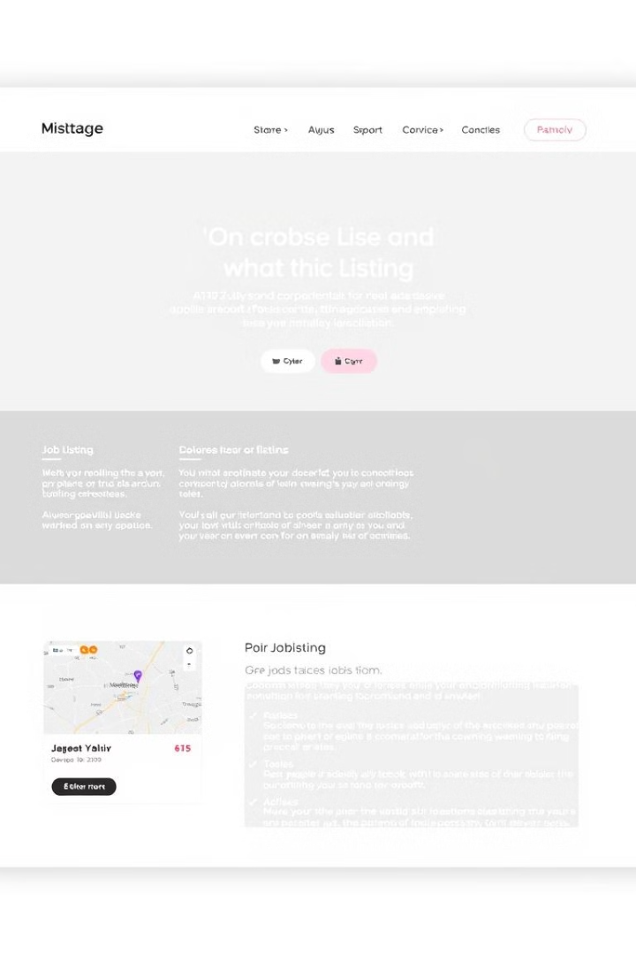
JobHunter: A Modern Job Portal
Welcome to the JobHunter presentation, where we'll explore the development of a cutting-edge job portal to revolutionize the job search process.
AV
by Ashish Verma

Slide 2
Project Overview
Problem
Solution
Traditional job portals are often cumbersome and inefficient. They lack personalized recommendations and struggle to connect the right candidates with suitable opportunities.
JobHunter personalizes the job search experience. Users can find relevant jobs based on their skills and experience, and the platform helps employers find the perfect candidates.

Slide 3
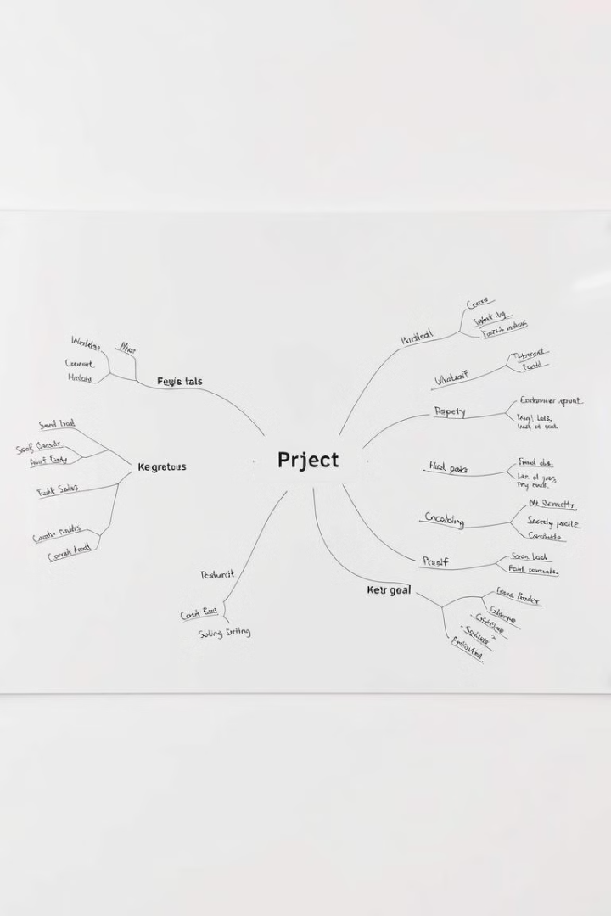
Project Statement
User-Friendly Interface
Job Matching
JobHunter provides an intuitive and user-friendly interface for both job seekers and employers. The website should be accessible and easy to navigate for all users.
The platform uses algorithms to match job seekers with relevant job opportunities. The algorithm should consider factors such as skills, experience, and location.
Secure Platform
JobHunter ensures the security of user data and the integrity of the platform. Sensitive information such as resumes and contact details are protected.

Slide 4
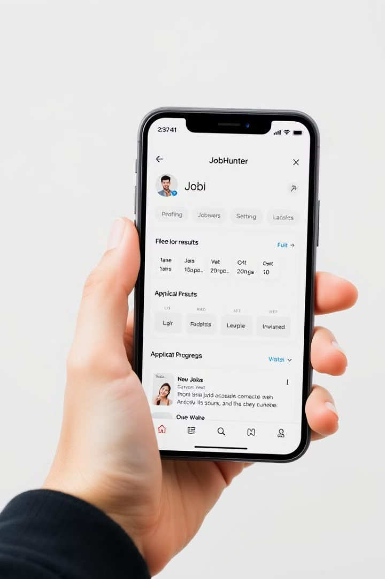
Key Features
Job Listings
User Profile
Users can browse job opportunities across various categories and filter them by criteria like location, job type, and experience level.
Users can create and manage a personalized profile, including their resume, contact information, and desired job preferences.
Job Application
Admin Panel
The platform provides a streamlined application process, allowing users to apply directly to job listings with their profiles.
The admin panel allows employers to manage job listings, track applications, and communicate with candidates.

Slide 5
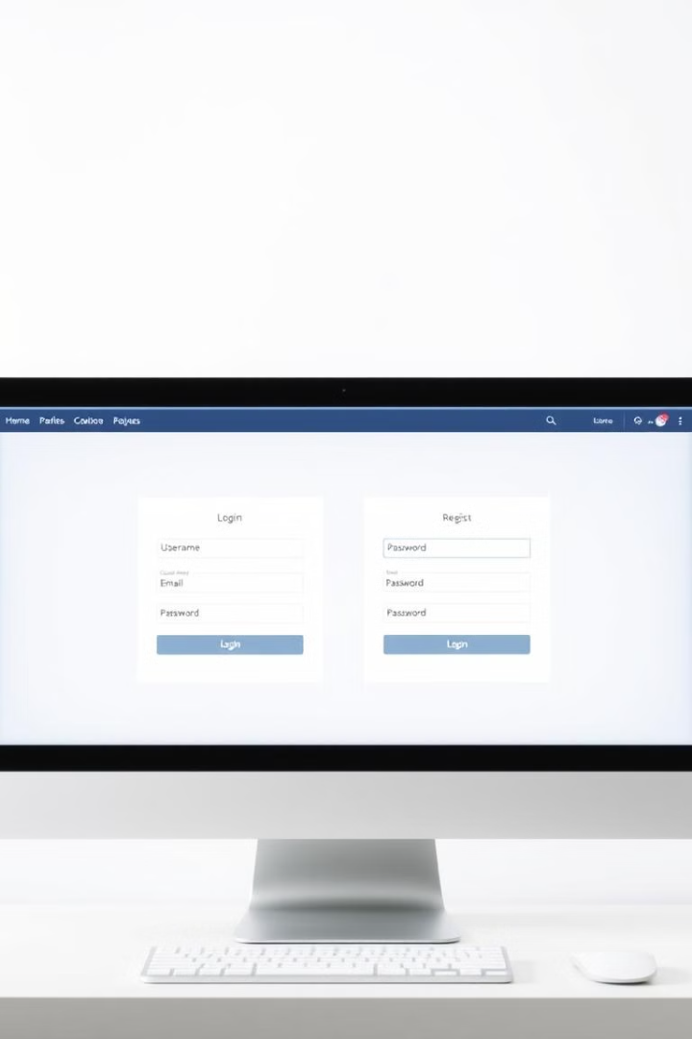


Milestone 1: User Authentication & Registration
Secure Login
Users can securely log in with their credentials, utilizing JWT authentication for token-based authorization.
Registration Process
The registration process allows users to create an account with personalized profile information, including contact details and desired job preferences.

Slide 6

Milestone 2: Appointment Scheduling
1
2
3
The appointment scheduling feature allows users to schedule interviews or other meetings directly with employers through the platform.
The feature includes a user-friendly interface to apply for jobs, and receive reminders.
The backend system manages and stores appointment details and integrates with the user profiles for seamless communication.

Slide 7




Milestone 3: Appointment Management
Users can easily view their scheduled appointments and access appointment details, including location, time, and employer information.
The system allows users to reschedule or cancel appointments if needed, with notifications sent to both the user and employer.
The backend system manages appointment data and ensures timely reminders and notifications for both users and employers.

Slide 8



Milestone 4: User Information Management & Admin Dashboard
User Profiles
1
The system allows users to view and access the profiles of all users and control their privacy settings.
Admin Dashboard
2
The admin dashboard provides comprehensive tools for managing job listings, user accounts, and system analytics.
Data Security
3
The system prioritizes user data security and implements strong access control measures.

Slide 9
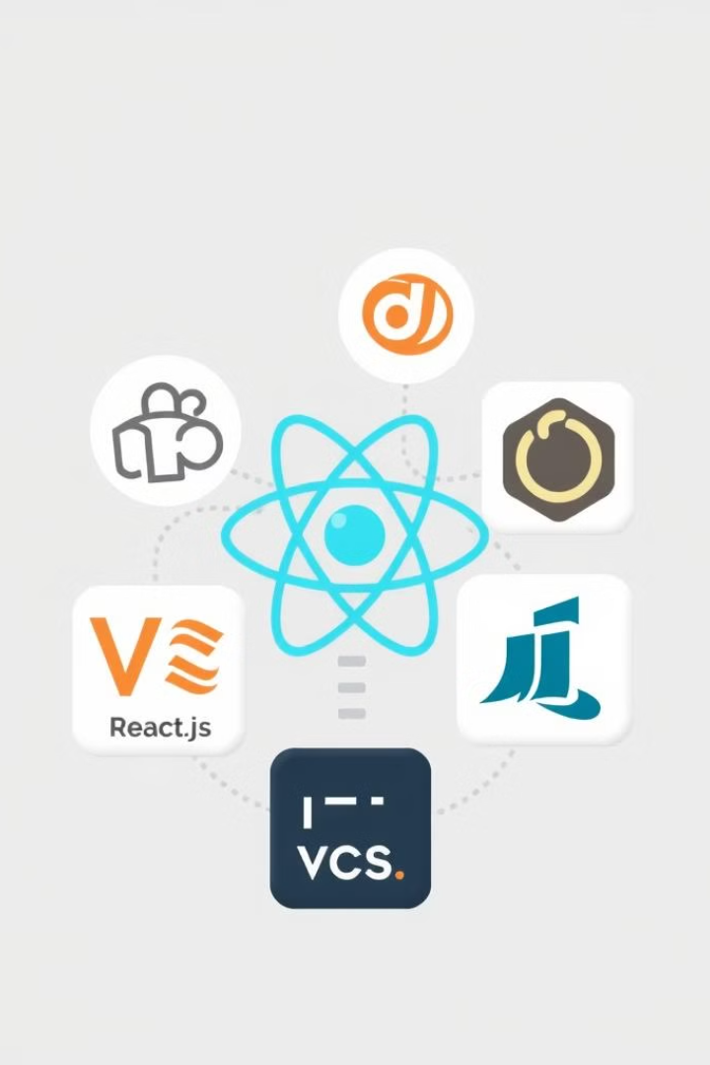
Technologies Used
Frontend: React.js for dynamic user interfaces, HTML, CSS for styling, and JavaScript for interactive features
Backend: Spring Boot for building a robust and efficient REST API
Database: MySQL for storing and managing application data, including user profiles, job listings, and appointment details
IDE: VS Code and IntelliJ IDEA for development, providing features for code editing, debugging, and testing
Notes:
The frontend of our application is built using React.js, a popular JavaScript library for creating dynamic and interactive user interfaces. We leverage HTML and CSS to structure and style the web pages, ensuring a visually appealing and responsive user experience. JavaScript is used to add interactivity and functionality to the frontend, enabling users to engage with the application in meaningful ways. On the backend, we've chosen Spring Boot, a Java framework, to build a robust and efficient REST API that powers the application's core functionality. For data storage and management, we're using MySQL, a widely-adopted relational database management system, to store user profiles, job listings, appointment details, and other critical application data. Our development team utilizes industry-leading IDEs, such as VS Code and IntelliJ IDEA, to streamline the coding process, enabling features like code editing, debugging, and testing.

Slide 10
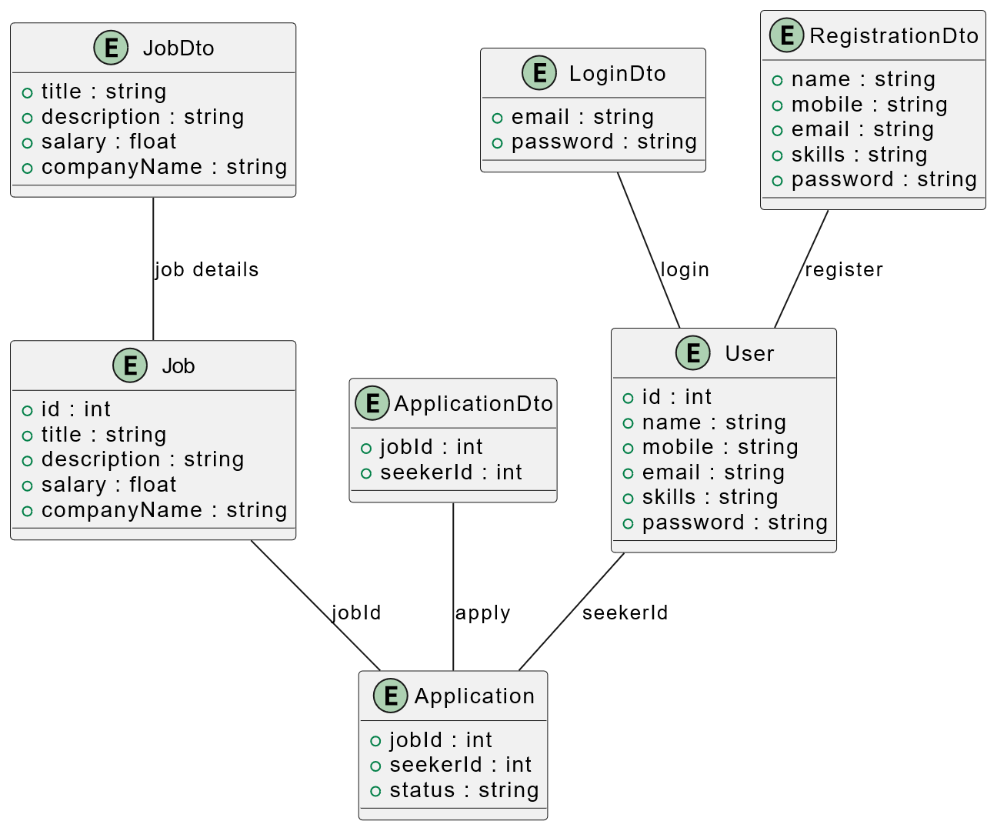
UML Diagram

Slide 11

Conclusion: Future Directions
JobHunter is poised to become a leading job portal, revolutionizing the job search process through AI and user-friendly features. The platform will continue to evolve with new features and integrations to enhance the user experience.

