Slide 1





Nextech Mind
INNOHACK 2.0
S2P Robotic
Presented By Bot Buddies
Notes:
1.7.2013
‹#›
‹#›

Slide 2


innohack 2.0
Team Name : Resume_Rangers
Team member : 1. Ashish kharat
2. Yashraj Sonawane
3. Krishnadas Lamdade
4. Rugved Mokashi
Institution : Keystone School of Engineering
Notes:
1.7.2013
‹#›

Slide 3

WHY THIS PROBLEM MATTERS
PROPOSED SOLUTION
1.Your The ATS Wall: Automated software rejects over 75% of resumes, filtering out skilled candidates based on simple formatting and keyword errors, not a lack of talent.text
1.Beat the Robots: Our AI simulates an advanced ATS, providing a clear compatibility score and identifying critical missing keywords to ensure your resume is seen by a human.
2.The Guidance Gap: Expert career advice is a luxury. This forces most applicants to guess what skills to highlight, leading to generic applications that fail to stand out
2.Instant Expert Analysis: Get immediate, detailed feedback from an AI trained to think like a top-tier recruiter. Go from guessing to knowing with one-click resume enhancements.
3.The Career Fog: In a rapidly changing job market, individuals struggle to identify their most critical skill gaps, hindering their ability to invest in the right training for future growth.
3.A Clear Path Forward: Our platform generates a personalized learning roadmap for your dream job, complete with course suggestions, portfolio projects, and future market trends.
4.Manually tailoring a resume and cover letter for every application is overwhelming, leading to burnout that forces talented candidates to miss opportunities.
4.Eliminate Application Fatigue: Automate the most time-consuming tasks. Generate tailored cover letters in seconds, cutting application time from hours to minutes.
Notes:
1.7.2013
‹#›

Slide 4
TECH STACK
Frontend:
Streamlit: For the interactive web application framework.
AI Engine:
Google Gemini API: For all generative AI tasks, including resume analysis, scoring, roadmaps, and content generation.
Data Processing:
PyMuPDF & python-docx: For parsing text from PDF and DOCX resume files.
Backend & Core Language:
Python: The core programming language for all logic.
Pandas: For data manipulation and generating the trend graph.
Deployment & Version Control:
Streamlit Community Cloud: For hosting the live application.
Git & GitHub: For version control and continuous deployment.
Notes:
1.7.2013
‹#›

Slide 5
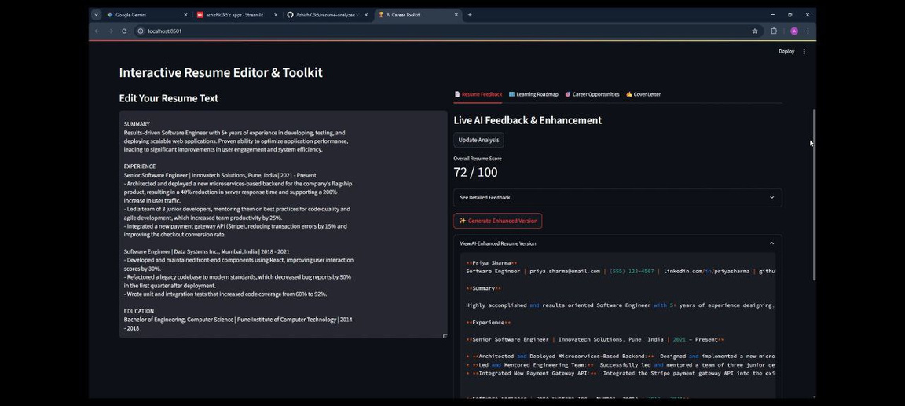
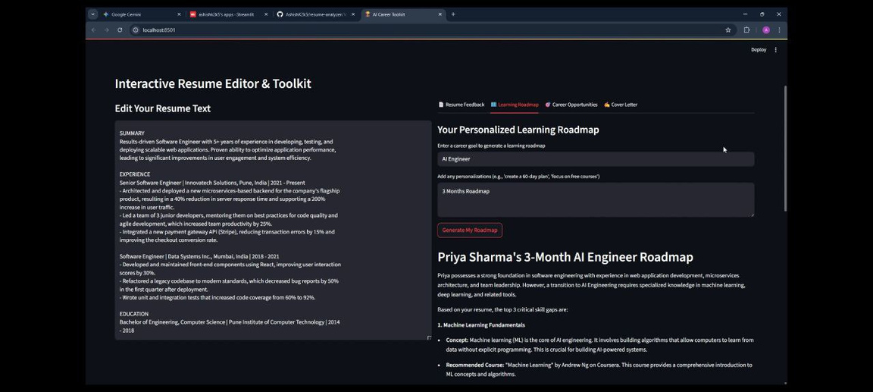
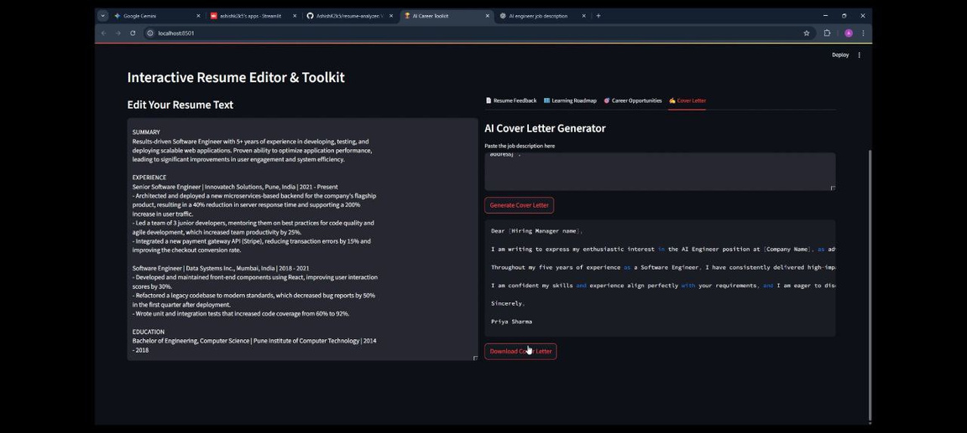
PROTOTYPE / SCREENSHOTS
Notes:
1.7.2013
‹#›

Slide 6
INNOVATION & IMPACT
Innovation:
All-in-One Platform: We combine five career tools into one seamless experience.
Actionable AI: Our AI provides solutions, not just analysis.
Future-Focused: We plan your future career, not just fix your past resume.
Dynamic, Interactive Workspace: It's not a static report. Our live editor provides real-time feedback, turning resume writing into an interactive, learn-as-you-go experience.
Impact:
Free career coaching for everyone.
Reduces job search anxiety and builds confidence.
Saves countless hours on every application.
Upskilling Job Seekers: Our tool doesn't just give users a better resume; it teaches them how to write one, providing them with valuable career skills that last a lifetime.
Notes:
1.7.2013
‹#›

Slide 7
TEAM & ROLES
Individual Roles/ Responsibilities:
1.Ashish Kharat : Lead Developer & Architect.
Built the core application in Python and Streamlit.
2.Rugved Mokashi : Presentation Lead & Storyteller.
Wrote the winning presentation script and story.
3.Krishnadas Lamdade : UX/UI & Design Lead.
Designed the intuitive, tabbed user interface and workflow.
4.Yashraj Sonawane : QA Lead & Product Manager.
Led all product testing to ensure a bug-free demo.
Notes:
1.7.2013
‹#›

