Slide 1
Hotel Rating Classification
Team Name :- G3 - The Blackholes
Mentors :- Vinod & Munmun
Start date:- 12/10/2020

Slide 2
Business Objective
The objective of the analysis is to examine how travelers are communicating their positive and negative experiences in online platforms for staying in a specific hotel and major objective is what are the attributes that travelers are considering while selecting a hotel. With this manager can understand which elements of their hotel influence more in forming a positive review or improves hotel brand image.

Slide 3
Project Architecture / Project Flow
Business Objective Discussion
Project
Flow
Dataset Details
Data Cleansing : EDA and Text preprocessing
Model Building
Feedback
Model Evaluation
Deployment
Final Presentation

Slide 4
EXPLORATORY DATA ANALYSIS(EDA)
Exploring data to the deep !

Slide 5
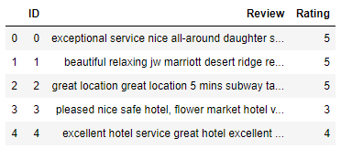
Dataset Details
Features / Variable / Columns : ID , Reviews , Rating
Dimensions of Train data = 14343 rows X 3 columns
No missing values

Slide 6
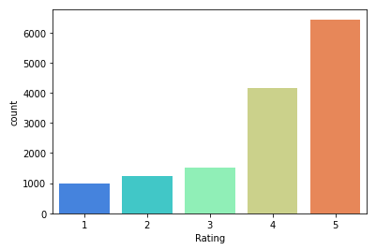
EDA
Ratings | No. of reviews
5 | 6436
4 | 4172
3 | 1510
2 | 1248
1 | 977
Number of reviews for each rating :

Slide 7
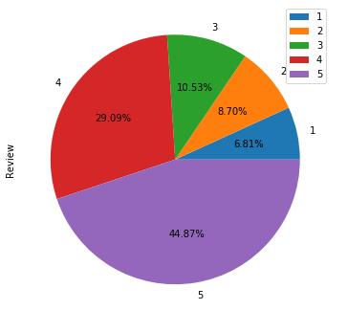
Proportion of Ratings
Rating | %
5 | 44.87
4 | 29.09
3 | 10.53
2 | 8.70
1 | 6.81

Slide 8
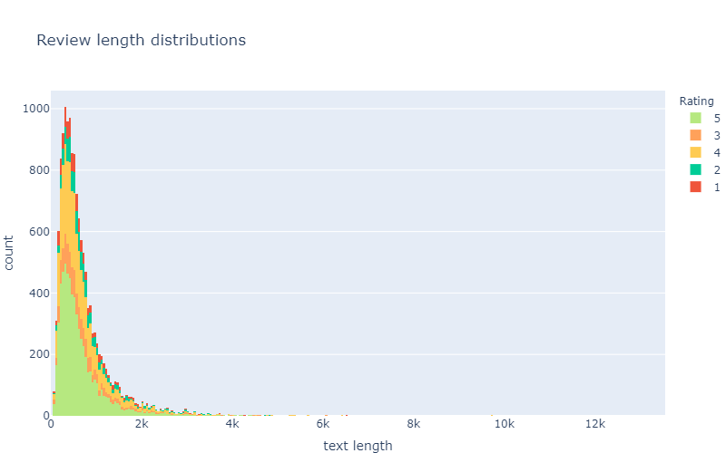

Slide 9
From previous graph it can be seen that graph is very close signifying that average difference of text length between all the rating is very small.
The average size of a review is ~700 characters.
There are some really big reviews in this dataset, mostly about 3+ stars ratings

Slide 10
TEXT PRE-PROCESSING
Text pre-processing is the most important step before further exploring a text data. It removes unwanted and un necessary texts. Following text pre-processing steps were included:
Converting to lower case
replace n't and 'nt with not
Removing stop words by creating some new custom stop words.
Remove punctuations
Remove tags
Remove special characters and digits
lemmatization

Slide 11
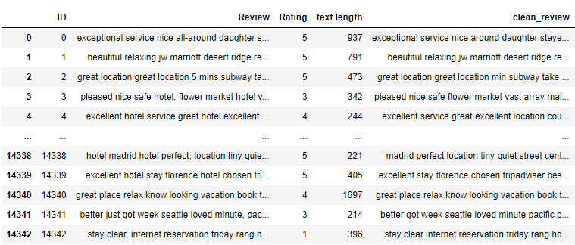

Slide 12
COMBINING THE RATINGS
The dataset seems to be highly imbalanced, this might turn out to be a problem in model building, we will have to take steps which can make the model balanced.
Or we can try to form 3 classes:
1. Negative(1) - Class 1 or 2
2. Neutral(2) - Class 3
3. Positive(3) - Class 4 or 5

Slide 13
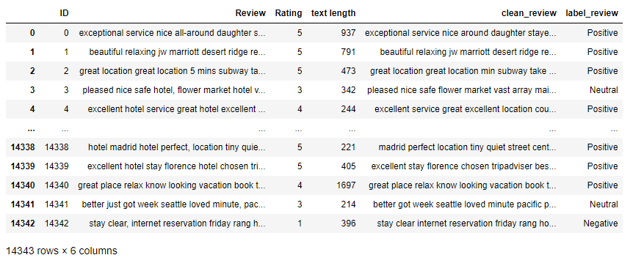

Slide 14
N-GRAM ANALYSIS
Exploring Bi-grams and Tri-grams

Slide 15
BI-GRAMS
A bigram is a sequence of two adjacent elements from a string of tokens, which are typically letters, syllables, or words.
A bigram is an n-gram for n=2. The frequency distribution of every bigram in a string is commonly used for simple statistical analysis of text in many applications, including in computational linguistics, cryptography, speech recognition, and so on.
In next slide it can be seen that negative reviews contains mostly ‘not’ like (not worth, not recommended, not good )pairs that can be describing bad characteristics about hotel.
Positive reviews have good pairs of words about hotel characteristics, like(highly recommended, friendly helpful, place stay).
It can be seen that Neutral reviews have both positive and negative pairs, like(not good, not great, walking distance, minute walk, staff friendly).

Slide 16
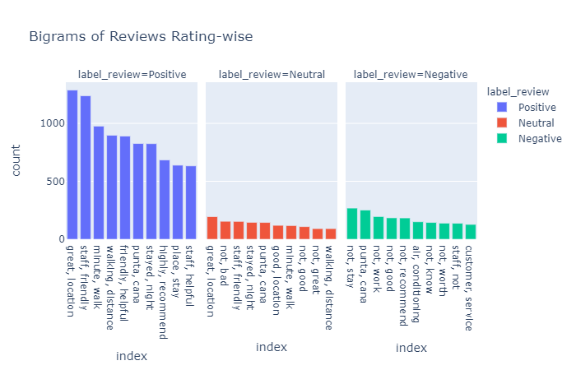

Slide 17
TRI-GRAMS
Trigrams are a special case of the n-gram, where n is 3. They are often used in natural language processing for performing statistical analysis of texts and in cryptography for control and use of ciphers and codes.
Analyzing tri-grams we can collect more details about reviews on different ratings.
In negative reviews pairs like(not speak English, food not good, not worth money) clearly says the problems associated with hotels.
In positive reviews, pairs like(easy walking distance, great location, good value money)
Neutral reviews contains both positive and negative words
Some pairs can be seen both in positive and neutral reviews like(free internet access, flat screen tv, staff friendly helpful)
Some pairs can be seen in all types of reviews like (king size bed, old san juan)

Slide 18
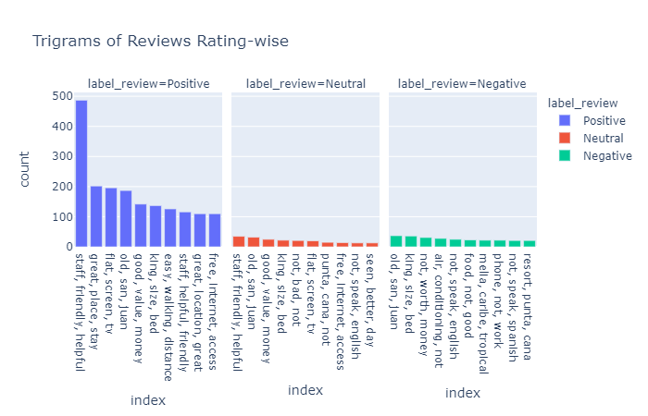

Slide 19
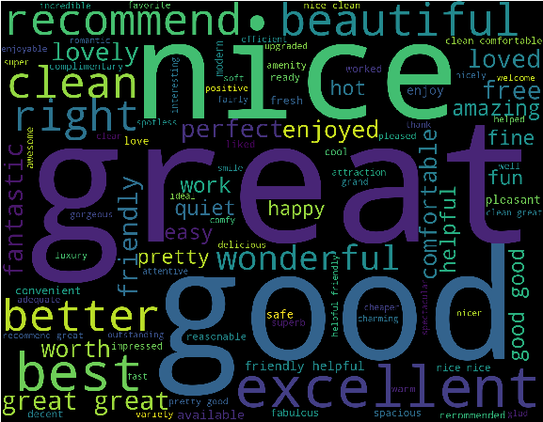
POSITIVE WORDCLOUD
It represents the positive words present in the overall dataset.
Words like good , great, nice are most frequent words
Words like beautiful , recommend , excellent better shows some of good characteristics of hotel.

Slide 20
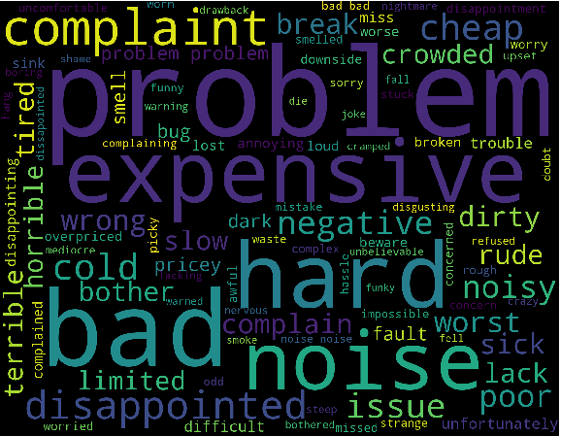
NEGATIVE WORD CLOUD
It represents the negative words present in the overall dataset.
Words like problem, bad , hard, noise are most frequently used words.
Words like complaint , disappointed , terrible , horrible depicts the bad characteristics of the hotel.

Slide 21
SENTIMENTAL ANALYSIS
Knowing the sentiments !!

Slide 22
Calculate sentiment using Text Blob or Vader
Depends on Polarity and Subjectivity
For Text blobs,
If polarity > 0, positive
If polarity == 0 , neutral
If polarity < 0, negative

Slide 23
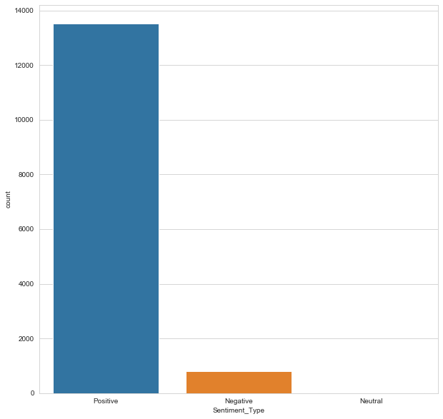
Most are positive sentiments
Very few negative
Very very less are neutral

Slide 24
VADER
Tells us how much positive or negative a sentiment is
Use Compound score - sum of all the lexicon ratings which have been normalized between -1 (most extreme negative) & +1 (most extreme positive).
positive sentiment : (compound score >= 0.05)
neutral sentiment : (compound score > -0.05) and (compound score < 0.05)
negative sentiment : (compound score <= -0.05)

Slide 25
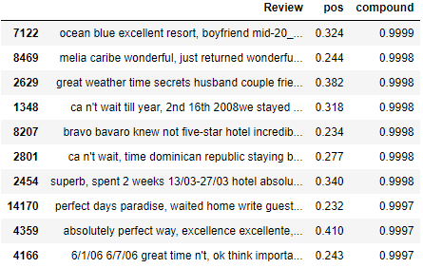
Most Positive Sentiment reviews based on Compound scores

Slide 26
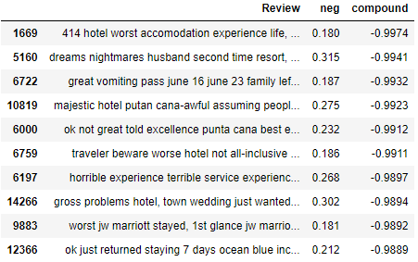
Most Negative Sentiment Reviews based on Compound Scores

Slide 27
NAMED ENTITY RECOGNITION(NER)
Entity Extraction !!

Slide 28
Named Entity Recognition/Entity Extraction
In any text document, there are particular terms that represent specific entities that are more informative and have a unique context.
These entities are known as named entities , which more specifically refer to terms that represent real-world objects like people, places, organizations, and so on, which are often denoted by proper names.
A naive approach could be to find these by looking at the noun phrases in text documents. Named entity recognition (NER) , also known as entity chunking/extraction.
It is a popular technique used in information extraction to identify and segment the named entities and classify or categorize them under various predefined classes.

Slide 29
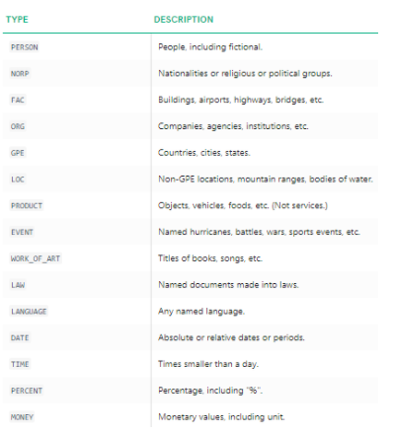

Slide 30
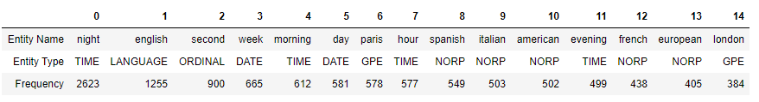
Named Entity Recognition/Entity Extraction
Top named Entities:
Here, we can see that it has correctly identified Spanish, Italian, American as nationalities. We can also see that night is mostly used.
Top named Entity types : Here we can see country/cities/states, persons, organizations are the most mentioned entities.

Slide 31
TOPIC MODELLING
Topic Modelling using LDA !!

Slide 32
What is topic modeling?
Topic Modeling is a technique to extract the hidden topics from large volumes of text.
At the moment, the most popular algorithm is LDA (Latent Dirichlet Allocation), but there are a lot of other approaches for different purposes.
For example, topic modeling for short text is a very difficult task with special algorithms.
Also, topic modeling is not a simple process, because we need clear text data at the start.
Well, here we have used Classical approach : LDA model.

Slide 33
Topic Modelling using LDA
Imported libraries
Added bigrams and trigrams to docs (only ones that appear 10 times or more).
Created a dictionary representation of the documents
Created Term-document matrix
Set training parameters – num_topics = 4
Built Model

Slide 34
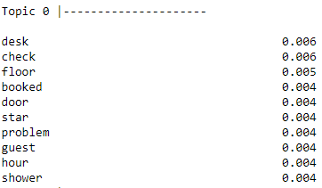
FIRST TOPIC
Topic 0 = "Worst Hotels",
It includes words like (desk,check,star,booked,problem),that make us think that this topic can be related with lower rating of hotels, and seems that those problems are related with reservation problems,reception desk problems,basically the worst hotels.

Slide 35
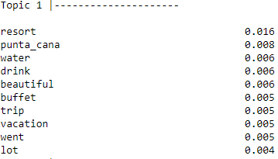
SECOND TOPIC
Topic 1 = "Resort Hotels",
words like(resort,punta_cana,vacation,trip) clearly shows that it's related to Resort hotels.

Slide 36
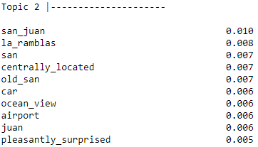
THIRD TOPIC
Topic_3 = ‘Beach Hotels’
Words like(san_juan, la_ramblas, ocean_views), says that these types of hotels are located near the sea beaches.

Slide 37
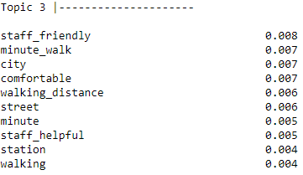
FOURTH TOPIC
Topic 2 = "Top/Best/Comfortable Hotels",
it includes words like(minute_walk,walking_distance,staff_helpful,comfortable).This means it's related with City Hotels, Close to station/airport or simply located in a major location.

Slide 38
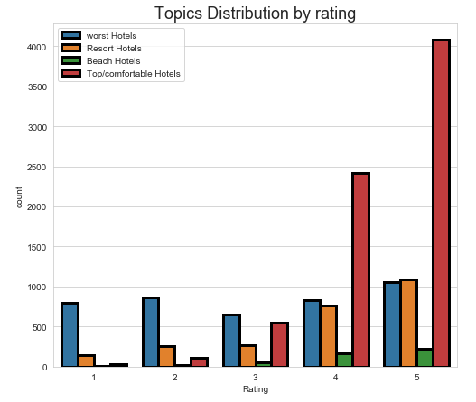
In this graph it can be clearly seen that keywords related to worst hotels are present in all the ratings and also in almost numbers.
It is obvious that keywords related to top/comfortable hotels are in 3+ ratings.

Slide 39
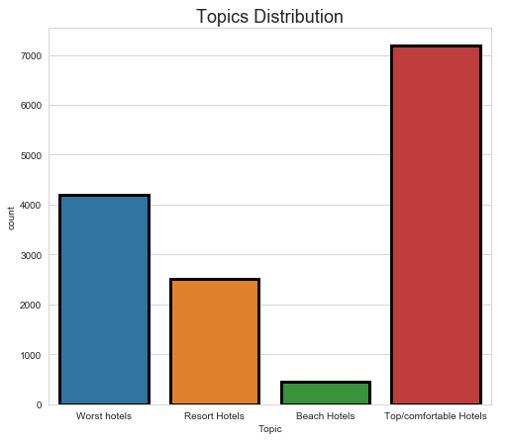
Here numbers of keywords related to top/comfortable hotels are high, followed by worst hotels and then by resort hotels.

Slide 40
MODEL BUILDING

Slide 41
It is not possible to feed text data into a model directly, it must be converted into a readable form for the model.
Here we have used TF-IDF vectors using maximum features of 3000.
Algorithm details :
Multinomial Logistic Regression
Random state = 123
Solver = ‘newton-cg’
Data partition details :
80:20 partition ratio preferred
Using random state = 123, stratify = yes
Created a pipeline to fit model.

Slide 42
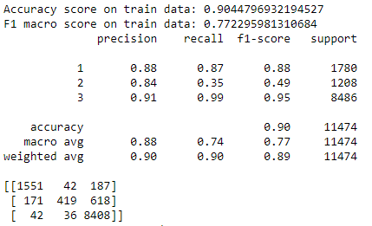
Fitting pipeline for train data and checking on validation data
Classification report and Confusion matrix of train data:

Slide 43
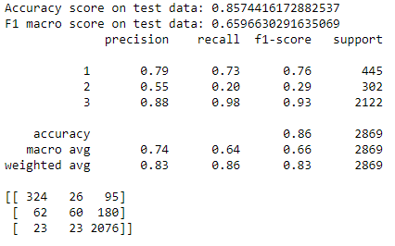
Classification report and Confusion matrix of test data:

Slide 44
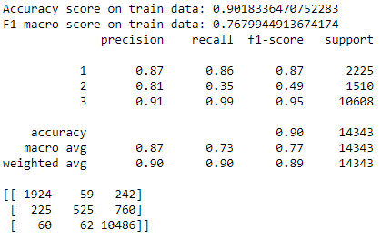
Fitting pipeline for full train data and predicting for same
Classification report and Confusion matrix of full available data:

