Slide 1
Project : mycloud
Architecture
Application design
Backend (DNS,Mysql, Apache,Shinken)
Ashish Kakran

Slide 2
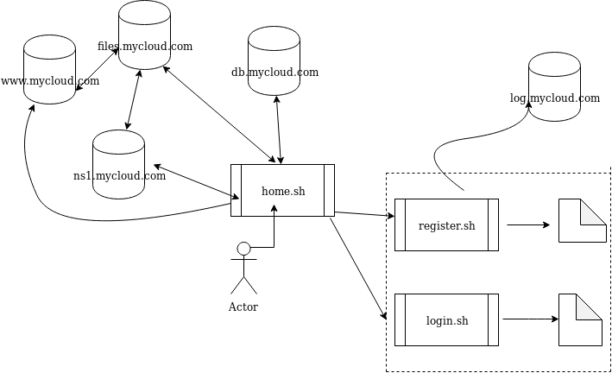
architecture

Slide 3
Front end
User initiates “home.sh” script (assumes root user)
Major script includes register.sh and login.sh
These two scripts call other sub scripts
Every script is modular

Slide 4
functions
Register and login
Sync files to cloud
Checkout backups/files
Rollback changes to local repo
Automated and manual backup support

Slide 5
DNS server (ns1.mycloud.com)
Used bind on a separate lxc so that other servers can query it
Defined “who can query ns1”
Defined zone
Defined NS, A, PTR records
Requires other lxc use this name server

Slide 6
Database server (db.mycloud.com)
Users can perform queries via client account on mysql server
This account has select,insert,update permission on mycloud database
Mycloud database has two tables
accounts<username,name,email,status,password>
plans<username,storage,backup,payment>

Slide 7
Web server (www.mycloud.com)
Simple apache setup
Every user has a file in var/www/html/
This file shows available backups for user
This file is “curled” from login.sh of user

Slide 8
Logging (log.mycloud.com)
Application level logs sync to separate log server
Logger.sh script in invoked with necessary argument
Meanwhile, apache, bind,mysql logs are kept in corresponding server, later sycned to logging server.

Slide 9
Monitoring (monitor lxc)
Used shinken with nagios plugins
check_ping plugin is used to monitor the up status of corresponding server

Slide 10
Questions?

