Slide 1
BA customer reviews analysis

Slide 2
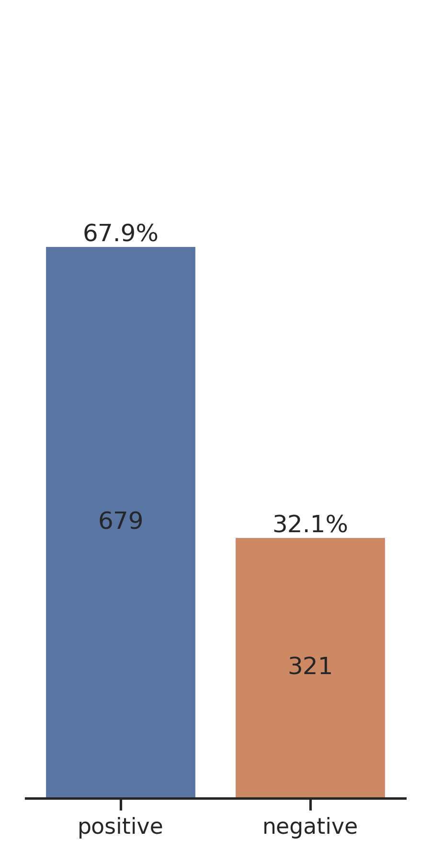
Customer Review Distribution (out of latest 1000 reviews)

