Slide 1
BA Booking Prediction

Slide 2
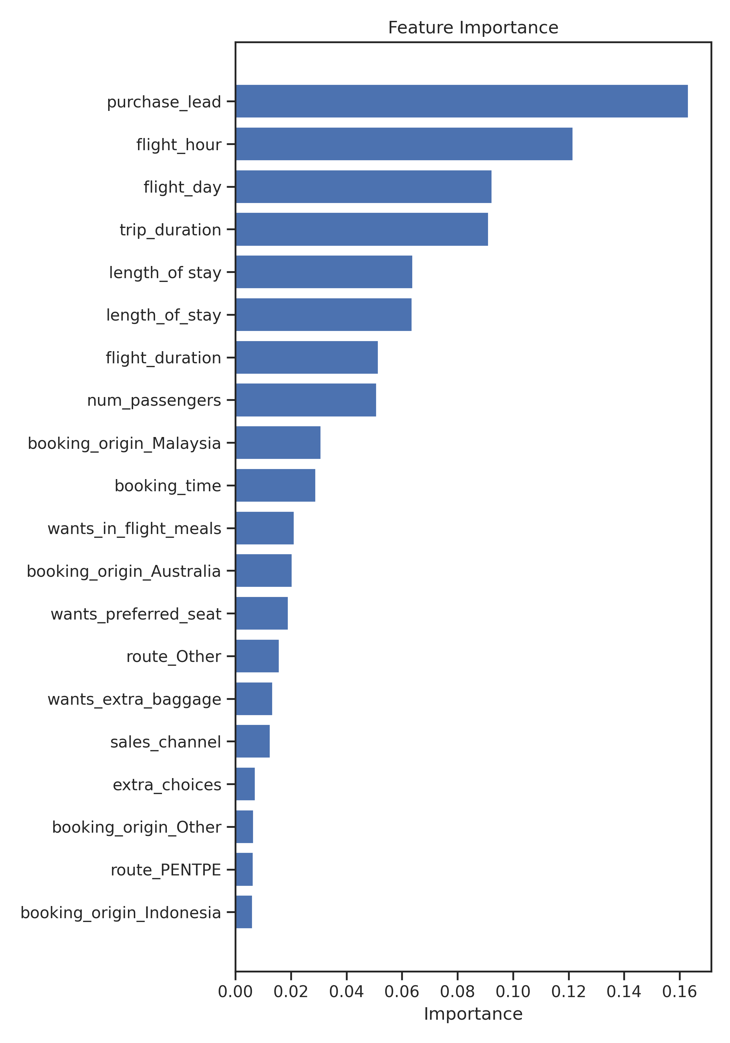
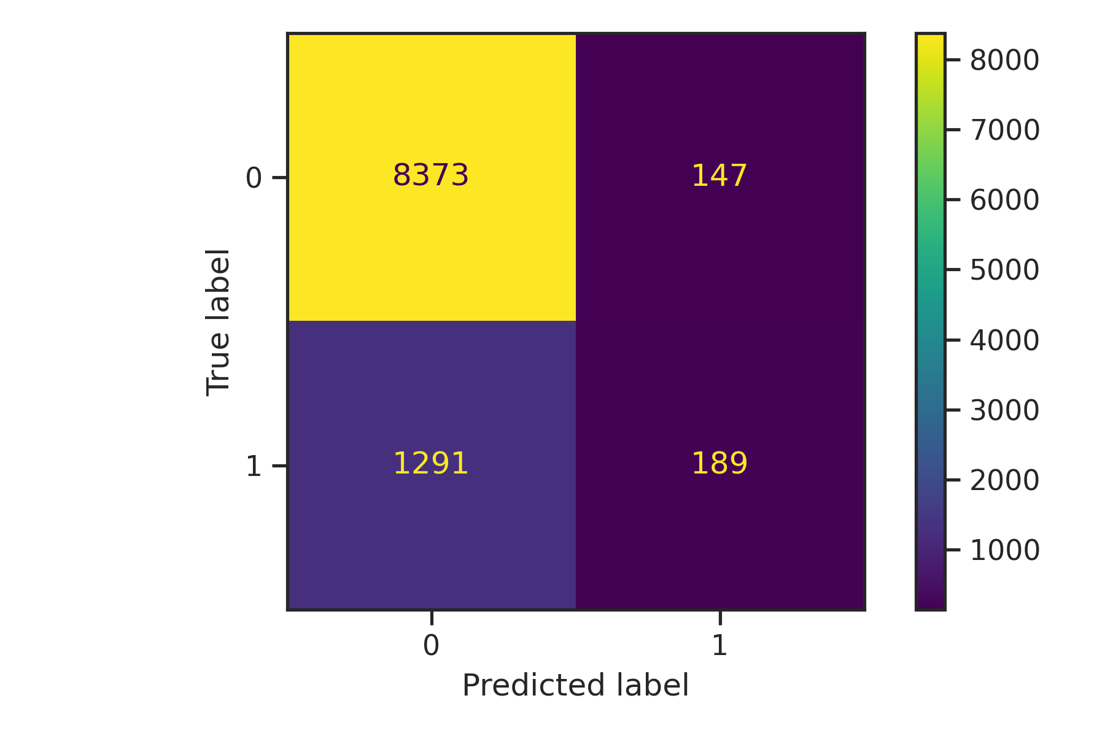
Booking prediction Model Summary
Model metrics on test set
Accuracy: 85%
Precision: 56%
Recall: 12%
f1_score: 20%
Model Interpretation:
A random forest classifier was
Trained with 1000 estimators.
The classifier was able to predict
56% of the booking cases correctly,
However, it only captures 12%
Of these positive cases.
This explains high false negative rate.
Purchase lead, flight hour, flight_day,
Length of stay and flight duration are key
Indicators of booking success.
Confusion matrix

