Slide 1
Resist the temptation to trade: Lo “Buy-n-Hold” the power of passive investing
Ashish Kakran

Slide 2
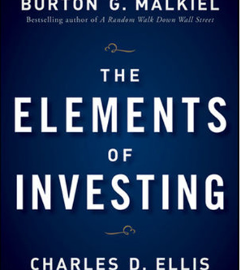
Contents
Introduction
Literature review
Hypothesis
Research methodology
Experimentation
Results
Conclusion
Q&A

Slide 3
“We generated stock prices data by simulating coin toss and sent it to an analyst, he said we’ve got to buy this immediately. This pattern’s a classic!” - Burton G. Malkiel
“If you found $10 on street, then according to efficient market hypothesis you should not pick it up as someone would have picked up already. ”
- Andrew W. Lo

Slide 4
Introduction
Stock prices in efficient markets are unpredictable
Machine Learning methods for trading
Is It all statistical fluke?

Slide 5
Literature review
Efficient Market hypothesis was popularized by (Fama, 1965)
Only empirical evidence exists
Some papers pointed by (Hsu et al., 2016) claims 70% accuracy!

Slide 6

Hypothesis
Null Model: Is mean of excess returns from machine learning models greater than mean of excess returns from random walk model?
Alternative Hypothesis says otherwise.

Slide 7
Methodology
OHLCV data
Exploration
Augmentation
Training
Backtesting
Portfolio Evaluation
Interpretation
Symbol (ticker) | Name | Market Cap | Industry
AAPL | Apple Inc. Common stock | 2.9 trillion (Mega) | Technology
MSFT | Microsoft Corporation Common stock | 2.2 trillion (Mega) | Technology
DIS | Walt Disney Company Common Stock | 184 billion (Large) | Movies/Entertainment
NKE | Nike Inc. Common Stock | 194 billion (Large) | Shoe Manufacturing
AAL | American Airlines Group Inc. Common stock | 8 billion (Medium) | Air Freight/Delivery services
ZG | Zillow Group, Inc. Class A Common stock | 9 billion (Medium) | Real estate/business services
VTI | Vanguard Total Stock Market Index Fund | 1.25 trillion (net assets) | finance

Slide 8
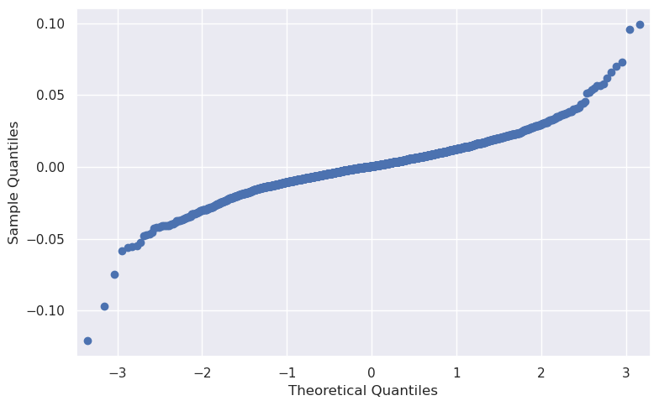
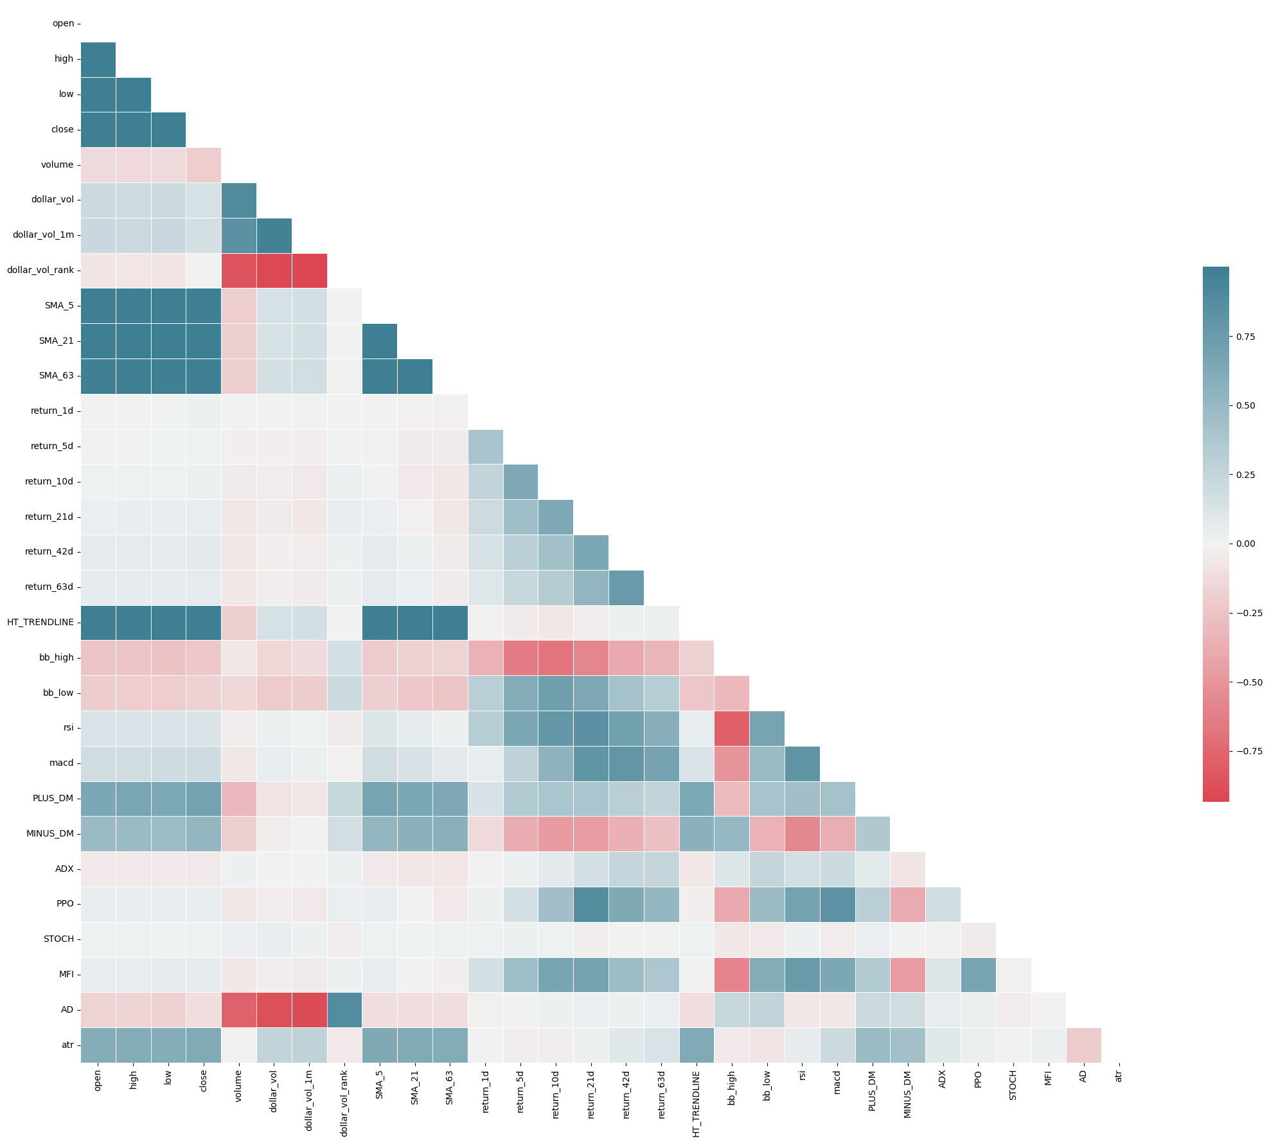
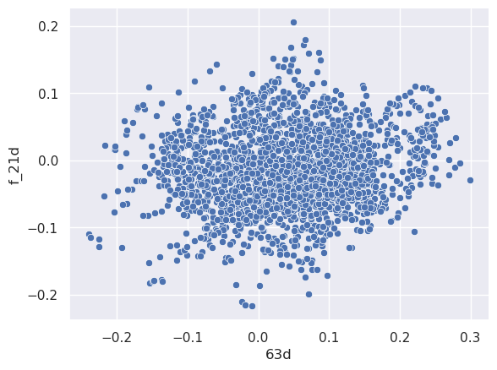
Exploration & Augmentation

Slide 9
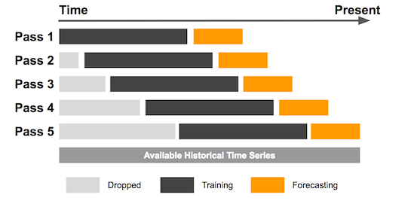
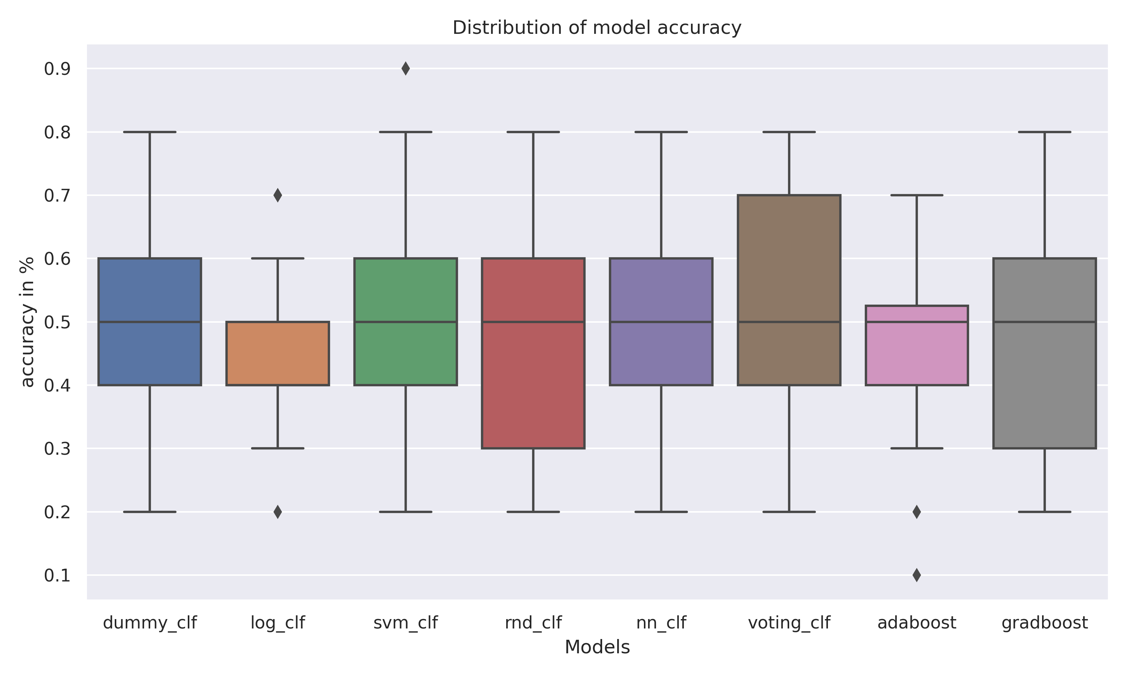
Experimentation
Train Classification models on past 252 days
Validate on next two weeks using TimeSeriesSplit
Time series CV (Yang, 2018)

Slide 10
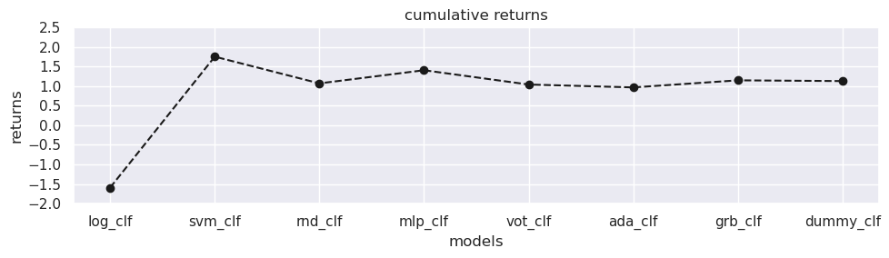
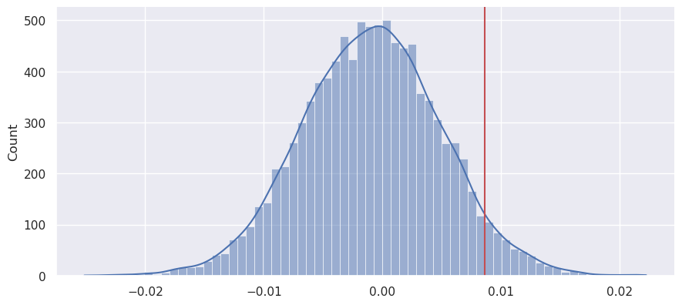

Results
T - Test | P - value
Buy-n-Hold | 0.76
Index | 0.74
$$μ_{best}<u_{dummy}$$

Slide 11
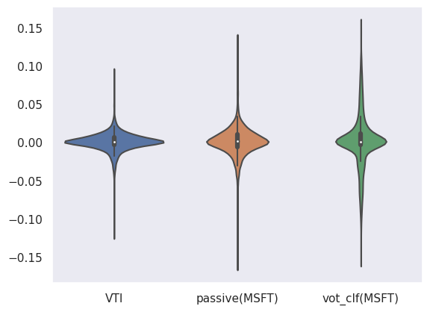
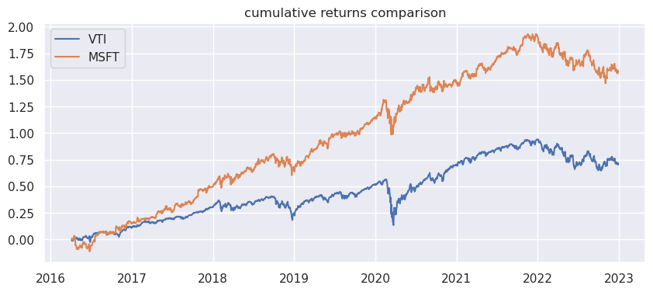
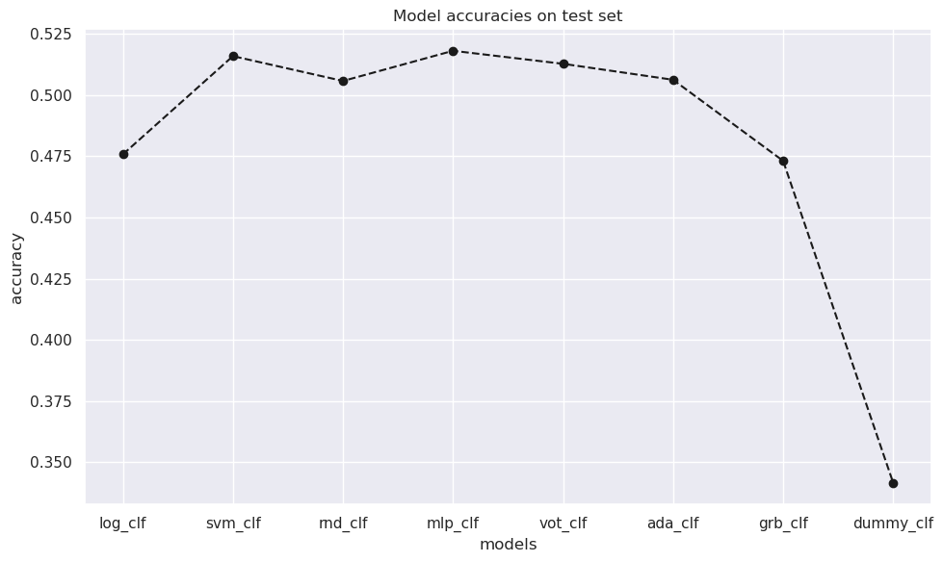
Interpretation

Slide 12


Conclusion
We cannot reject random walk hypothesis
Market anomalies > Market movement

Slide 13

Q&A

Slide 14
References
Fama, E. (1965) 'Random Walks in Stock-Market Prices', Financial Analysts Journal, Available at: https://doi.org/10.2469/faj.v21.n5.55.
Hsu, M. et al. (2016) 'Bridging the divide in financial market forecasting: machine learners vs. financial economists', Expert Systems with Applications, 61, pp. 215-234. Available at: https://doi.org/10.1016/j.eswa.2016.05.033.
Yang, R. (2018) Omphalos, Uber’s Parallel and Language-Extensible Time Series Backtesting Tool. Available at: https://www.uber.com/en-GB/blog/omphalos/ .

