Slide 1
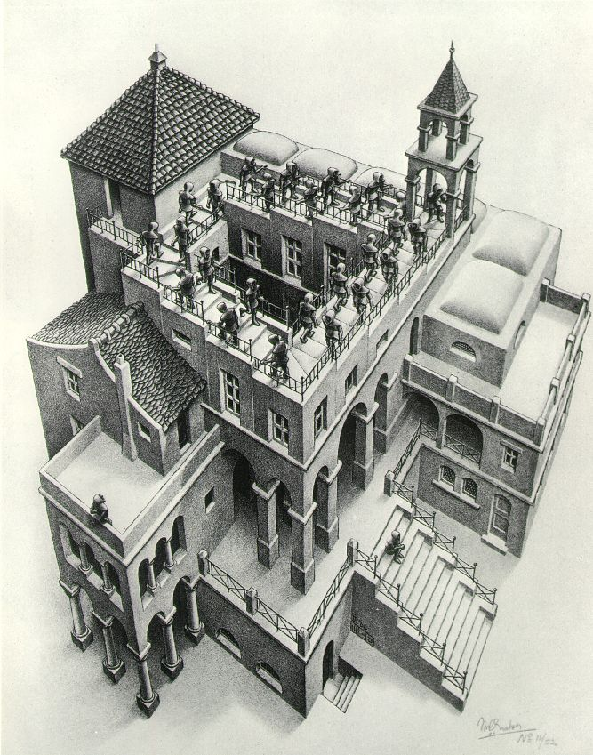
PRIORITY QUEUES AND HEAPS

Slide 2
Priority Queue
A Bag in which data items are Comparable
lesser elements (as determined by compareTo()) have higher priority
extract() returns the element with the highest priority = least in the compareTo() ordering
break ties arbitrarily

Slide 3
Priority Queue Examples
Scheduling jobs to run on a computer
default priority = arrival time
priority can be changed by operator
Scheduling events to be processed by an event handler
priority = time of occurrence
Airline check-in
first class, business class, coach
FIFO within each class

Slide 4
java.util.PriorityQueue<E>
boolean add(E e) {...} //insert an element (insert)
void clear() {...} //remove all elements
E peek() {...} //return min element without removing
//(null if empty)
E poll() {...} //remove min element (extract)
//(null if empty)
int size() {...}

Slide 5
Priority Queues as Lists
Maintain as unordered list
insert() puts new element at front – O(1)
extract() must search the list – O(n)
Maintain as ordered list
insert() must search the list – O(n)
extract() gets element at front – O(1)
In either case, O(n²) to process n elements
Can we do better?

Slide 6
Heaps
A heap is a concrete data structure that can be used to implement priority queues
Gives better complexity than either ordered or unordered list implementation:
insert(): O(log n)
extract(): O(log n)
O(n log n) to process n elements
Do not confuse with heap memory, where the Java virtual machine allocates space for objects – different usage of the word heap

Slide 7
Heaps
Binary tree with data at each node
Satisfies the Heap Order Invariant:
Size of the heap is “fixed” at n. (But can usually double n if heap fills up)
The least (highest priority) element of any subtree is found at the root of that subtree

Slide 8
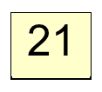
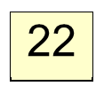
Heaps
Least element in any subtree
is always found at the root
of that subtree
4
6
14
8
19
35
38
55
10
20
Note: 19, 20 < 35: we can often find
smaller elements deeper in the tree!

Slide 9
Examples of Heaps
Ages of people in family tree
parent is always older than children, but you can have an uncle who is younger than you
Salaries of employees of a company
bosses generally make more than subordinates, but a VP in one subdivision may make less than a Project Supervisor in a different subdivision

Slide 10
Balanced Heaps
These add two restrictions:
Any node of depth < d – 1 has exactly 2 children, where d is the height of the tree
implies that any two maximal paths (path from a root to a leaf) are of length d or d – 1, and the tree has at least 2^{d} nodes
All maximal paths of length d are to the left of those of length d – 1

Slide 11
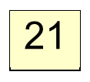
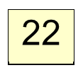
Example of a Balanced Heap
4
6
14
8
19
35
38
55
10
20
d = 3

Slide 12
Store in an ArrayList or Vector
Elements of the heap are stored in the array in order, going across each level from left to right, top to bottom
The children of the node at array index n are found at 2n + 1 and 2n + 2
The parent of node n is found at (n – 1)/2

Slide 13


Store in an ArrayList or Vector
4
0
6
1
14
2
3
8
4
19
5
35
6
7
38
8
55
9
10
10
20
11
children of node n are found at 2n + 1 and 2n + 2

Slide 14
insert()
Put the new element at the end of the array
If this violates heap order because it is smaller than its parent, swap it with its parent
Continue swapping it up until it finds its rightful place
The heap invariant is maintained!

Slide 15
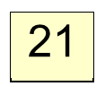
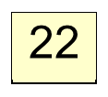
insert()
4
6
14
8
19
35
38
55
10
20

Slide 16
insert()
4
6
14
8
19
35
38
55
10
20
5

Slide 17
insert()
4
6
14
8
5
35
38
55
10
20
19

Slide 18
insert()
4
6
5
8
14
35
38
55
10
20
19

Slide 19
insert()
4
6
5
8
14
35
38
55
10
20
19

Slide 20
insert()
4
6
5
8
14
35
38
55
10
20
19
2

Slide 21
insert()
4
6
5
8
14
2
38
55
10
20
19
35

Slide 22
insert()
4
6
2
8
14
5
38
55
10
20
19
35

Slide 23
insert()
2
6
4
8
14
5
38
55
10
20
19
35

Slide 24
insert()
2
6
4
8
14
5
38
55
10
20
19
35

Slide 25
insert()
Time is O(log n), since the tree is balanced
size of tree is exponential as a function of depth
depth of tree is logarithmic as a function of size

Slide 26
insert()
insert()
class PriorityQueue<E> extends java.util.Vector<E> {
public void insert(E obj) {
super.add(obj); //add new element to end of array
rotateUp(size() - 1);
}
private void rotateUp(int index) {
if (index == 0) return;
int parent = (index - 1)/2;
if (elementAt(parent).compareTo(elementAt(index)) <= 0)
return;
swap(index, parent);
rotateUp(parent);
}

Slide 27
extract()
Remove the least element – it is at the root
This leaves a hole at the root – fill it in with the last element of the array
If this violates heap order because the root element is too big, swap it down with the smaller of its children
Continue swapping it down until it finds its rightful place
The heap invariant is maintained!

Slide 28

extract()
4
6
5
8
14
35
38
55
10
20
19

Slide 29
extract()
4
6
5
8
14
35
38
55
10
20
19

Slide 30
extract()
4
6
5
8
14
35
38
55
10
20
19

Slide 31
extract()
4
19
6
5
8
14
35
38
55
10
20

Slide 32
extract()
4
5
6
19
8
14
35
38
55
10
20

Slide 33
extract()
4
5
6
14
8
19
35
38
55
10
20

Slide 34
extract()
4
5
6
14
8
19
35
38
55
10
20

Slide 35
extract()
4 5
6
14
8
19
35
38
55
10
20

Slide 36
extract()
4 5
6
14
8
19
35
38
55
10
20

Slide 37
extract()
4 5
20
6
14
8
19
35
38
55
10

Slide 38
extract()
4 5
6
20
14
8
19
35
38
55
10

Slide 39
extract()
4 5
6
8
14
20
19
35
38
55
10

Slide 40
extract()
4 5
6
8
14
10
19
35
38
55
20

Slide 41
extract()
4 5
6
8
14
10
19
35
38
55
20

Slide 42
extract()
Time is O(log n), since the tree is balanced

Slide 43
extract()
public E extract() {
if (size() == 0) return null;
E temp = elementAt(0);
setElementAt(elementAt(size() - 1), 0);
setSize(size() - 1);
rotateDown(0);
return temp;
}
private void rotateDown(int index) {
int child = 2*(index + 1); //right child
if (child >= size()
|| elementAt(child - 1).compareTo(elementAt(child)) < 0)
child -= 1;
if (child >= size()) return;
if (elementAt(index).compareTo(elementAt(child)) <= 0)
return;
swap(index, child);
rotateDown(child);
}

