Slide 1
Advanced Data Mining for Data-Driven Insights and Predictive Modeling
MSCS-634-M20 | July 24-26, 2026
Ashish Mahajan
Murali Krishna Vattikunta
Sreesh Sattiyamourthy
Sreeharsha Varma Tinnanuri
Notes:
Hello. Our project is Advanced Data Mining for Data-Driven Insights and Predictive Modeling for MSCS-634. Our team is Ashish Mahajan, Murali Krishna Vattikunta, Sreesh Sattiyamourthy, Sreeharsha Varma Tinnanuri. Data mining prepares data and applies statistical or machine-learning methods to discover patterns and support predictions or decisions. We used predictive methods to estimate Amount and fraud Class, plus exploratory methods to reveal structure without directly predicting an outcome. Predictive results were evaluated on held-out data, while exploratory results were treated as descriptions rather than decisions. Deliverable 1 established the cleaned dataset and exploratory analysis. Deliverable 2 modeled transaction amount. Deliverable 3 compared fraud classifiers, discovered transaction clusters, and mined association rules. Deliverable 4 integrates that evidence into the final report, presentation, and recommendation. Our central question was how these methods can support fraud investigation while avoiding leakage, misleading metrics, and automatic accusations. We learned that a model result is meaningful only when its data preparation, evaluation, interpretation, and intended use are also appropriate.

Slide 2
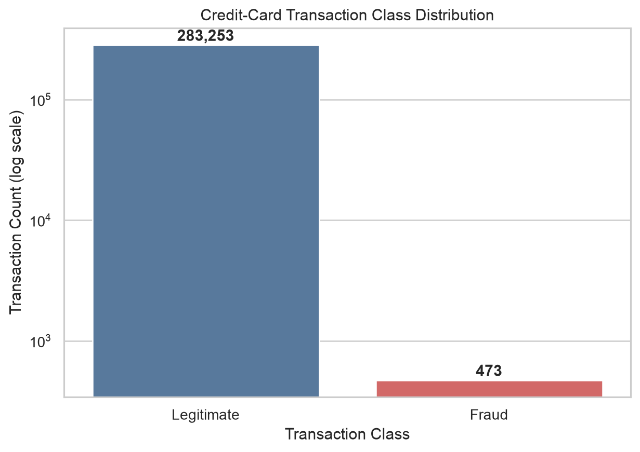
Problem and Dataset
Goal: analyze transaction amount and screen fraud risk
284,807 original rows; 283,726 after deduplication
473 fraud records (0.1667%)
31 numerical columns; PCA features are anonymized
Notes:
The business problem is fraud screening: identifying suspicious transactions while limiting disruption to legitimate customers. A false negative misses fraud and may create financial harm. A false positive flags legitimate activity and increases customer inconvenience or review workload. The Kaggle dataset contained 284,807 European card transactions and 31 columns. Time records elapsed seconds, V1 through V28 are anonymized principal-component features, Amount is the transaction value, and Class marks legitimate transactions as zero and fraud as one. PCA transforms original variables into components that retain variation while hiding the original meanings. The records cover only about two days, and anonymization limits direct business interpretation, so our conclusions must remain focused on this dataset. Deduplication left 283,726 records with only 473 fraud transactions, or 0.1667%, about one fraud case per six hundred transactions. With this imbalance, predicting every record as legitimate would still produce high accuracy. The data supported Amount estimation, fraud classification, unlabeled segmentation, and recurring-pattern analysis. We learned that each method answers a different question and needs its own evaluation evidence.

Slide 3
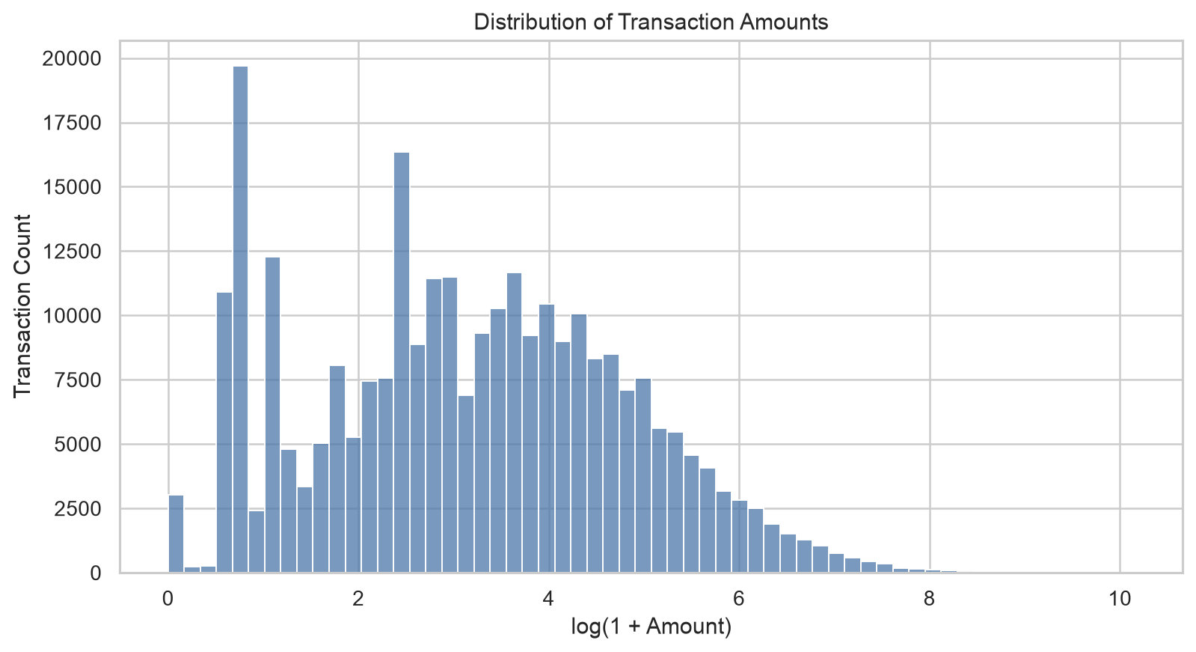
Cleaning and Exploratory Analysis
No missing values; exact duplicates removed
Statistical extremes retained as possible signal
Amount is strongly right-skewed
Imbalance requires stratification and rare-class metrics
Notes:
Data preprocessing checks and transforms raw data so later analysis is accurate and reproducible. We verified the schema, data types, missing values, duplicates, and class counts. No values were missing, so imputation was unnecessary. We removed 1,081 exact duplicates because repeated records could distort distributions and evaluation. We retained statistical extremes because an unusual amount or PCA pattern may be valid or may contain fraud signal. EDA, or exploratory data analysis, uses summaries and visualizations to understand distributions, relationships, and quality concerns before modeling. It showed a strongly right-skewed Amount distribution, extreme class imbalance, time-varying volume, and selected PCA relationships with Class. We engineered Hour and DayIndex from Time, LogAmount to reduce skew, HourSin and HourCos for the daily cycle, and PCA_L2_Norm as a magnitude summary, while preserving the original columns. These findings guided stratified splitting, a log-transformed regression target, class weighting, and rare-class metrics. Stratification preserved the rare fraud proportion in both training and test data, making the final comparison more representative. Learned preprocessing stayed inside training pipelines to prevent data leakage, where test information influences training and inflates performance. We learned that cleaning is not simply deleting unusual rows; each decision must protect quality and meaningful signal.

Slide 4
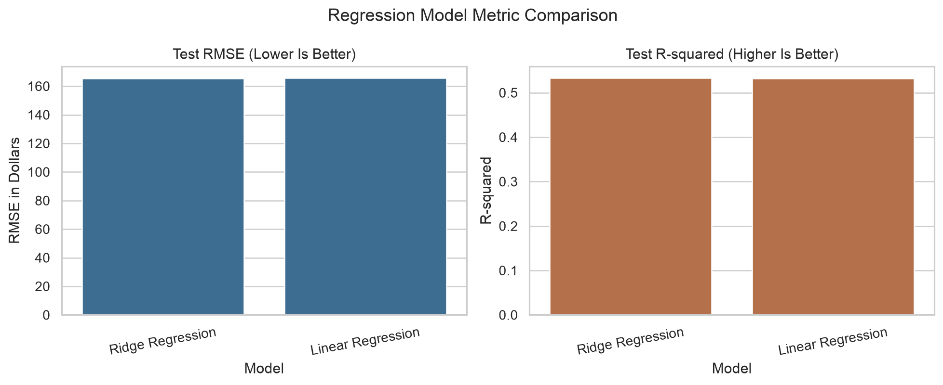
Regression Models and Findings
Linear Regression and Ridge Regression
Standardized predictors and log-transformed target
Best: Ridge Regression
RMSE $165.4704; R-squared 0.5332
Notes:
Regression predicts a continuous numerical outcome. We asked how well anonymized and time-derived features could estimate transaction Amount. Linear Regression fits a weighted linear relationship. Ridge Regression adds L2 regularization, which penalizes large coefficients and can reduce instability; alpha controls the penalty strength. We standardized predictors, applied log one plus Amount to reduce target skew, and selected alpha through five-fold training-only cross-validation. The log transformation compresses very large values during fitting, while predictions are converted back to dollars for evaluation. Cross-validation compares settings across repeated training and validation portions without touching the final test set; the selected Ridge alpha was 100. MAE is the average absolute dollar error, RMSE gives more weight to large errors, and R-squared measures explained variation relative to a mean baseline. Ridge performed slightly better, with MAE $57.9663, RMSE $165.4704, and R-squared 0.5332, compared with Linear Regression RMSE $165.7208. A training-derived prediction bound prevented unsupported inverse-transform extrapolation. We learned that regularization gave a small improvement and the features explain useful variation, but rare large amounts remain difficult. Regression estimates Amount; it does not identify fraud or establish causation.

Slide 5
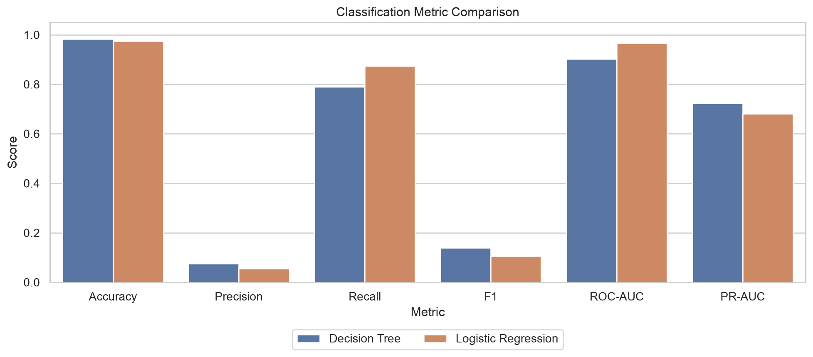
Classification and Tuning
Class-weighted Logistic Regression and Decision Tree
Tree tuned with stratified GridSearchCV and average precision
Recommended: Decision Tree
PR-AUC 0.7224; Recall 0.7895
Notes:
Classification predicts a category, here legitimate activity or fraud. We compared class-weighted Logistic Regression and Decision Tree models. Logistic Regression estimates fraud probability from a weighted linear combination of features, while a Decision Tree creates feature-based decision rules. Class weighting makes rare fraud errors more costly without fabricating records. GridSearchCV tested tree criterion, depth, and minimum leaf size. Five stratified folds preserved the fraud proportion, and average precision was used because it focuses on ranking the rare positive class. The selected tree used entropy, depth eight, and minimum leaf size twenty. Precision is the share of alerts that are truly fraud. Recall is the share of actual fraud recovered. F1 balances both. ROC-AUC measures ranking across false-positive rates, while PR-AUC emphasizes the precision-recall tradeoff and is more informative here. In the confusion matrix, a true positive is detected fraud, a false negative is missed fraud, and a false positive is a legitimate transaction sent for review. The tree achieved PR-AUC 0.7224, recall 0.7895, precision 0.0761, F1 0.1388, and ROC-AUC 0.9025. It found 75 fraud cases, missed 20, and created 911 false alerts. Logistic Regression recovered more fraud, with recall 0.8737, but had lower PR-AUC 0.6804 and more false positives. We selected the tree for its stronger rare-class ranking and alert tradeoff. We learned that model selection must consider both missed fraud and review burden, and the operating threshold must reflect real costs.

Slide 6
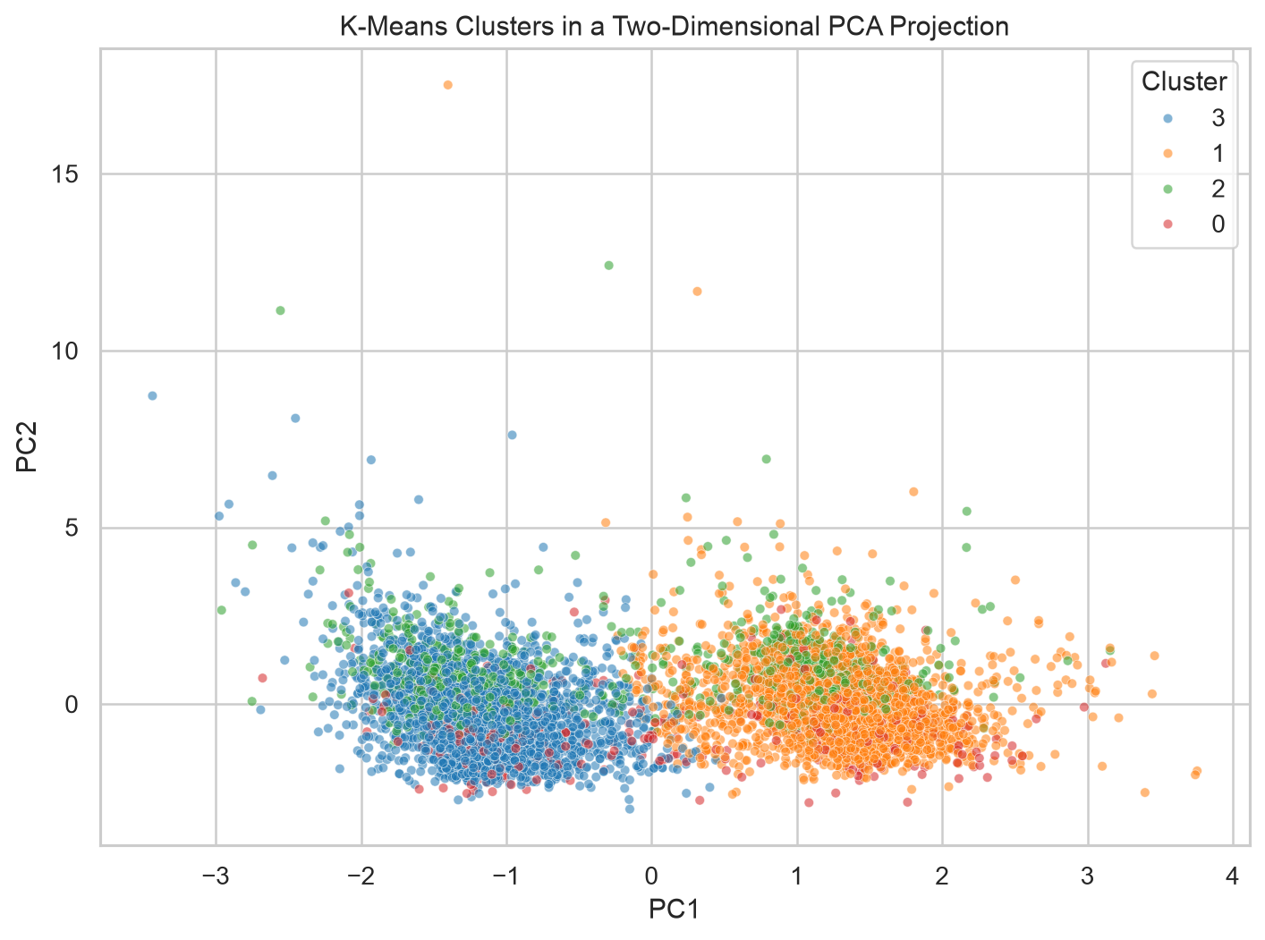
Clustering Analysis
K-Means: 32 standardized inputs; Class excluded
50,000-row sample; evaluated k=2 through k=6
Selected k=4: silhouette 0.0762; smallest cluster 6.97%
PCA shows the fitted clusters in two dimensions only
Notes:
Clustering is unsupervised learning: it groups observations by similarity without a target label. Common types include partitioning, hierarchical, density-based, and model-based clustering. Partitioning divides data into a selected number of groups. Hierarchical clustering builds nested groups shown in a dendrogram. Density-based methods such as DBSCAN find dense regions and may label isolated points as noise. Model-based methods such as Gaussian mixtures represent clusters with probability distributions and may provide soft membership.
This project used K-Means, a partitioning and hard-clustering method, so every transaction was assigned to exactly one cluster. It suited the project because the inputs were numerical, could be standardized, and could be processed reproducibly on the 50,000-row sample. K-Means assigns observations to the nearest of k centers, updates each center using its cluster mean, and repeats until stable. It uses Euclidean distance, so standardization prevents larger-scale features from dominating. The 32 inputs were V1 through V28, LogAmount, HourSin, HourCos, and DayIndex. Class was excluded because clustering was intended to discover structure without the fraud label.
We tested k from two through six. Inertia measures within-cluster compactness and decreases as clusters are added. Silhouette score compares within-cluster cohesion with separation from other clusters. We also checked the smallest-cluster percentage so a tiny group would not control the choice. k=6 had the highest silhouette score, but its smallest cluster held only 1.00% of observations. We selected k=4, with silhouette 0.0762 and a 6.97% smallest cluster. The modest silhouette score indicates overlapping rather than sharply separated transaction groups.
PCA reduced the fitted 32-dimensional result to two dimensions only for visualization; it did not create the clusters. After fitting, Class was reattached for external profiling. Cluster 0 contained 3,487 transactions and had the highest observed fraud rate, 0.4875%, compared with 0.1540% across the sample. Cluster 2 had the highest mean Amount, $130.90, but very low observed fraud. We learned that the clustering type and selection criteria must fit the data and purpose. A higher post-fit fraud concentration describes a segment, but it does not make that cluster a fraud label or replace the classifier.

Slide 7
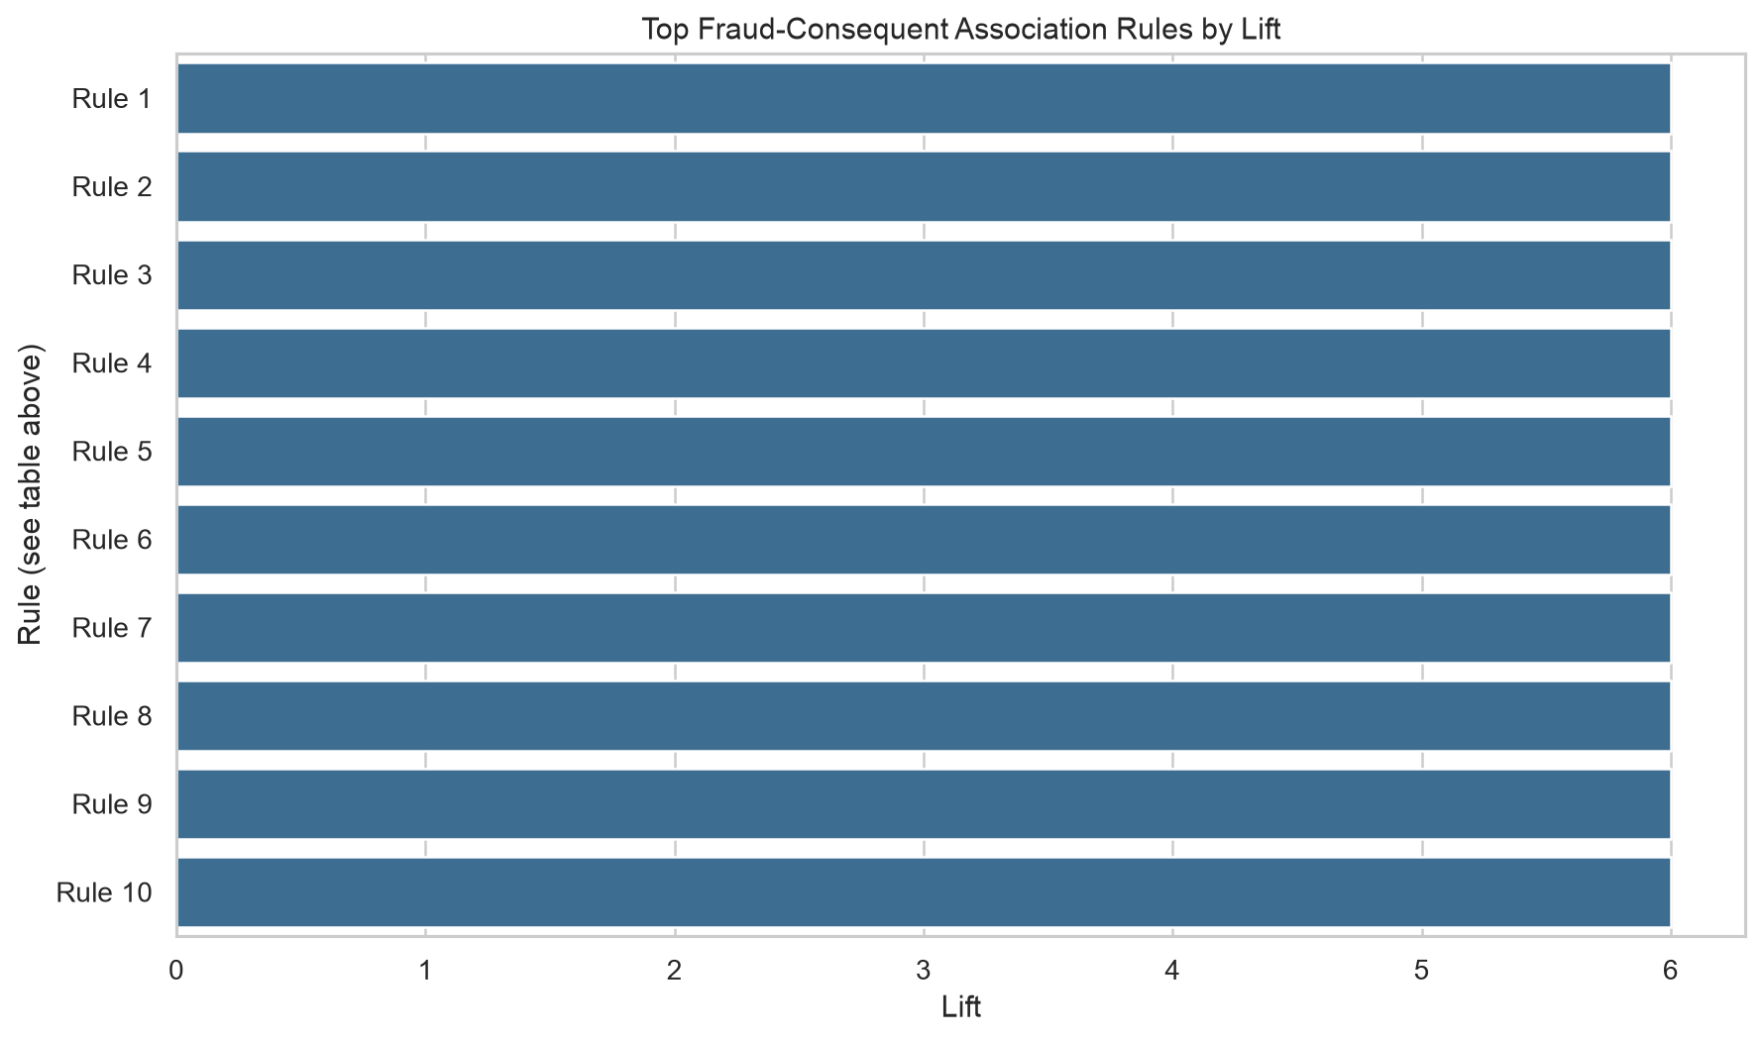
Association Rule Mining
Cluster 0: 3,487 transactions; 0.4875% observed fraud
FP-Growth retained 319 fraud-consequent rules
Top displayed rule: confidence 1.0000; lift 6.0000
Cluster profiles and rules are exploratory evidence
Notes:
Association-rule mining discovers conditions that occur together. The antecedent is the condition set on the left, and the consequent is the outcome on the right. FP-Growth efficiently counts frequent combinations without generating every candidate set. Because our variables were continuous, we discretized selected Amount, time, and PCA values into categories using training-derived boundaries. Those boundaries are part of the rule definition, so different bins could produce different patterns. We created an enriched sample with all training fraud records and five legitimate records per fraud record so fraud combinations were frequent enough to study, then retained rules whose consequent was Class Fraud. Support is the sampled proportion containing the full rule. Confidence is the probability of the consequent when the antecedent occurs. Lift compares confidence with the baseline consequent rate; lift above one indicates a stronger-than-baseline association in that sample. FP-Growth retained 319 rules. The strongest displayed antecedent was V10_Low AND V12_Low AND V14_Low AND V16_Low AND V3_Low, with support 0.1287, confidence 1.0000, and lift 6.0000. Confidence one means every enriched-sample record with that antecedent was fraud, and lift six means six times the enriched-sample baseline. We learned that rules describe co-occurrence, not causation. Their stability should be checked on later time periods. Because the sample was enriched, support is not original fraud prevalence, and rules should not replace classification.

Slide 8
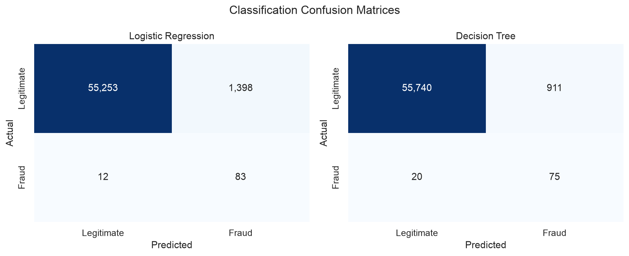
Recommendations and Ethics
Use Decision Tree as a screening layer
Tune thresholds to false-positive and false-negative costs
Require human review, audit logs, and access controls
Monitor precision, recall, calibration, and drift
Notes:
We recommend the Decision Tree as a monitored screening layer that prioritizes transactions for trained human review, not an autonomous decision maker. A classification threshold converts a model score into an alert. Lowering it usually increases recall and false positives; raising it reduces review volume but may miss fraud. The threshold should reflect investigated costs, staffing capacity, and the harm of both error types. Human-in-the-loop operation means reviewers remain responsible for consequential decisions and can use context unavailable to the model. Reviewers should receive supporting evidence, record decisions, and correct errors. Governance should include access controls, audit logs, model-version records, and escalation procedures. Monitoring should track precision, recall, PR-AUC, calibration, feature drift, and alert volume. Calibration checks whether predicted probabilities match observed frequencies; drift means incoming data or feature-fraud relationships have changed. Ethical use also requires privacy and fairness review. Anonymization limits direct identity exposure, but protected attributes are unavailable, so we cannot measure demographic error differences. Their absence does not prove fairness. The model should not accuse customers, deny services, or trigger irreversible action without human review and an appeal process. Clusters and rules remain supporting context. We learned that responsible deployment is part of deciding whether a model is usable, not an extra step after modeling.

Slide 9
Limitations, Future Work, and Conclusion
Short historical period and anonymized feature meanings
Protected attributes unavailable for fairness testing
Future: temporal validation, calibration, and drift monitoring
Reproducible evidence supports monitored human decisions
--- Thank You ---
Notes:
Several limitations define our conclusions. The data covers about two days, so a random split cannot show performance as fraud behavior changes over months. The anonymized V features protect privacy but prevent direct business explanations. Fraud is extremely rare, default thresholds may not match costs, cluster separation was limited, and rule support came from an enriched sample. Future work should use temporal validation, cost-sensitive threshold tuning, probability calibration, cluster and rule stability checks, and continuous drift monitoring. Approved features could improve interpretation without compromising privacy. Re-running the complete pipeline on later data would show whether the models, clusters, and rules remain stable. We learned that preprocessing protects evidence, EDA guides choices, regression estimates a continuous outcome, classification provides direct fraud-screening evidence, clustering explores unlabeled segments, and association rules describe recurring conditions. These methods are complementary, not interchangeable. The final outcome is a reproducible foundation for human-reviewed fraud screening. Its value comes from the selected model together with transparent assumptions, suitable metrics, cautious interpretation, and safeguards that keep people responsible for consequential decisions. Thank you.

