Slide 1
DSCI-6011-03
Deep Learning
Project Proposal
Team:
Sai Karthik Navuluru
Deepika Linga
Ashish Manchala

Slide 2
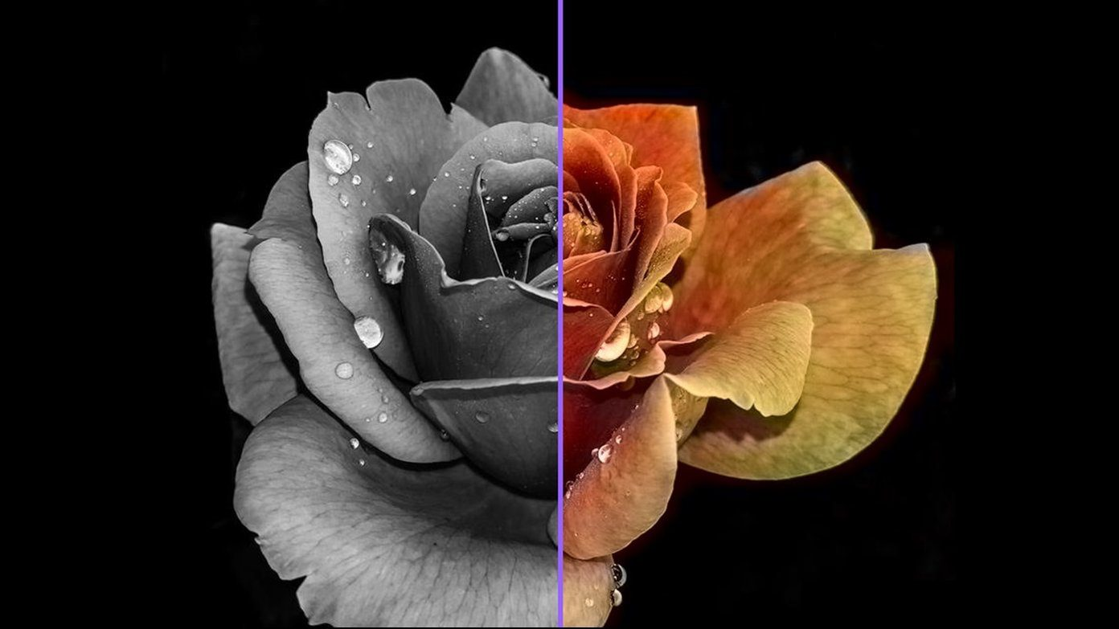
Black and White Image Colorization using DL
Project Topic

Slide 3
Statement of Project Objectives
We aim to create a high-accuracy deep learning model for colorizing grayscale images through the use of convolutional neural networks (CNNs) and, if needed, techniques like autoencoders or Generative Adversarial Networks (GANs). Our model's performance will be assessed using metrics like SSIM (Structural Similarity Index). Furthermore, we will benchmark our model against existing state-of-the-art solutions like DeOldify and Colorful Image Colorization to determine its effectiveness in producing realistic and accurate colorizations.

Slide 4
Statement of value
Restore and Modernize Historical and Old Images: We bring old and historical images back to life using advanced deep learning techniques, preserving cultural heritage and making them visually appealing.
Offer a Tool for Filmmakers, Museums, and Individuals to Enhance Old Visuals: Our technology provides a user-friendly tool for filmmakers, museums, and individuals to improve old visuals, facilitating their use in modern contexts, exhibits, and personal storytelling.
Contribute to Ongoing Research and Advancements in Image Processing Using Deep Learning: We actively engage in research and innovation in image processing, pushing the boundaries of what deep learning can achieve, benefiting both our users and the broader scientific community.

Slide 5
Review of the State of the Art and Relevant works
"Deep Colorization", Zhang et al., 2016
"Let there be Color!: Joint End-to-end Learning of Global and Local Image Priors for Automatic Image Colorization with Simultaneous Classification", Iizuka et al., 2016

Slide 6
Approach
Algorithms: Convolutional Neural Networks (CNNs), Generative Adversarial Networks (GANs).
Datasets: ImageNet, custom dataset of grayscale and colored image pairs.
Tools: TensorFlow, and Keras.
Techniques: Transfer learning, Image augmentation, and Batch normalization.

Slide 7
Deliverables
A trained model for Image Colorization.
Web based interface for users to upload and colorize their greyscale images.
Detailed documentation on model architecture, training procedure, and results.

Slide 8
Evaluation methodology
Quantitative Metrics: Mean Squared Error (MSE) between the predicted and actual colors, Structural Similarity Index (SSI) for evaluating image quality.
Qualitative Metrics: Visual comparison with ground truth, user surveys to evaluate colorization accuracy and aesthetics.

Slide 9
Thankyou

