Slide 1


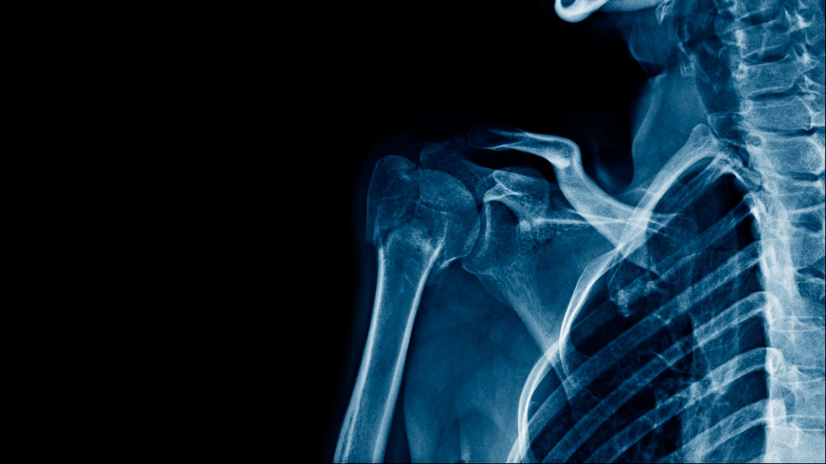



Diagnostic performance of Artificial Intelligence model for Pneumonia from CXR (chest x-ray)
- Ashish Manchala
- Nehanvitha Adapa
- Gangai Kali Prasad

Slide 2
INTRODUCTION
Pneumonia is a serious respiratory illness that affects millions of people worldwide, causing severe
morbidity and mortality. Early detection and accurate diagnosis of pneumonia can significantly improve
patient outcomes, making it a critical area of research in medical imaging. The use of artificial
intelligence (AI) and machine learning (ML) algorithms in medical image analysis has shown promising
results in improving the accuracy and efficiency of diagnosis.
In this project, we aim to develop an AI model that can detect pneumonia from chest radiography images.
We will use a dataset of chest X-ray images to train and test our model, and evaluate its performance
using various metrics. The project will involve data preprocessing, feature extraction, and selection,
as well as the implementation and evaluation of different ML algorithms. The ultimate goal of this project
is to develop an accurate and efficient pneumonia detection model that can assist medical professionals in
diagnosing and treating patients.

Slide 3
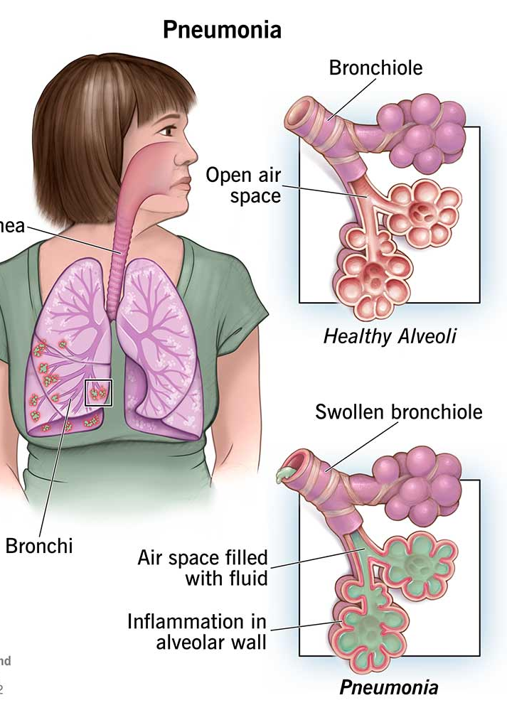
WHAT'S PNEUMONIA?
Pneumonia is a type of lung infection that can affect one or both lungs. It occurs when the air sacs in the lungs become filled with fluid or pus, leading to inflammation and difficulty breathing. Pneumonia can be caused by a variety of microorganisms, such as bacteria, viruses, and fungi, and can range in severity from mild to life-threatening. Some common symptoms of pneumonia include coughing, fever, shortness of breath, chest pain, and fatigue. It is important to seek medical attention if you experience any of these symptoms, as early detection and treatment can improve outcomes.

Slide 4




PROJECT STATEMENT
The goal of this project is to develop an artificial intelligence (AI) model for the detection of pneumonia from chest radiography images. The project will involve the use of CNN (Convolution Neural Network) algorithms to train and test the model on a dataset of chest X-ray images.
The model will be evaluated using various metrics to assess its accuracy and efficiency in detecting pneumonia.
To achieve this goal, an AI model might help to diagnose Pneumonia disease from the chest x- rays more quickly and accurately.
The project will ultimately aim to develop a highly accurate and efficient AI model for pneumonia detection. This model has the potential to significantly improve patient outcomes and reduce the burden on healthcare systems worldwide.

Slide 5
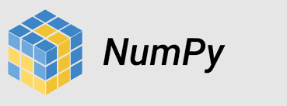

Packages used in the project
Python libraries such as NumPy, Pandas, Matplotlib
TensorFlow and Keras for building and training deep learning models, particularly Convolutional Neural Networks (CNNs).

