Slide 1
Kabaddi Game Comparison of AI Agents: Random, Greedy, Alpha-Beta, MCTS
Ashish Mishra | Roll - MT24020

Slide 2
Overview
Goal: To design and test AI agents in a custom grid-based Kabaddi game.
Objective: Analyze how different AI strategies perform in predictable vs. uncertain environments.
Agents Implemented: Random, Greedy, Alpha-Beta Search, Monte Carlo Tree Search (MCTS).
Environments: Turn-Based (predictable) vs. Simultaneous-Move (uncertain).

Slide 3
The Game: Rules & Formulation
Visual: Show your Game Board Layout diagram (Image Placeholder 1) prominently on the slide.
Key Rules :
Grid: 8x5 grid, 2 players per team.
Objective: Steal the opponent's gold and return to your home territory.
Win: Successfully return with the gold.
Capture: An opponent is captured if you move onto their square while they are in your territory.
Draw: Turn limit exceeded.

Slide 4
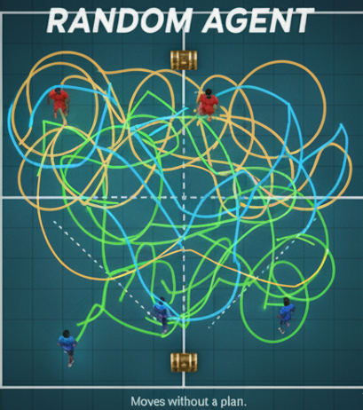
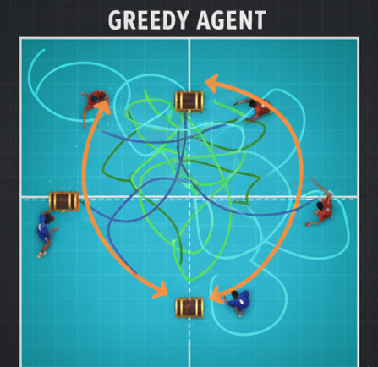
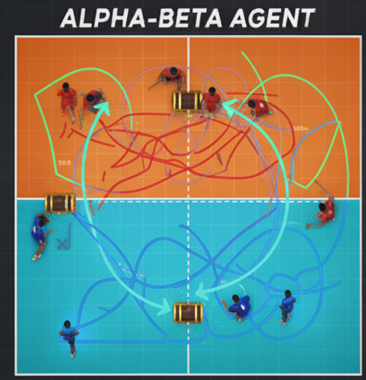
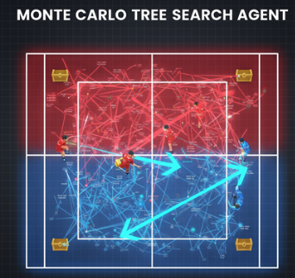
The Agents: A Spectrum of Intelligence
The Four AI Agents
Use a four-quadrant layout or four columns.
Random: Baseline. Makes random moves.
Greedy: Heuristic-based. Chooses the move with the best immediate score. Short-sighted.
Alpha-Beta: Search-based. Plans ahead, assuming an optimal opponent. Aims for the "perfect" move.
MCTS: Simulation-based. Runs hundreds of random games to statistically find the best move.

Slide 5
Heuristic Evaluation Function
Title: The Heuristic Function (for Greedy & Alpha-Beta)
Equation (center of the slide): h(s) = (Player Advantage Score) + (Objective Score)
Explanation:
Player Advantage: More points for having more active players. (500 * Player_Difference)
Objective Score:
Offense: Penalty for being far from the enemy gold.
Defense: Huge bonus for returning with the gold.
Key Takeaway: This function is the "strategic brain" that guides our planning agents.

Slide 6
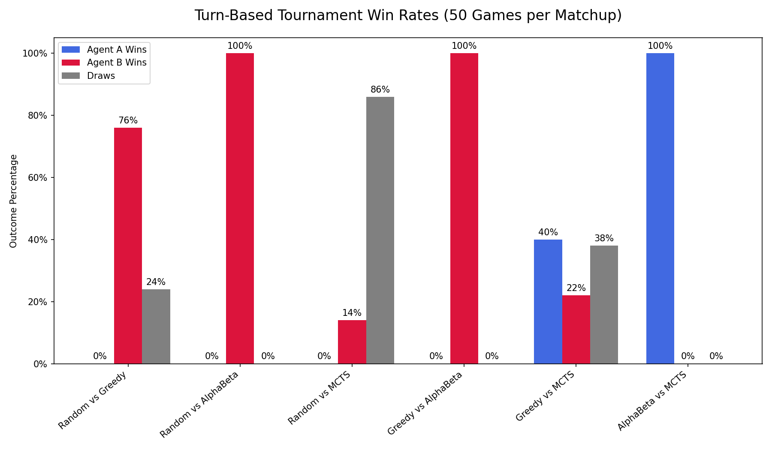
Results: Turn-Based Tournament
Key Finding : Alpha-Beta Dominates (100% Win Rate)
Analysis Bullets (concise):
Alpha-Beta's look-ahead strategy is unbeatable in a predictable game.
The low-iteration MCTS agent played too passively, resulting in many draws.
Heuristics (Greedy) are clearly better than chance (Random).

Slide 7
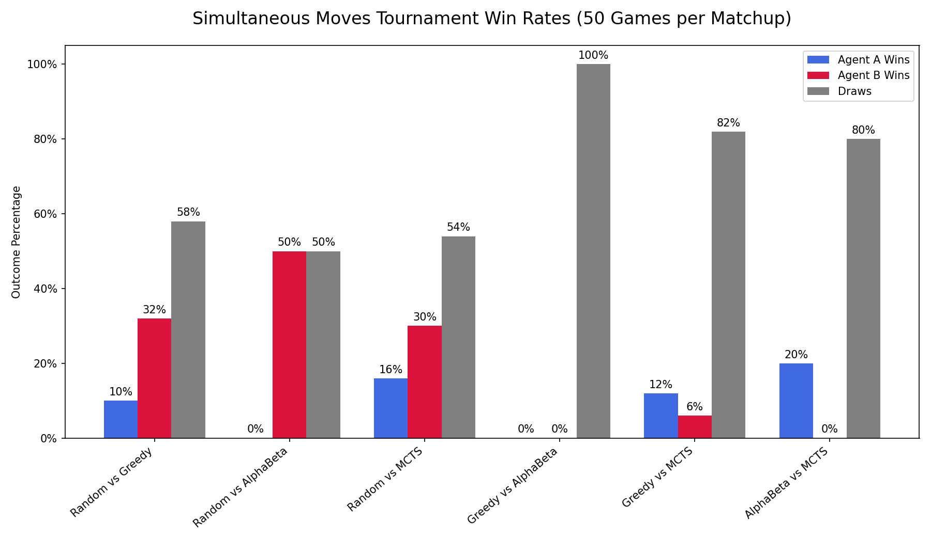
Results: Simultaneous-Move Tournament
Visual: Show your Simultaneous-Move Results Bar Chart (Image Placeholder 5) as the main content.
Key Finding (in a large, bold font): Performance Collapses, Draws Dominate
Analysis Bullets (concise):
Alpha-Beta's planning fails when the opponent's move is unknown.
100% Draw Rate (Greedy vs. Alpha-Beta) shows strategic paralysis.
Uncertainty forces all intelligent agents into safe, defensive strategies.

Slide 8
Insights & Conclusion
Environment is Everything: An agent's effectiveness is not intrinsic; it depends entirely on the environment.
The Fragility of Deterministic Search: Alpha-Beta is dominant in predictable settings but brittle and ineffective under uncertainty.
Tuning is Critical: The MCTS agent's poor performance was due to a low iteration count, not a fundamental flaw in the algorithm.
The "Best" Agent: For turn-based, it's Alpha-Beta. For simultaneous, no agent was truly effective, proving the difficulty of the problem.
Result demonstrated the trade-offs between different AI search techniques. While deterministic planning excels in structured environments, handling uncertainty is critical for more realistic scenarios.

Slide 9
! Thank You !
Links
Github Repo for Code , Reports & PPT - https://github.com/AshishMishra2001/AI_Assignment_2
Submission Drive Link - https://drive.google.com/drive/folders/1933parkl-8qKCNMnQFOUx0iLTVY1gT_N?usp=sharing

