Slide 1
Decision Trees
CART (Classification And Regression Trees)
Gini Index, Entropy (Information Gain)
Over-fitting
Options

Slide 2
Decision Tree Introduction
Supervised Learning
Can be used for classification / Regression
Binary or Multi-class Both Supported
Similar to human decision making
Weak Algorithm
Easy to over-fit on training data
Ex. Which mobile to purchase ?
How you decide?
What are imp parameters ?

Slide 3
Decision Trees Introduction
Popular Algorithms
ID3 (Iterative Dichotomiser 3)
CART (Classification And Regression Trees)
Applications:
Classification problems
Regression problems
Feature Selection

Slide 4
CART Introduction
CART creates a binary tree
Binary tree means every node of the tree can have maximum 2 branches ONLY (TRUE and FALSE )
Every internal node is a splitting condition on one feature from data, it splits all rows present currently in two parts
Continuous feature : Binary split
Categorical Feature : Binary Split
Leaf nodes have the prediction or decision class

Slide 5
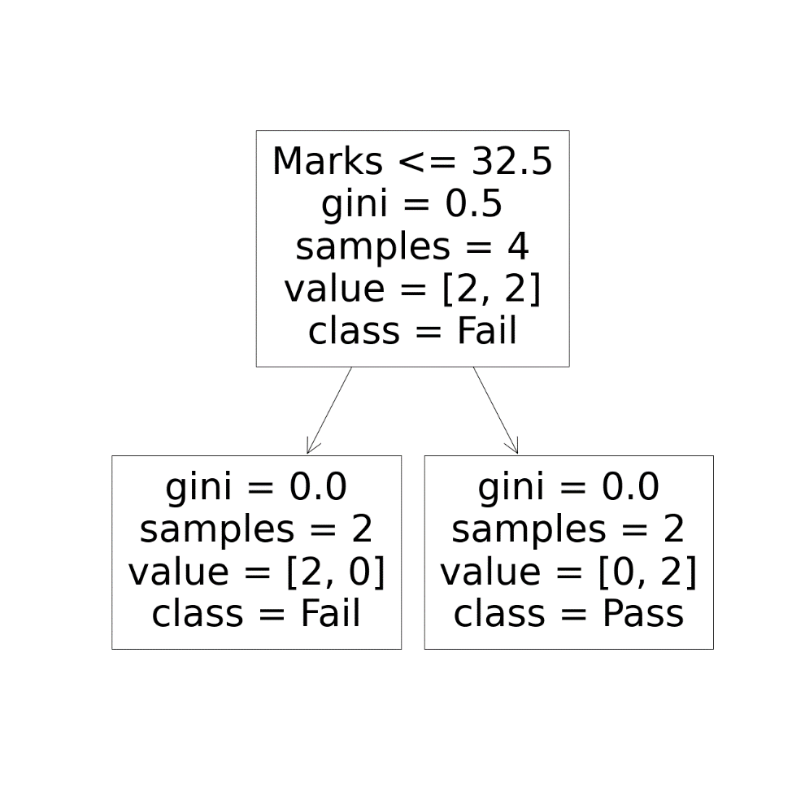
CART Structure
Continuous feature
Binary Split using
numeric condition
So, total samples (4)
Split into 2 and 2
Two Branches
TRUE
FALSE
True
False
Leaf nodes don’t have condition!

Slide 6
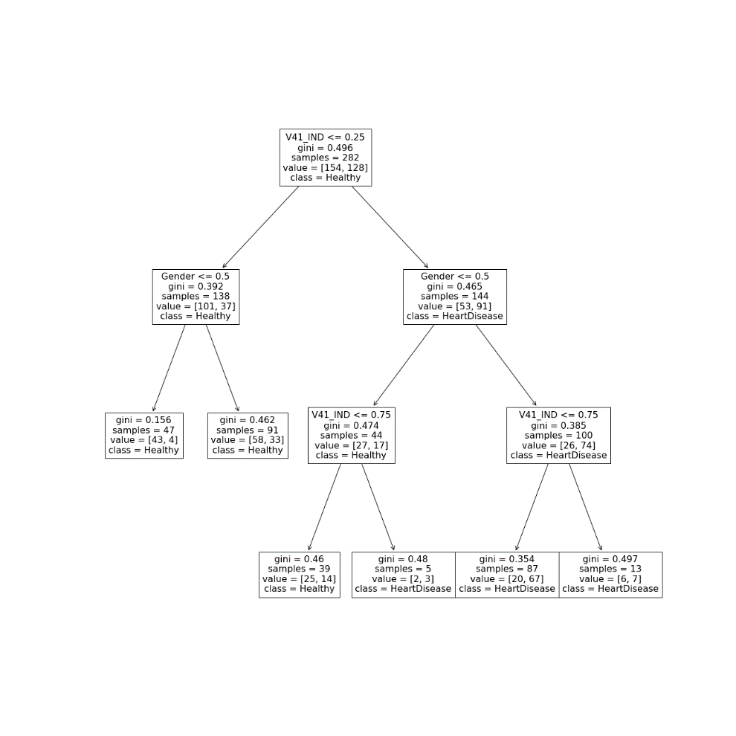
CART Structure
Complete samples (282)
Split to two parts
138 and 144
Categorical feature
Binary Split using
numeric condition

Slide 7
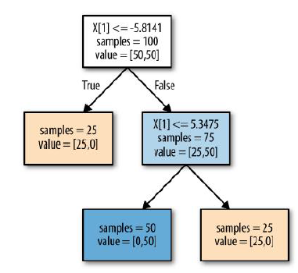
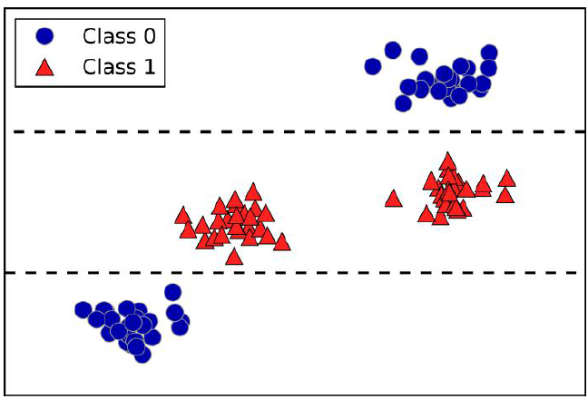
CART Structure
Same feature
can repeat
in nodes
This allows non-linear
boundaries
X[1]
5.3475
-5.8141
X[0]

Slide 8
Basic Terminologies
Root Node: It represents entire population or sample and this further gets divided into two partitions.
Splitting: It is a process of dividing a node into two sub-nodes.
Decision Node: When a sub-node splits into further sub-nodes, then it is called decision node.
Leaf/ Terminal Node: Nodes do not split is called Leaf or Terminal node.

Slide 9
Basic Terminologies
Pruning: When we remove sub-nodes of a decision node, this process is called pruning.
Branch / Sub-Tree: A sub section of entire tree is called branch or sub-tree.
Parent and Child Node: A node, which is divided into sub-nodes is called parent node of sub-nodes where as sub-nodes are the child of parent node.

Slide 10
CART Algorithm
CART at every step divides currently available rows in two parts in way that cost will be minimized (greedy approach)
This is called as recursive binary splitting
At every step, all input features and their all possible values are lined up and all possible split points are tried out
Then split feature and value which gives minimum cost is selected
Ideally, When a part has all rows with same output class or ONLY one row is present in the part then splitting is stopped

Slide 11
CART Algorithm
Cost Function
For Classification: Gini Index / Entropy
For Regression : sum of squared error
Stopping Criteria
Ideal: all rows in the part should have same class
OR only 1 row in the part
Actual: min_samples_leaf parameters allows CART to stop splitting if no of rows are less than minimum value given

Slide 12
CART for Classification

Slide 13
CART
Leaf nodes will have the predicted class
Directly supports
Binary Classification
Multi-class Classification
No extra calculation or processing for multi-class classification

Slide 14
Criterian for Split (Cost function)
Measures how each feature/column is important
Options
Gini Index → CART uses it by default
Entropy ( Information Gain)

Slide 15

Gini index / Gini Impurity
Minimum Value is 0
Max value is 0.5
Formula :
Here Pj is probability of value in jth class
So for binary classification
GiniIndex = 1 – (p1^2 + p2^2)

Slide 16
Gini Index
Gini Index for a Split Point is
G = ((1 – (T_c1^2 + T_c2^2)) * (nT/n))
+ ((1 – (F_c1^2 + F_c2^2)) * (nF/n))
T_c1 – portion of class 1 in True part
T_c2 – portion of class 2 in True part
nT – total samples in True part
F_c1 – portion of class 1 in False part
F_c2 – portion of class 2 in False part
nF – total samples in False part
n – Total samples in current node

Slide 17
Gini Index Example
X1 | X2 | Y
Gender | Marks | Result
0 | 35 | 1
1 | 25 | 0
0 | 30 | 0
1 | 45 | 1
Target: Result Feature Names : Gender,Marks
Features / Columns : 2, Samples / rows : 4
Possible splits:
1 split on Gender – (0.5)
3 splits on Marks – (27.5,32.5,40)
Calculate Gini Index for split Gender 0.5
Calculate Gini Index for split Marks 32.5
Then Select split which has minimum Gini Index

Slide 18
Gini Index Example
X1 | X2 | Y
Gender | Marks | Result
0 | 35 | 1
1 | 25 | 0
0 | 30 | 0
1 | 45 | 1
Calculate Gini Index for split Gender 0.5
True Part : nT: 2 where Gender <= 0.5
T_c0 = 1/2, T_c1 = 1/2
False Part: nF : 2 where Gender > 0.5
F_c0 = 1/2, F_c1 = 1/2
n=4
G = ((1 – (T_c0^2 + T_c1^2)) * (nT/n))
+ ((1 – (F_c0^2 + F_c1^2)) * (nF/n))
G = ((1–(0.5^2+0.5^2)*(2/4))+((1–(0.5^2 + 0.5^2) *(2/4))
G = (1-0.5)*0.5 + ( 1-0.5)* 0.5
G = 0.5

Slide 19
Gini Index Example
X1 | X2 | Y
Gender | Marks | Result
0 | 35 | 1
1 | 25 | 0
0 | 30 | 0
1 | 45 | 1
Calculate Gini Index for split Marks 32.5
True Part : nT: 2 where Marks <= 32.5
T_c0 = 2/2, T_c1 = 0/2
False Part: nF : 2 where Marks > 32.5
F_c0 = 0/2, F_c1 = 2/2
n=4
G = ((1 – (T_c0^2 + T_c1^2)) * (nT/n))
+ ((1 – (F_c0^2 + F_c1^2)) * (nF/n))
G = ((1–(1^2+0^2)*(2/4))+((1–(0^2 + 1^2) *(2/4))
G = (1-1)*0.5 + ( 1-1)* 0.5
G = 0.0

Slide 20
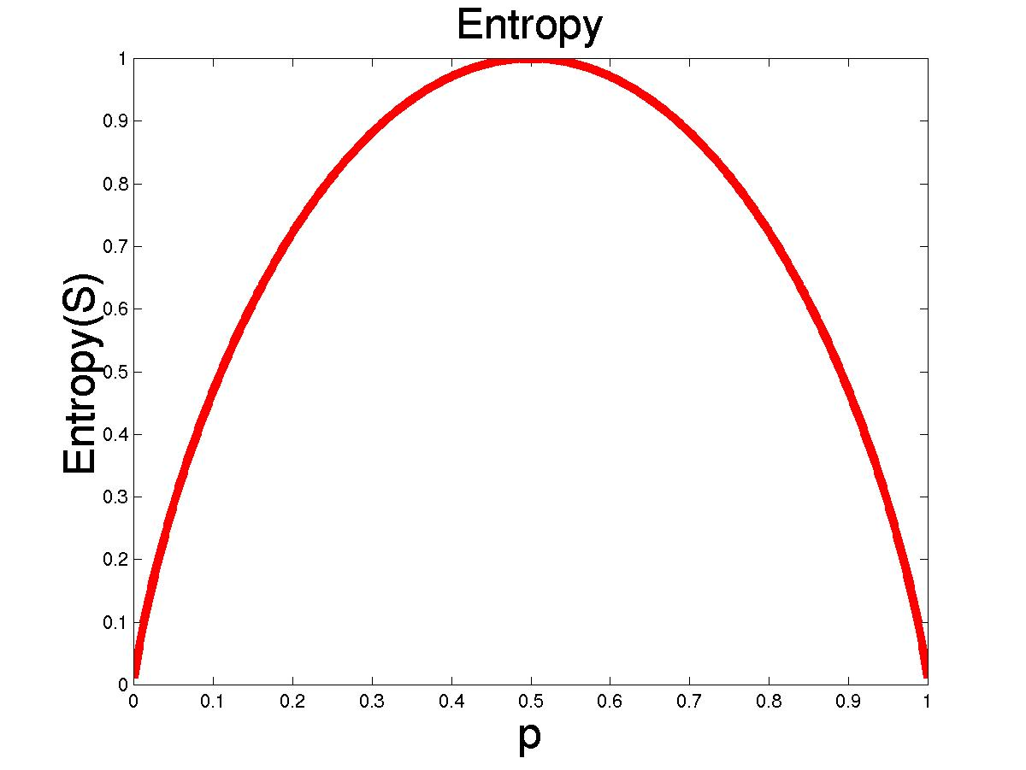
Entropy (Amount of Information)
S is a sample of training examples
p₊ is the proportion of positive examples
p₋ is the proportion of negative examples
Entropy measures the impurity of S
Entropy(S) = -p₊ log₂ p₊ - p₋ log₂ p₋
Entropy is amount of element of surprise

Slide 21
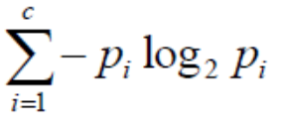
Entropy
Entropy of Parent Node
E(Parent) =
Entropy of split on Feature x1
E(x1)=
(-T_c1*log(T_c1) - T_c2*log(T_c2))(nT/n)
+ (-F_c1*log(F_c1) - F_c2*log(F_c2))(nF/n)
Working is very similar to Gini Index
Information Gain = E(Parent) – E(x1)
Split with maximum Information Gain (minimum Entropy) is selected

Slide 22
Gini Index vs Entropy
Gini Index | Entropy
Uses Square of probability | Uses Log of probability
Fast | Slow
Range : 0 to 0.5 | Range : 0 to 1
More used | Less Used
BOTH select almost similar features

Slide 23
CART for Regression

Slide 24
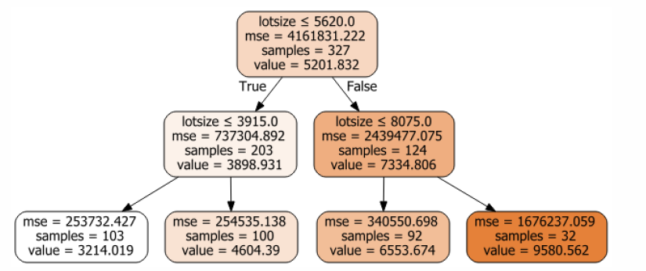
CART for Regression
Leaf nodes have mean of the target column ( prediction value)
Mean of target from all rows present in leaf node is taken for prediction

Slide 25
Criteria for Split
Data is split to reduce the variance (error) in the Target variable
Split which results in minimum variance is selected as best feature
Working is similar to classification trees ONLY criteria is changed here

Slide 26
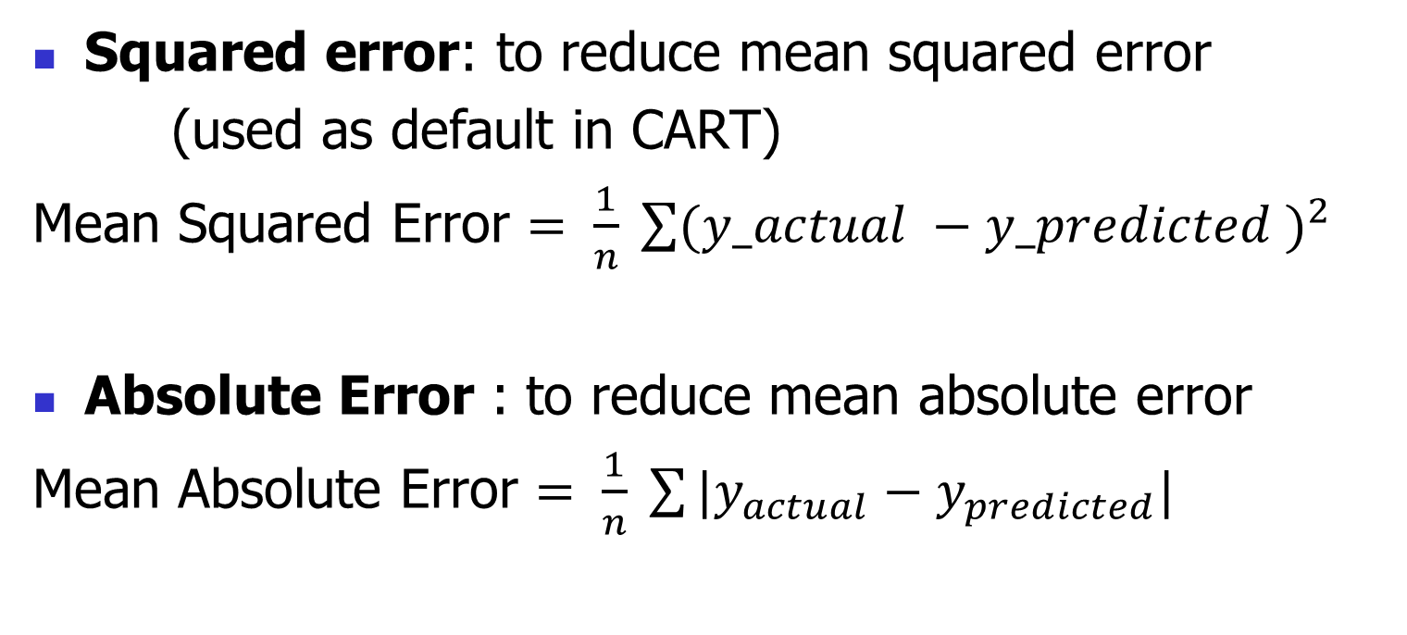
Criteria for Split
Squared error: to reduce mean squared error
(used as default in CART)
Mean Squared Error $= \frac{1}{n} \sum{{(y_actual −y_predicted )}^{2}}$
Absolute Error : to reduce mean absolute error
Mean Absolute Error $= \frac{1}{n} \sum{|y_{actual}−y_{predicted}| }$

Slide 27
Parameters in Decision Tree (Sklearn)

Slide 28
Criterian (for Split)
Measures how each feature/column is important
Options
Gini Index ( Gini Impurity)
Entropy (Information Gain)

Slide 29
min_samples_leaf
Split only if min samples are present in the branch
Used for controlling over-fitting
Values:
int → min number required
float → minimum fraction of samples required
Best value needs to be searched by fine tuning

Slide 30
max_features
The number of features to consider when looking for the best split.
If not set then consider all features for best split
Which value to use?
“int” : to select given features
If too many features then use “sqrt” / “log2”
Best value: Needs to be fine tuned

Slide 31
Splitter for Every Node
Way to search feature / column and split value for that column
Options:
Best Split
Consider all features (max_features) for current node
Select best out of all possible splits
Random split
Select random split from all possible splits for current node

Slide 32
max_depth
Allowed depth of the tree
Controls over-fitting
Helps in pruning the tree
No fixed ‘best’ value of max_depth
Need to fine tune the value

Slide 33
ccp_alpha
Cost complexity pruning parameter
Used to avoid over-fitting
Greater value of ccp_alpha → more pruning
More on : https://scikit-learn.org/stable/auto_examples/tree/plot_cost_complexity_pruning.html#sphx-glr-auto-examples-tree-plot-cost-complexity-pruning-py

Slide 34
class_weight
In general all classes in data are assigned same weightage
But, in case of imbalanced data one class may have very less samples than others
Values:
none : all classes same
Balanced : weights taken from training data
(used for imbalanced data)
dict : user given values

Slide 35
CART Advantage and Dis-Advantage

Slide 36
Advantages of CART
Easy to understand for humans & Explainable
Data Scaling is not required
Robust to different variables having different range of values
Doesn’t need to have Normally distributed features
Provides feature importance, so can be used for feature selection in classification or regression
Can create non-linear boundaries easily

Slide 37
Dis-Advantage of CART
Easy to Over-fit
Solution: Ensemble learning
Slow when high Number of features
Splitting takes time when features are many
In Regression, CART can’t predict values beyond range of values it is trained on
Out of range value prediction is NOT possible
Even after Ensemble this problem PERSISTS
Trees can have high depth
Because, CART does only Binary splits

Slide 38
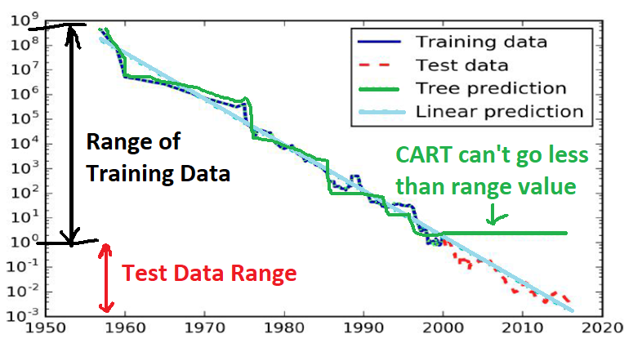
CART Regression Failure Case

Slide 39
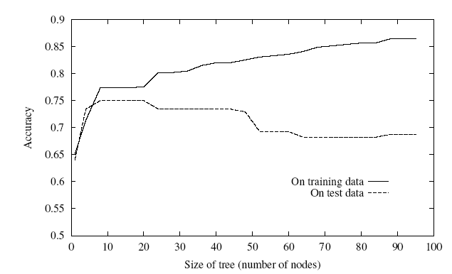
Overfitting
One of the biggest problems with decision trees is Overfitting
Performance on training data increases but test data performace decrease after a threshold
Model cannot generalise for new data

Slide 40
Solution to Overfitting
Fine Tune min_samples_leaf
Fine Tune depth of tree
Use Cross Validation than just train test split
Use Ensemble Learning than just single tree

