Slide 1
Feature Selection
By Dr Shantanu Pathak

Slide 2
Feature Selection
Select best or relevant features / columns from data
Every problem / target may have different features which are relevant
Becomes important task when high dimensional data
When no of columns are very high
Features affect the model
Better features : improve performance
Irrelevant features : increase complexity and computational cost

Slide 3
Feature Selection Methods
Unsupervised
PCA - Principle Component Analysis
Kernel-PCA
ICA** - Independent Component Analysis
Boruta Algorithm **
Supervised
Model based
Select From Model
RFE : Recursive Feature Elimination
Regularization Based
L1 Penalty based
L2 Penalty based

Slide 4
Unsupervised Feature Selection

Slide 5
Principle Component Analysis
Create components based on Eigen values and Eigen vectors
Components represent the data effectively
Components are created using linear relationship in all columns
Few components can be selected based on variance addressed by every component
Advantage:
Un-supervised way of feature reduction
Disadvantage:
Addresses ONLY linear relationship in data
Selecting few components may lead to information loss

Slide 6
Supervised Feature Selection

Slide 7
Model Based Feature Selection
Select From Model
RFE : Recursive Feature Elimination

Slide 8
Select From Model
Train a supervised model and extract feature importance
Select the top few features by threshold or by count
Compatible Models ( Classification / Regression )
Decision Tree, Random Forest, AdaBoost
Linear SVM
Logistic Regression ( only Classifier)
LASSO, RIDGE ( only Regression)
Pass the threshold or pass max_features to select

Slide 9
RFE: Recursive Feature Elimination
Step 1: Take a model
Step 2: First evaluate model for all features
Step 3: Eliminate a feature and check performance : remove feature if performance is constant or improves after removal
Step 4: Repeat step 3 for all features one by one.
Selected (i.e., estimated best) features are assigned rank 1.
All other features are ranked differently
It is applicable to classification as well as regression models

Slide 10
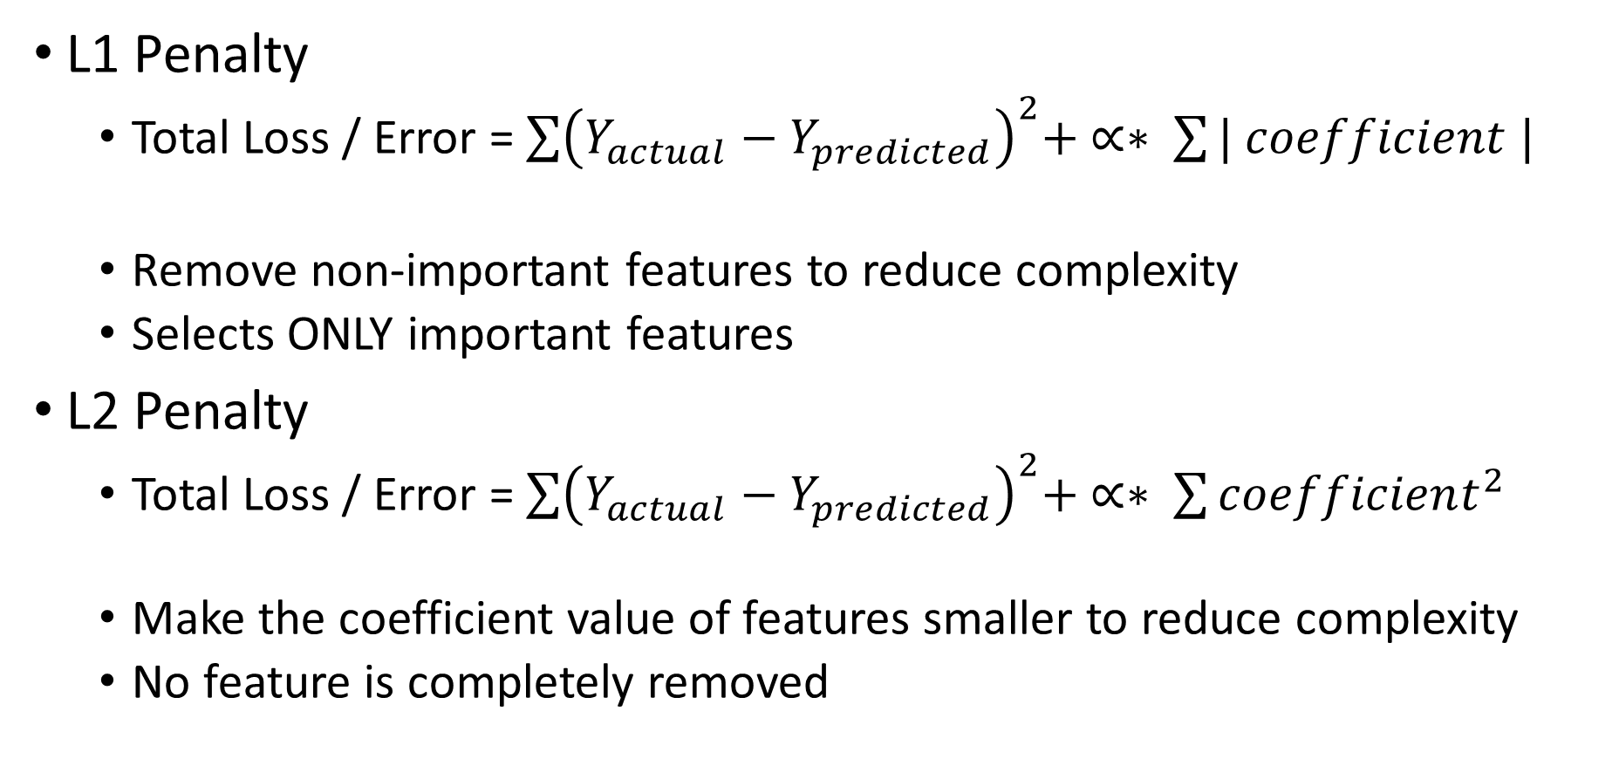
Regularization Based Feature Selection
L1 Penalty
Total Loss / Error = $\sum{{\left(Y_{actual}−Y_{predicted}\right)}^{2}+ ∝∗ \sum{| coefficient |}}$
Remove non-important features to reduce complexity
Selects ONLY important features
L2 Penalty
Total Loss / Error = $\sum{{\left(Y_{actual}−Y_{predicted}\right)}^{2}+ ∝∗ \sum{coefficient^{2}}}$
Make the coefficient value of features smaller to reduce complexity
No feature is completely removed

Slide 11
Regularization Based Feature Selection
Classification Models Using L1 or L2
Linear SVM ( L2 penalty)
Logistic Regression ( L1 or L2 anyone can be used)
SVM non linear kernel:
but here feature selected cannot be interpreted by humans because it maps the features to completely new hyperspace.
Regression Models using L1 or L2
LASSO – L1 Penalty
Ridge – L2 Penalty
ElasticNet – L1 & L2 Both

