Slide 1
Basic Supervised Machine Learning Models
By Dr Shantanu Pathak

Slide 2
Tasks in Supervised Learning
Classification
Regression

Slide 3
Classification Task

Slide 4
Classification Task
Predict a class / label using features/ columns
Types of Classification in Supervised Learning
Binary Classification
Multi-Class Classification

Slide 5
Binary classification
Only Two classes in output
Positive class (Represented by 1)
When test results are positive
Ex In diabetes detection, when test results are positive, then person has diabetes
Negative class (Represented by 0)
When test results are negative
So, in patient blood report, diabetes detected is positive class and no diabetes detected is negative class
Ex. In an image Dog is present ?
Dog present is positive class
Dog absent is negative class

Slide 6
Multi Class Classification
More than two classes in output
Example:
Predict Breathing problem using X-ray
Normal
Asthma
Covid-19

Slide 7
Classification Models
Basic Models
Logistic Regression
Naïve Bayes
SVM
K Nearest Neighbors
Decision Tree
Linear Discriminant Analysis (LDA)
Ensemble Learning
Random Forest (Bagging)
XG Boost (Boosting)
Cat Boost (Boosting)
LightGBM (Boosting)

Slide 8
Logistic Regression

Slide 9
Logistic Regression (logit classifier/MaxEnt classifier)
Used for classification (binary and multi-class) ONLY
Models linear relation between independent variables to predict a binary or categorical output.
Target is to have minimum loss, so it does find the right coefficients by doing multiple iterations
Output is in form of probability, between 0 to 1
Output gives the probability that Y will be class 1
t = b0 + b1X1 + b2X2 + …. bnXn
Where b0 is intercept
b1 to bn are coefficients just like linear regression
Y = sigmoid(t) = 1 / ( 1 + e ^ (-t) )
Sigmoid / logistic function converts the real valued t into value between 0 to 1

Slide 10
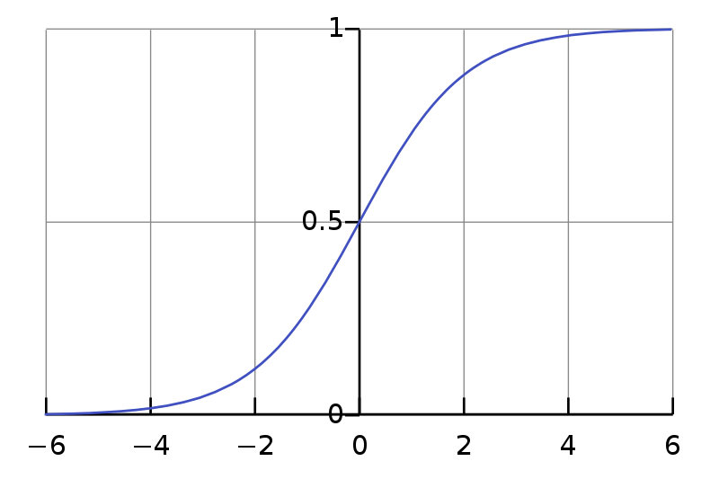
Logistic / Sigmoid Function
S-Shaped curve
Output(y) is always between 0 to 1
Input(x) can be any value between –inf to + inf
Converts real valued input to binary or in terms of probability
By Qef (talk) - Created from scratch with gnuplot, Public Domain, https://commons.wikimedia.org/w/index.php?curid=4310325

Slide 11
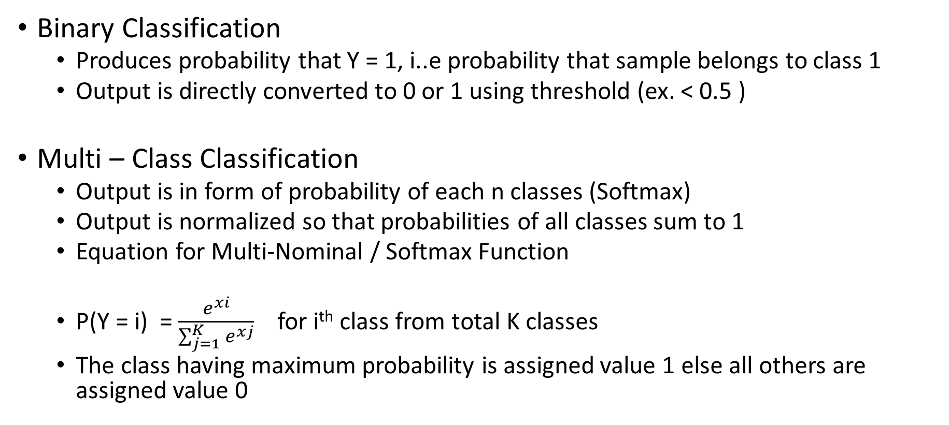
Logistic Regression (logit classifier/MaxEnt classifier)

Slide 12
Logistic Regression Parameters
Solver = ‘saga’ , ‘liblinear’, ’lbfgs’
According to Scikit Documentation: The SAGA solver is often the best choice.
l1_ratio : to give l1 , l2, elasticnet penalty
l1_ratio=1 then l1 penalty, l1_ratio=0 then l2 penalty
else 0<l1<1 then ‘elasticnet’ penalty and it tells portion of l1 penalty
The ‘liblinear’ solver supports both L1 and L2 regularization
The l1,l2,Elastic-Net regularization is only supported by the ‘saga’ solver.
class_weight: balanced
C : regularization parameter (like in SVM)
smaller value :: high regularization, less misclassification allowed
high value : low regularization and more misclassification allowed
NOTE:: For multi class classification problem
‘multinomial’ : all solvers supports this to model multiple classes (except liblinear)
‘ovr’ is deprecated now (One vs rest strategy supported by ‘liblinear’ solver)
Further Reading: https://stackoverflow.com/questions/38640109/logistic-regression-python-solvers-definitions
SAGA is variant of SAG ( Stochastic Average Gradient)

Slide 13
Naïve Bayes

Slide 14
Probability
Joint probability is the probability of two events occurring simultaneously.
Marginal probability is the probability of an event irrespective of the outcome of another variable.
Conditional probability is the probability of one event occurring in the presence of a second event.

Slide 15
Probability
Joint Probability to Bayes Rule
P(AB) = P(A) * P (B) .. A & B independent
P(AB) = P(A) * P(B|A) = P(B)*P(A|B)
When A & B are dependent

Slide 16

Naive Bayes
Bayesian Model
P(C | x) =
P(C|x) -> Probability of given sample ‘x’ belonging to class ‘C’
P(x) -> Probability of ‘x’ in complete sample space / training data
P(C) -> Probability of ‘C’ in complete sample space / training data
P(x|C) ->Probability of occurrence of ‘x’ when ‘C’ is given in training data

Slide 17
Naive Bayes
Used for Binary Classification Task ONLY
Assumption : Input consists of set of independent features / columns
Bayesian Probabilistic Model is used
Simple yet effective
Highly scalable
Application: Automatic medial case classification / diagnosis

Slide 18
Data : Example of Naive Bayes
Sr No | Time(X1) | Vehicle Type(X2) | Accident(Target/Y)
1 | Early Morning | Heavy | Yes
2 | Early Morning | Light | No
3 | Early Morning | Light | Yes
4 | Early Morning | Heavy | No
5 | Early Morning | Heavy | Yes
6 | Early Morning | Heavy | No
7 | Evening | Light | Yes
8 | Evening | Light | No
9 | Evening | Heavy | No
10 | Evening | Heavy | Yes
11 | Day Time | Heavy | No
12 | Day Time | Heavy | Yes
13 | Day Time | Light | No
14 | Night | Light | Yes

Slide 19
Probabilities : Example of Naive Bayes
P(Accident) =0.5 P(No Accident) =0.5
P(em)=6/14 P(day time)= 3/14
P(ev)=4/14 P(night)=1/14
P(light)=6/14 P(heavy)=8/14

Slide 20
Probabilities : Example of Naive Bayes
P(daytime | Accident) = 1/7
P(em | Accident) = 3/7
P(ev | Accident) = 2/7
P(n | Accident) =1/7
P(Light | Accident) = 3/7
P(Heavy | Accident) = 4/7

Slide 21
Probabilities : Example of Naive Bayes
P(daytime | Accident = ‘No’) = ??
P(em | Accident = ‘No’) = ??
P(ev | Accident = ‘No’) = ??
P(n | Accident = ‘No’) =??
P(Light | Accident = ‘No’) = ??
P(Heavy | Accident = ‘No’) = ??

Slide 22
Example of Naive Bayes
What is probability of an accident given that its early morning?
P(Accident|em)=P(em|Accident)P(Accident)/ P(em)
= (3/7 * 7/14 ) /(6/14) = 3/6
P(Accident|DT) = P(DT|Accident)P(Acc)/P(DT)
= (1/7 * 7/14 ) / (3/14) = 1/3
P(Accident | (em,light)) = P(Acc|em) * P(Acc|light)
= 3/6 * 3/6 = 0.25
P(C | (x1,x2,x3 ... xn)) = P(C|x1) * P(C|x2) * ... *P(C|xn)

Slide 23
Types of Naïve Bayes
Gaussian Naive Bayes
For numeric data
For large data
Multinomial Naïve Bayes
For data with frequency of categorical features like Text data
Complement Naive Bayes
particularly suited for imbalanced data sets
it is modified Multi -nomial NB for imbalanced data
Used in text classification tasks
Categorical Naive Bayes
for simple categorical data
assumes every feature has its own categorical distribution
Bernoulli's Naïve Bayes
For Binary Variables like one-hot-encoded features

Slide 24
Support Vector Machine

Slide 25
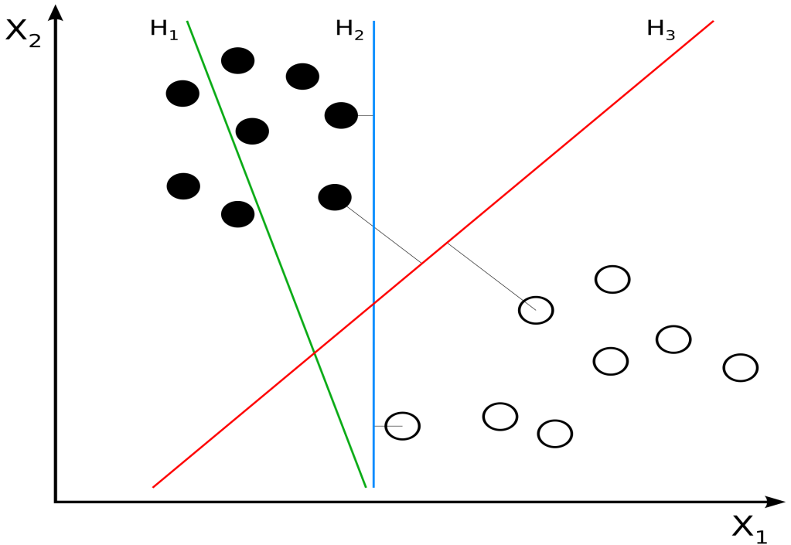
Support Vector Machines(SVM)
Used ONLY for Binary Classification or Regression
It can handle Linear / Non-Linear boundary
Goal (basic classification principle):
Find the decision boundary between two classes with maximum margin
Margin is based on
Samples close to the
boundary. These
samples are called as
“Support Vectors”

Slide 26
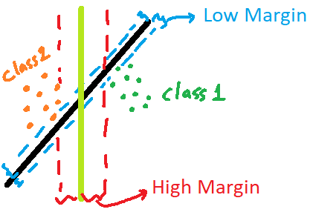
Support Vector Machines(SVM)
Margin
Minimum distance between proposed boundary and closest point(s) from each class
Which boundary to choose?
Single dataset may have multiple possible boundaries between two classes
Boundary with maximum margin is most beneficial
Such boundary avoids misclassification, even if there is some deviation in new data from original data

Slide 27
Support Vector Machines(SVM)
Binary Classification:
Points which are on either side of the boundary are given to respective class
For new point, class is predicted by using which side of the boundary it is
Regression
Using decision boundary linear equation is formed
This is transformed into probability using logistic function
Output of logistic function ( probability) is used for regression

Slide 28
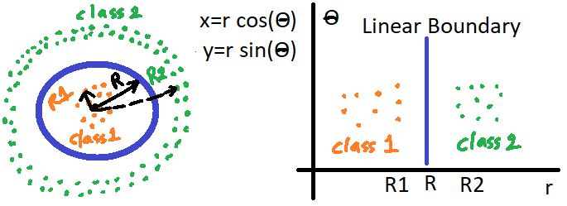
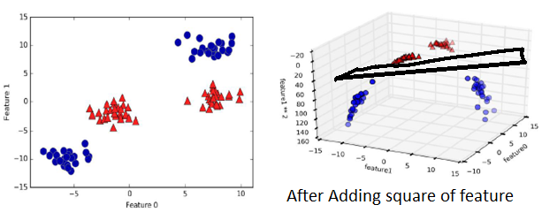
SVM Kernel Trick
Transform the data by adding non-linear features
( x^2 , cos(x) , x^5, Convert points in form of polar coordinates.. etc)
This enables to have non-linear boundary between classes
Kernel does this transform efficiently ONLY once and not every iteration
RBF Kernel : Radial basis Function / Gaussian Kernel
Considers similarity between points in the dataset
Similarity is based on gamma and distance between points

Slide 29
SVM Parameters
C: regularization parameter
Higher value less regularization / more misclassification is allowed
Always positive
kernel: ‘linear’, ‘rbf’, ’poly’, ’sigmoid’
gamma : Kernel coefficient for ‘rbf’
How much each support vector impacts
Less value : more support vectors are selected
slow
High Value: less support vectors are selected
Fast
Needs fine tuning
NOTE: svm in optimization by default applies l2 regularization to keep coefficients small

Slide 30
K Nearest Neighbors

Slide 31
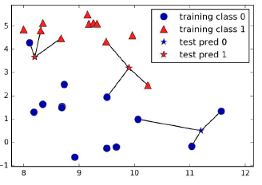
K Nearest Neighbors (KNN)
Supervised or Un-supervised
Works by creating Tree using data
Tree gives closest points / neighbors
K-Neighbors are used for doing predictions for any new data
K number is given by user
In classification majority class of K neighbors is taken
In regression Mean of K neighbors is taken
Used for classification (binary and multi-class) & Regression
Used for Un-supervised learning to understand the distribution of data and distance between neighbors
Star : denotes new points
Class 1 : red color
Class 0 : blue color
New points class is predicted using majority class
in neighbors

Slide 32
Regression Task

Slide 33
Regression Task
Linear Regression
Multiple Linear Regression
Polynomial Regression
LASSO
RIDGE

Slide 34
Extra
Solvers in Logistic regression
https://stackoverflow.com/questions/38640109/logistic-regression-python-solvers-definitions
https://scikit-learn.org/stable/modules/linear_model.html

