Slide 1
Ensemble Learning
By Dr Shantanu Pathak

Slide 2
Ensemble Learning
Can be used for Binary Classification, Multi-Class Classification and Regression
NOTE: There are some unsupervised ensemble learning models also like IsolationForest
Combines multiple models together
Together a strong model can be built
How to train multiple algorithms on same data ?
Bagging and Boosting
How to Use output of one ML Algorithm into Another model ?
Stacking
Ex. Flood prediction : first predict water in river and predict rain amount. Both together can be used to predict flood conditions

Slide 3
Types of Ensemble Learning Models
Bagging Models
Boosting Models
Stacking Models

Slide 4
Bagging Models

Slide 5
Bagging (Bootstrap Aggregation )
Bootstrap : create ‘n’ new datasets from given dataset using sampling
Some % of original data is kept and remaining part is filled with repetition
Random sampling is done on samples (rows)
Ensures that every new dataset created is different from each other
Model Training: train ‘n’ models
Aggregation : combine results of all ‘n’ models created using different datasets
Aggregation can be by simple voting / weighted voting / averaging

Slide 6
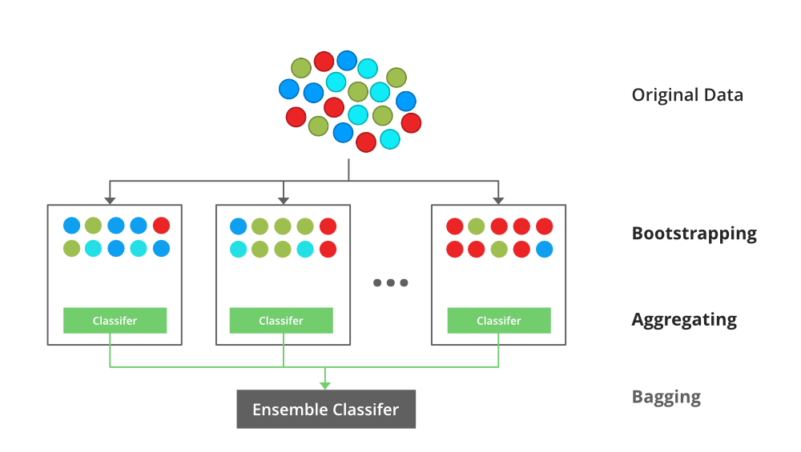
Bagging (Bootstrap Aggregation )
Link: https://media.geeksforgeeks.org/wp-content/uploads/20210707140912/Bagging.png

Slide 7
Bagging (Bootstrap Aggregation )
Step 1: Bootstrap:
Fix Percentage of original data are taken and remaining are repeated
Ex. Assume n_estimators= 3 (number of models to be created)
Data = [0,1,2,3,4,5,6,7,8,9] 80% (given by max_samples)
So, select 80% samples randomly
D1 = [4,0,3,1,6,8,2,5, 3,6] 🡪 80% from original 20% repetition
D2 = [9,3,1,6,7,2,5,8, 8,1]
D3 = [9,3,1,0,7,4,5,8, 4,9]
This introduces randomness and newly created datasets will be different from each other

Slide 8
Bagging (Bootstrap Aggregation )
Step 2: Model Training
On newly created ‘n’ datasets train ‘n’ estimator models
Here each estimator model can have same algorithm / different
Ex. Assume n_estimators=3
‘3’ models of Decision Tree can create an Ensemble
One Naïve Bayes, One SVM , and one KNN can create an Ensemble together

Slide 9
Bagging (Bootstrap Aggregation )
Voting Types for Classification:
Hard Voting
Each estimator model predicts class
Soft Voting
Each Estimator model predicts probability
Aggregation Types:
Simple Aggregation:
Use ‘mode’ for hard voting : class with maximum votes is predicted
Use ‘mean’ for soft voting : class with highest ‘mean’ probability is predicted
In Regression, ‘mean’ of all models is predicted
Weighted Aggregation:
Use weighted average

Slide 10
Bagging Sklearn based Models
BaggingClassifier / Regressor
Creates bagging model using given algorithm
VotingClassifier / Regressor
Creates bagging ensemble for given list of algorithms
RandomForest Classifier / Regressor
Creates bagging model using DecisionTrees
Has added randomness in features also

Slide 11
Random Forest model

Slide 12
Random Forest
Used for classification and regression also
Same working as Bagging model with few improvements
Does random sampling on rows (samples) and on columns (features) also
Uses max_samples and max_features parameters
It uses ‘soft voting’ in aggregation step
Advantage
Widely used model
Two way randomization helps avoid the variance in model
Robust model
Because it is based on bagging it can be trained using parallel computing
Dis-advantage
More memory and time than linear models (bit slow for very large data)
Not very well suited for text data / sparse data
In regression, predictions cannot go beyond range of training values

Slide 13
Random Forest Parameters
n_estimators:
No of decision trees to be created
need to be fine tuned ( use GridSearch)
max_samples :
How many samples to draw from original data in each new dataset
generally set to 0.8 ( 80%) by default 1 ( 100%)
max_features
Number of columns to be considered inside every decision tree split
Higher value then stable decision trees and overall model
If equal to all features then decision trees may overfit
If very low then deep decision trees are created , not good
oob_score: (Out of Bag Score)
Each decision tree is tested on samples which are not present in its training data
If TRUE : model created is generalized and good on unseen data (test data / user input)
If false : model is poor on unseen data ( test data / user input)
max_depth:
Controls depth of each tree
Needs to be fine tuned if less memory should be used by the model
n_jobs: should be -1 for maximum parallel computing

Slide 14
Boosting Models

Slide 15
Boosting Models
Boost a small / weak model iteratively to perform better and aggregately use all models created in iterations
In every iteration model tries to minimize the total error / loss
Repeated iterative training avoid Bias in Model
Aggregation of multiple models helps avoid variance in the model
In each iteration model is changed based on learning rate. More learning rate more changes are made
Learning rate and no of estimators (iterations) needs careful fine tuning
Boosting models can be used for Binary / Multi-Class Classification or Regression
Limitation: Special Packages are needed for parallel training. Normal Gradient Boosting works slow in sequential manner

Slide 16
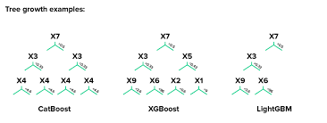
Boosting Based Models
Sklearn based:
AdaBoost
Each iteration updates the weights
Has fixed loss function ( exponential loss)
Outliers affect performance badly
Special Packages:
XGBoost : Extreme Gradient Boost
Parallel Gradient boost with optimized libraries
Very high speed and performance
Catboost : Categorical Gradient Boosting
Directly works with strings, text, numeric data : almost no preprocessing required
Uses balanced trees for better performance
Does ordered boosting : train model only on subset of data remaining subset is used for loss calculation. This avoids overfitting
LightGBM : Light Gradient Boosting Machine
Its fast and requires less memory (light)
lightGBM uses leaf based splitting than level wise splitting of XGBoost/ CatBoost
In leaf based splitting, best leaf which gives minimum cost will be split. (Best-first)
It may have deep imbalanced trees and not good for small datasets

Slide 17
Stacking Models

Slide 18
Stacking
Output of one machine learning model is given as input to another model
In neural networks output of one layer is given as input to another layer
Used to solve multi stage problems
Ex. Stock Index Prediction
Predict the stocks of major companies and then predict the index

Slide 19
Extra
XGBoost :
https://xgboost.readthedocs.io/en/stable/
CatBoost
https://catboost.ai/
LightGBM
https://lightgbm.readthedocs.io/en/stable/
https://neptune.ai/blog/when-to-choose-catboost-over-xgboost-or-lightgbm

