Slide 1

Enabling Precedence Constrained
Task Scheduling in LITMUS^{RT}
By
Ashish Prasad
Digvijay Singh
Shashank Sharma

Slide 2
Index
• LITMUS^{RT} : Design and Architecture
• Task model
• Data Structure
• GSN-EDF
• User Interface
• System Call
• Kernel Interface
Result
Challenges

Slide 3
LITMUS^{RT}
The LITMUS^{RT} patch is a (soft) real-time extension of the Linux kernel with a focus on multiprocessor real-time scheduling and synchronization. The Linux kernel is modified to support the sporadic task model and modular scheduler plugins. Clustered, partitioned, and global scheduling are included, and semi-partitioned scheduling is supported as well.
The primary purpose of the LITMUS^{RT} project is to provide a useful experimental platform for applied real-time systems research.
The current version of LITMUS^{RT} is 2012.1 and is based on Linux 3.0

Slide 4
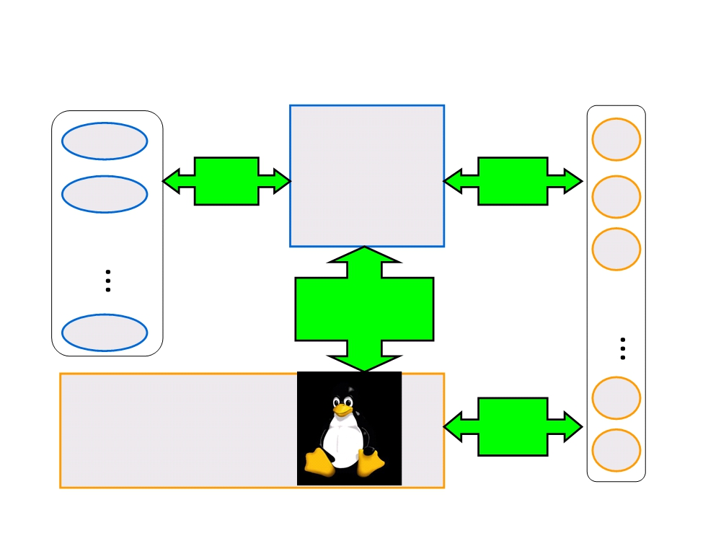
LITMUS^{RT} Design
P-EDF
RT
LITMUS^{RT}
sched.
RT sys.
G-EDF
interface
Core calls
RT
Policy
Plugins
RT
RT
Plugs into the
Linux Scheduler
Apps
PFAIR
RT
Linux 2.6.36
std. sys.
calls
RT

Slide 5
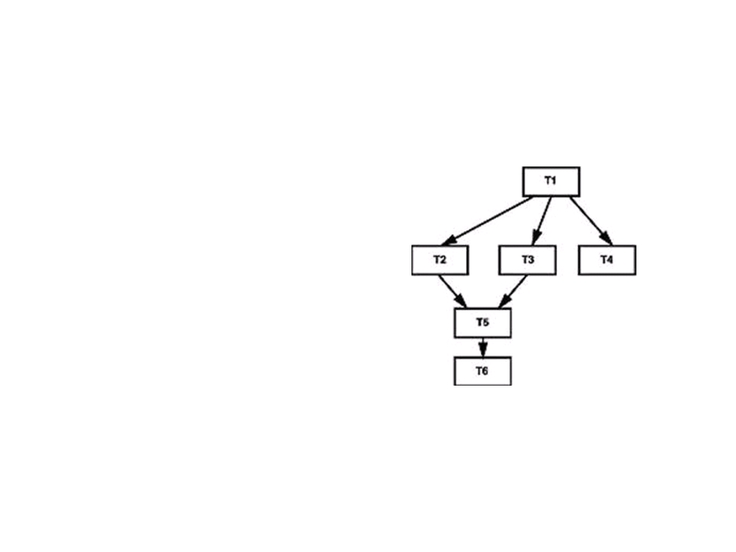
Dependent Constrained Tasks
•Directed Acyclic Graph
•Source Node
•Sink Node
•Dependency

Slide 6
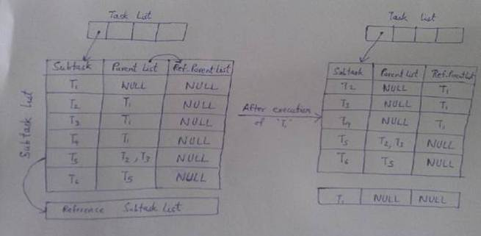
Data Structure
•Task List
• Task
• Subtask

Slide 7
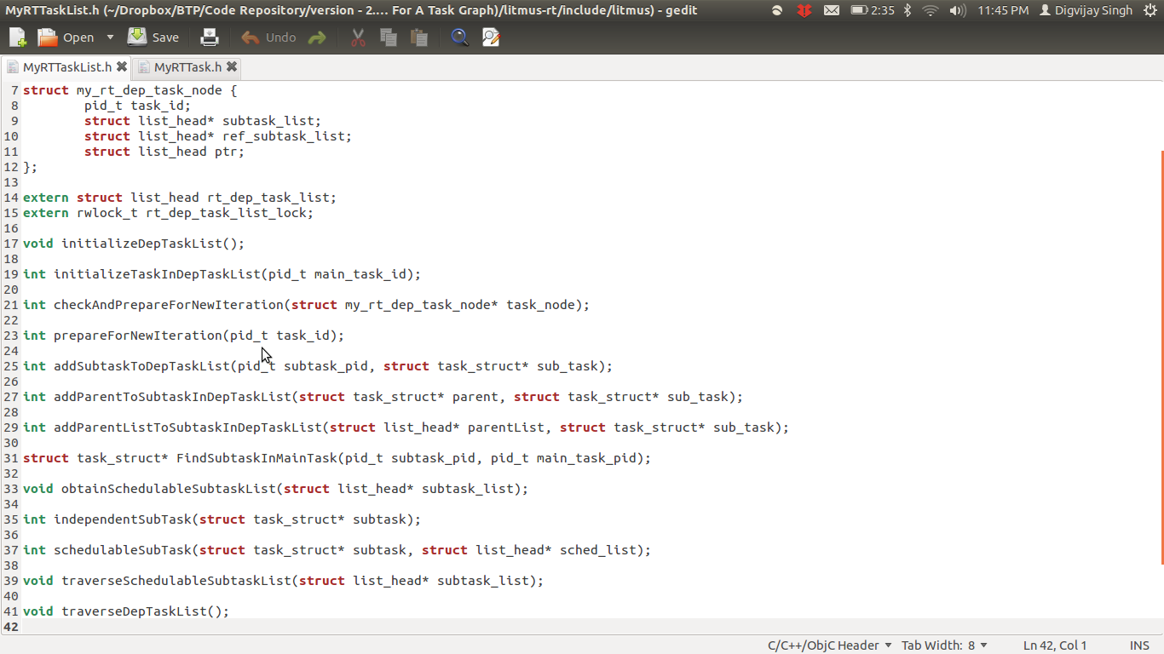
Code Snippet

Slide 8
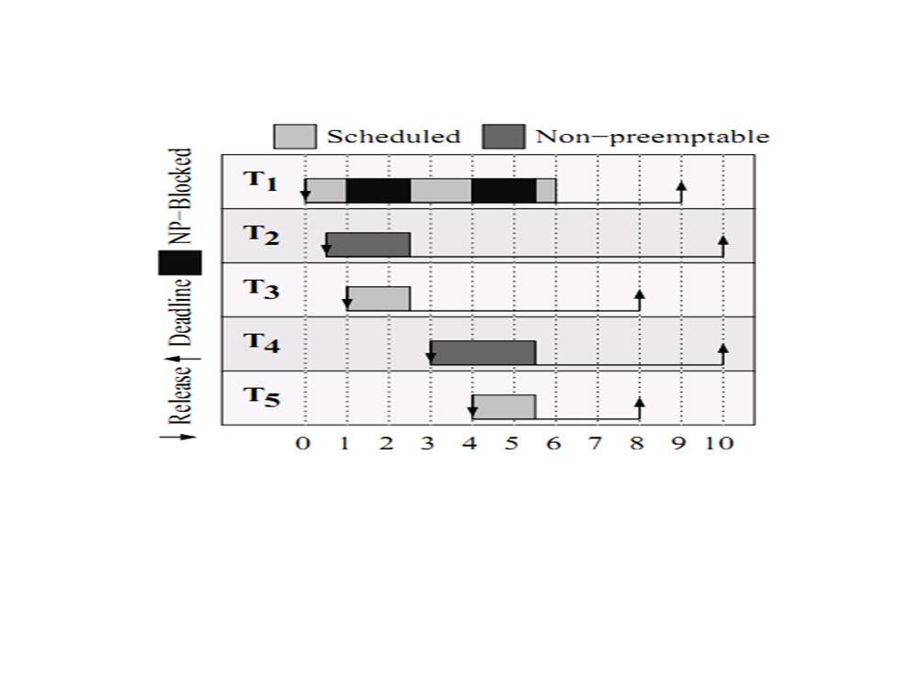
Why-GSN-EDF
•T2 and T4 are non-preemptive
•Priority:
•T1>T2, T1>T4
•T1<T3, T1< T5

Slide 9
GSN-EDF Algorithm
• Jobs can become non preemptable for short durations of
time.
• A job Tij is only blocked by another non-preemptable job
when Tij is either released or resumed, and that such
blocking durations are reasonably constrained.
• A job Tij is non-preemptively blocked at time t iff Tij is one of
the highest-priority runnable jobs and it is not scheduled at
t because a lower-priority non-preemptable job is
scheduled instead.
• Each processor has a scheduled and linked job.
• Handle cases of Job arrival, Job completion and conversion
of a non-preemptable task to a preemptable one.

Slide 10
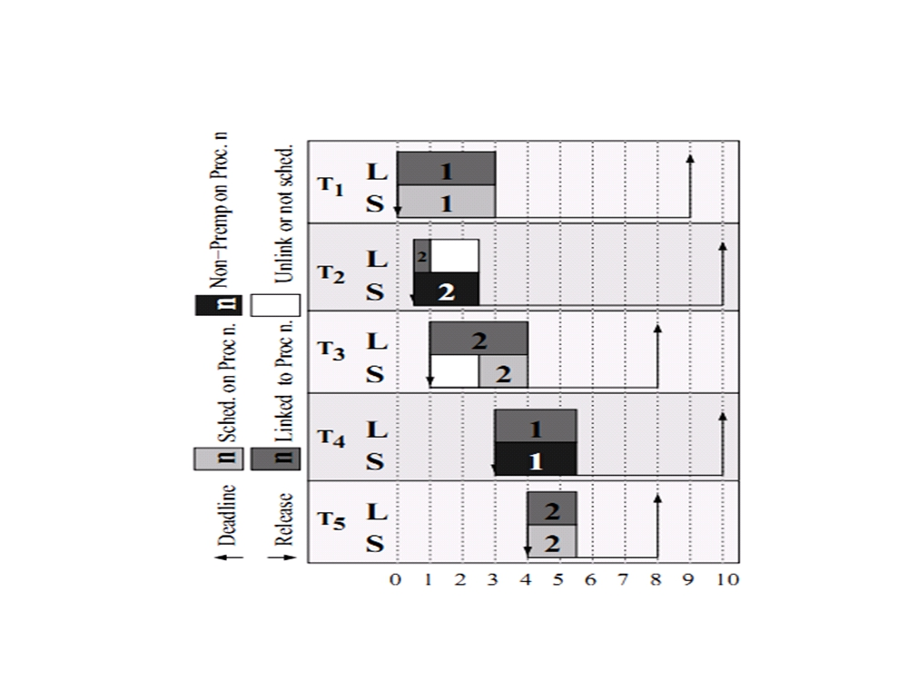
GSN-EDF Advantage:

Slide 11
OUR CHANGES
The changes done are in the following three sections :
User Space
System calls
Kernel Space

Slide 12
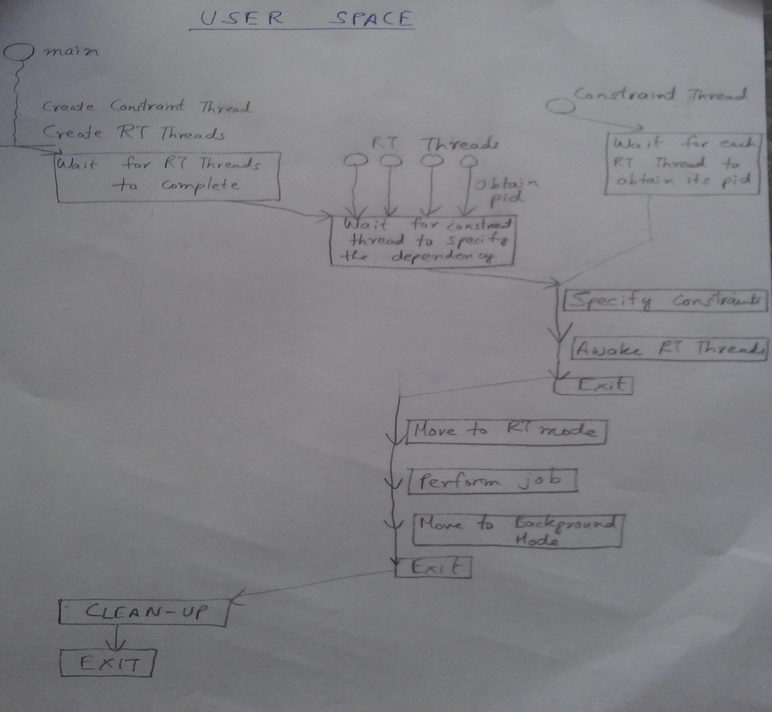
User Interface

Slide 13
USER SPACE-I
Creation of threads-In the user space, we create multiple threads. Each thread via the inbuilt system call (getid()), obtains its PID and this PID is used by our syscall to initialize a subtask in the data structure
Dummy Thread-Apart from the RT threads, we created a dummy thread to specify the constraints.

Slide 14
USER SPACE-II
Lock-Dummy thread waits on a lock until all the threads obtain their pids. The threads wait till all the constraints are specified and then resume to accomplish their tasks in real time mode.
Deletion of Threads -Once the task gets completed, the corresponding subtasks are removed from the data structure at kernel side via our defined syscall.

Slide 15
SYSCALLS
Syscall-1 long sys_set_main_task_pid(pid_t subtask_pid, pid_t main_task_pid
Syscall -2: long sys_init_dep_subtask (pid_t subtask_pid)
Syscall-3:long sys_add_parent_to_subtask(pid_t parent_pid, pid_t subtask_pid)
Syscall -4: long sys_exit_dep_task (pid_t main_task_pid)

Slide 16
KERNEL SPACE
Only a released task whose parent list is empty is eligible for scheduling.
From the data structure we implemented, we maintain a list of schedulable tasks (whose parent list is empty).
If an arrived job is released and has all preceding subtasks executed, it passed to the ready queue for scheduling. Else, we keep it in a waiting list.
When a task is executed, we refresh the schedulable tasks list and add the waiting schedulable tasks to ready queue.

Slide 17
CHALLENGES
Kernel compilation : Unstable kernel – 2.6.36
Understand the control flow. (No documentation available for Litmus code.)
Making changes in the code without breaking the existing flow.
Multithreaded programming: shared resourced, race conditions, thread blocking, condition variables and locks.

Slide 18
Demonstration

Slide 19
Thank you.

